Slide 1
COS700 SUPERVISOR PROGRESS MEETING
Implementation
progress through Phase 6
5G Network Slicing Forensic Framework
Glen Mukota | 4 September 2026
Notes:
Talk track:
This update shows the completed six-step proof of concept. I will demonstrate the live controlled laboratory, then the evaluation result and the retained evidence that supports it.
[Sources]
- Research proposal and implementation action plan.
- Current Phase 6 evaluation run: artifacts/runs/phase6-20260904-184135.

Slide 2
What I set out to build
A practical way to collect and organise reliable records from a 5G test network.
Three simple building blocks
Docker
runs the safe 5G test network
The aim is to make it easier to understand what happened in a particular network slice after a test.
C#
collects and organises the records
GitHub
keeps the work backed up and shareable
A network slice is simply a separate logical lane for a type of network activity.
4 AUGUST 2026 | 02
Notes:
Talk track:
Avoid technical words here. Docker is the safe test environment, C# is the program I wrote, and GitHub is the online version history. A slice is a separate logical lane, not a physical wire.
[Sources]
- Proposal: Mukota LG_Makura SM.pdf, proposed adaptive framework and 5G slicing context.
- Implementation Action Plan: Mukota_Implementation_Action_Plan.docx.
Diagram 1 - framework architecture: Blue identifies what has been reported as working in Phases 1-3. Amber identifies the approved next layers. Green identifies stored evidence or outputs. The key flow is: laboratory evidence -> C# normalised records -> explainable slice decision -> integrity and custody -> retrieval and reporting.

Slide 3
IMPLEMENTATION PATH
The first three planned steps are complete
Each completed step gives the next one something solid to build on.
Build the test lab
Add virtual devices
Organise the records
1
2
3
Create the safe 5G core network and capture a starting record.
Run a virtual base station, virtual phones and controlled traffic.
Use C# to place selected records into one usable format.
COMPLETED
COMPLETED
COMPLETED
4 AUGUST 2026 | 03
Notes:
Talk track:
This slide answers the supervisor's request directly: these are the practical steps already taken. I am now at the end of Step 3, not at the end of the research.
[Sources]
- Implementation Action Plan: Mukota_Implementation_Action_Plan.docx, Stages 1 to 3.
- Updated progress report: Mukota_Phase_1_and_2_Development_Progress_Report.docx.
How the diagrams fit the path: The framework architecture diagram shows the complete research structure. The prototype deployment diagram shows where Phases 1-3 fit in the actual laboratory. The use-case diagram shows what is demonstrated now and what follows in Phases 4-6.

Slide 4
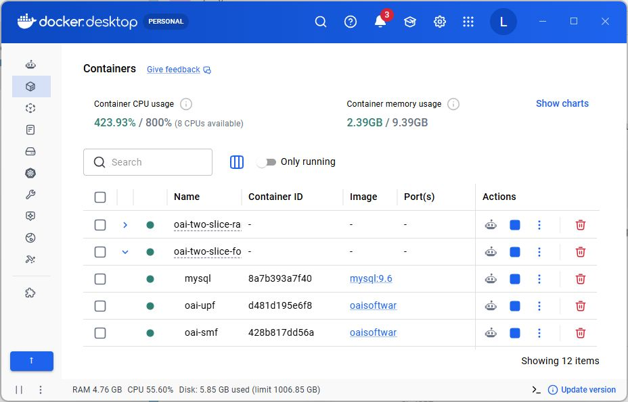
COMPLETED DEVELOPMENT
Phase 1: I built the 5G test environment
COMPLETED
What I did
Set up the core 5G network in Docker.
Checked that each core service starts correctly.
Saved a baseline record of the healthy lab.
Why it matters
I now have a safe, repeatable test environment instead of relying on a real mobile network.
Docker Desktop: the core 5G services are running (captured 4 August 2026).
4 AUGUST 2026 | 04
Notes:
Talk track:
Say: Docker lets me run each required 5G part safely on my laptop. The screenshot is fresh and shows the core services running. A baseline record means I captured the starting healthy state before later tests.
[Sources]
- Docker Desktop capture: assets/docker-desktop-containers-expanded.png, 4 August 2026.
- Implementation Action Plan: Stage 1 - establish the controlled 5G test environment.
Diagram 2 - prototype deployment: Point to the upper blue layer: it is the implemented 5G laboratory. Point to the lower green layer: this is the C# evidence-organising step. The diagram deliberately shows a laboratory boundary. It does not claim that this is a live operator network.

Slide 5
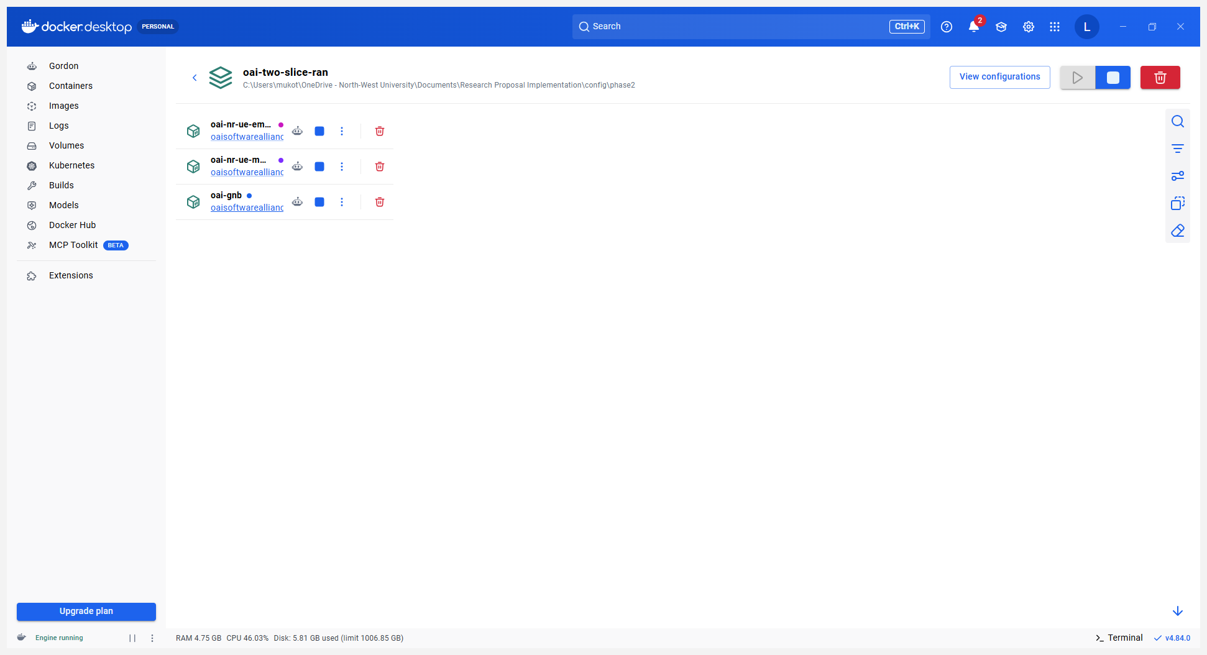
COMPLETED DEVELOPMENT
Phase 2: I added virtual devices and controlled traffic
COMPLETED
What I did
Added one virtual base station.
Added two virtual test devices.
Ran two controlled traffic scenarios.
Result
Docker Desktop: one virtual base station and two virtual test devices are running.
Both traffic scenarios completed and created records for the next step.
4 AUGUST 2026 | 05
Notes:
Talk track:
Say: These are software versions of a base station and phones. They let me run repeatable tests without physical radios. I used two different traffic scenarios so the evidence records are not all the same.
[Sources]
- Docker Desktop capture: assets/docker-desktop-ran-expanded.png, 4 August 2026.
- Phase 2 summary: artifacts/runs/phase2-20260804-073242/phase2-summary.json.
- Implementation Action Plan: Stage 2 - introduce virtual gNB/UE and controlled traffic scenarios.
Diagram 2 - Phase 2: The virtual gNB and two virtual UEs sit in the upper laboratory layer. Their controlled traffic produces the retained artefacts that enter the lower evidence-organisation layer.

Slide 6
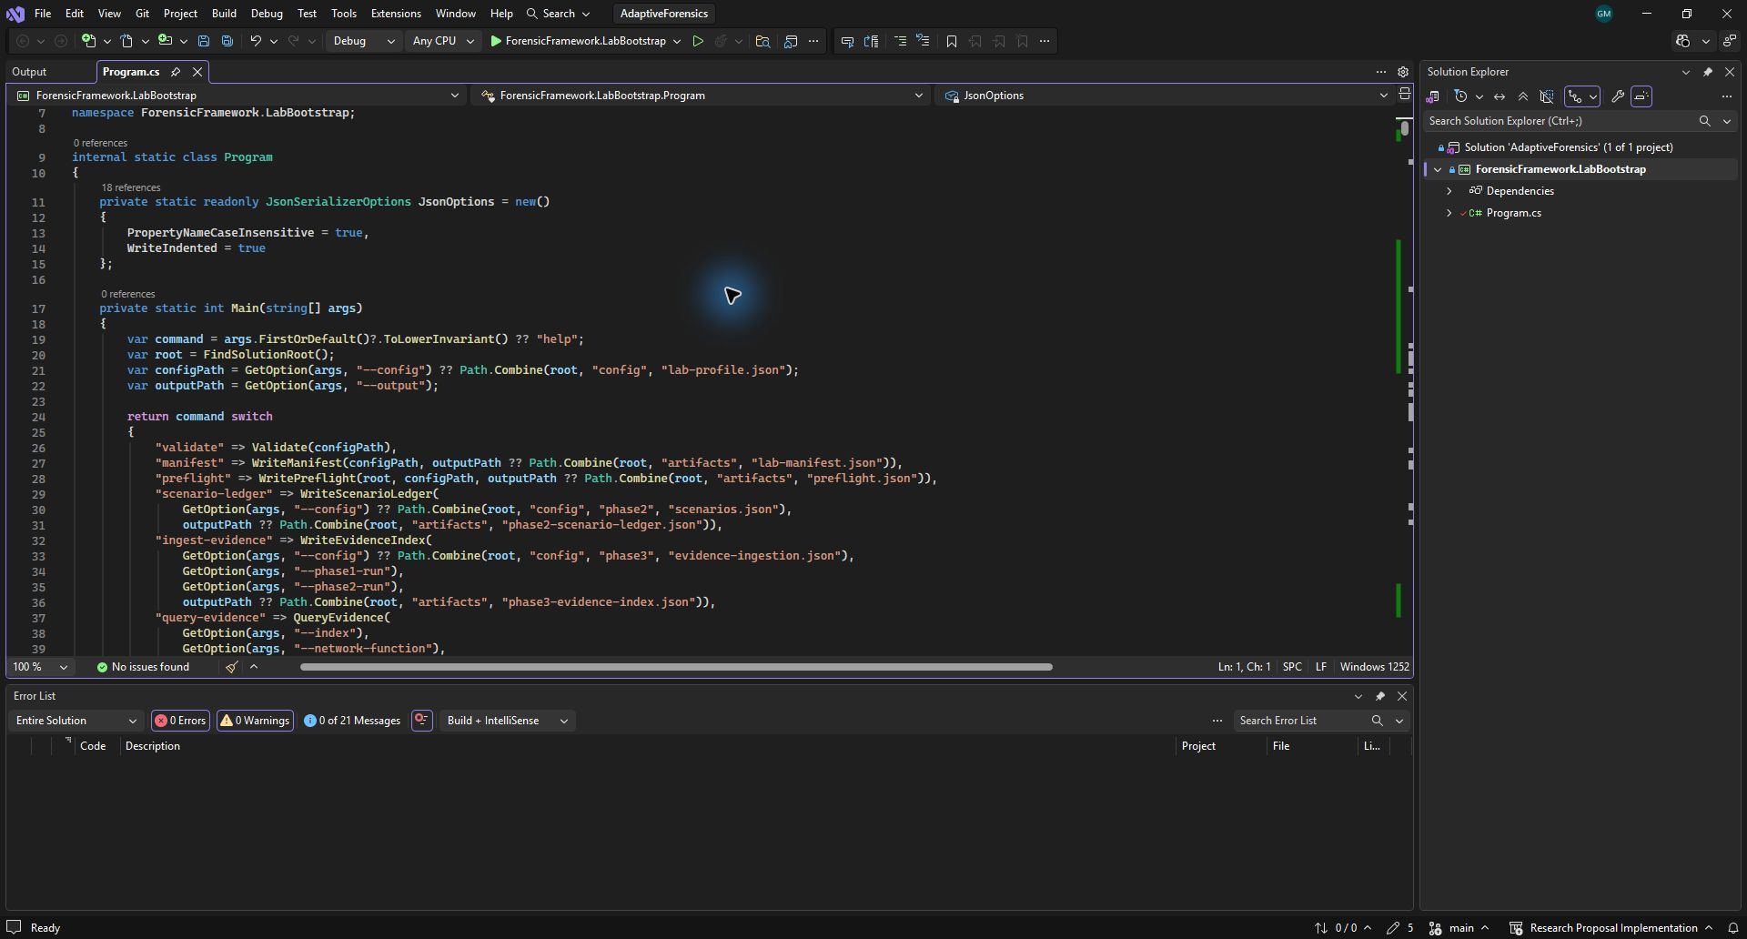
COMPLETED DEVELOPMENT
Phase 3: My C# program organises the records
The program reads selected test files and creates a common record for each item. It does not change the original files.
A simple record includes
when the event happened
where it came from
which test scenario it belongs to
an initial slice label
a link back to the original file
27 records from 17 selected inputs
4 AUGUST 2026 | 06
Notes:
Talk track:
Say: C# is the language used to write the evidence collection program. It reads selected files, puts key details into the same format, and keeps a reference to the original file. This is useful because I can search the records later without changing the evidence.
[Sources]
- Visual Studio capture: assets/visual-studio-build.png, 4 August 2026.
- Phase 3 summary: artifacts/runs/phase3-20260804-073407/evidence-index.json.
- Implementation Action Plan: Stage 3 - implement normalised evidence ingestion.
Diagram 2 - Phase 3: The C#/.NET component is deliberately outside the OAI core. It reads selected retained artefacts and creates a searchable evidence index. It does not change the original source files.

Slide 7
FRESH VALIDATION - 16 AUGUST 2026
Phases 1-3 were rerun before Phase 4
The laboratory, controlled traffic and C# evidence ingestion all completed before the attribution step.
13
2
27
healthy Docker containers
traffic scenarios completed
queryable evidence records
10 core network containers + 3 virtual-radio containers
Two controlled tests produced usable activity records
Created from 17 approved inputs; source files unchanged
Test lab → traffic → organised evidence
16 AUGUST 2026 | 07
Notes:
Talk track:
Say: I did not build Phase 4 on an untested base. I reran the Docker laboratory, the two controlled traffic scenarios and the C# evidence ingestion first. Those checks passed, so the attribution result is based on working Phase 1 to 3 components.
[Sources]
- Phase 1 validation: artifacts/runs/20260816-123157.
- Phase 2 summary: artifacts/runs/phase2-20260816-123218/phase2-summary.json.
- Phase 3 index: artifacts/runs/phase3-20260816-123355/evidence-index.json.

Slide 8
PHASE 4 ACCEPTANCE
Every evidence record now has a traceable decision
Rules assign a slice only where the context supports it. Shared and missing context is not guessed.
27
8/8
7 + 12
record decisions
labelled records correct
held safely
A decision is stored for every Phase 3 record.
All known eMBB and mMTC test records matched.
7 ambiguous; 12 left unattributed.
Test lab → evidence index → rule + rationale
16 AUGUST 2026 | 08
Notes:
Talk track:
Say: Phase 4 does not hide uncertainty. For each of the 27 records, the program stores a decision, the rule identifier and the reason. The eight labelled records matched the known test scenarios. Seven shared records and twelve records without enough context are safely held rather than forced into a slice.
[Sources]
- Implementation Action Plan: Step 4, transparent slice attribution and rule logic.
- Phase 4 summary: artifacts/runs/phase4-20260816-123422/phase4-summary.json.
- Rule configuration: config/phase4/slice-attribution-rules.json.

Slide 9
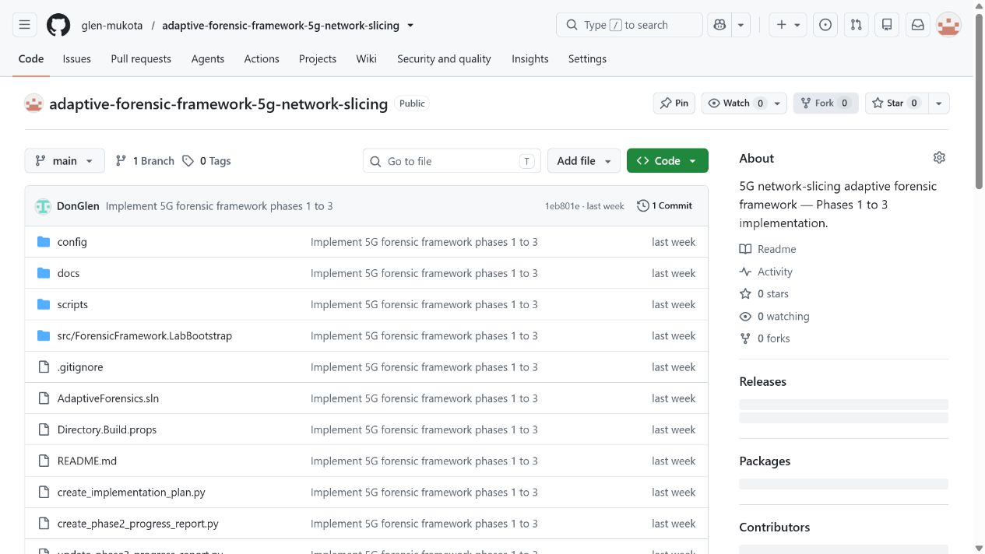
TRACEABILITY AND SHARING
Phase 4 is now saved and visible in GitHub
What is in the repository
the C# project
Docker configuration
Phase 4 rules and reports
simple run instructions
Latest update
Commit 938d1cf on main includes the Phase 4 implementation.
github.com/glen-mukota/adaptive-forensic-framework-5g-network-slicing
16 AUGUST 2026 | 09
Notes:
Talk track:
Say: The public repository contains the C# program, Docker configuration, attribution rules and the scripts used to reproduce the run. Commit 938d1cf is the Phase 4 implementation that I tested locally before pushing it.
[Sources]
- Public repository: https://github.com/glen-mukota/adaptive-forensic-framework-5g-network-slicing.
- Pushed commit: 938d1cf, Implement Phase 4 slice attribution.

Slide 10
COMPLETED IMPLEMENTATION PATH
The final three planned steps are complete
The prototype now connects its live laboratory, retained evidence, approved adaptation and controlled evaluation into one reproducible path.
Phase | Meaning | Evidence available
Phase 4 | Explain each slice decision | 27 records; 8/8 labelled cases correct
Phase 5 | Protect and adapt evidence | 2 approved updates; 27/27 hashes verified
Phase 6 | Evaluate known scenarios | 5/5 scenarios; 6/6 measures passed
Demonstration focus: start the laboratory, run the six steps, then inspect the retained evaluation evidence.
4 SEPTEMBER 2026 | 10
Notes:
Talk track:
The earlier planned steps are now complete. This table is not a future plan: it is a short evidence trail showing the outcome available for each of the final three steps. I will now demonstrate this chain from the running laboratory to the Phase 6 measures.
[Sources]
- Current Phase 4, 5 and 6 retained reports.

Slide 11
PHASE 5 ACCEPTANCE
Phase 5 adapts collection and protects each record
An approved rule raises collection priority only for attributed traffic. Original evidence is not changed.
2
27/27
27/27
approved priority updates
SHA-256 checks matched
complete custody records
eMBB and mMTC traffic each triggered the approved rule.
Each source matched when it was checked after collection.
Each record has source, collector, action, time, hash and storage location.
Test lab → attribution → approved rule → hash + custody
22 AUGUST 2026 | 11
Notes:
Talk track:
Say: Phase 5 is now complete. The program applies a priority update only after a controlled traffic record has been attributed to a slice. It does not change the source evidence. It then records the custody details, calculates SHA-256 and verifies each source again.
[Sources]
- Implementation Action Plan: Step 5, adaptive control, integrity and chain-of-custody controls.
- Phase 5 summary: artifacts/runs/phase5-20260822-170606/phase5-summary.json.
- Approved rule catalogue: config/phase5/adaptive-collection-rules.json.
[/Sources]

Slide 12
CURRENT POSITION
The six planned prototype steps are complete
The controlled evaluation passed all five scenarios and six measures. The next meeting can demonstrate the working prototype.
Phase | Meaning | What I can show
Phase 4 | Explain a slice decision | 27 records; 8/8 labelled cases correct
Phase 5 | Protect and adapt collection | 2 approved changes; 27/27 hashes verified
Phase 6 | Evaluate the framework | 5/5 scenarios; 6/6 measures passed
Next meeting focus: demonstrate the six-step prototype and review the retained evaluation evidence.
4 SEPTEMBER 2026 | 13
Notes:
Talk track:
Phase 5 is complete and Phase 6 now completes the prototype evaluation. I will use the remaining slides to show the measured result, the current running laboratory and the program that writes the evaluation report.
[Sources]
- Current Phase 6 summary and metrics report.

Slide 13
PHASE 6 EVALUATION
The completed prototype passed every planned check
Five controlled scenarios were compared with known inputs. Each scenario passed, and every defined measure passed.
5/5
6/6
13
scenarios passed
measures passed
healthy containers
Normal operation, anomaly replay, isolation, cross-layer evidence and adaptation.
Accuracy, completeness, integrity, custody, timing and observed overhead.
The current controlled laboratory remained available during validation.
Known inputs -> retained evidence -> measured result
4 SEPTEMBER 2026 | 13
Notes:
Talk track:
Phase 6 is the evaluation step. I did not simply show that the program runs. I ran five controlled scenarios and checked six measurable outcomes against the retained evidence. All five scenarios and all six measures passed in the current run.
[Sources]
- artifacts/runs/phase6-20260904-184135/phase6-summary.json
- artifacts/runs/phase6-20260904-184135/metrics.json

Slide 14
PHASE 6 LIVE CHECK
The two-slice laboratory is running
VERIFIED
What I checked
Confirmed 13 core and radio containers are healthy.
Re-ran the evidence chain from Phase 1 through Phase 6.
Retained before and after resource snapshots for the evaluation.
Why it matters
The final evaluation uses a live controlled laboratory, not a paper-only example.
Docker Desktop: current controlled laboratory view. All 13 required containers report healthy on 4 September 2026.
4 SEPTEMBER 2026 | 14
Notes:
Talk track:
This is the running laboratory that underpins the evaluation. The green healthy statuses show that the required core, virtual base station and virtual device containers are available before I run the evidence pipeline.
[Sources]
- Current Docker Desktop capture, 4 September 2026.
- Current docker ps validation.

Slide 15
PHASE 6 PROGRAM
The program produces a repeatable evaluation report
The final command checks the complete evidence chain and writes the result into a time-stamped folder.
The report confirms
the input runs are complete
five scenarios passed
six measures passed
the stored hashes still match
the limits of the laboratory
phase6-summary.json + metrics.json
4 SEPTEMBER 2026 | 15
Notes:
Talk track:
This screen shows the source project in Visual Studio. The program reads the Phase 1 to Phase 5 reports, checks that they link together, runs the five defined Phase 6 scenarios and writes the evaluation evidence.
[Sources]
- Current Visual Studio capture, 4 September 2026.
- src/ForensicFramework.LabBootstrap/Program.cs.
- scripts/Run-Phase6Evaluation.ps1.

Slide 16
COMPLETED PATH
The final three planned steps are complete
These steps complete the evidence path from the running laboratory to a measured result.
Explain slice decisions
Protect and adapt evidence
Evaluate the prototype
4
5
6
Use clear rules and retain the reason for every slice decision.
Apply approved priority changes, record custody details and verify hashes.
Compare all five scenarios with ground truth and record the measures.
COMPLETED
COMPLETED
COMPLETED
4 SEPTEMBER 2026 | 16
Notes:
Talk track:
These are the final three steps from the implementation plan. Together with the first three steps, they complete the intended proof of concept: a working laboratory, structured evidence, explainable attribution, safe collection adaptation, integrity and custody controls, then controlled evaluation.
[Sources]
- Implementation Action Plan: Steps 4 to 6.
- Current Phase 4, 5 and 6 retained reports.

