Slide 1
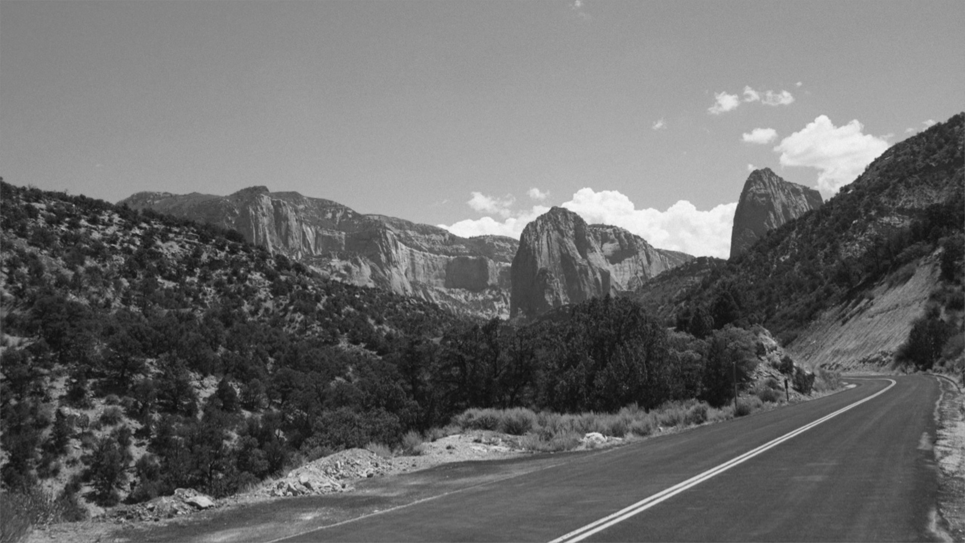

Front End Development workshop
WEEK One: HTML BASICS

Slide 2
Syllabus
2-3 hours/week outside of session is expected.
Tentative timeline:
HTML – basics
CSS – basics
HTML – advanced
CSS - advanced (mobile-first, breakpoints)
Heroku / JS (jQuery) - basics

Slide 3
Resources
Available on Github each week:
Lecture (Power Point Presentation)
Code examples
Slack Channel:
Links (pinned)
Online help

Slide 4
Week One
Intro (10 mins)
Set up (15 mins)
What we’re building
Tools & technologies
Getting set up
HTML page structure (10 mins)
Common HTML tags (10 mins)
Building our page in HTML / live coding session (15 mins)

Slide 5

Week One

Slide 6
Tools & technologies
Browsers
Chrome
Text editors (IDE’s)
Sublime Text (https://www.sublimetext.com/download)
Repositories
Github (https://github.com/glenelkins/front-end-workshop)
Local environment
python -m SimpleHTTPServer 8000

Slide 7

page structure
Semantics: the meaning or relationship of meanings of a sign or set of signs
Browsers are dumb
They need help understanding the content they’re given

Slide 8
page structure
Weather From
Basic Page Structure:
<html>
<head>
<body>
<header>
<main>
<footer>
<aside>

Slide 9
page structure
Weather From
Basic Page Structure:
<html> - Tells the browser “Hey! This is HTML”
<head>
<body>
<header>
<main>
<footer>
<aside>

Slide 10
page structure
Weather From
Basic Page Structure:
<html> - Tells the browser “Hey! This is HTML”
<head> - Contains (invisible) information about the whole page
<body>
<header>
<main>
<footer>
<aside>

Slide 11
page structure
Weather From
Basic Page Structure:
<html> - Tells the browser “Hey! This is HTML”
<head> - Contains (invisible) information about the whole page
<body> - Contains the content of the page
<header>
<main>
<footer>
<aside>

Slide 12
page structure
Weather From
Basic Page Structure:
<html> - Tells the browser “Hey! This is HTML”
<head> - Contains (invisible) information about the whole page
<body> - Contains the content of the page
<header> - Headlines, summaries, etc…
<main>
<footer>
<aside>

Slide 13
page structure
Weather From
Basic Page Structure:
<html> - Tells the browser “Hey! This is HTML”
<head> - Contains (invisible) information about the whole page
<body> - Contains the content of the page
<header> - Headlines, summaries, etc…
<main> - The bulk of the content
<footer>
<aside>

Slide 14
page structure
Weather From
Basic Page Structure:
<html> - Tells the browser “Hey! This is HTML”
<head> - Contains (invisible) information about the whole page
<body> - Contains the content of the page
<header> - Headlines, summaries, etc…
<main> - The bulk of the content
<footer> - Copyright, links, contact, etc…
<aside>

Slide 15
page structure
Weather From
Basic Page Structure:
<html> - Tells the browser “Hey! This is HTML”
<head> - Contains (invisible) information about the whole page
<body> - Contains the content of the page
<header> - Headlines, summaries, etc…
<main> - The bulk of the content
<footer> - Copyright, links, contact, etc…
<aside> - Extra content (in support of the <main>)

Slide 16
Common HTML Tags
Weather From
Basic Page Structure:
<h1> - First headline
<h2> - Secondary headline
<div> - Generic container
<p> - Paragraph
<img> - Image
<a> - Link

Slide 17
Let’s build!
Live coding / working session:
Basic page layout (head, body)
Header
Main (list if images)
Aside (headline, paragraph)

Slide 18
Homework
Complete your HTML page: build a header, main, aside elements with content.
Use the “week one” folder (available on Github) example as a guide.

