Slide 1
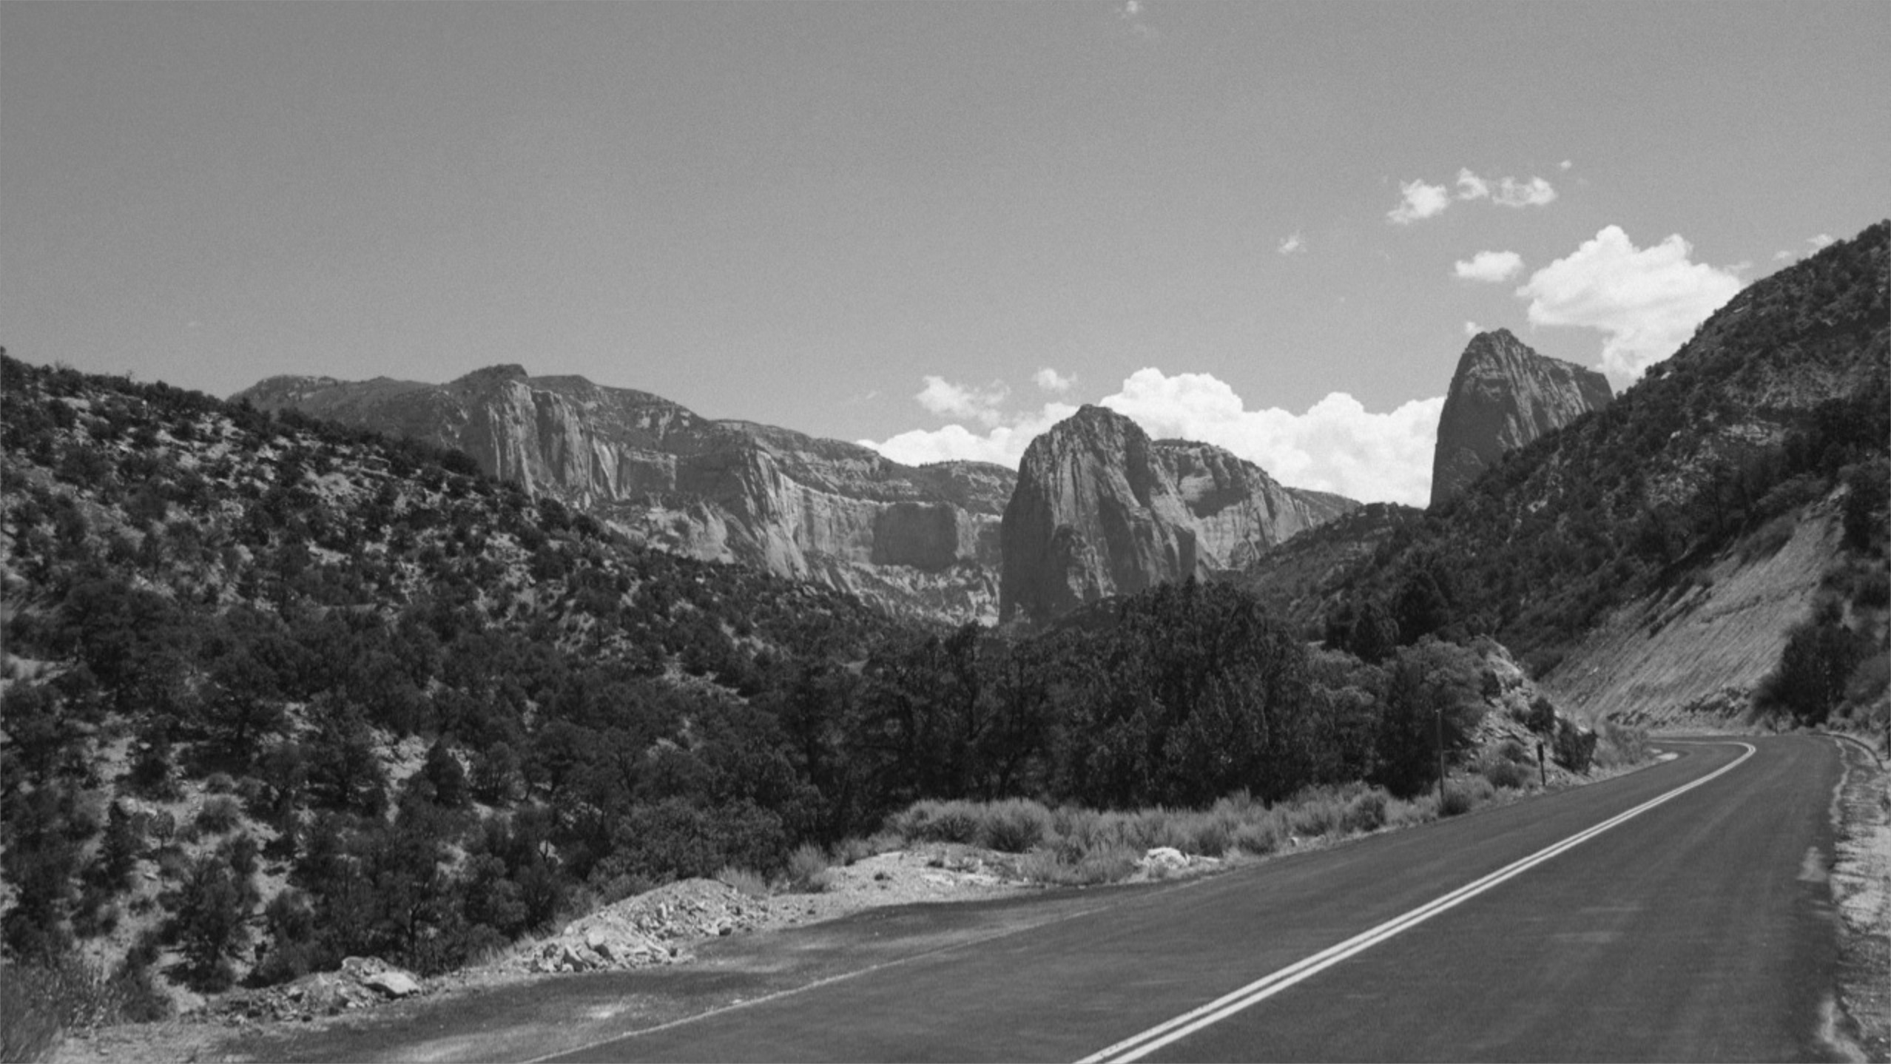

Front End Development workshop
WEEK THREE: Intermediate CSS

Slide 2
Review
Tentative timeline:
HTML – basics
CSS – basics
CSS - intermediate
Javascript (jQuery)
Heroku

Slide 3
Review
Tentative timeline:
HTML – basics
CSS – basics
CSS - intermediate
HTML – advanced
Heroku / JS (jQuery) - basics
Targeting
Cascade
Layout Styles
Text Styles

Slide 4
This week
Tentative timeline:
HTML – basics
CSS – basics
CSS - intermediate
HTML – advanced
Heroku / JS (jQuery) - basics
Custom Fonts (15 mins)
Background Images (15mins)
Media Queries (15mins)

Slide 5
What are Custom Fonts?
“Standard” vs. “Custom” fonts
Standard fonts live on your computer
Common fonts (http://www.cssfontstack.com/)
Custom ones can be loaded from a website
The New Yorker Magazine (http://www.newyorker.com/magazine/2009/06/29/ziggurat)

Slide 6
Adding Custom Fonts
Exercise:
Find a Font
Google Web Fonts - https://fonts.google.com/
Include the font on your <head> element
<link href="https://fonts.googleapis.com/css?family=Poppins:400,600,700%7CLora:400,700italic" rel="stylesheet" type="text/css">
Use in CSS
A “Font Stack” declaration lists many fonts that can be used in order of priority

Slide 7
Background images
Background images vs. <img src=“../path/image.jpg”> elements
Style vs. content
Image formats: png, jpg, gif, svg, etc…
http://www.apple.com/

Slide 8
Background images
Exercise:
Let’s add a background image to the address on our page
aside .location {
background-image: url(../images/pin.png);
background-position: 0 0;
background-repeat: no-repeat
line-height: 30px;
padding-left: 30px;
}
or
background: url(../images/pin.png) 0 0 no-repeat;

Slide 9
Media Queries
Scope CSS to specific browser size
Can re-arrange layout on phone vs. desktop
Example: Navigation on http://www.apple.com/
“Mobile first” development
Evolution of “responsive web”
http://www.lukew.com/ff/entry.asp?1514
Desktop only
Separate mobile & desktop websites
Separate mobile & desktop CSS files
Responsive design
Adaptive design

Slide 10
Media Queries
Exercise:
Let’s add a media query to our two-column layout

Slide 11
Homework
Complete the styling of your page using CSS & HTML.
Use the “week three” folder (available on Github) example as a guide.

Slide 12
References
Browsers
Chrome
Text editors (IDE’s)
Sublime Text (https://www.sublimetext.com/download)
Repositories
Github (https://github.com/glenelkins/front-end-workshop)
Local environment
python -m SimpleHTTPServer 8000

