Slide 1
The What, Why and How of NodeJS
An introduction for Rubyists

Slide 2
Glen Mailer
Web Developer for about 10 years
JavaScript, Ruby, Python, PHP
Working for SkyBet.com
Mainly a PHP Web Stack
Increasing use of NodeJS
Notes:
Hobby, Freelance, professional
Using node to consume AMQP queues and process messages, inserting into MySQL

Slide 3
The What and Why…

Slide 4
Reactor Pattern in JavaScript on V8
Notes:
Lets look at these bits in more detail

Slide 5
Reactor Pattern

Slide 6
Python: Twisted Ruby: EventMachine Pretty much any GUI
Notes:
Anyone used these?

Slide 7
Do something react after IO
Notes:
Basically this, we’ll look at some diagrams to illustrate

Slide 8
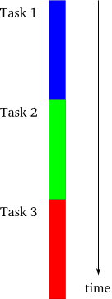
Images stolen from http://krondo.com/?p=1209
Notes:
We can speed this up by doing all the tasks at the same time

Slide 9
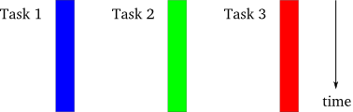
True concurrency
Notes:
However this comes with its own set of problems – not all tasks play nicely together
Locks – and thus deadlocks
Immutable state
Software Transactional Memory
One core/cpu = 1 thing at a time, so unless number of tasks <= number of CPUs/cores threads aren’t optimal

Slide 10
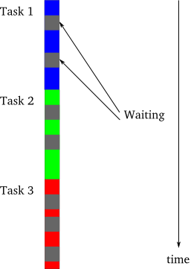
Wasted time waiting for IO
Notes:
Looking again at the first approach, we see time is wasted waiting for external resources
Filesystem writes
Remote HTTP calls
User input

Slide 11
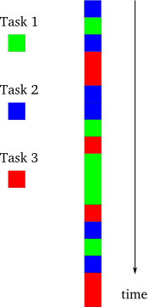
Reactor Pattern approach
Notes:
By splitting into smaller subtasks we can achieve a sort of parallelisation.
Whenever we would be waiting for IO, lets do something else and return when the IO is ready
Single thread means we don’t have to worry about locks and things

Slide 12
Unusual program flow

Slide 13
Don’t block the loop!

Slide 14
JavaScript

Slide 15
Loose Dynamic Typing
Notes:
Python/Ruby has strict dynamic typing, java has strict static typing.
Can cause problems, but just have to be careful when comparing types

Slide 16
Prototypal Inheritance
Notes:
Powerful, but often poorly understood, everyone + dog has implemented some sort of un-needed classical sugar for JS classes.
We’ll look at this in more detail later.

Slide 17
Lots and lots of closures
Notes:
Higher order functions are extremely powerful, but as rubyists you already know this.

Slide 18
No standard library
Notes:
For NodeJS this was actually a huge advantage, there was no previous standard library for things like filesystem access or subprocess management, so unlike in python and ruby where everything needs to re-implemented in such a way as to support the reactor – the only implementation is the asynchronous one.

Slide 19
Everyone knows JavaScript…
Notes:
Or thinks they do…

Slide 20
It is the language that people use without bothering to learn it first Douglas Crockford, Javascript: The Good Parts
“
”

Slide 21
V8
Notes:
The open source JavaScript engine that powers Google chrome

Slide 22
Began the JS arms race
Notes:
V8 is fast. Extremely fast. Fast enough to make every other browser maker start making their JS engines much faster

Slide 23
JIT Compilation
Notes:
The main reason for this is its JIT compiler. This is the same concept as PyPy or rubinius.
When interpreting JavaScript V8 does a quick pass and produces an ordinary executable bytecode. It then profiles the running script in the background and identifies any “Hot Loops” and the types passing through them. This information is used to produce a more more optimised version of the compilation (which takes longer to produce than the first pass).
This all happens transparently to the execution, and the result is simply very fast execution.

Slide 24
ECMAScript 5
Notes:
The standardised version of JavaScript 1.5
Provides a number of useful language improvements – unlike the browser we don’t have to use shims and wrapper libraries

Slide 25
“use strict” Array.forEach Object.keys Function.bind Object.defineProperty

Slide 26
1 GB Heap Limit!
Notes:
Something to watch out for, due to the way GC works in v8, if your program uses more than 1GB of heap space, it will crash.

Slide 27
The How…

Slide 28
The REPL
Notes:
An interactive interpreter just like irb, or python

Slide 29
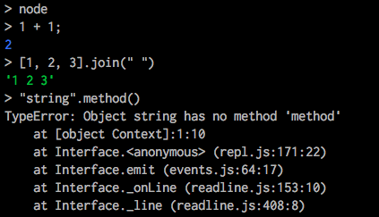
The Node REPL

Slide 30
Modules
Notes:
Python style, rather than ruby’s single namespace

Slide 31
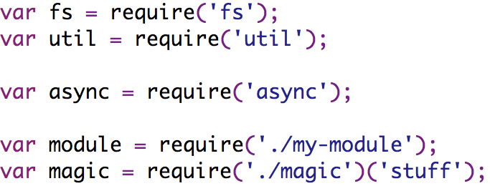
Requiring other modules
Notes:
Require returns an ordinary javascript object which is defined by the module
To use it, we just store this object in a variable scoped to the requiring module
If we start with . or / then interpret as file path, otherwise use module load paths
There is an internal cache so subsequent calls to require will always return the same module

Slide 32
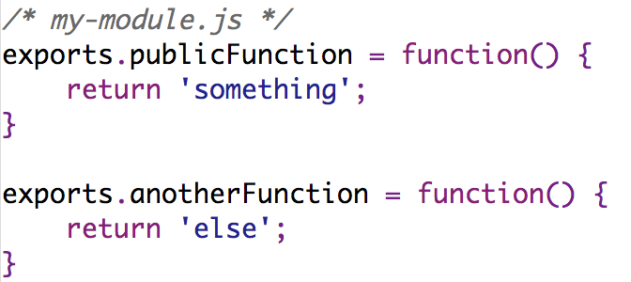
Defining your own modules
Notes:
Each module has an “exports” object, which becomes the return value of “require”

Slide 33
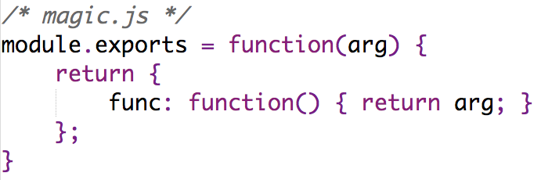
Re-defining the exports object
Notes:
“module” in a module refers to the current scope, exports === module.exports.
We can set module.exports to anything we want – like a function.

Slide 34
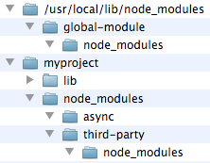
Load path using node_modules
Notes:
Algorithm:
Native module?
node_modules in pwd?
node_modules in parent dir?
require.paths (for system modules)

Slide 35
npm http://npmjs.org
Notes:
Like rubygems, manage your dependencies

Slide 36
npm install (-g) <package>
Notes:
Discuss difference between global and local
discuss briefly package.json

Slide 37
Callbacks

Slide 38
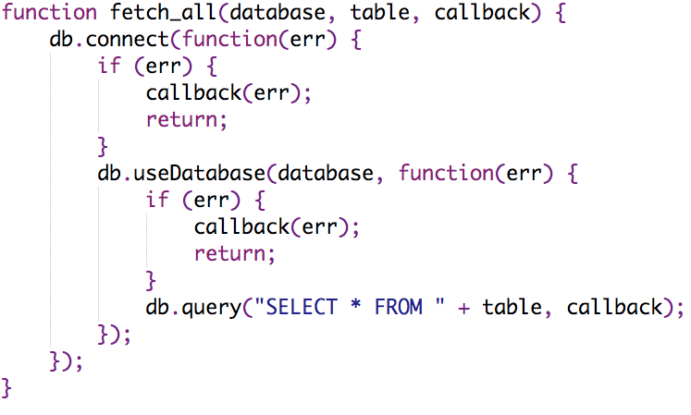
Using callbacks to wait for IO
Notes:
Note the error argument in all callbacks
And the if error bail out pattern

Slide 39
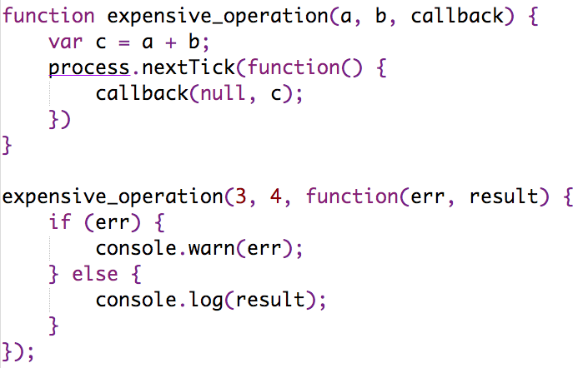
process.nextTick to release the loop
Notes:
When writing computationally expensive code, we can use process.nextTick to schedule some code to be run after releasing the loop to other subroutines

Slide 40
EventEmitter

Slide 41
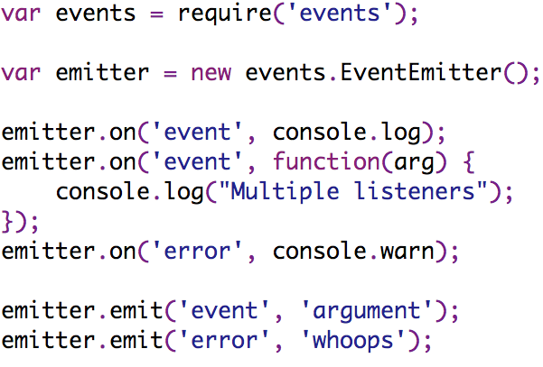
EventEmitter example
Notes:
A standard pattern for listening to and broadcasting events.
The “error” event is special cased to raise an exception if it is fired when there is no listener

Slide 42
The basis of most stdlib modules
Notes:
stream, net, fs, http, https

Slide 43
Prototypal Inheritance

Slide 44
Not Classical Inheritance

Slide 45
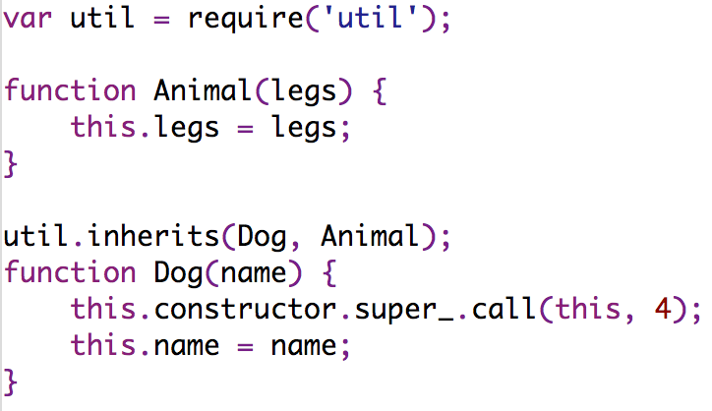
Defining “classes”
Notes:
“Classes” are simply functions which we then use as constructors
The util module provides an inherits function which is all we need to do inheritance.
It sets the prototype of the child object to the parent object, and also sets up this.constructor and .super_ correctly

Slide 46
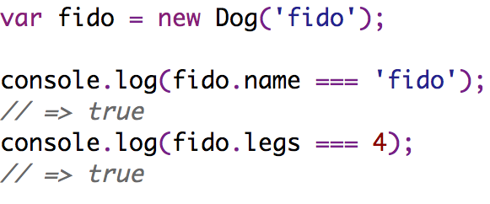
Instance and properties
Notes:
We use the “new” operator to create instances

Slide 47
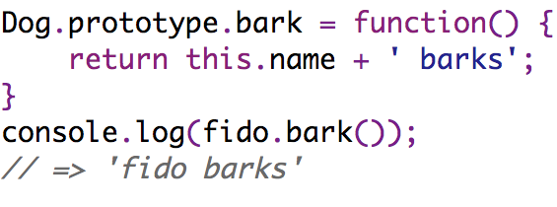
Method on a “class”
Notes:
By assigning to the prototype we make functions / properties available to all instances

Slide 48
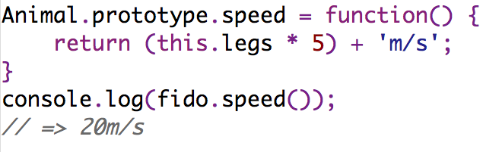
Method on a parent “class”
Notes:
Any class has a “prototype chain”, property/method access looks along this chain – here we attach a method on Animal
Interpreter checks fido.speed, Dog.prototype.speed and then matches Animal.prototype.speed – if this didn’t exist it’d look at Object.prototype.speed

Slide 49
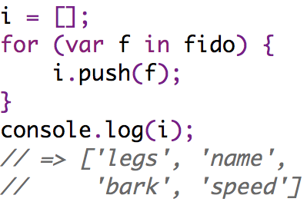
Iterating over an instance
Notes:
When using for..in to iterate over an instance, we get all of its properties and those up the prototype chain.

Slide 50
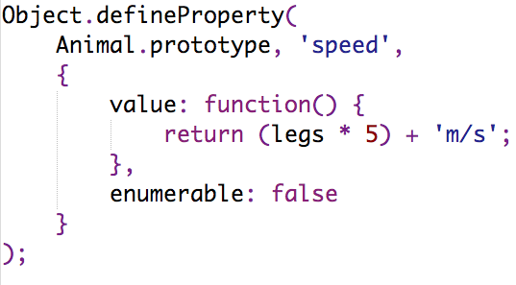
Controlling iteration behaviour
Notes:
If we want further control over this then we can use Object.defineProperty and make non-enumerable properties

Slide 51
HTTP

Slide 52
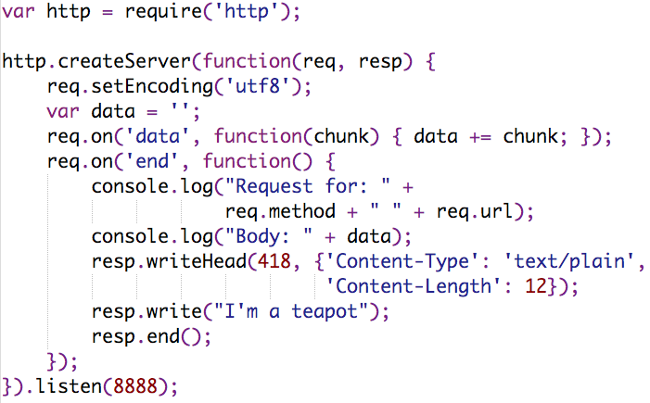
Simple HTTP Server
Notes:
Quite low level
Server gets a request event
Request emits a number of data events followed by end
Response is a writeable stream
Intentionally non-buffering because its easy to buffer over the top, but hard to get streams out of a higher level api

Slide 53
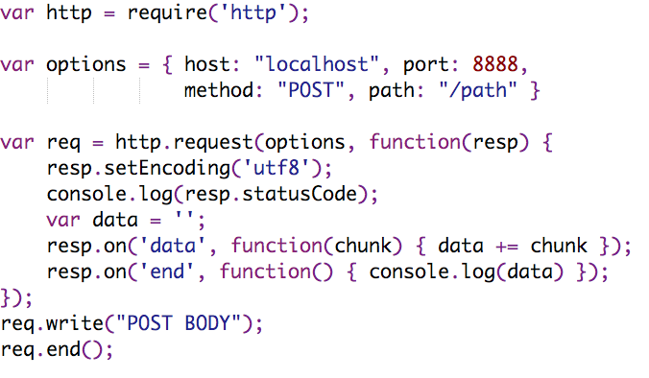
Simple HTTP Client
Notes:
Again, quite low level, we deal with streams which we must buffer ourselves – there are 3rd party libs which can tidy this up if we want them
When we hit req.end we start getting events from the response, again a series of data events followed by end.

Slide 54
Control Flow

Slide 55
async https://github.com/caolan/async
Notes:
Common async control patterns abstracted out

Slide 56
Function nesting without async
Notes:
Consider if there were more than just 2 pre-requisites before we could call query, the nesting is annoying.
Note also the repeating (if error then bail out) pattern

Slide 57
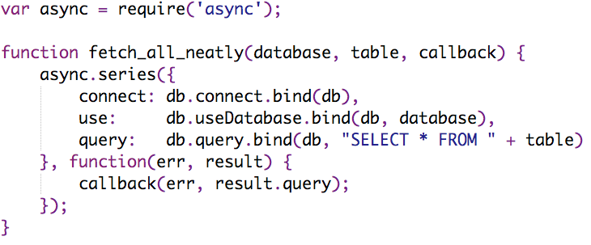
Tidied up with async
Notes:
Function.bind makes sure “this” is set properly in the tasks, and also allows us to curry the function

Slide 58
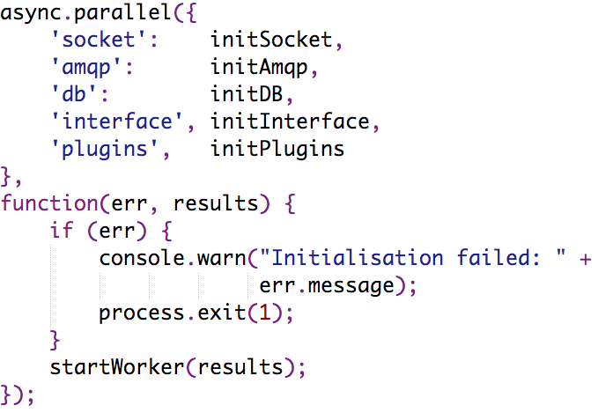
Parallel initialisation tasks
Notes:
We have a number of different connections and miscellanea to set up before we can start processing data in this program
We spool them all up in parallel, and then continue with the program flow

Slide 59
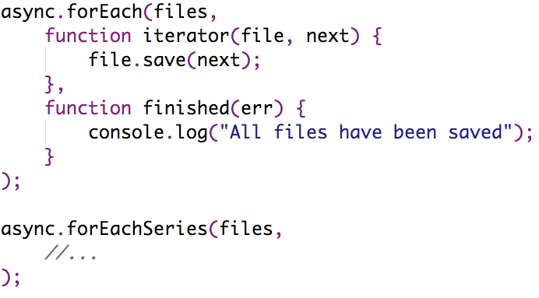
Iterating and calling async functions
Notes:
Assume that files is an array of high-level file objects which have a save() method that accepts a callback to be triggered on completion
The series variant has the same signature, but runs the tasks in series.

Slide 60
async.map[Series] async.filter[Series] async.reduce[Series] async.detect[Series]
Notes:
Also provides the common functional constucts

Slide 61
async.queue async.auto
Notes:
And some funky control flow constructs
Queue: takes a worker function and a concurrency limit, when tasks are pushed onto the queue will only run up to the limit at once. Emits events for saturated and drained
Auto: specify workers much like series and parallel, but can say which tasks are dependencies of each other. A bit like in Rakefiles. Imagine this for an async deploy script.

Slide 62
Web Frameworks

Slide 63
Connect http://senchalabs.github.com/connect/
Notes:
Rack / WSGI
Heavily based around pluggable middleware components which operate on the request/response objects
Provides things like routing, sessions, post-data / querystring parsing, profiling and even a little favicon server

Slide 64
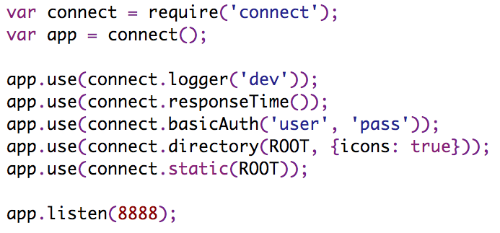
Simple connect example

Slide 65
express http://expressjs.com
Notes:
While connect does provide a sinatra-style routing middleware, it’s fairly basic.
Express is a framework designed to work on top of connect and connect compatible middleware to provide a much richer sinatra-like experience

Slide 66
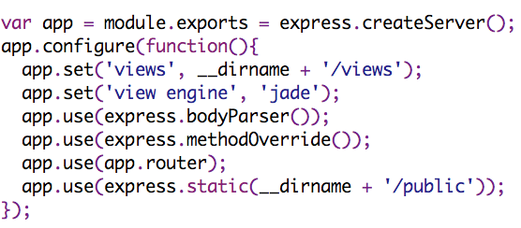
Express app initialisation
Notes:
You can see the similarities with connect, including using the middleware.

Slide 67
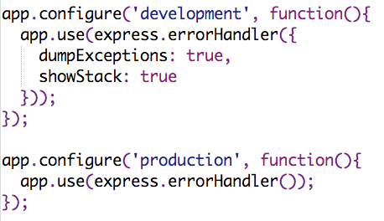
Express understands environments

Slide 68
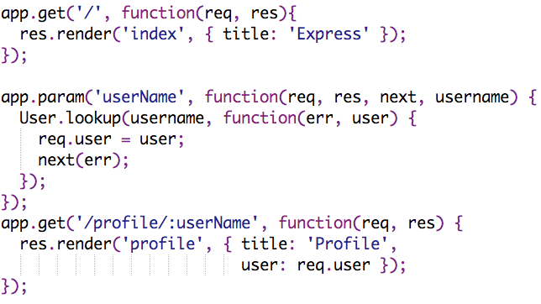
Handling requests

Slide 69
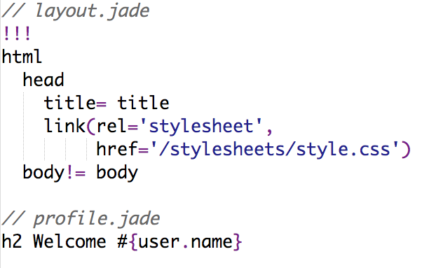
Templating with Jade
Notes:
HAML inspired, there’s also a JS implementation of HAML available

Slide 70
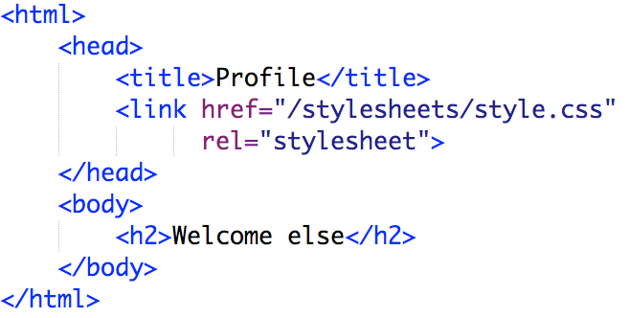
The output from the Jade template

Slide 71
Testing

Slide 72
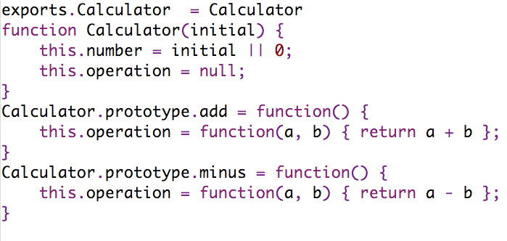
Sample code we’ll be testing
Notes:
Here’s the little sample module we’re going to be testing
A traditional calculator, where the methods are roughly equivalent to buttons you’d get

Slide 73
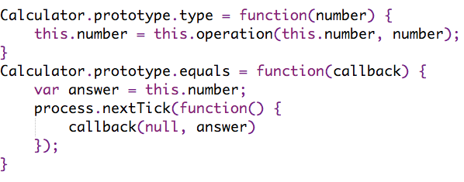
With some contrived asynchronous aspect
Notes:
And to see how the test frameworks handle async code, we’ll add some arbitrary callback component into the implementation
In most real cases you’d probably be doing some form of IO and so this would occur naturally

Slide 74
Scenarios to Test
New instance has methods:
add
minus
type
equals
Can initialise with default value
Can calculate: 2 + 2 = 4 + 2 = 6

Slide 75
Vows http://vowsjs.org

Slide 76
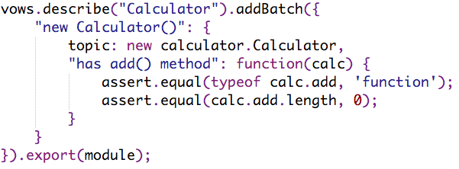
Basic Vows usage

Slide 77
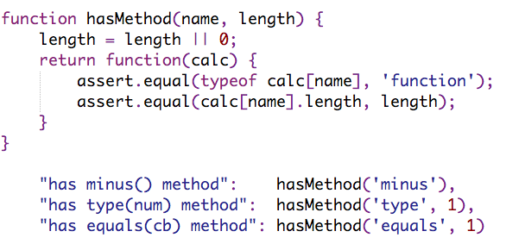
Define your own sugar

Slide 78
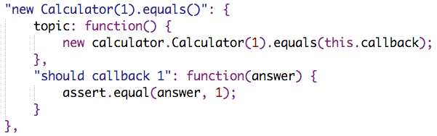
Async testing with Vows

Slide 79
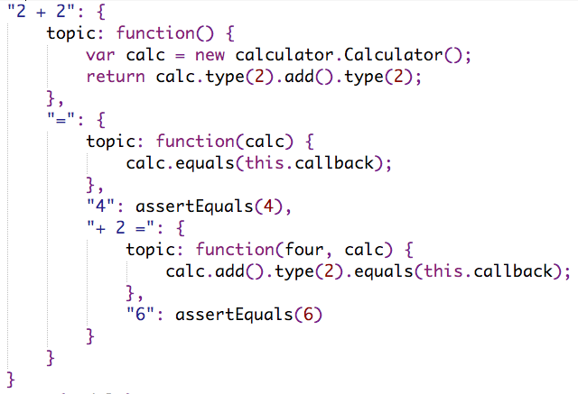
Nested async contexts with Vows

Slide 80
Vows Summary
Upsides
Downsides
Expressive DSL-like syntax
Good range of formatters
Coverage via jsCoverage
Unusual execution model
Forced to separate evaluation & assertion
Topic not clean per vow
Only one formatter per run
Commas!

Slide 81
nodeunit https://github.com/caolan/nodeunit

Slide 82
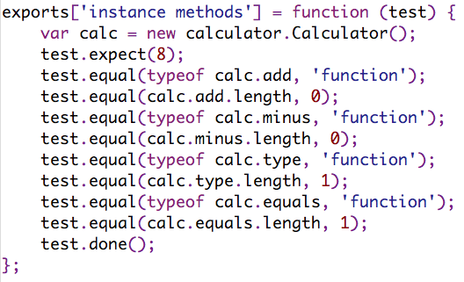
Basic nodeunit usage

Slide 83
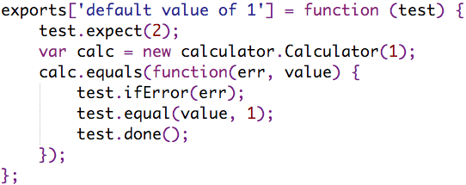
Async testing with nodeunit

Slide 84
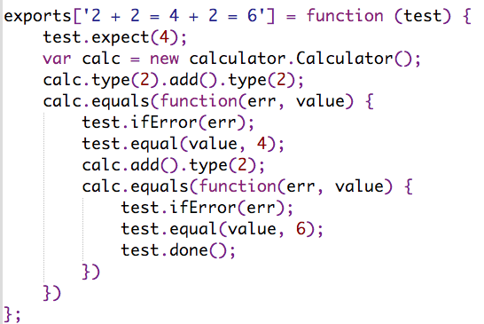
Nested async with nodeunit

Slide 85
Nodeunit Summary
Upsides
Downsides
Lightweight
Track number of assertions
Doesn’t force a particular style
Range of formatters
No code coverage
Have to roll your own structure
No nested contexts

Slide 86
nodespec https://github.com/glenjamin/nodespec

Slide 87
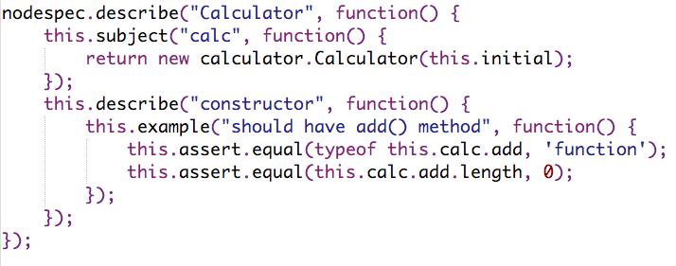
Testing with nodespec

Slide 88
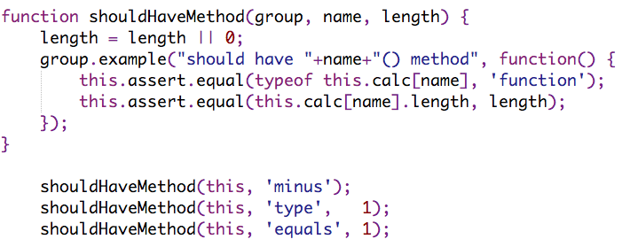
Sugaring tests with nodespec

Slide 89
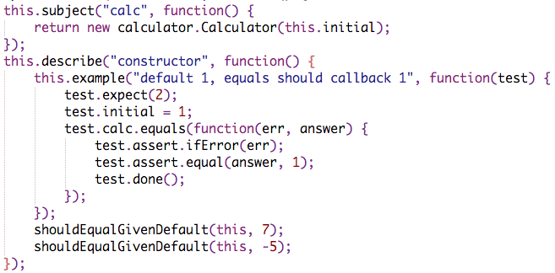
Async testing and subjects with nodespec

Slide 90
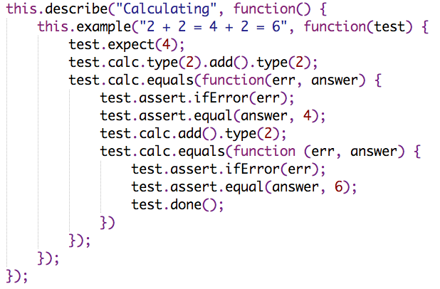
Chaining async with nodespec

Slide 91
Why nodespec?
Take best aspects from vows and nodeunit
Stick to native nodeJS stdlib assertions
Some RSpec-esque sugar
Nested contexts
Before/after blocks
Lazily evaluated subjects
Notes:
Not rspec-style assertions though!
No reason they couldn’t be plugged in

Slide 92
Still work in progress
Done
Todo
Nested contexts
Friendly sync/async syntax
Before/after hooks
Lazy subjects
Basic formatter
Cukes!
More formatters – including multiple outputs from one run
Command-line runner
Code coverage

Slide 93
Questions?

Slide 94
Further Reading
MDC – JavaScript 1.5 Referencehttps://developer.mozilla.org/en/JavaScript/Reference
NodeJS homepage http://nodejs.org/
My blog post on prototypes http://blog.glenjamin.co.uk/i-think-i-finally-really-understand-javascrip

Slide 95
Your Turn

Slide 96
Challenge: Parallel Searching
Install node + npm, and clone https://github.com/glenjamin/node-intro-challenge
Make requests in parallel then output first 100 chars
Modify to make requests one at a time
Now go back to parallel, and implement:
function search(term, callback(err, results))
results = {google: {data: ‘html…’, time: 1.34},
yahoo: {data: ‘html…’, time: 2.01}, … }

