Slide 1
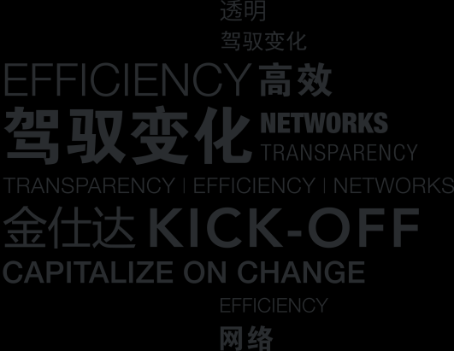
2014 Hackathon: N-Monitor

Slide 2
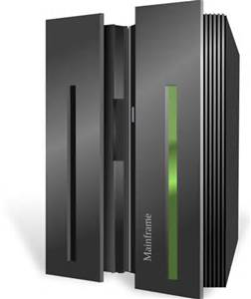
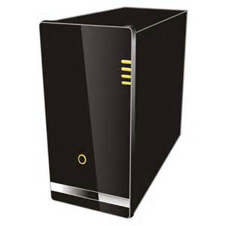
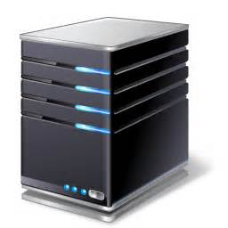
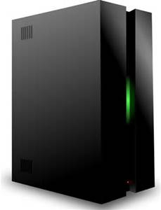
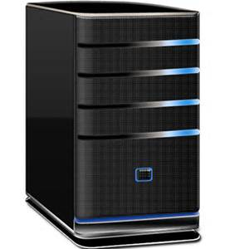
Scenario
ERP
Financial System
CRM System
Inter-message System
Daily Record System
How to manage this CHAOS?

Slide 3
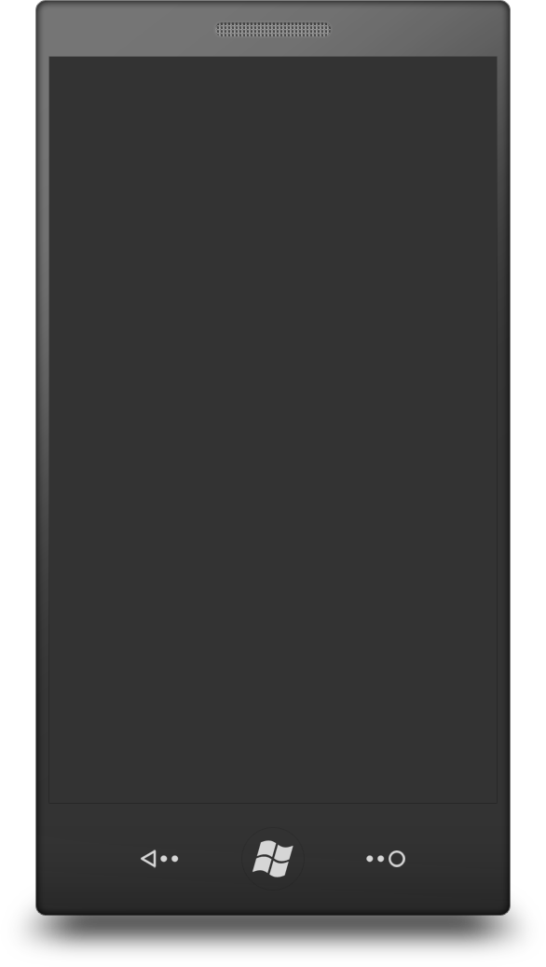
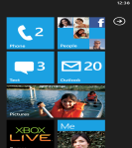
Solution
MQTT Broker
App 1
App 2
Monitor
Computer1
Monitor
Monitor
App 3
Java Program
Java Web App
App 4
Nodejs App
Computer2

Slide 4
Inner View
Notifier
Main Program
Webkit
TCP
Node
Starter
UDP
Monitor
Application

Slide 5
Technologies Used
Node-webkit
An integration of Nodejs and Webkit.
Can be a front-end and back-end at the same time
Bootstrap
A HTML Framework
Simplify the view construction work
Nodejs
A software platform
Non-blocking, scalable, multi-platform support…

Slide 6
Vote KWAN
Good Point:
Plugin-able
Non-blocking
Multi-device accessable
Scalable
Real-time

Slide 7
TEAM KWAN
Captain
Zhang, Shulai(shulai.zhang@sungard.com)
TEAM MEMBERS
Sun, Bingjue(bingjue.sun@sungard.com)
Li, Qiaoqiao(qiaoqiao.li@sungard.com)
From Kingstar and Banking(Shanghai, China)

Slide 8

Thanks!

