Slide 1
New IOT
New Architecture
New Programmer
New Technician

Slide 2
New IOT Architecture Introduction
Conventional IOT Architecture
Edge IOT Architecture
New IOT Architecture
Data Centered Based Architecture

Slide 3
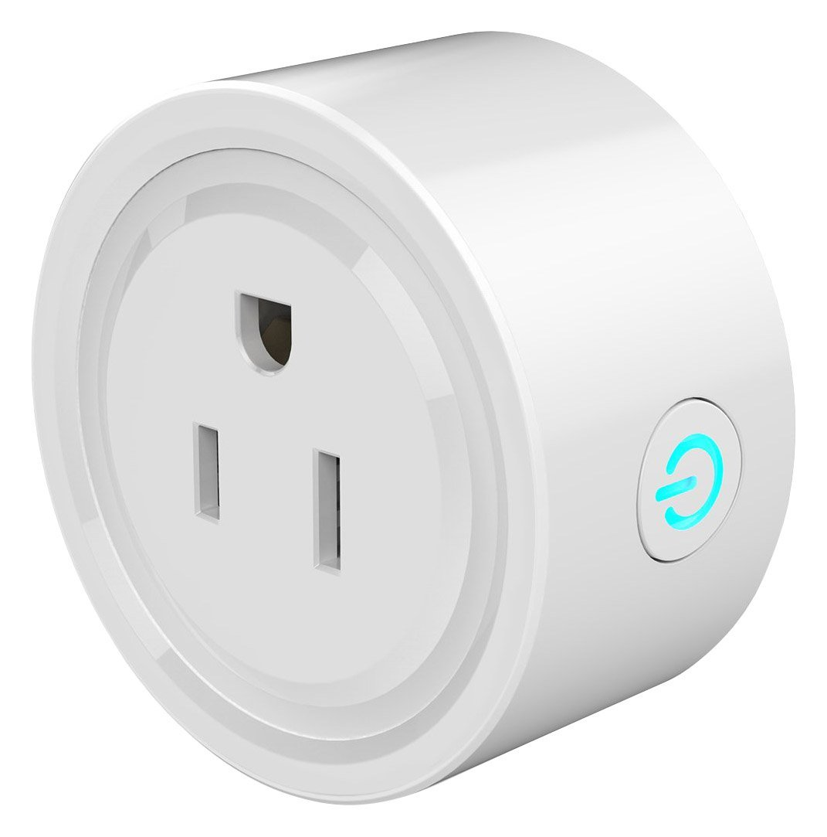
Classic IOT Architecture
Consider the following device that turns an electrical appliance on or off.
This device is controlled by a smart phone app or by a voice command from alexa

Slide 4

Typical IOT Layout
Https from Alexa
Cloud
RPC Type
Interface
AMQP or MQTT
Wifi
Cloud
Web Server
internet
Local Wifi Access
Https from Cellphone Apps

Slide 5
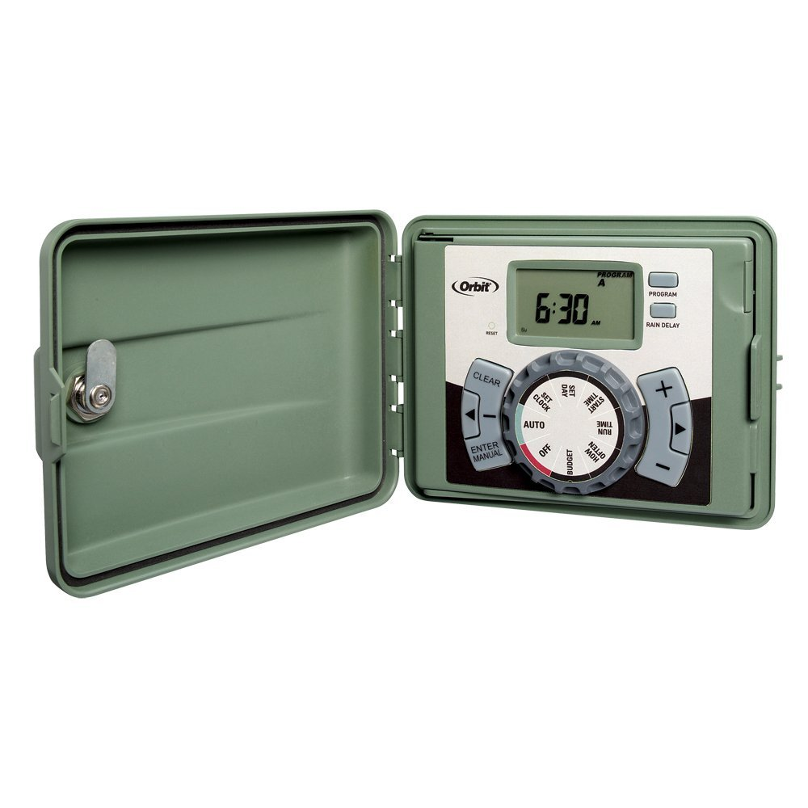
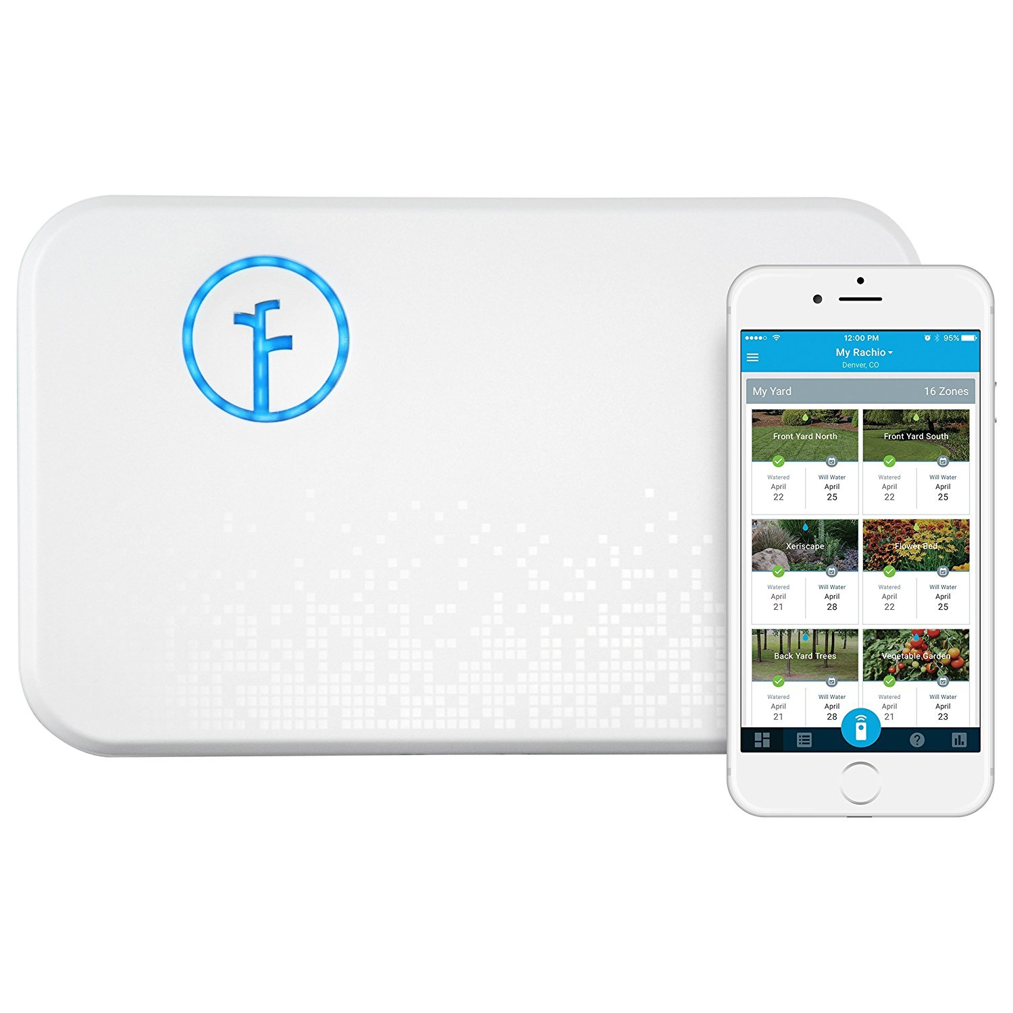
Edge Process IOT Devices
Conventional Embedded System
Edge IOT Device

Slide 6
Typical IOT Layout
Cloud History Data Store
Local web command
Cloud Web Commands
Cloud
RPC Type
Interface
AMQP or MQTT
Wifi
Internet
Cloud Web Server
Devices are more complex
Web servers for local setup and control
Multiple Applications executed
Simple Data Base of History and Configuration
Communication with Cloud Device is more complex
Logic to Configure Setup of System

Slide 7
Problems with Previous Architectures
The architectures listed above have problems:
Fixed functions – cannot add or modify capabilities
Costly to develop
Edge Device requires extensive NRE costs
Requires large numbers to over come NRE costs
Requires large Number of Expertise
Embedded Programmers
Cloud Developers
Hardware Developers
Large amount of custom software for a single project
Been there, done that
Problem also is that two groups with very little in common
Cloud people
Embedded People

Slide 8
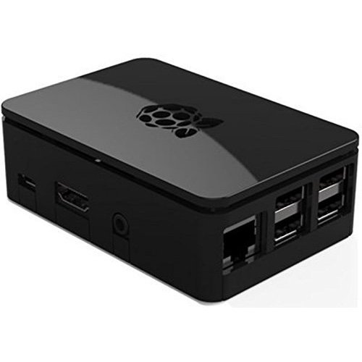
New Approach is like Cell Phone Apps Functions are added to an existing platform much like apps are to a cell phone
Local Graph
System Graph
Edge Device is a Nano Data Center
Cloud Interface
AMQP or
equivalent
Device Data
Base
Event Bus
Local Apps
Local
Web Pages
Local Web
Sockets
Cloud Apps

Slide 9
Goals of the Nano Data Center
The Nano Data Center is easy to setup.
The Nano Data Center makes developing applications easier
The Nano Data Center make the target device IOT compatible.
Docker Technology may make the setup even easier.

Slide 10
What is a Nano Data Center
This topic will be presented more in the next lecture.
Companies that field online businesses have tools to monitor their operation. Among the tools or features are
Event bus
Time History Database
Web Server to Display Data
Document Database to store log events ( Elastic Search )
An Additional feature is a Graphical Data Base

Slide 11
Why use a Nano Data Center?
IOT Edge Devices are controlling things
Failures happen to items that the IOT edge devices control.
Monitoring Systems are necessary
IOT Edge Devices must have Web and Alexa Interfaces
IOT Edge Devices must at least have the ability to connect to the cloud
Multiple processes communication is a necessity to maintain modularity

Slide 12
Why is the graphical data base important
The Graphical Data Base allows:
List system resources including applications
List location applications obtain startup and input data
List location applications obtain output data
List location applications use for event queues
List location applications use for time history queues
By using the graphical Data Base commands, an application can concentrate of the core function of a task.

Slide 13
Nature Of Local Apps
Local Apps have the following properties
Local Apps are Linux Processes
Local Apps could be put in docker containers
Advantage – network deployment
Local Apps obtain startup information through Nano Data Center
Local files could be used in limited cases
Anything outside of the process is through the data center
There are helper service for writing process applications
Chain Flow services to handle flow control

Slide 14
Nature of Application Web Pages
Over a period of 20 years there is a need for a local web server located at the node device. Many times attempts have been made to remove it and was quickly put back in place.
There are many applications running, but there can only be one web server. Therefore, applications must integrate into a single web frame work.
Rules for the web frame work.
Web pages must support a mobile touch layout
Need to navigate to any web page within 3 clicks

Slide 15
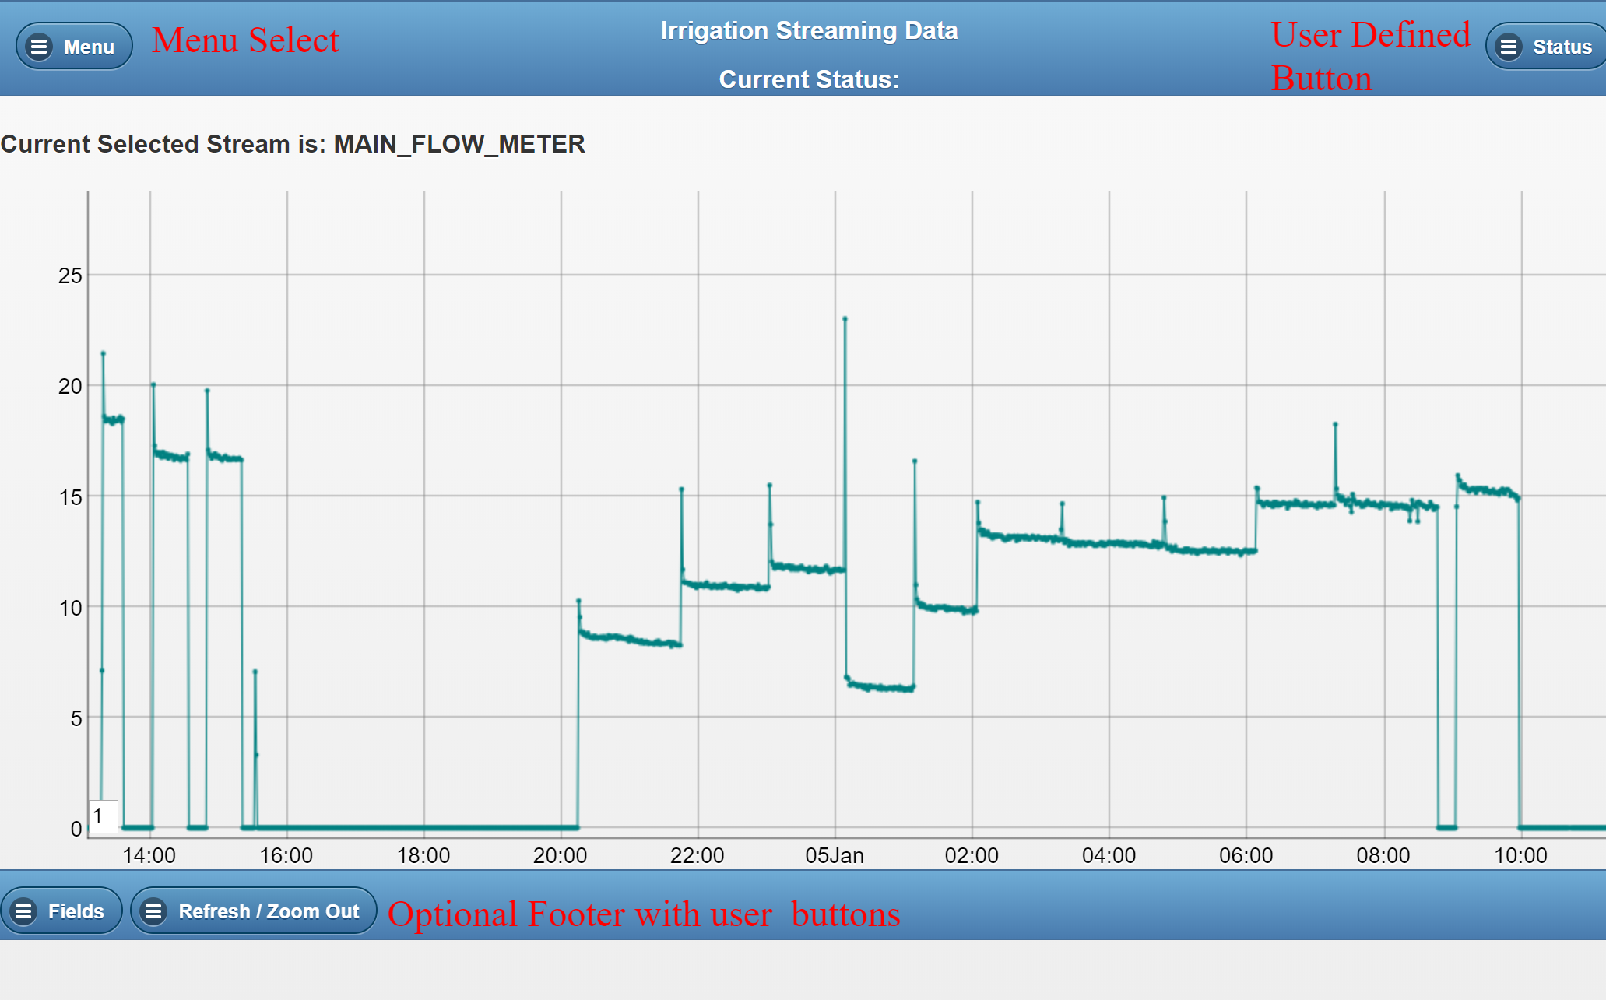
A typical web layout

Slide 16

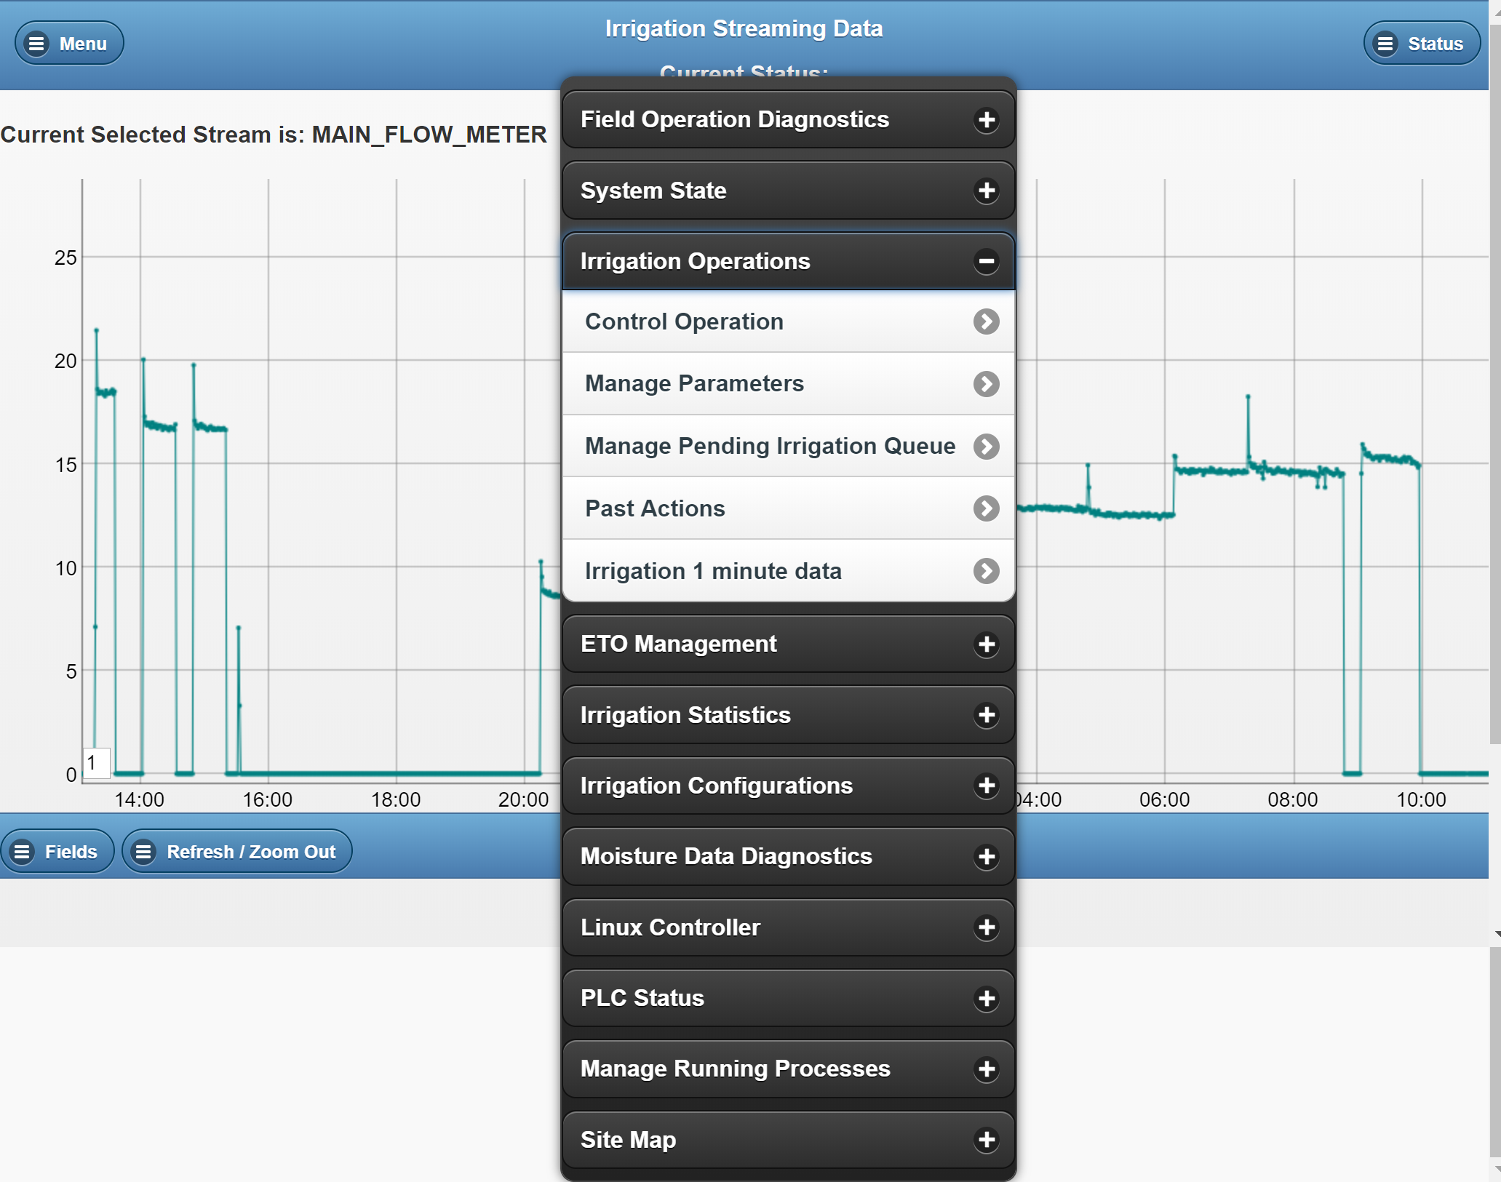
Example of Menu Selection with Pop Up Menu

Slide 17
Web Frame Works Continued
Applications live within the framework. The framework offers:
Authentication is provided by the framework
A mobile framework such as jQuery mobile, React Bootstrap
Navigation is taken care of by the framework
A common template to add application code into
JavaScript and Css files are included into the template. No files except for library files

Slide 18
Web Sockets
Many user applications require telnet or ssh type use cases.
For lack of a better term console services
A Web Socket Service is setup to allow users setup web Sockets
Setting up Web Socket Service is straight forward
Main problem with Web Sockets is Service

Slide 19
Local and System Graphs Feed a Graphical Data Base
A graphical data base is:
A collection of nodes ( python dictionaries )
Nodes are collected by relationships and labels
Relationships can be searched by a query language
Why is that important?
An application can search the graph to find remotes that are moisture sensors.
An application can search the graph to find input data location and output locations
In essence no more hardcoding apps and having ever growing configuration files.

Slide 20
New Programmer -- A Renaissance Man?
In the past a programmer could function in a very narrow area such as:
Embedded
Data Base
Web Front End/ Web Back End
Data Center activities
In the New Web Based architecture a programmer may have to be versed in the areas above as well as other areas such as
Wireless Devices and Power Management
RS-485 and Modbus
Ladder Logic and PLC’s
Sensor and Actuators
Enclosures
Wiring
Printed Circuit Boards and all the Ada Fruit Stuff
This is the reason the maker movement came to be.

Slide 21
New Technician
Adaption of these systems will not take place until industries have an organic technician base to install and service these devices.
The author has been for over 25 years been involved in fielding edge IOT devices in retail stores. The result is that the installation and maintenance costs greatly exceed the cost of the system
In agriculture, these IOT systems will not be successful until the farmers or farm workers can configure and maintain these systems
An attempt will be made to create a technician track.

Slide 22
A purpose of the Maker Space
Provide the training for the next generation programmer
Provide the training for the next generation technician
Because no one else is doing it.
Also, provide a frame work for companies that wish to start.
Only requirement is to contribute back non proprietary technology.

