Slide 1
PLC Irrigation Controller

Slide 2
PLC Irrigation Controller Description
The Irrigation Controller is my basic field irrigation controller.
22 Irrigation Controllers
(8) 24 Volt Digital Inputs
The first 4 digital inputs can be used as flow meter counters
The field installation is designed to be done without opening the enclosure.
Automation Direct C0-00DR-D plc
User Manual
https://cdn.automationdirect.com/static/manuals/c0userm/c0userm.html

Slide 3
Field Connection
The PLC controller will have three wire bundles
7 Wire Bundle containing control and power signals
12 Wire Bundle containing sprinkler inputs 1-11 + common return
12 Wire Bundle containing sprinkler inputs 12-22 + common return

Slide 4
Power and Control Bundle
The power and control Bundle contains the following lines
Blue – 24 volts
White --24 return
Yellow --Sprinkler Power High
Green – Sprinkler Power Low
Red – RS485 High
Orange – RS485 Low
Black or Brown 485 Ground

Slide 5
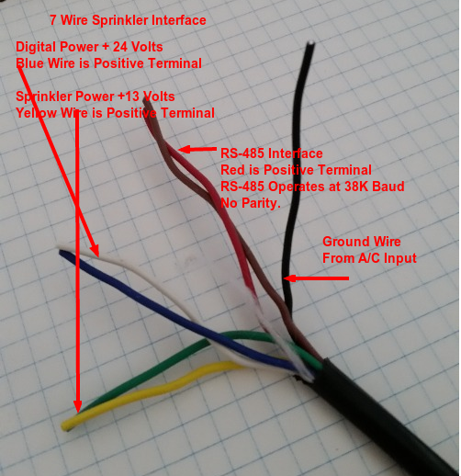
Connection – Match Colors of Controller Box with Field Cable
Sprinkler
Wire
Provides
The power
And RS485
Links to Units

Slide 6
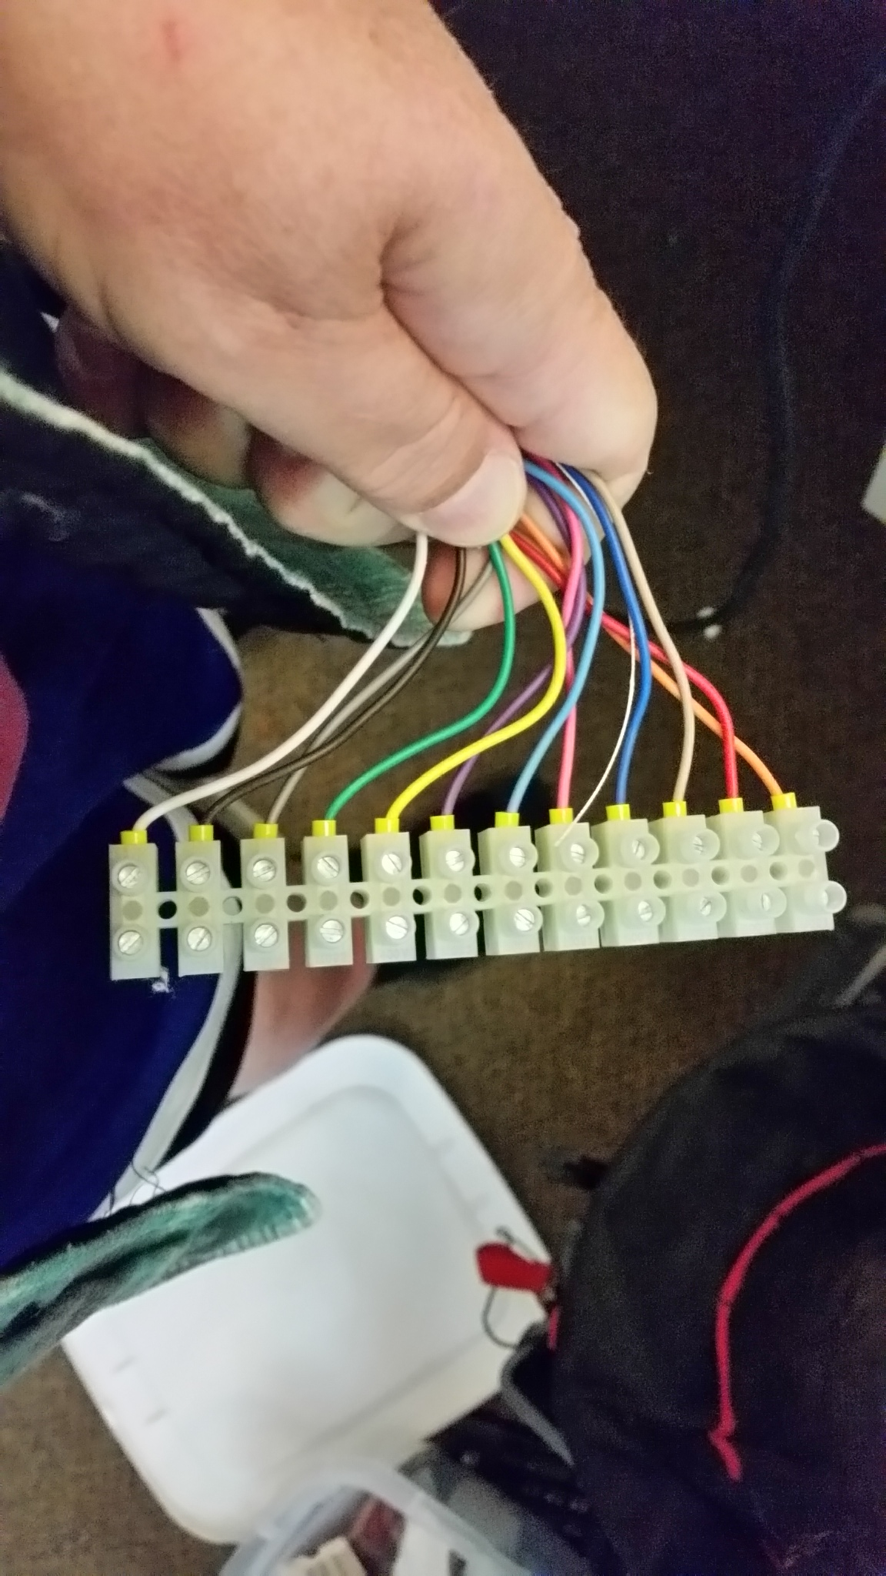
Sprinkler Cables
The sprinkler inputs are referenced by cable connector, connector 1 (1-11) and connector 2 (12-22)
The white wire in the cable is the sprinkler power return. The next wire after the white wire is either sprinkler #1 or #22.
Inputs Numbers can be determined based upon counting from the white wire

Slide 7
Irrigation Controller Design
Enclosure Design is described in Appendix A
24 Volt inputs are designed in Appendix B
Relay Drive capability is described in Appendix C
Wiring Consideration is described in Appendix D
RS485 Implementation is described in Appendix E
Lightning Protection Appendix F

Slide 8
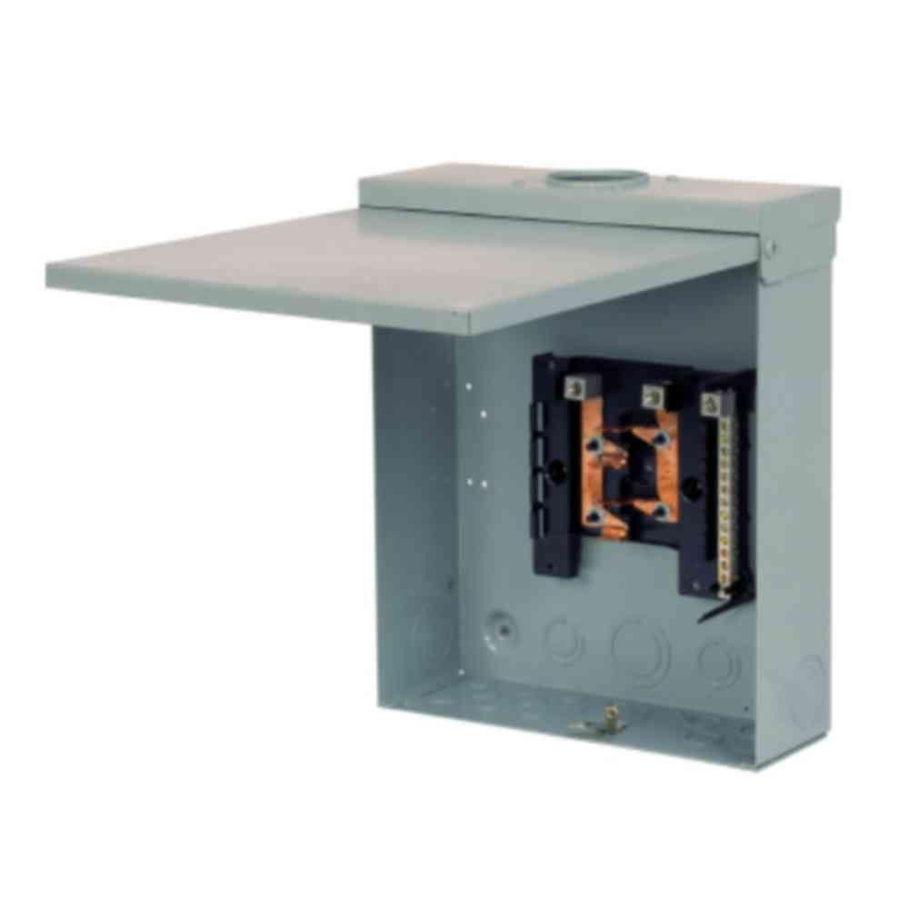
Appendix A Enclosure Design
Outdoor Electrical Load Center Boxes are used as shown below.
The Insides of the Load Center Box is removed

Slide 9

Enclosure Design Continued
A 10- 15 degree lower temperature in summer is possible if the enclosure is painted white.

Slide 10

Enclosure Design has proven resilient
The Enclosure Design has been used for over 4 years. And survived a snow storm

Slide 11
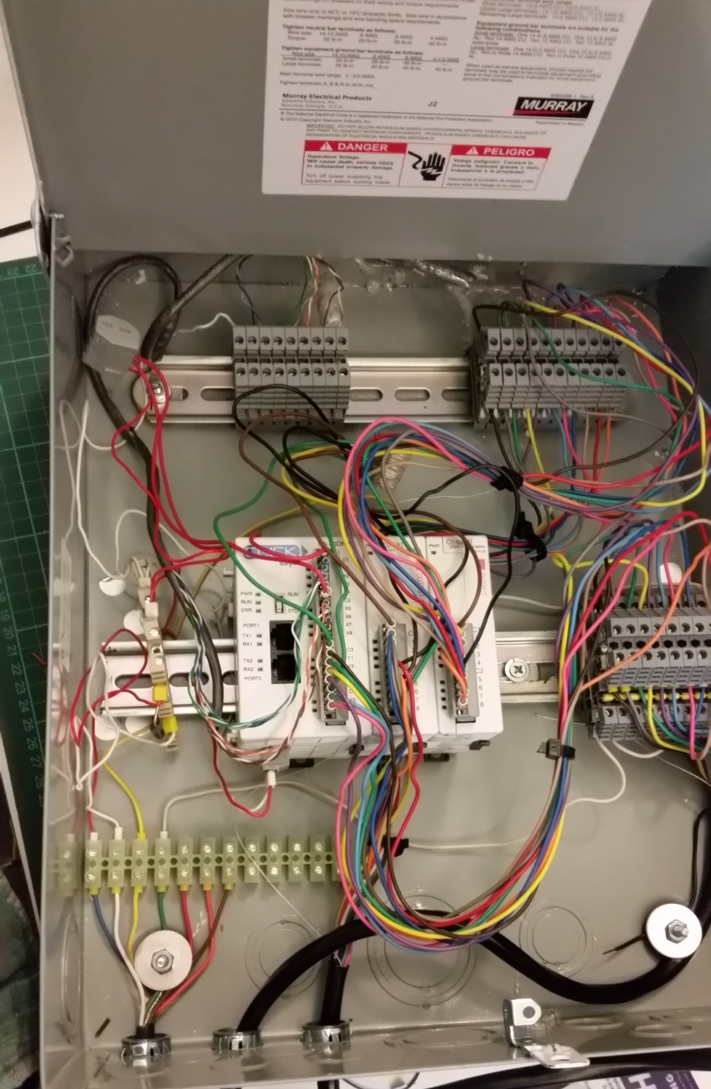
Enclosure Design Continued
Attached Two DIN Rails as shown in the picture below. Exact position of the DIN Rails is dependent upon the enclosure selected.

Slide 12
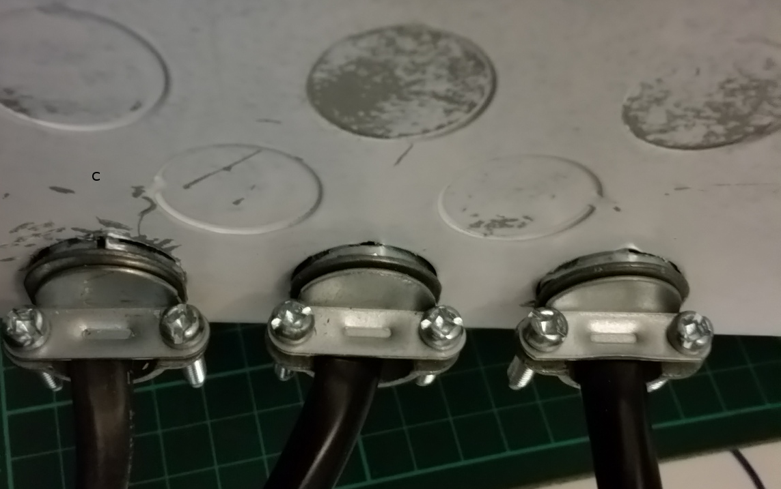
Enclosure Design Continued
Punch out three ½ cable conduits and attach cable retainers.
The first punch out cable is 7 strand 18 gauge sprinkler wire.
The second and third punch out cable is 13 strand 18 gauge sprinkler wire.

Slide 13
Populate Components on Din Rail
Din Rail in Middle
3 unit Plc
Diode Terminal Block 1-11
Din Rail at Top
8 input blocks + ground terminal
Diode Terminal Block 12-22

Slide 14
Appendix B PLC Input Design
1. Recommended Layout for PLC Inputs
2. Actual Input Implementation
3. PLC Inputs are configured as sourcing
4. Performance Of PLC opto isolators
Impacts Voltage Threshold
Impacts Flow Meter Maximum Count

Slide 15
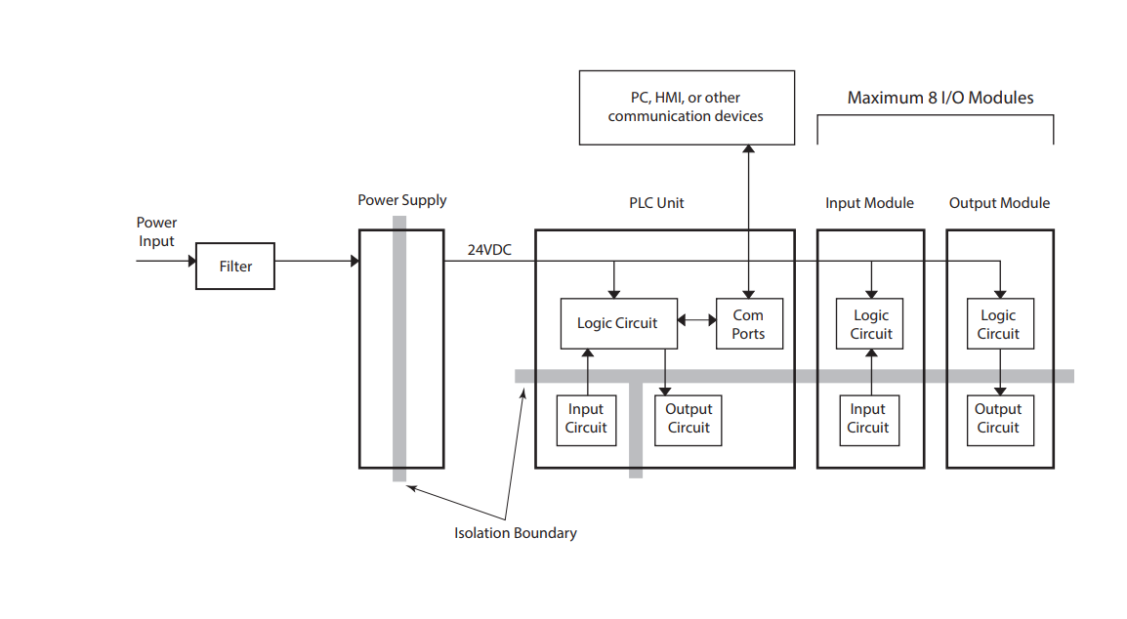
Ideal Arrangement For Inputs

Slide 16
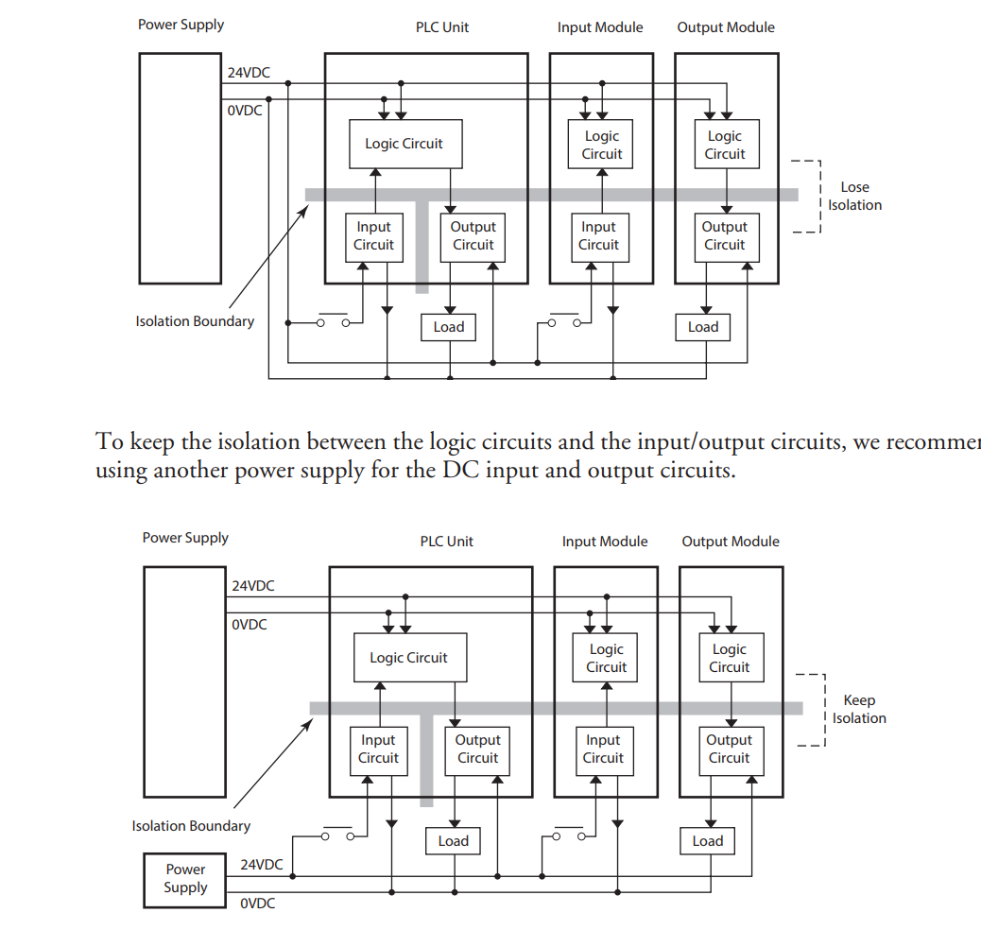
Actual Implementation for Inputs Extra 24 volt power supply would take an Extra Two Wires

Slide 17
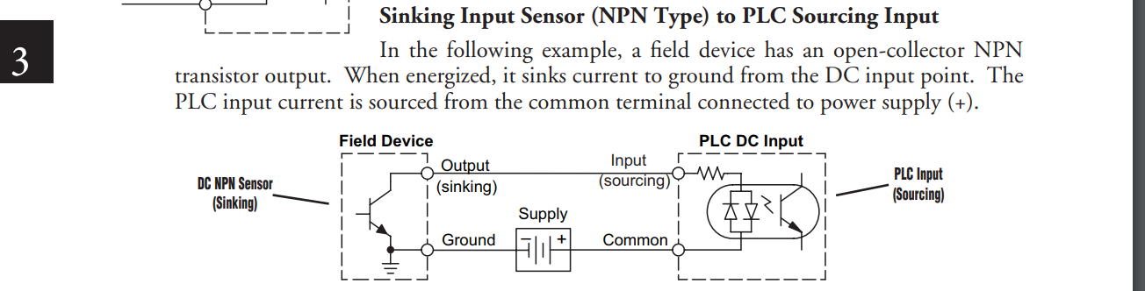
Wiring of The PLC Inputs. Devices pull to ground

Slide 18
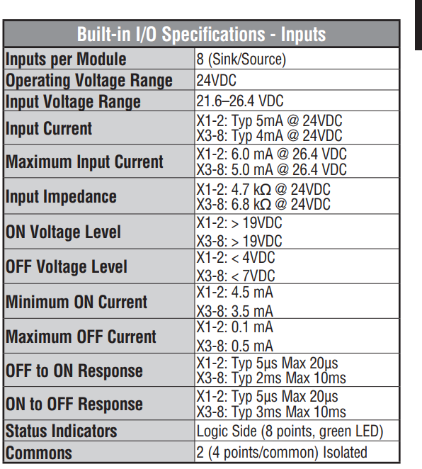
Catches pulses on order of 10000 Hz opto isolators limit

Slide 19
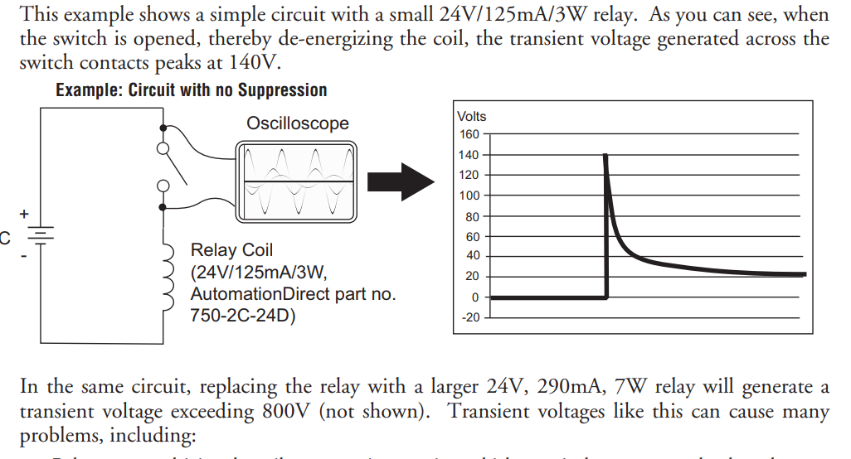
Appendix C Relay Drive Considerations

Slide 20
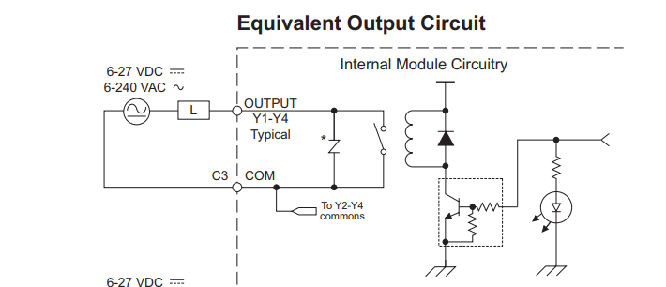
Relay Output Considerations
The Circuit for the PLC Relay Drive is shown below. The strength of the transorb is 20 J. Automation Direct recommends
Additional transient suppression should be used in both these examples. If you are unable to measure the transients generated by the connected loads of your control system, using additional transient suppression on all inductive loads would be the safest practice.

Slide 21
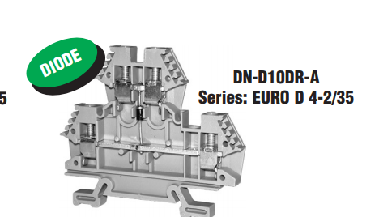
To Add Additional Relay Protection The following Terminal Block was added

Slide 22
Wiring Considerations
In the field the sprinkler wire is 18 gauge
The current caring capacity is 2.3 amps
A solenoid short will cause 4 amps to flow through the system for as much as 15 seconds.
11 wires needed to be color coding
The wiring for the sprinkler lines inside the chasis was selected as 18 gauge wire.
Current Carring Capacity for various wire sizes can be found at
https://www.powerstream.com/Wire_Size.htm

Slide 23
Appendix E RS-485 Considerations
Will be describe next week

Slide 24
Appendix F. Lighting Considerations
A 1N6284A transorb placed across the 24 volt power lines.
The transorb will ingage if the voltage is greater than (34.2 - 37.8 ) voltage range

