Slide 1
Temperature sensor
Glenn norris jr
Cmpe 3434 – microprocessor lab
Dr. lei

Slide 2
Overview
Purpose
PRACTICAL USE
Parts
PROCESS
CODE
DEMONSTRATION
REFERENCES

Slide 3
PURPOSE
TO DEVELOP HARDWARE AND SOFTWARE TO DETECT TEMPERATURE IN A DEGREE WITH LITTLE ERROR
USE KNOWLEDGE AQUIRED FROM CMPE 3434 – MICROPROCESSOR LAB TO CREATE, TEST AND USE SUCH A PRODUCT
USE WHERE APPLICABLE

Slide 4
PRACTICAL USE
SUCH HARDWARE AND SOFTWARE COULD BE USED IN A LAB SETTING WHERE MONITORING TEMPERATURE IS VITAL
IT CAN BE USED IN VARIOUS RESEARCH WHERE DETECTING TEMPERATURE NEEDS TO BE QUICK AND ACCURANT
CAN ALSO BE USED TO SHOW IMPORTANT CONCEPTS LEARNED IN CMPE 3434(LAB 5 , LAB9) TO INCOMING STUDENTS

Slide 5
Parts
BeagleBone Black
Bread Board
Shift Register(2)
7 Segment Display(2)
Various wires
Thermistor
10,000 Ohm Resistor

Slide 6
Process
Using knowledge from lab 5 and lab 9
First develop a voltage divider
We develop a voltage divider, because the changing resistor value of the thermistor is unknown and in order to calculate temperature we must know that value
Therefore solve for resistor and set up beaglebone to read in Analog Input Values

Slide 7
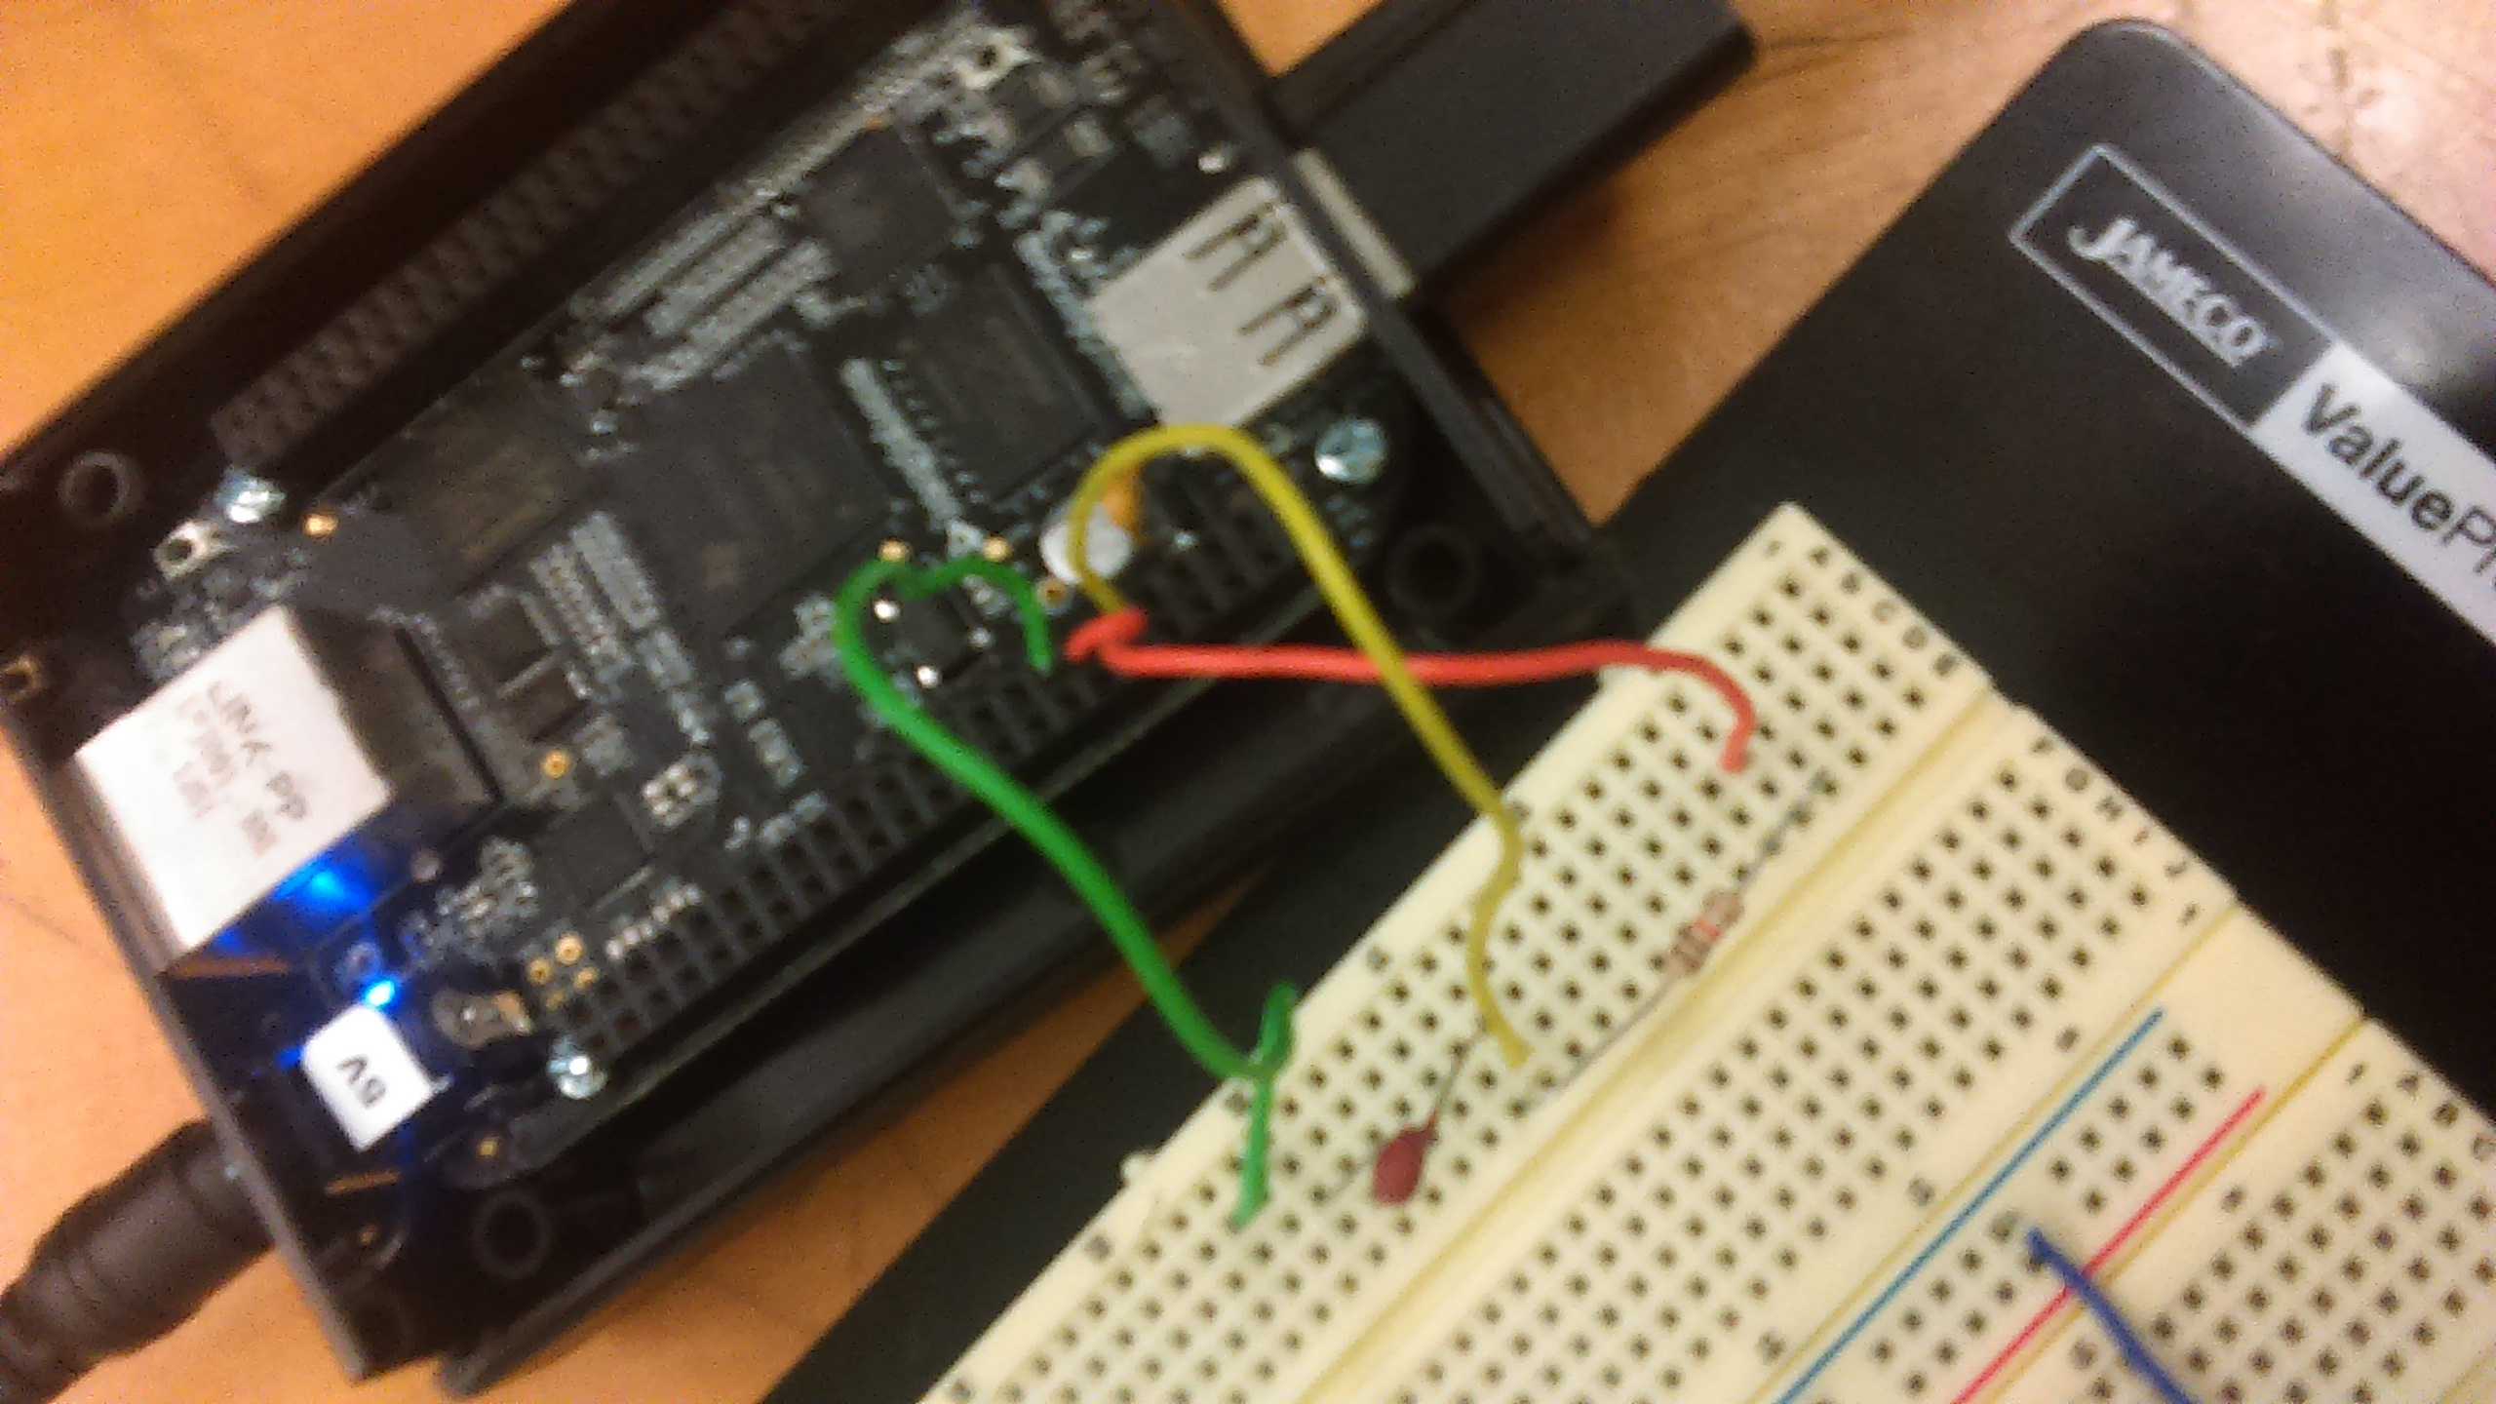
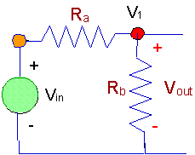

Slide 8
…
Once temperature has been solved for it is time to set up display in order to print out values
In my case I used the 7 segment display to accomplish this where the daisy chaining we developed in lab9 was used here
Being that you cannot load bacone.dtbo and spidev0.dtbo at the same time I had to go with the bacone approach so that I could use the analog input signals

Slide 9
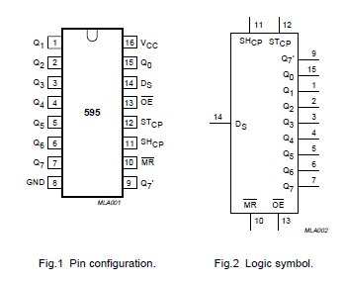
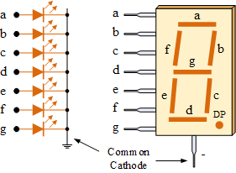
…

Slide 10
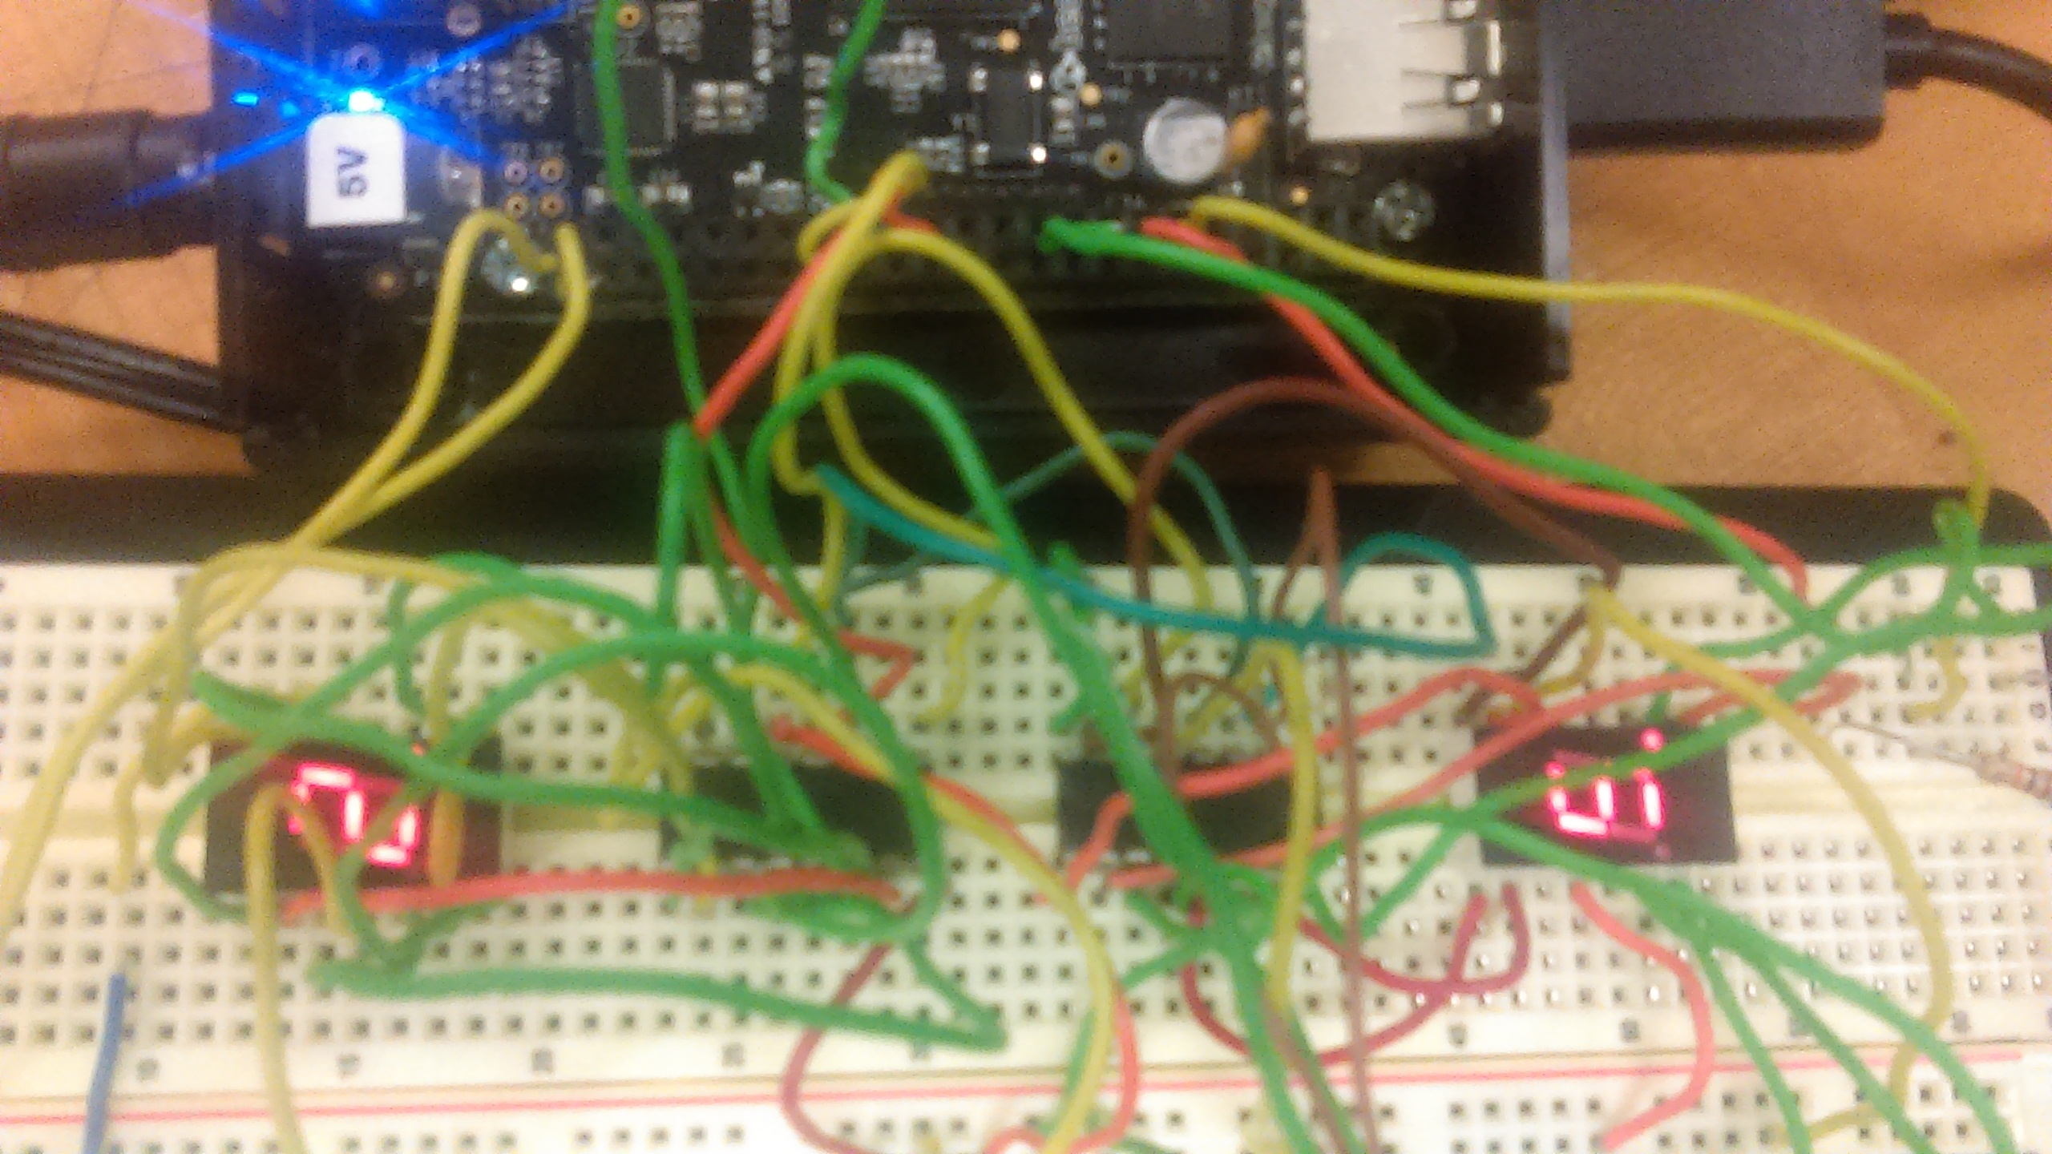

Slide 11

Code
Even though file is a .cpp extension the file entirely c for the most part
I took a function and modular approach
Where I read in the analog value in and computed the temperature
Used an algorithm to split number so that I could print the number
Through trial and error this was successful

Slide 12
Reference
Lab 5
Lab 9
Dr. Lei for input

