Slide 1
Parabolic Framework and Trading Hacks
Hernan Segovia
BOH Society
www.bohsociety.com
Investagrams Traders’ Summit 2018
08 December 2018
Samsung Hall, SM Aura Premier

Slide 2
DISCLAIMER
I make no representation that the information contained herein or any of the analytical tools or reports referenced herein are accurate, reliable, complete, or appropriate for use by all investors in all locations.
I am not using this document or this presentation to provide investment or other advice to you or any other party. The materials and information contained herein are intended for informational and educational purposes only and should not be regarded as recommendation. Performance after attending this lecture is not guaranteed.
I shall have no liability in any way to you or any other entity for any loss or damage, direct or indirect arising from the use of the information contained herein or any of the analytic tools referenced herein.

Slide 3
HELLO, I AM SPYFRAT.

Slide 4
SPYFRAT’S TRADING SYSTEM
Trading System:
Bollinger Bands (BBand) = 50-period with 0.20 standard deviations
Relative Strength Indicator (RSI) = 30-period
Parabolic Framework:
Parabolic Theory
Parabolic High Risk (PHR)
Extreme Parabolic High Risk (ePHR)
Trading Hacks:
20 percent rule
Bebemon trade set-up

Slide 5
MY TRADING SYSTEM

Slide 6
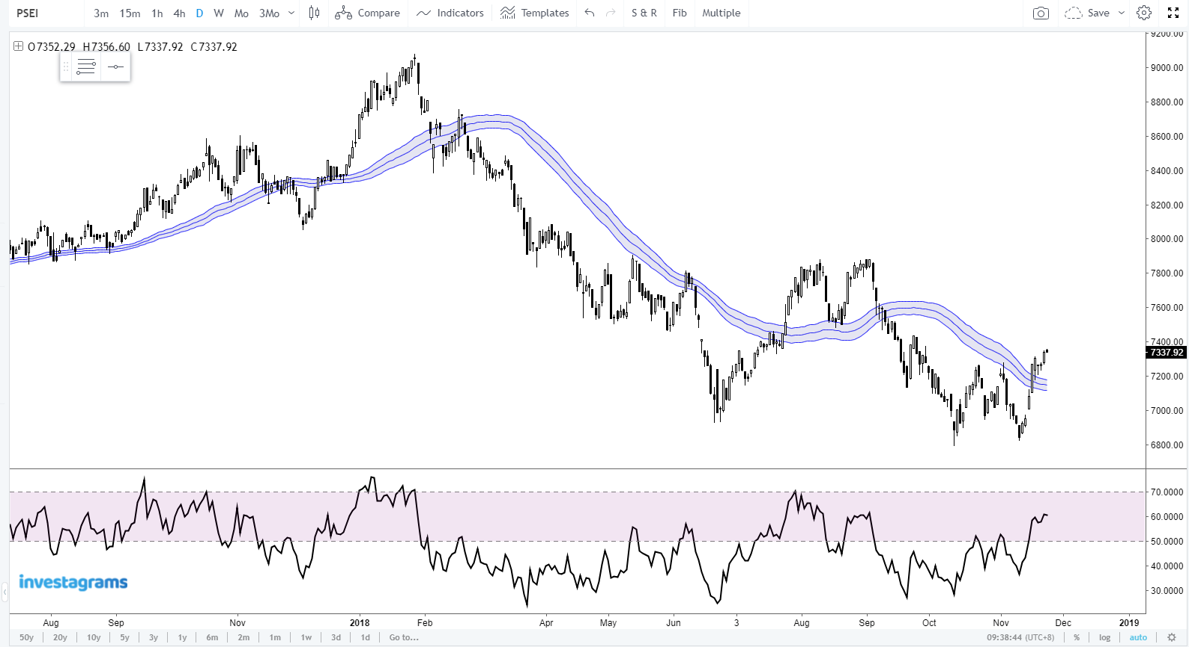
SPYFRAT’S TRADING SYSTEM
Principal Components:
Bollinger Bands
50-period and
0.20 width
Relative Strength Indicator
30-period
Bbands(50, 0.20)
RSI(30)

Slide 7
WHY USE A CUSTOM BOLLINGER?
John Bollinger’s Bollinger Band uses Bband(20, 2), which he uses to measure price volatility.
I use a custom Bband(50, 0.20) to enclose the 50-day simple moving average inside an envelope to measure trend volatility.
My custom Bband is like the Keltner channel but is more dynamic since it can adjust quickly to changes in the trend. In a sense, it’s like the cloud component of the Ichimoku system without the messiness.
I particularly like it when the Bband contracts and becomes “slimmer” as it often signals an area where a big move can occur. This info cannot be captured by a standalone 50-period simple moving average.
This system generates buy and sell crossover signals between price and the custom Bband. The Bband can also be used to define dynamic support and resistance across different time frames.

Slide 8
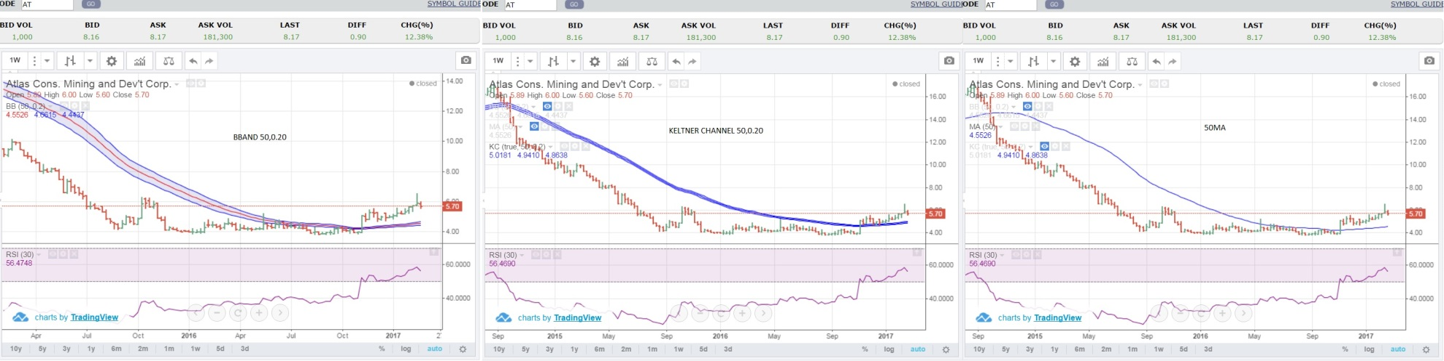
WHY USE A CUSTOM BOLLINGER?
BBAND(50, 0.20)
KELTNER(50,0.20)

Slide 9
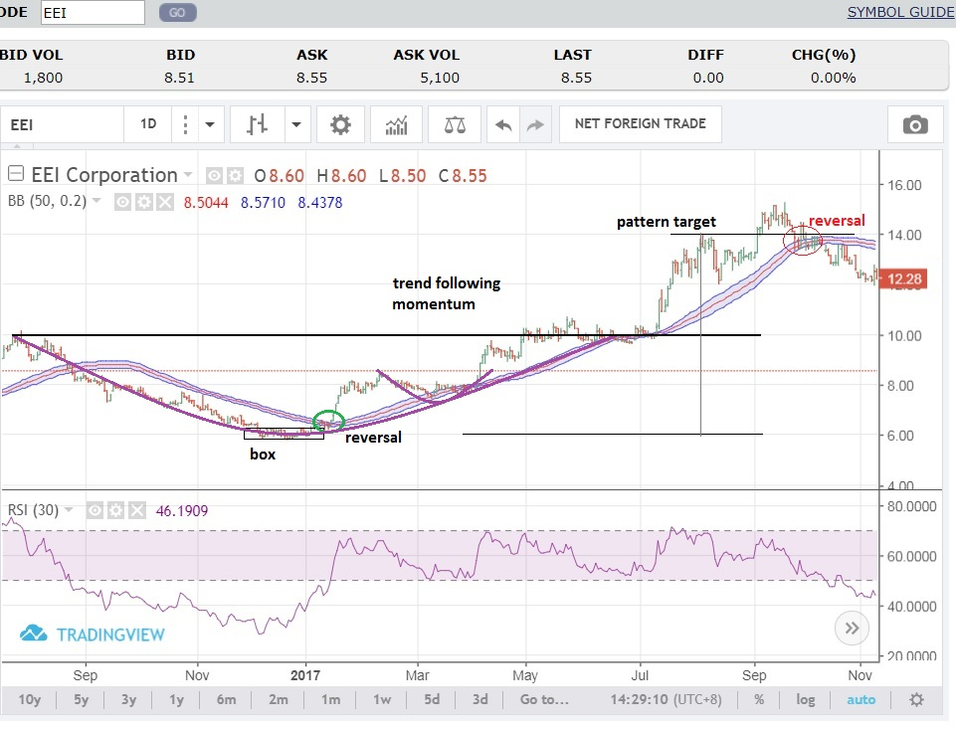
WHY USE A CUSTOM BOLLINGER?
BBAND(50, 0.20)
KELTNER(50,0.20)

Slide 10
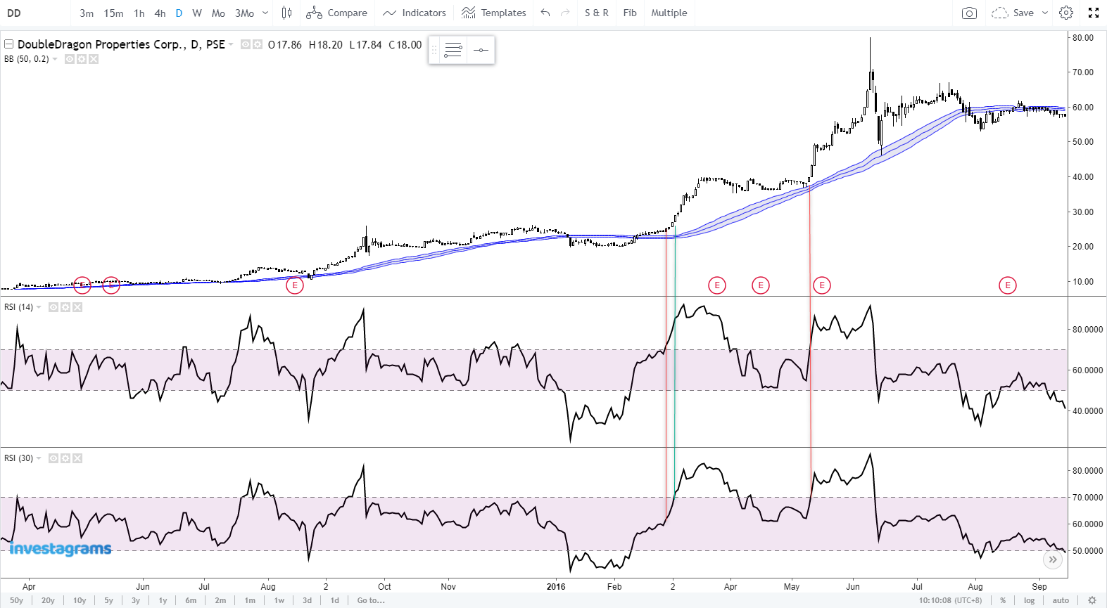
WHY RSI 30 NOT RSI 14?
RSI30 vs RSI14
RSI14 signaled DD overbought at low 20s versus RSI30, which signaled start of parabolic move
RSI14 again signaled overbought at 40 versus RSI30, which signaled resumption of parabolic run
A
B

Slide 11
PARABOLIC FRAMEWORK

Slide 12
HOW TO DEFINE A PARABOLIC STATE
A stock is in a parabolic state once RSI(30) is above 70.
Once in parabolic, there is a strong chance that price can move even higher despite overbought readings (on other RSI settings).
In short, “walang overbought overbought when in parabolic”. ☺
A parabolic state can be triggered on any time frame (i.e. weekly, daily, hourly, minutes) in a high RSI environment.
For example, if a stock’s RSI(30) exceeds 70 on the weekly chart then it is parabolic on the weekly. If RSI(30) exceeds 70 on the daily timeframe then it is parabolic on the daily chart.

Slide 13
HOW TO DEFINE PARABOLIC HIGH RISK
A stock is in Parabolic High Risk (PHR) when,
Both daily and weekly RSI(30) are greater than 70, and
RSI Daily > RSI Weekly
Call to Action: Slice up and trail stop.
Application of Senor Pethuel’s Modified Parabolic System at this site https://medium.com/@pethuel03/parabolic-theory-based-stock-trading-c92e0be53230.

Slide 14
HOW TO DEFINE EXTREME PARABOLIC HIGH RISK
A stock is in Extreme Parabolic High Risk (ePHR) when both daily and weekly RSI(30) are greater than 80.
An ePHR signals that the stock is likely to top out, it’s higher risk, and extremely volatile. ePHR also suggests FOMO condition that’s unsustainable and will likely reverse and trigger a deep correction.
Call to Action: Sell on sight. Sell when it’s easy. Don’t wait for the stampede. Bid and offer will widen when price reverses and panic sets in. Bid volume will dry up and this leads to a “paraburst”.

Slide 15
ALL PARABOLICS POP AND ALWAYS END IN TEARS
A parabolic burst or “paraburst” is an event that takes place at the end of a parabolic run.
While price can transition from uptrend to range to downtrend in an orderly manner, always remember that the distribution phase happening while price is moving up and participation and volume is rising.
This means that price can transition from uptrend to downtrend without moving sideways in a paraburst.
When “new money” stops coming in, price can reverse and leave the investing public with deep losses.
A paraburst can be traded on deep dips, but only if you know what you’re doing. Bounce trades from a paraburst should be sold into.

Slide 16
KEY RISK WHEN TRADING PARABOLICS
When a stock is in parabolic, the stock has a higher risk. While price can move higher exponentially, the trade-off is extreme volatility. In other words, you can lose a lot chasing a stock in parabolic.
Trading stocks in parabolic can be profitable, but only if you know what you’re doing. Know the risk and prepare yourself for wild swings as price moves higher.
TIP: Only trade the parabolic within the time frame it occurs. Don’t assume that parabolic run will persist at higher time frames.

Slide 17
EXAMPLES OF PARABURST

Slide 18
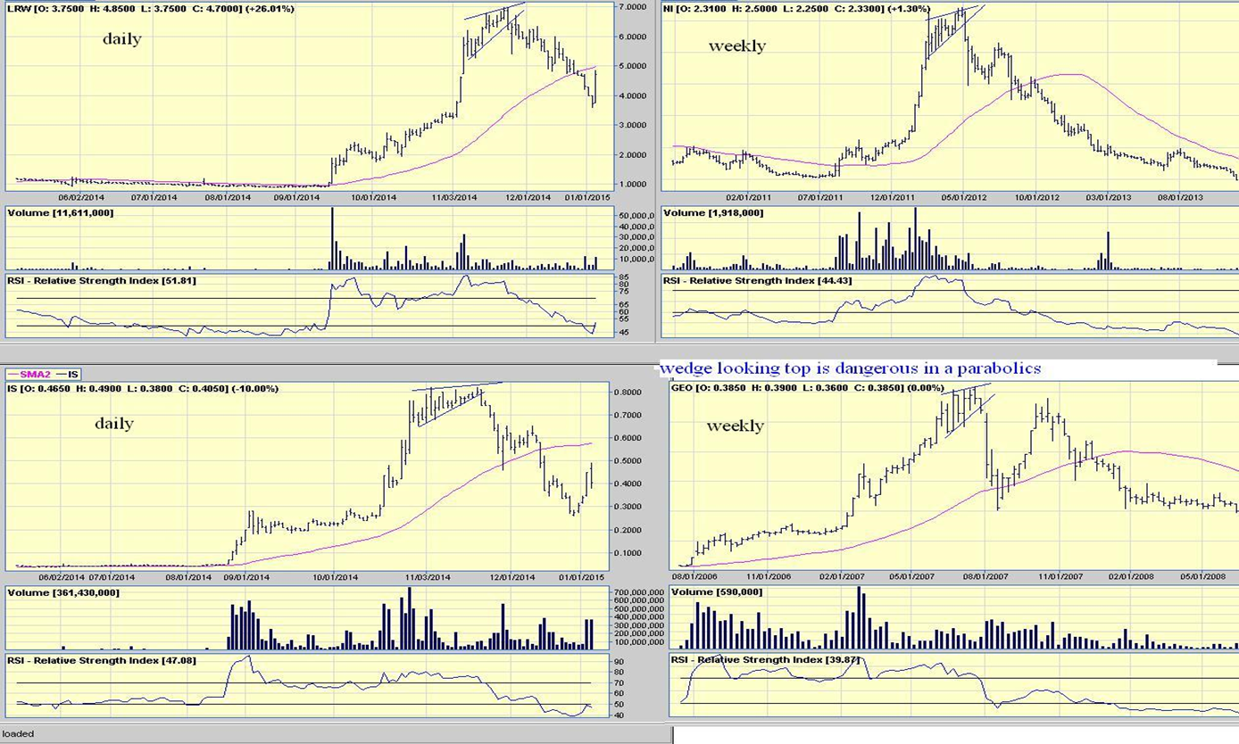
BEARISH WEDGE EARLIEST SIGN OF A TOP

Slide 19
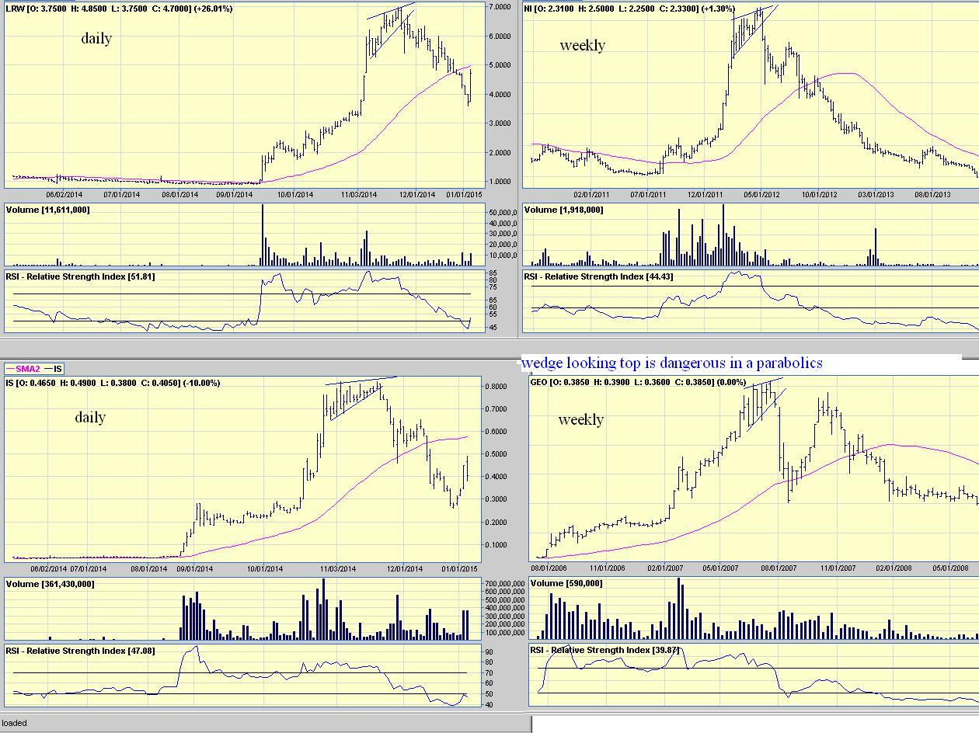
BEARISH WEDGE EARLIEST SIGN OF A TOP

Slide 20
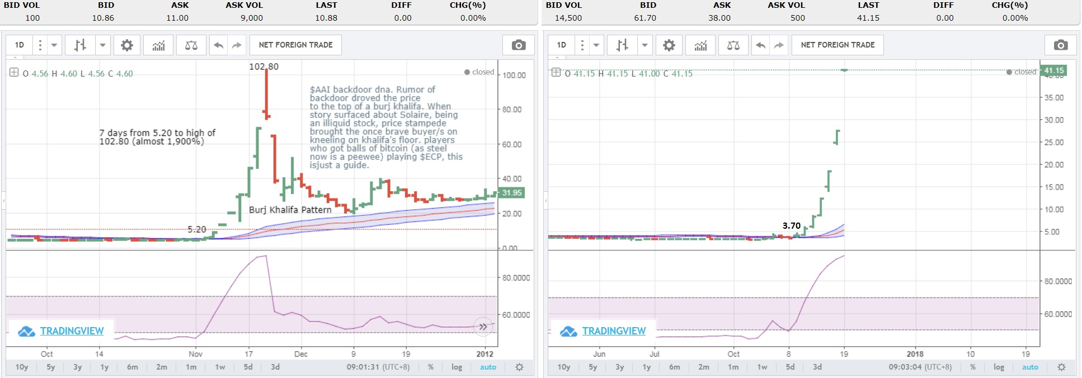
BURJ KHALIFA: WORST CASE SCENARIO IN A PARABURST

Slide 21
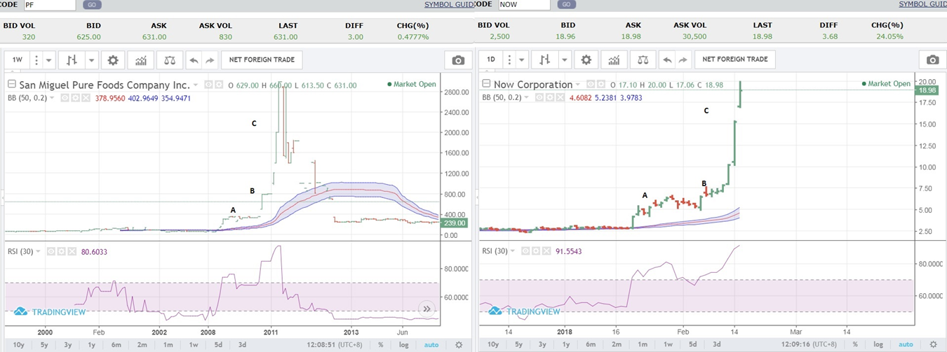
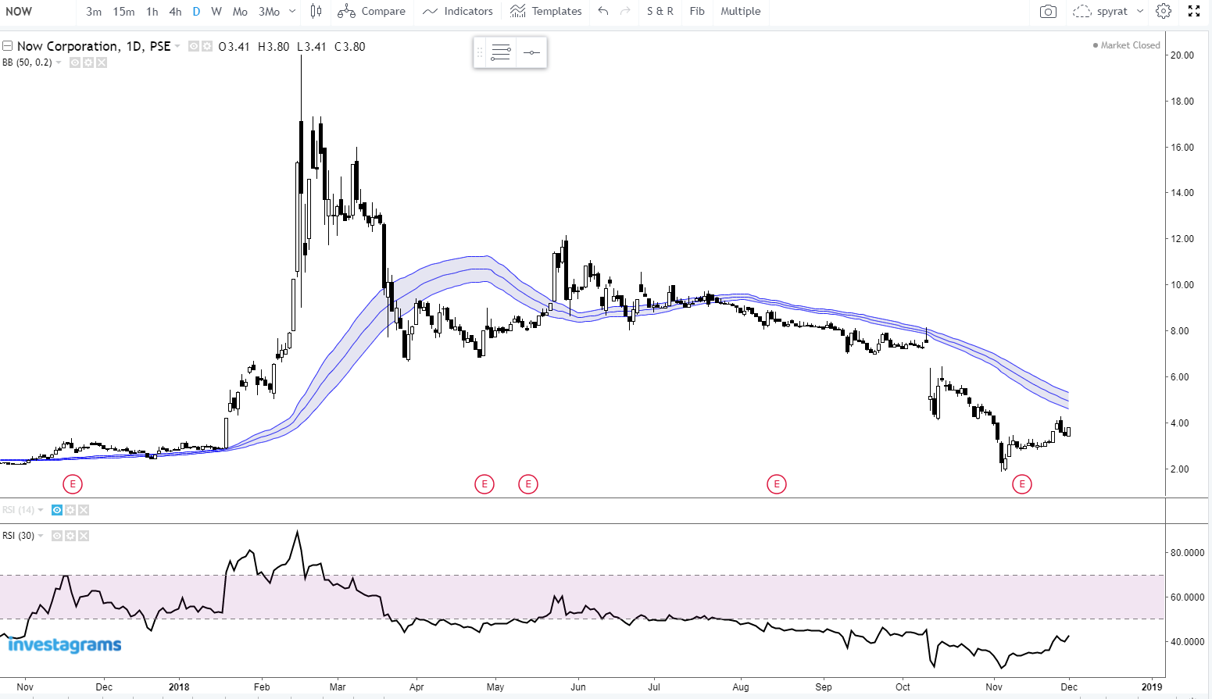
BURJ KHALIFA: WORST CASE SCENARIO IN A PARABURST
C
B
A

Slide 22
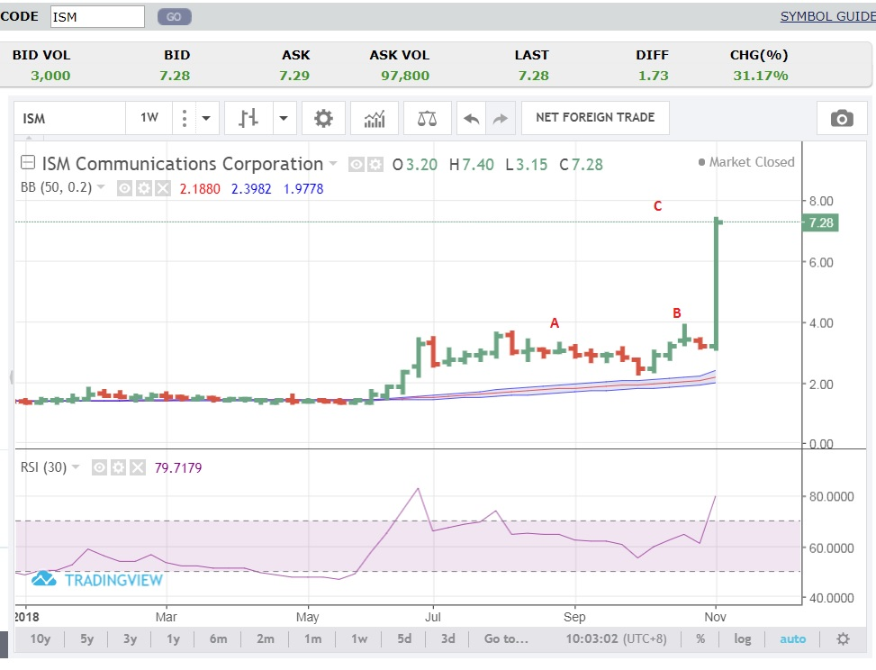
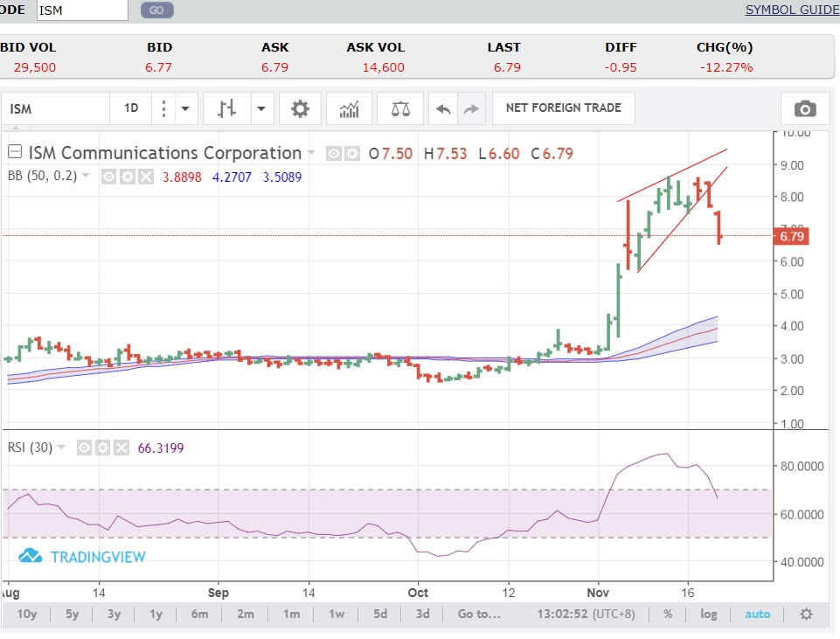
BURJ KHALIFA: WORST CASE SCENARIO IN A PARABURST

Slide 23
PARABURST EXCEPTION: GOLDEN BRIA HOLDINGS
this is the burj khalifa's pattern coined by Jaycob Yedra of AP Sec. may mga hint's kung papano natin maiwasan to.. prob lang minsan, sadyang gusto talaga ng tao ng one shot retirement bagger. unfortunately very common na mentality sa mga heroes nating ofw (at least sa mga clients ko all these years). kasi sobrang hirap ng buhay sa ibang bansa and kapag na hype na yun isang ofw, inaambisyo rin nya na maka bagger rin sya. in short yun inaakala ng marami na yun stock market ang magiging ticket to way home nila.. until the reverse happened at na stuck yun puhunan. di na po bago tong parabolics and ive been sharing this ng libre.. pero sadyang kokonti lang talaga ang interesado, or di patok lang.. kahit yun mga turo ni senor fred (the responsible trader), ewan, sobrang ganda nun pero kahit yun mga post nya ay rarely got the likes.. same rin sa mga kasama ko sa boh .. yun algos dun, the blackbox, mga parameters, it's a new universe kung baga pero kapag ng focus na ang isang investor sa process, talaga ma prove mo sa sarili mo na mag improved greatly yun trading discipline and consistency mo. nadaanan ko yun libre for 20yrs, kaso, yun nga lang, di ka seseryosohin, come and go lang ang peg, sa umpisa lang ang urge, ningas cogon lang. pero kung may bayad, seseryosohin ka, susulitin yun gusto nilang matutunan, wala ng next time next time, kasi may bayad, may subscription. nasa mentality na ng trader yan, kahit ilang freebies pa kung walang passion talaga na matuto, olats pa rin.

Slide 24
PARABURST EXCEPTION: GOLDEN BRIA HOLDINGS
nabubuo ang burj khalifa dahil naging parabolic to na kung saan kapag nasa parabolic state na ay walang overbought condition dahil parabolic lives in a high rsi environment. pero sa mga nagdaan na ganitong laro at marahil sa experensya na rin (maganda at pangit man) ay may bagay tayong napupuna at naihasa. para ma gauge ang parabolic, ng lagay tayp ng risk guide, eto yun phr and ephr na kung saan na explain natin sa mga previous post. kung ang isang stock ay ng ka EPHR, malaki ang chance nito na magkakaroon eto ng mamalim na selloff dulot ng panic. ang burj khalifa at may malaking spike (pls see chart A B C) na kung saan ang pag akyat nito ay HIGHLY EXTREME, eto yun tinatawag na fear of missing out or FOMO RUN, eto yun takot ka maiwan dahil akala mo ay di ka na makakabili kung hindi ka hahabol. eto rin yun feeling na pinapanuod mo yun pagakyat nun isang stock na may kaba sa umpisa pero sa sa kalaunan yun kaba na yun ay naging daan ng di mo na matiis na tingnan yun presyo na umaakyat at bumili ka na rin. and extreme high risk ay ng papahiwatig the price in subject ay masyado ng emotional at short term in nature, meaning indi sya sustainable. unfortunately kapag ng ka fomo run na, ang burj khalifa pattern ay vulnerable sa paraburst (ang meaning nasa prev post rin). nun ng ka ePHR ang $ISM, may paalala na tayo sa BoH Society at bookaka na maging extreme caution na.

Slide 25
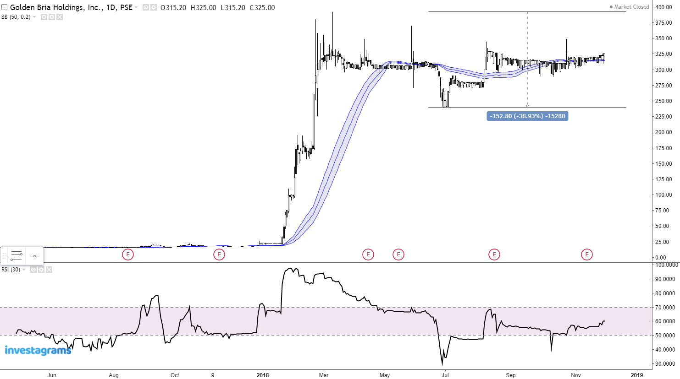
PARABURST EXCEPTION: GOLDEN BRIA HOLDINGS
ORDERLY TRANSITION INTO A TRADING RANGE

Slide 26
THE 20 PERCENT RULE

Slide 27
THE 20 PERCENT RULE
The 20 percent rule is a rule for trading various scenarios.
I use the 20 percent rule for setting up the following trades:
Major support from a price high after a 20% correction; bearish if price falls more than 20%.
Major resistance from a price low after a bottom reversal and a stock gains 20%; bullish if price gains more than 20% and keeps this advance.
Trigger for momo and ceiling candidates.
Pivot level for follow-through play.

Slide 28
USING THE 20 PERCENT RULE AS MAJOR SUPPORT
bounce
bounce
average bounce 5 to 7 percent
20% decline
from high
Computation: high x 0.80 = 20% price level
1
2
Notes:
The first 20 percent correction will normally have a bounce; an overshoot is common but still has high success rate for a bounce.
But a second test of support will have a high likelihood of breaking through major support so avoid.

Slide 29
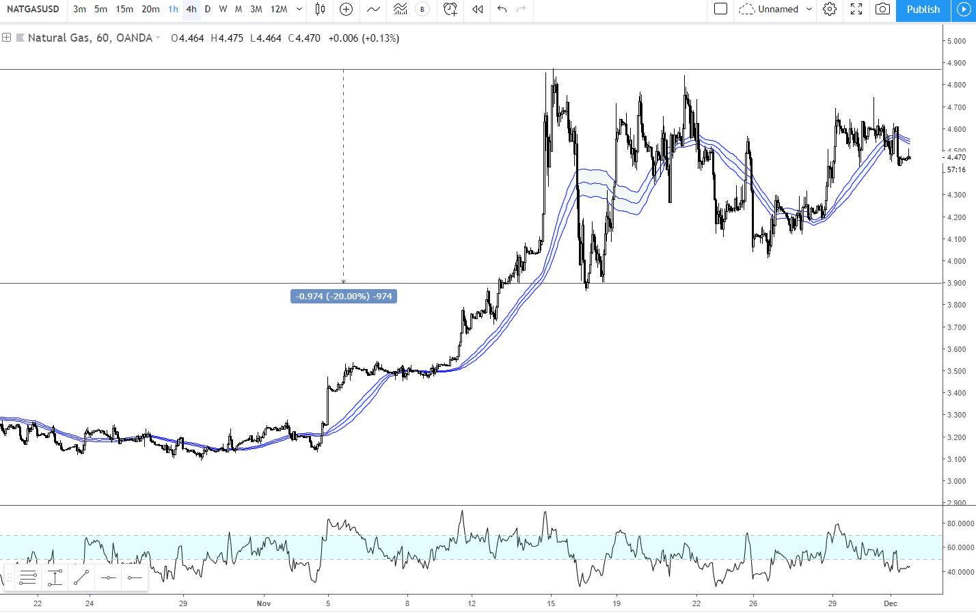
NATURAL GAS
The beauty of the 20% rule…

Slide 30
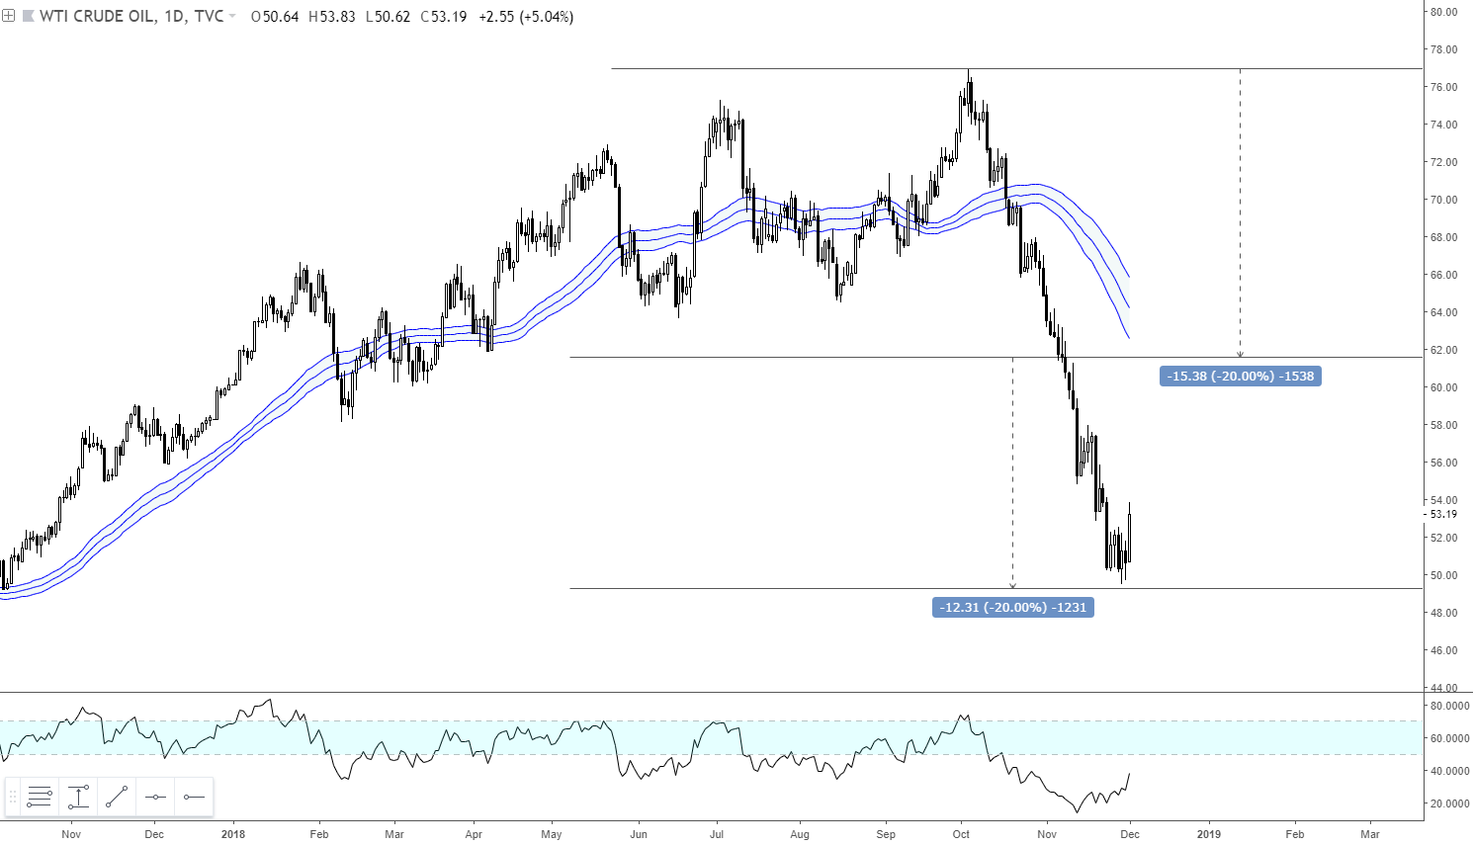
WTI OIL
The break below 20% pivot triggered sharper downside
Approx. another 20% downside risk after breaking through 20% pivot

Slide 31
USING THE 20 PERCENT RULE FOR FOLLOW-THRU PLAY
How to use 20% pivot rule:
After a ceiling day, price must gain +20% on the follow-through day to signal strong momentum.
If open price on follow-through day is less than a +20% gain then take profits/slice.
If open price advanced more than +20% then use open price as pivot. Slice/sell if price goes below open price. Sell all if gain falls below 20% gain.
1.80
1.50
ceiling = price up 50 percent
Example:
If price opens 1.80 or higher then hold. Be disciplined and ride winner.
If price opens below 1.80 but above 1.50, then sell/slice since it’s below the 20% pivot.
If price opens at 1.83 and rallies to 1.90, slice if it breaks below 1.83 open. Sell all if below 1.80.
1.00

Slide 32
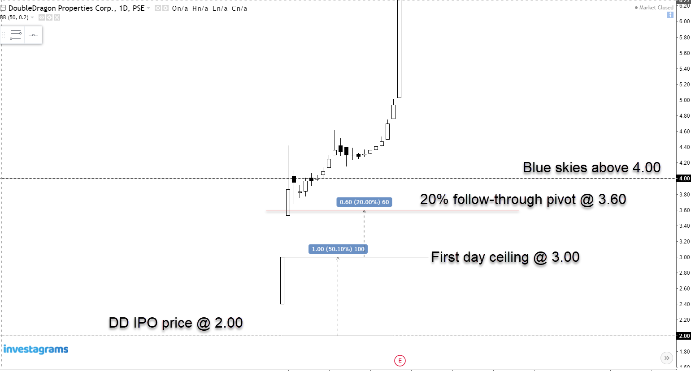
DOUBLE DRAGON

Slide 33
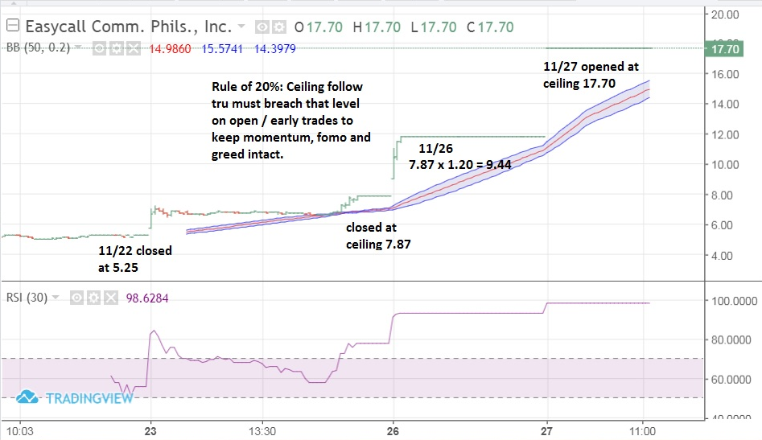
ECP
NOTES:
Follow-through on 11/28 must breach 20% at open / early trading. Otherwise ditch.
A stock that completes a third day ceiling are very risky.
Trading a fourth day ceiling play is silly and will always end in tears for those who chase.

Slide 34
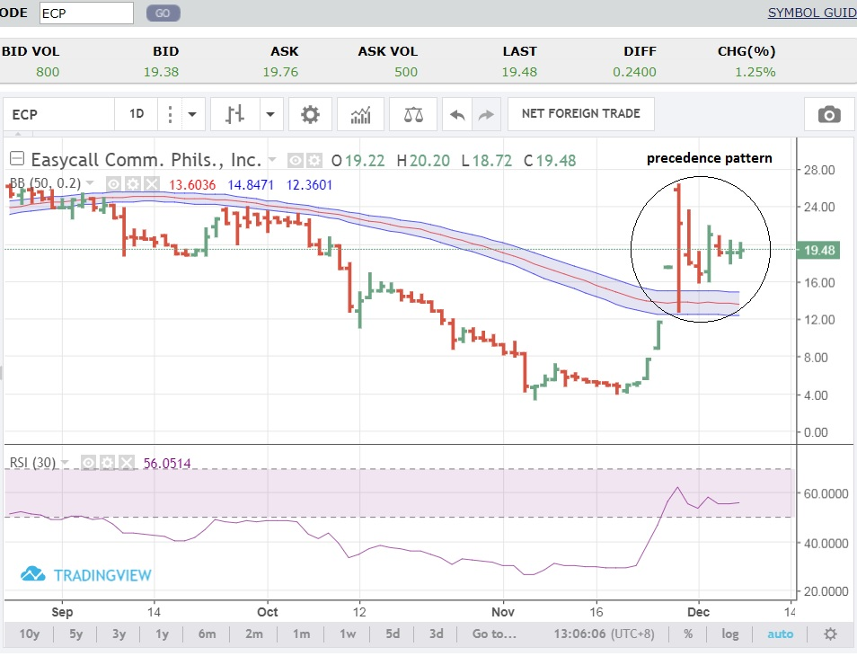
ECP
NOTES:
On 11/28 ECP opened at 26.00 with high of 26.45, and recovered well from the low of 13 to close at 22.40
Early formation of precedence pattern equates to wide range and great volatility, until said pattern materialized
Precedence pattern can be wedgies, penant, flag, triangles

Slide 35
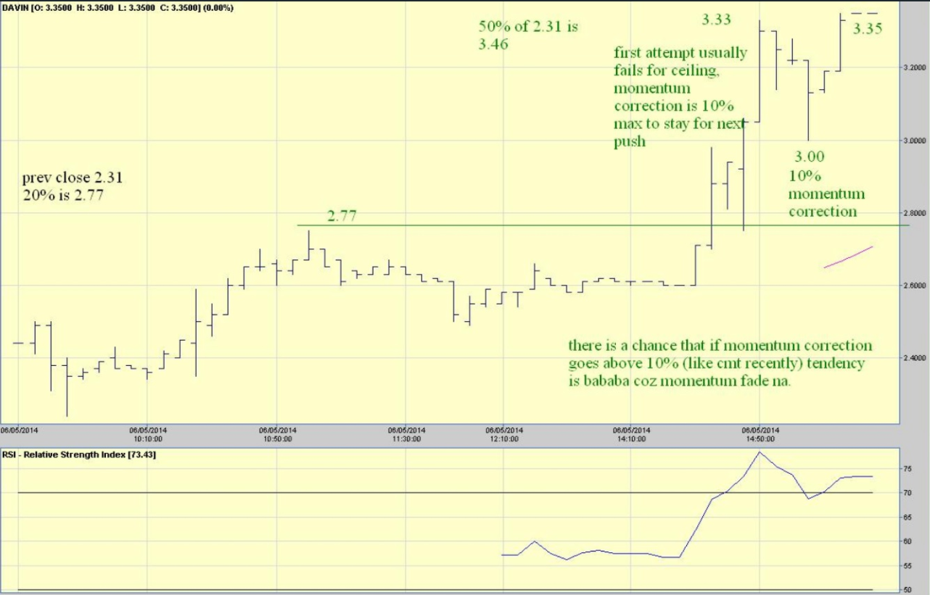
DAVIN (I)

Slide 36
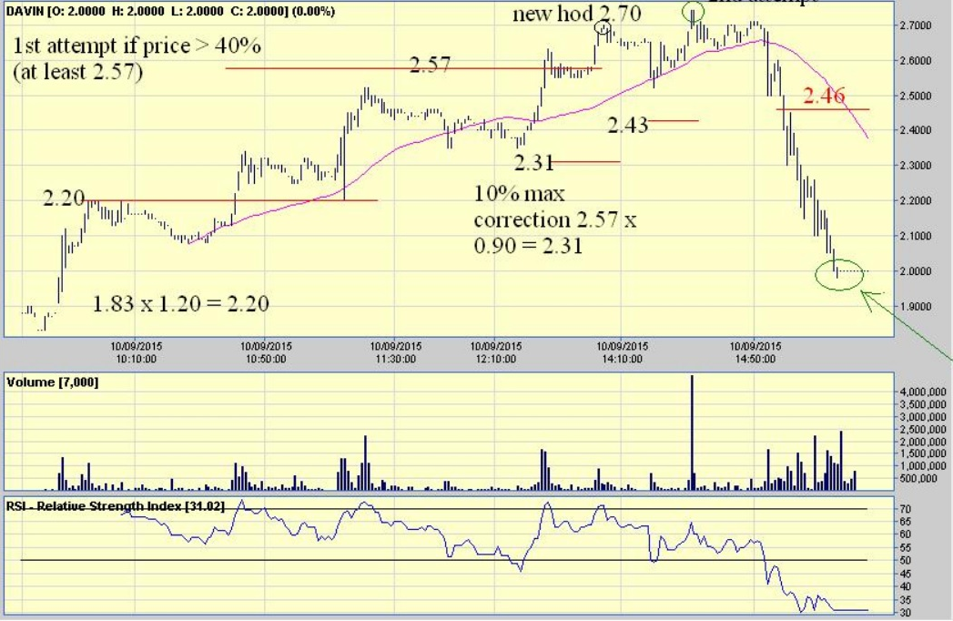
DAVIN (II)
NOTES:
New high of day means 2.70 x 0.90 = 2.43 max momentum correction to stay bullish.
Ceiling play will typically have two attempts. This means that 2.46 needs to hold after hitting 2.74 otherwise olats. Any correction > 10% after a parabolic is a momentum killer.
At oversold levels after a paraburst, can trade bounce, but must sell quickly the next day.

Slide 37
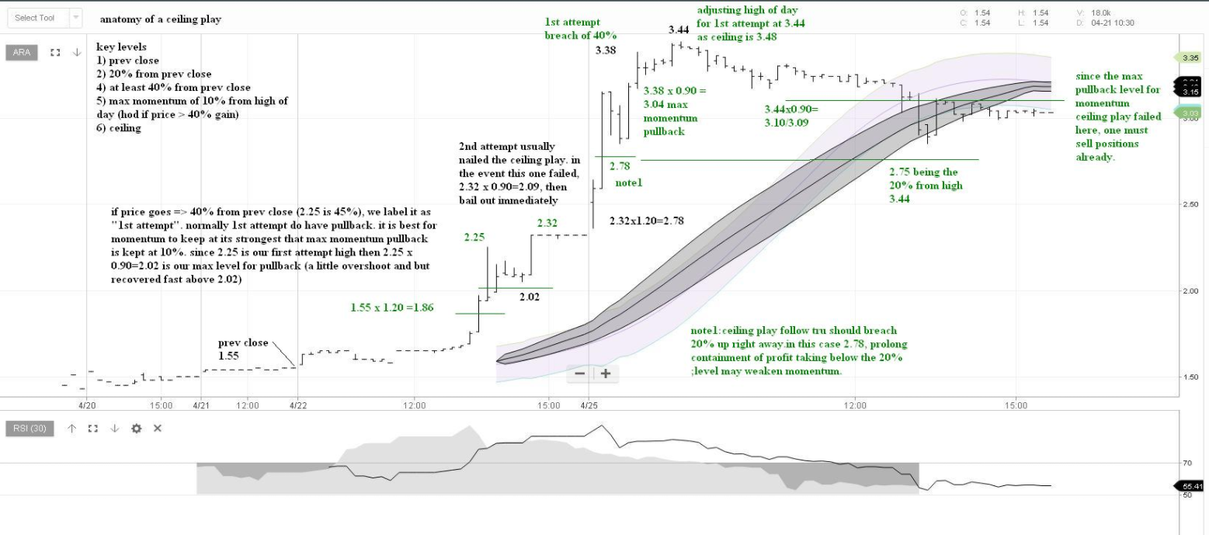
ANATOMY OF A CEILING PLAY

Slide 38
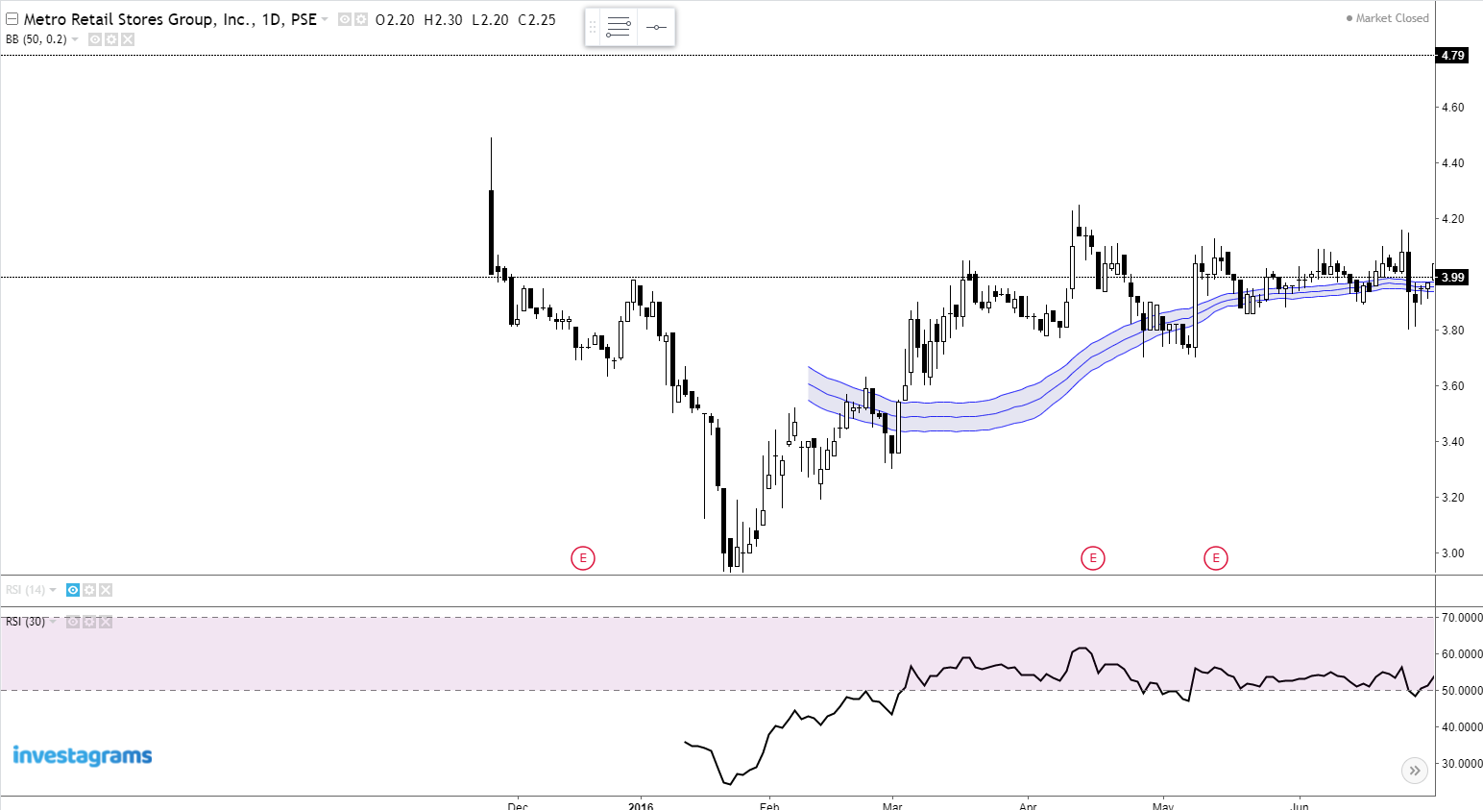
THE 20 PERCENT RULE AS PIVOT FOR IPOs
NOTES:
Use 20% as first day hurdle rate for assessing strength of an IPO stock.
If IPO stock gains less than 20% on first day, ditch.
Sell at ceiling if bid volume diminishing.
Sell if price corrects 10% after hitting ceiling.
MRSGI IPO + 20% = 4.79
MRSGI IPO HIGH = 4.49 = +12.5% GAIN
MRSGI IPO PRICE = 3.99

Slide 39
MY BEBEMON TRADE SET-UP

Slide 40
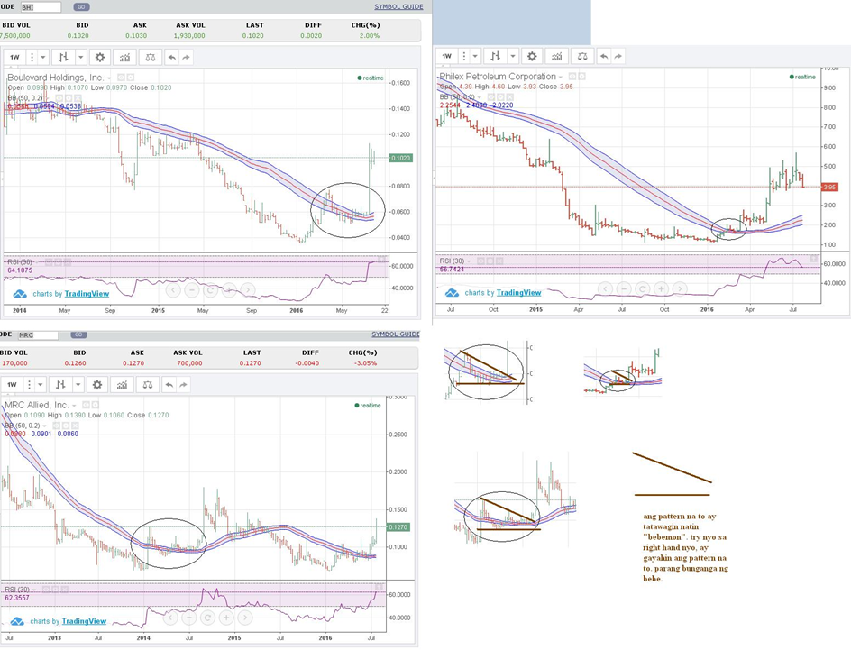
MY BEBEMON TRADE SET-UP
NOTES:
Bebe or bibe refers to a price transition around or above the 50-period moving average that looks like a duckbill. That’s for the “pa-arte” pattern. Bebemon stands for Bollinger Band Monster.
Can be traded two ways: a) around the 50-prd MA or as the bill is being formed, or b) on the pattern breakout.
Stop loss placement below the 50-prd MA or inside the pattern for breakout traders.

Slide 41
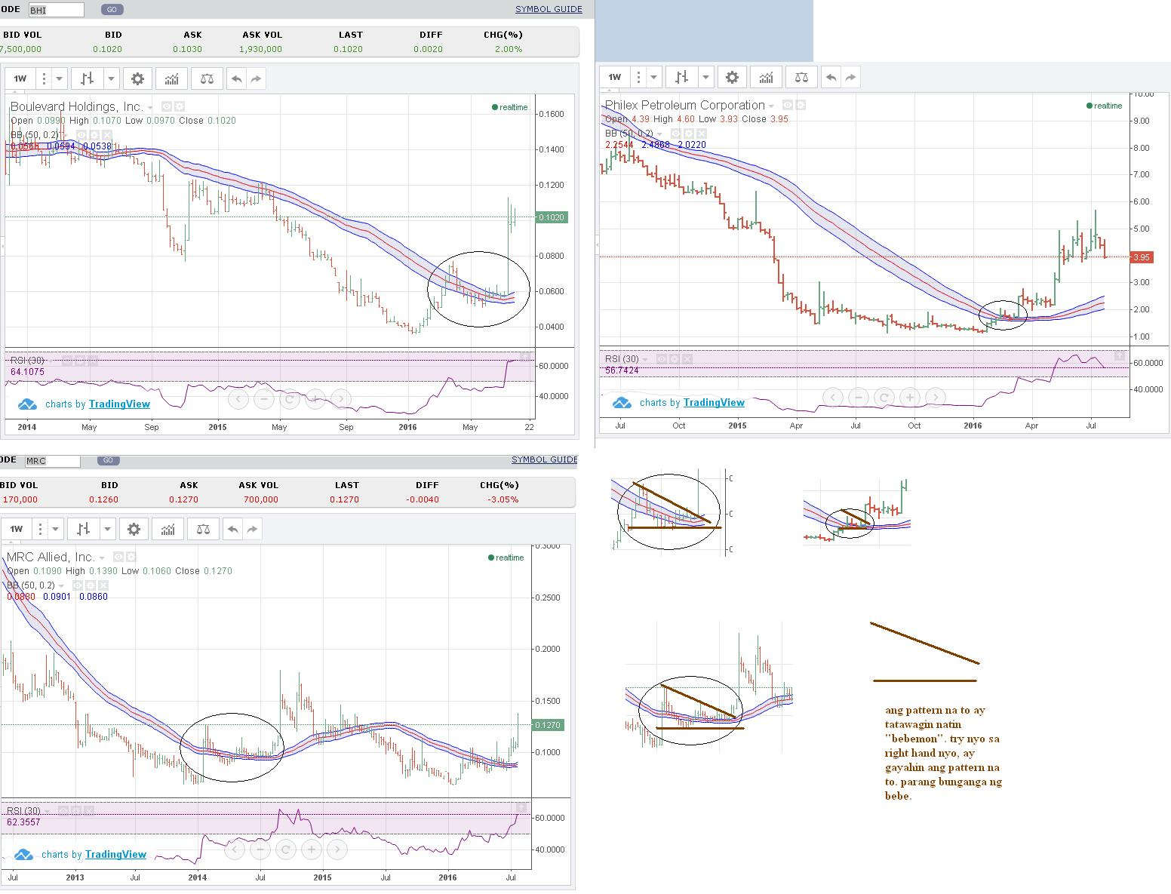
BHI

Slide 42
PXP

Slide 43
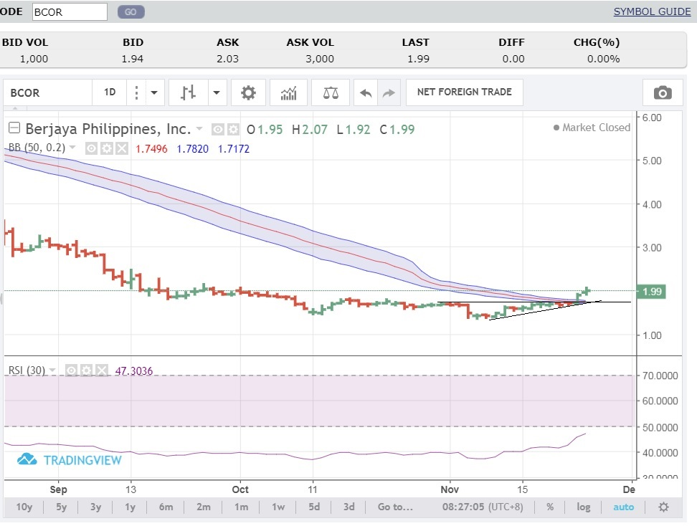
BCOR

Slide 44
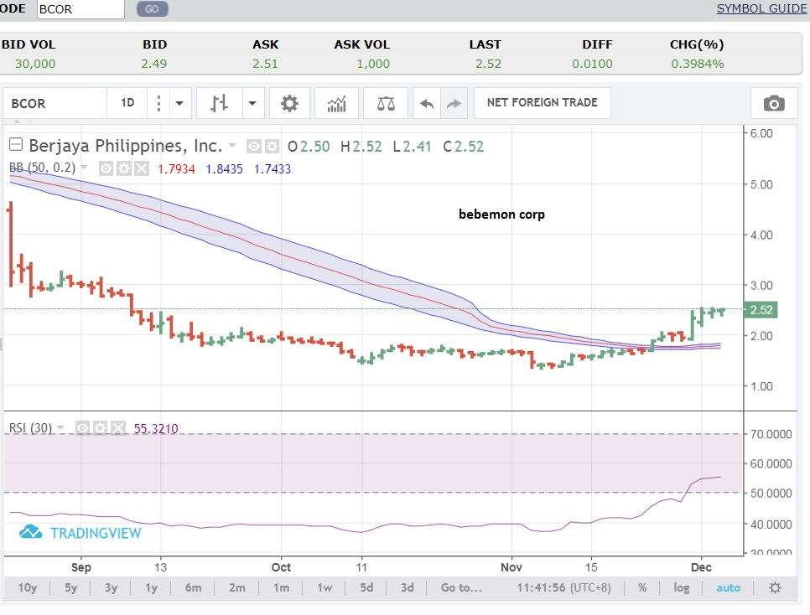
BCOR

Slide 45
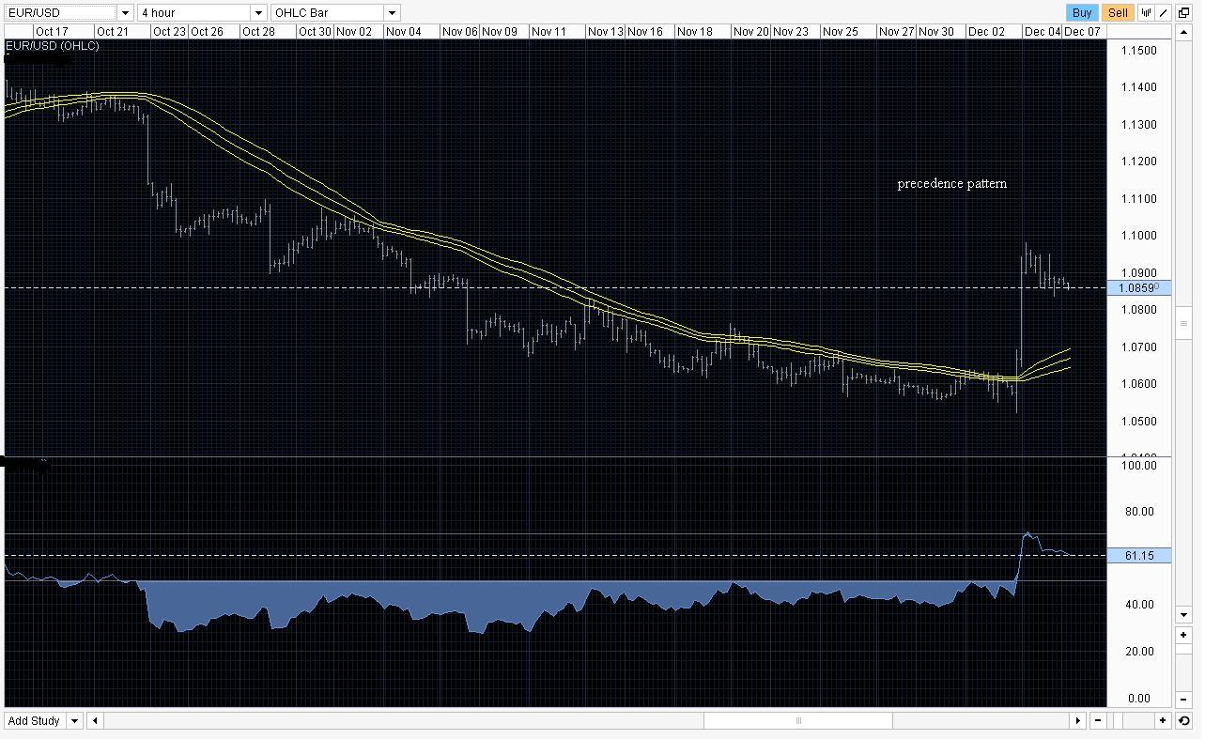
EUR/USD

Slide 46
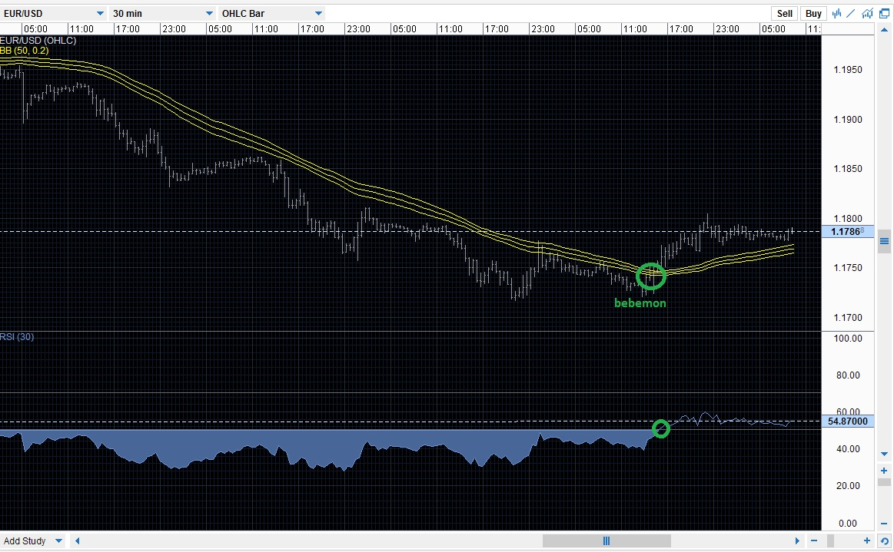
EUR/USD

Slide 47
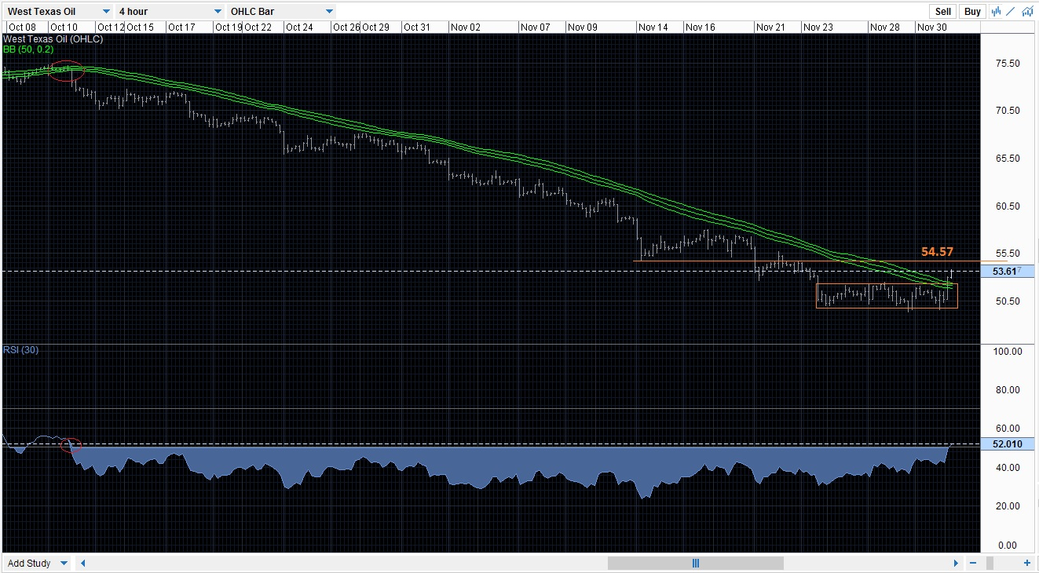
WTI

Slide 48
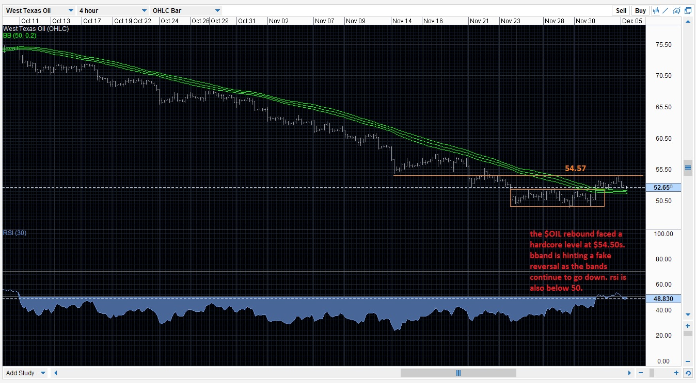
WTI

Slide 49
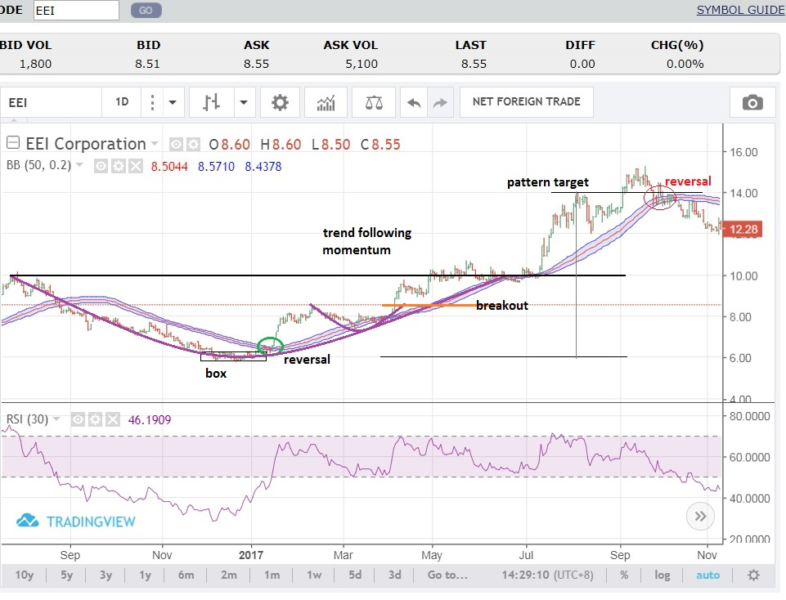
MY BEBEMON TRADE SET-UP
NOTES:
Bebemon or Bollinger Band Monster can be a one shop trade set up. That is, it can be
a) Bottom Play
b) Reversal
c) Trend following
d) Momo play
e) Pattern formation
f) Breakouts
g) Parabolics

Slide 50
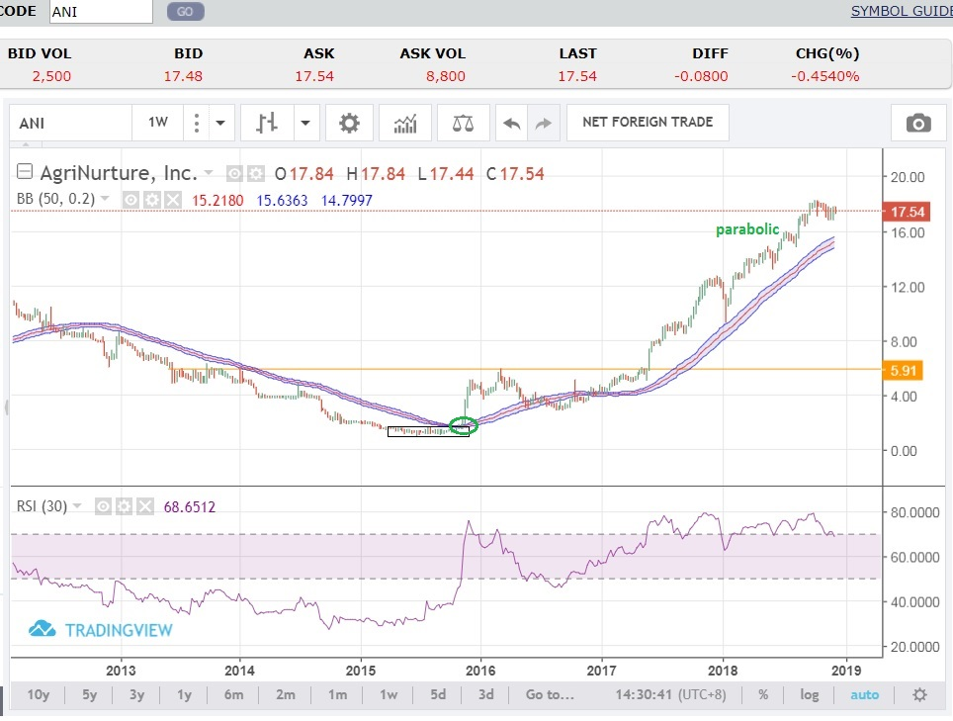
MY BEBEMON TRADE SET-UP
NOTES:
Bebemon or Bollinger Band Monster can be a one shop trade set up. That is, it can be
a) Bottom Play
b) Reversal
c) Trend following
d) Momo play
e) Pattern formation
f) Breakouts
g) Parabolics

Slide 51
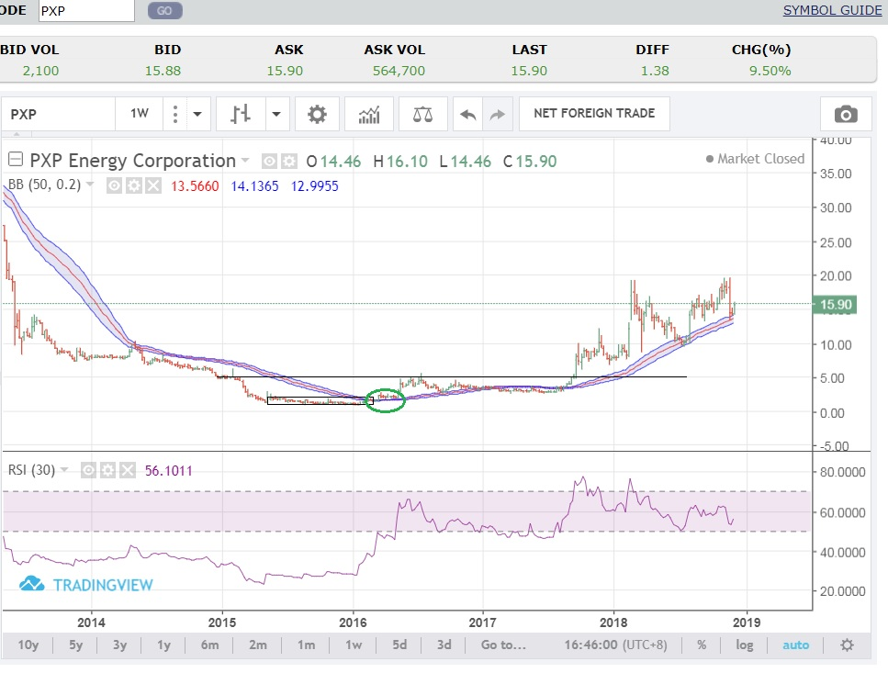
MY BEBEMON TRADE SET-UP
NOTES:
Bebemon or Bollinger Band Monster can be a one shop trade set up. That is, it can be
a) Bottom Play
b) Reversal
c) Trend following
d) Momo play
e) Pattern formation
f) Breakouts
g) Parabolics

Slide 52
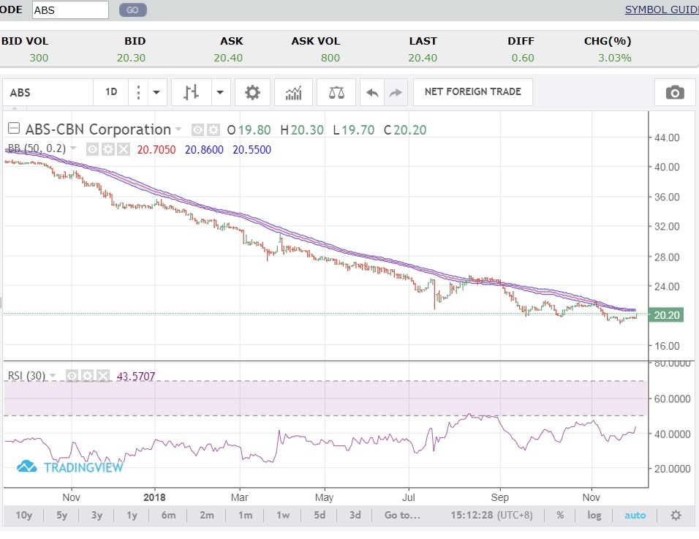
Bebemon Watch - ABS

Slide 53
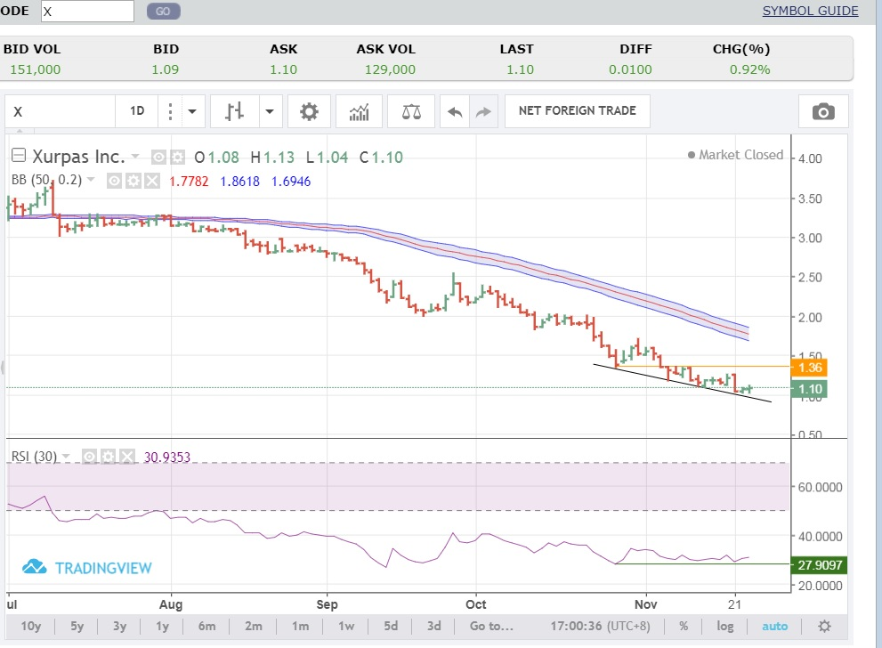
Bebemon Watch – X Daily

Slide 54
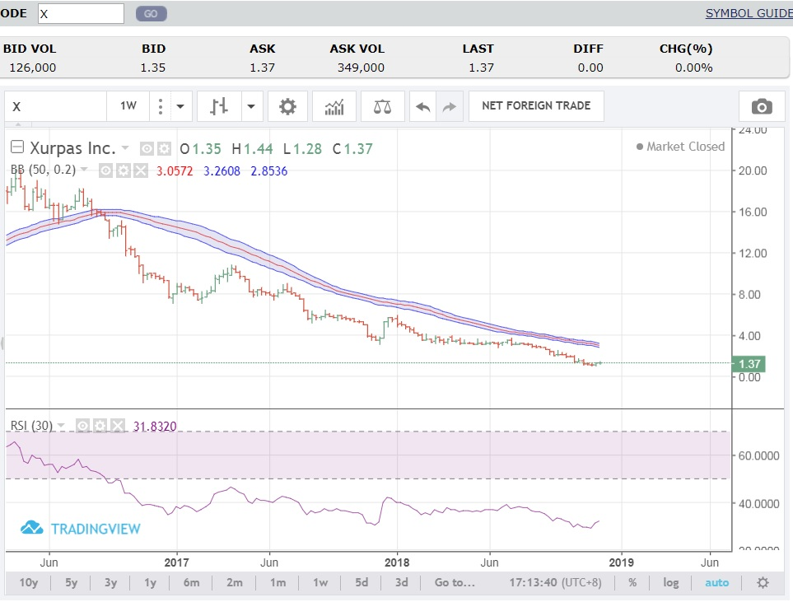
Bebemon Watch – X Weekly

Slide 55
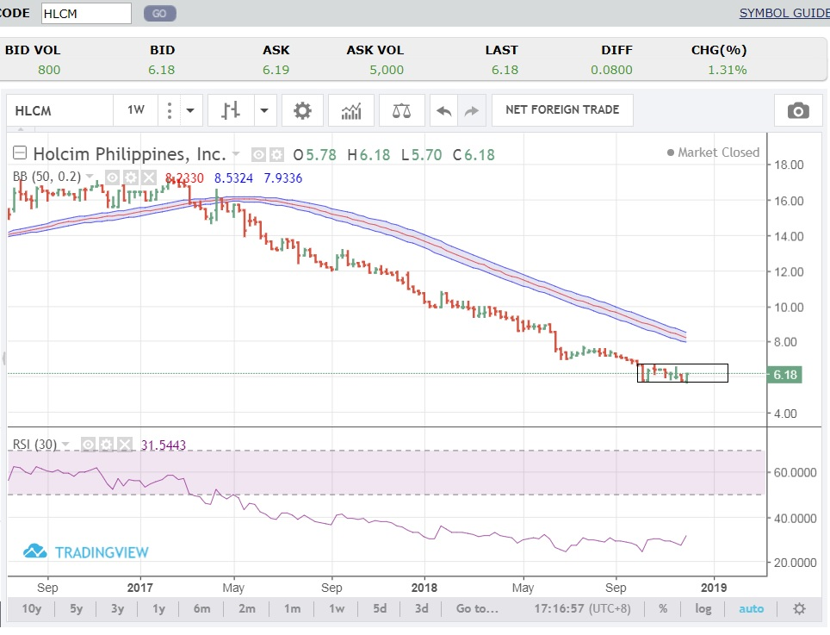
Bebemon Watch - HLCM

Slide 56
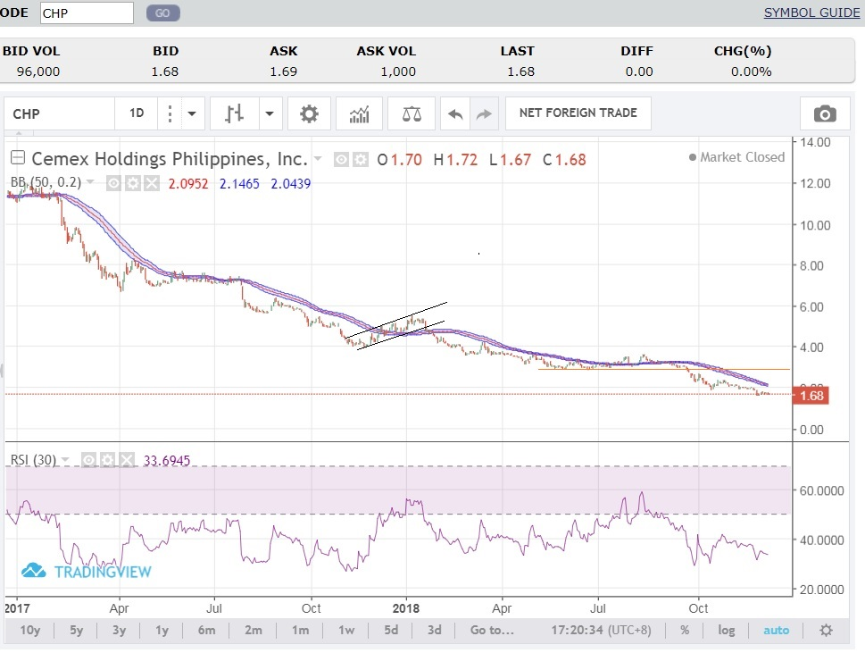
Bebemon Watch – CHP (NOT ALL HAVE BEEN PROFITABLE)

Slide 57
THE HOLY GRAIL

Slide 58


Slide 59

THE HOLY GRAIL IS YOU

Slide 60
THANK YOU! TO GOD BE THE GLORY!

Slide 61
WWW.BOHSOCIETY.COM 20% OFF ON ANNUAL PLAN PROMO CODE: SPYFRAT@INVESTA *valid until 31 December 2018
SPECIAL RATE* FOR SUMMIT ATTENDEES

