Slide 1

PHP and The Web
Idg2003: Back-end web development 1
Lecture 6
Luvin Ragoo (luvin.m.ragoo@ntnu.no)
Notes:
Intro to PHP

Slide 2
Assignment 1
What is expected :
Clear understanding of fundamentals of PHP
Use of expressions, loops and conditionals
Use of functions, classes, arrays(specially associative arrays)
Use of file handling
Expectations

Slide 3
Assignment 1
Final Deadline : 1st November 2020
(for submission)
Soft Deadline : 11th of October 2020
(for feedback)
Deadline

Slide 4
Assignment 1
3 Executable files :
Data.php
File upload
Populating your databases
Students.php
Fetch Students data from databases and display
Courses.php
Fetch Courses data from databases and display
Helper file : functions.php
Tips on how to structure your program
Database files (.csv format) | Classes
StudentDatabase.csv CoursesDatabase.csv CoursesTakenDatabase.csv | Example : class_Student.php class_Courses.php

Slide 5
Assignment 1: Tips
explode: breaks a string into an array.
<?php
$str = "It is a beautiful day.";
echo "<pre>";
print_r (explode(" ", $str));
?>
Explode function

Slide 6
Assignment 1: Tips
Implode: combines an array into a string.
<?php
$array = ['StudentNum','Name','Surname'];
$arrayString = implode(",",$array);
print_r($array); echo "<br>";
echo "Converted String : $arrayString";
?>
Implode function

Slide 7
Assignment 1: Tips
Move uploaded files
<?php
if($_FILES){
$name = $_FILES['filename']['name’];
$tempName = $_FILES['filename']['tmp_name’];
move_uploaded_file($tempName, $name);
}
?>
move_uploaded_file ( string $filename , string $destination )
Move Uploaded File

Slide 8
Assignment 1: Tips
Additional Functions that may be useful :
file_get_contents()
https://www.php.net/manual/en/function.file-get-contents
file_put_contents()
https://www.php.net/manual/en/function.file-put-contents.php

Slide 9
PHP and the Web: Form Handling
What is a Form ?
You use it all the time!
To enter data on the web :
Login into websites(For example : Mail Box, Facebook page, etc)
Search Engines
Forms are used to get input from the user and submit to the web server for processing

Slide 10
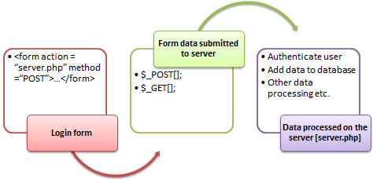
PHP Form Handling
A form is an HTML tag that contains graphical user interface items such as input box, check boxes radio buttons etc.

Slide 11
PHP Form Handling: Creating a form
What you need to create a form :
Opening and closing form tags <form>… </form>
Form submission type POST or GET
Submission URL that will process the submitted data
Input fields such as input boxes, text areas, buttons, checkboxes etc

Slide 12
Forms – text box
<input type="text" name="myName" value="">
Attributes
Type – what type of form object
Name – the name of the object
Value – whatever is entered into the text field

Slide 13
Forms – radio button
<input type="radio" name="gender" value="m">Male
<input type="radio" name="gender" value="f">Female
Attributes
Type – what type of form object
Name – the name of the group
Value – the value of each individual radio button

Slide 14
Forms – checkbox
<input type="checkbox" name="Sprinkles" value="1">Sprinkles
<input type="checkbox" name="chocSauce" value="2">Chocolate Sauce
<input type="checkbox" name="whipped_cream" value="1">Whipped Cream
Attributes
Type – what type of form object
Name – the name of the object
Value – whatever is set as the value

Slide 15
Forms – pull down menu (select)
<select name="size">
<option value="s">Small</option>
<option value="m">Medium</option>
<option value="l">Large</option>
</select>
Attributes
Name – the name of the pull down menu
Value – the value of each of the options within the pull down menu

Slide 16
Forms – text area
<textarea cols="60" rows="5" name="myComment"></textarea>
Attributes
Cols – number of columns
Rows – number of rows
Name – the name of the object
Value – whatever is entered into the box. To preload content you enter text in between the start and end tag

Slide 17
Forms – hidden
<input type="hidden" name="userID" value=“bla">
Attributes
Type – type of object
Name – the name of the object
Value – the value of the object – hidden in the browser window

Slide 18
Forms – submit button
<input type="submit" name="button1" value="Send">
Attributes
Type – type of object
Name – the name of the object
Value – the caption that appears on the button

Slide 19
Forms – form
<form action="processForm.php" name="myForm" method="get"></form>
Attributes
Action – the URL of the script that the data will be sent to – this is the page that will display once the submit button is clicked
Name – the name of the form
Method – the way the data is sent to the script

Slide 20
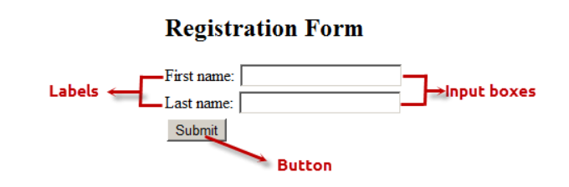
Input form example
All objects must be inside of a form tag
All objects inside a form tag have name and value attributes
Example :
<h2>Registration Form</h2>
<form action= "registration_form.php" method= "POST”>
First name: <input type= "text" name= "firstname"> <br>
Last name: <input type= "text" name= "lastname">
<input type= "hidden" name= "form_submitted" value= "1" />
<input type= "submit" value= "Submit">
</form>

Slide 21
Input form example
When a user makes a selection or enters data into a form element, the value of the element is automatically set
The way the data is sent to the backend script is dependent upon the method attribute set in the form tag

Slide 22
PHP GET method
This is the built in PHP super global array variable that is used to get values submitted via HTTP GET method.
The array variable can be accessed from any script in the program; it has a global scope.
Sends a series of name value pairs appended to the URL
It can be book marked
Can use the back button to reload it
Limited to the amount of data that can be sent

Slide 23
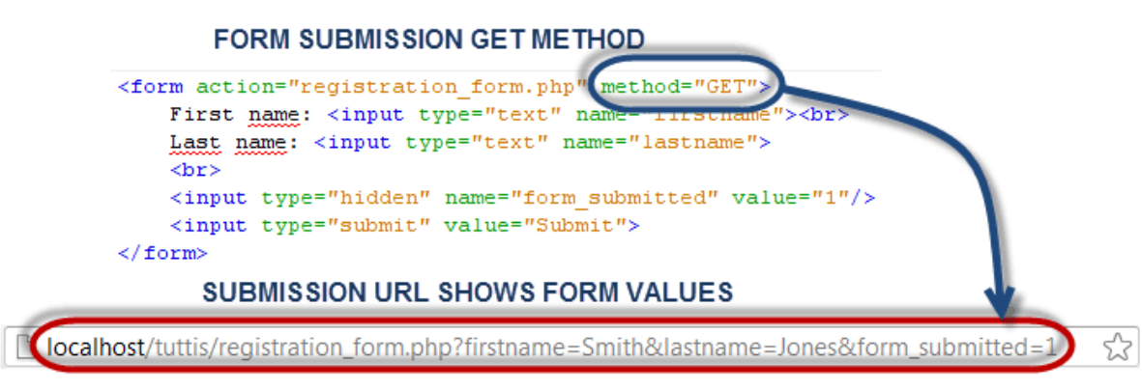
PHP GET method

Slide 24
PHP POST method
This is the built in PHP super global array variable that is used to get values submitted via HTTP POST method.
It also has a global scope.
Sends the name value pairs to the server invisibly – they are not seen by the user -> ideal when you do not want to display the form post values in the URL. (such as password)
Cannot be book marked
Page must be reloaded if you use the back button
Much larger amounts of data can be sent

Slide 25
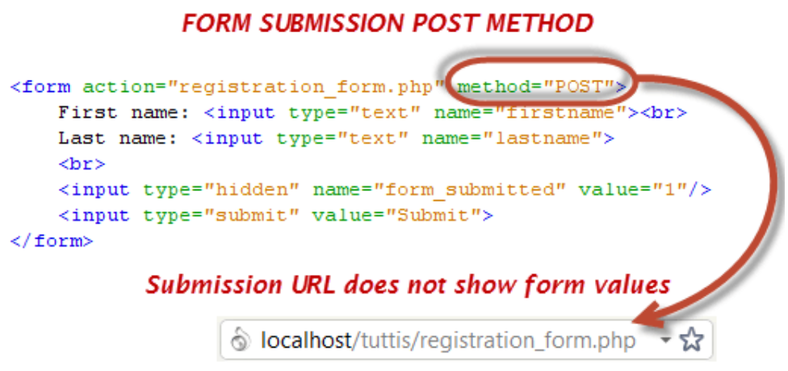
PHP POST method

Slide 26
$_POST & $_GET superglobals
In order to get at the values stored in the name value pairs you use the $_POST[] and $_GET[] superglobals
These superglobals are really arrays. They hold information about all the name value pairs that are sent to the script from the form.
The superglobal used is based on the method chosen in the form action

Slide 27
PHP $_POST example
For the form element on the input page:
<form method="post" action="processForm.php“>
<input type="text" name="myCat" value="" size="20“>
</form>
In order to get at the value entered into the myCat form
element you would use the following code: echo “I have a cat named ” . $_POST[‘myCat’];

Slide 28
PHP $_GET example
For the form element on the input page:
<form method=“get" action="processForm.php“>
<input type="text" name="myCat" value="" size="20“>
</form>
In order to get at the value entered into the myCat form
element you would use the following code: echo “I have a cat named ” . $_GET[‘myCat’];

Slide 29
PHP $_POST & $_GET variables example
It is also possible to assign the value to a variable, and then use it
$myCat = $_GET[‘myCat’];
echo “I have a cat named $myCat.”
For clarity it is good practice to name your variables the same as the form elements

Slide 30
PHP isset()
<?php
if (isset($_POST)){
echo “data received!” . “<br>” ;
}
?>
The isset() function checks if the $_POST superglobal has been set.
Also works with regular arrays, variables or entries in associative arrays.

