Slide 1

OMS V3 Update Status
The 123rd OGC Member Meeting
Meeting sponsor
Kathi Schleidt, Data Cove e.U.
16 June 2022

Slide 2
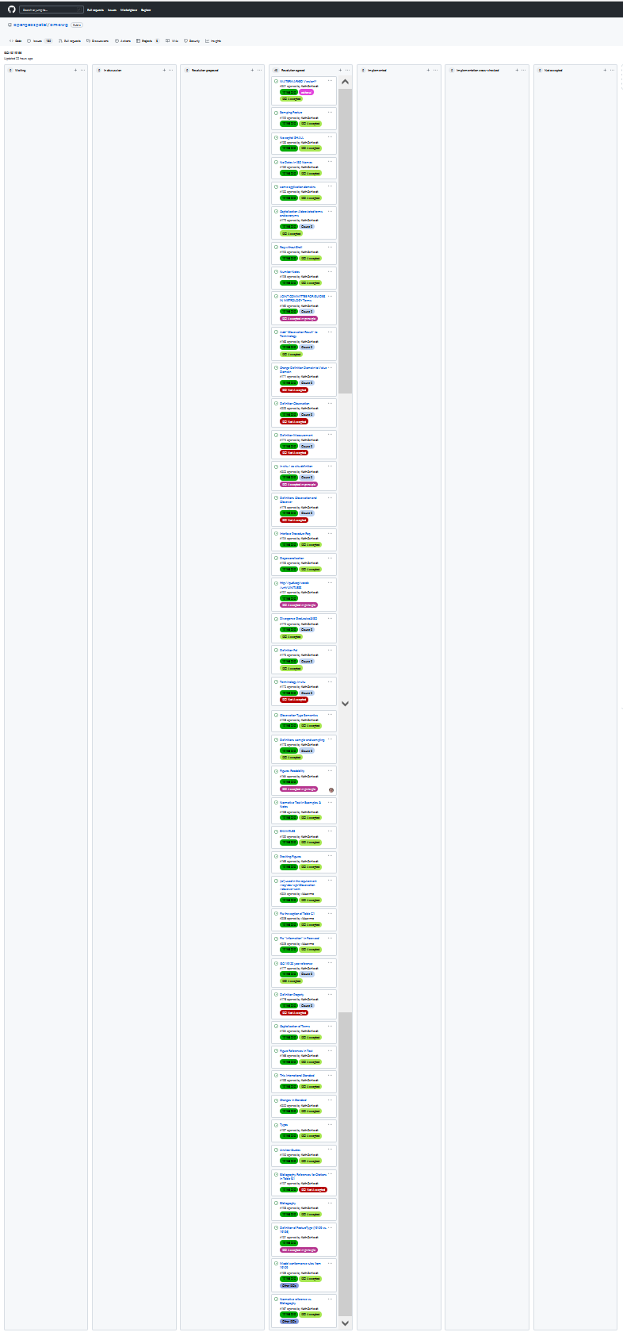
Resolution Agreed!

Slide 3
9
12
105

Slide 4
Not Accepted – in situ
JRC (EC)-014: In Earth Observation (EO) the opposite to ‘in-situ’ would be ‘remote’…
ex situ (off-site): referring to the study, maintenance or conservation of a specimen or population away from its natural surroundings Note 1 to entry: Opposite of in-situ (on-site).
Reasoning: Adding in situ, to our logic, remote observation of the earth is still in situ, as the earth remains where it’s supposed to be.
in situ: referring to the study, maintenance or conservation of a specimen or population within its natural surroundings

Slide 5
Not Accepted – Value Domain
DK-013: When reading the standard we think that the term “value domain” much better covers what is meant with the present term (i.e. “domain”).
Value domain: set of accepted values EXAMPLE The range 3-28, all integers, any ASCII character, enumeration of all accepted values (green, blue, white). [SOURCE: ISO 19103:2015, 4.37]
Domain: well-defined set Note 1 to entry: All elements within a domain (set) are of a given type. [SOURCE: ISO 19109:2015, 4.8, modified — Original Note 1 to entry has been replaced with a new note to entry.]
Reasoning: We use the term Domain in the semantic sense, Domain is what we’re observing, Range provided the values. Proposed change not in line with the model.

Slide 6
Not Accepted – Definition Observation/Observer
TMG-022: definition of Observation changed from 2011 version, now reused in 19170
Old: act of measuring or otherwise determining the value of a property
New: act carried out by an observer to determine the value of an observable property of an object (feature-of-interest) by using a procedure, with the value is provided as the result
Reasoning: Definition was extended from the 19156:2011 version to reflect the content of the UML model (most of which was already in 2011 version of the UML but not in the text) and the updated semantics

Slide 7
Not Accepted – Definition Observation/Observer
DK-023: The definitions seems to be circular
Observation: act carried out by an observer to determine the value of an observable property of an object (feature-of-interest) by using a procedure, with the value is provided as the result
Observer: identifiable entity that can generate observations pertaining to an observable property by implementing a procedure
Reasoning: introducing further terms will only introduce further confusion

Slide 8
Not Accepted – Definition Observer
DK-025: This definition seems to be a little lengthy and with some overlap to 3.13 (see previous Danish comment)
Proposal: identifiable entity that can generate observations
Observer: identifiable entity that can generate observations pertaining to an observable property by implementing a procedure
Reasoning: to our view, better defines the concept

Slide 9
Not Accepted – Definition Observation/Observer
JRC (EC)-024: clarify potential usage of Observations for simulated data, issues with phenomena
Reasoning 1: That the Observation class can be utilized for the provision of simulated data is clarified in a NOTE under Observation semantics requirement. The formal definition of the term Observation should not be confounded with simulation.
Reasoning 2: The term phenomena is overloaded in ISO due to the definition of feature as “abstraction of real world phenomena”, determining the value of a phenomenon of a phenomenon gets too circular

Slide 10
Not Accepted – Definition Measurement
JRC (EC)-021: According to this definition a model qualifies as a measurement. This is counter-intuitive and practical use of the terms.
Proposal: A measurement is the observation of a quantity. NOTE 1: The process of collecting a measurement is called measuring.
Measurement: set of operations having the object of determining the value of a quantity [SOURCE: ISO 19101-2:2018, 3.21]
Reasoning: MANY measurements actually rely on models, e.g. liquid-in-glass thermometer is based on a model describing the thermal expansion of the liquid that is translated to a scale. Further clarified under Observation definition and semantics

Slide 11
Not Accepted – Definition Property
JRC (EC)-026: Not all phenomena that have properties are objects (e.g. the ‘big bang’), change to “attribute which is observable”. Add definition of phenomenon.
Property: facet or attribute of an object referenced by a name EXAMPLE Abby's car has the colour red, where "colour red" is a property of the car. [SOURCE: ISO 19143:2010, 4.21, modified — Example has been added to the entry.]
Reasoning 1: 19143 definition works for us, modification changes meaning
Reasoning 2: The term phenomena is overloaded in ISO due to the definition of feature as “abstraction of real world phenomena”, determining the value of a phenomenon of a phenomenon gets too circular

Slide 12
Not Accepted – Bibliography References for Citations
**-112: Remove external references from this table, move to Bibliography and only provide bibliographical callout
Pertains to the PlanetarySurface Concept from SWEET http://sweetontology.net/realm/PlanetarySurface
Reasoning: this is a concept, not an external resource.

Slide 13
Accepted in Principle - UML
**-001 & **-002: UML Text too small, issues with colors
→ Reformating diagrams with less context, putting full diagrams in annex
→ Toning down colors, but retaining to indicate difference between Interfaces and Classes

Slide 14
Accepted in Principle – UCGM Terms
DK-011: Reuse JOINT COMMITTEE FOR GUIDES IN METROLOGY Terms
DK-018, TMG-019: Source of “Measurand” definition not cited
→ Measurand not used in text, deleted from Terminology
DK-020 “measure” is not a term specific to the GML domain, use JCGM ”quantity value”
→ Different meaning, 19136 definition of measure works
DK-031 Update source [on Sensor] to [SOURCE: JCGM 200:2012, 3.8, modified — EXAMPLES and NOTE deleted.]
→ Will be done accordingly
DK-032: Change “unit of measure” to “measurement unit”
→ Won’t change as goes against OGC usage

Slide 15
Accepted in Principle – in situ
TMG-015 in situ referenced in context to ex situ, but not defined
→ added in situ: referring to the study, maintenance or conservation of a specimen or population without removing it from its natural surroundings
→ adding notes:
in-situ & direct (mercury thermometer in a patients rectum)
in-situ & remote (infra-red thermometer at a distance)
ex-situ & direct (mercury thermometer in a blood-sample)
ex-situ & remote (infra-red thermometer pointed at the blood sample)

Slide 16
Accepted in Principle – FeatureType definition
DK-035: The FeatureType is defined in ISO 19109, not in ISO 19136
→ This text is unchanged from the 2011 version. It does not say that the FeatureType metaclass is defined 19136, but that the stereotype FeatureType is, and there is also a reference to 19109
→ the reference to GF_FeatureType should be replaced by FeatureType, as this is updated in 19109:2015.

Slide 17
Accepted in Principle – Concept Reference
**-055: Move link http://qudt.org/vocab/unit/UNITLESS to Bibliography
Won’t move, as this URI is a concept, not a reference
Adding the word “entry” to clarify

Slide 19
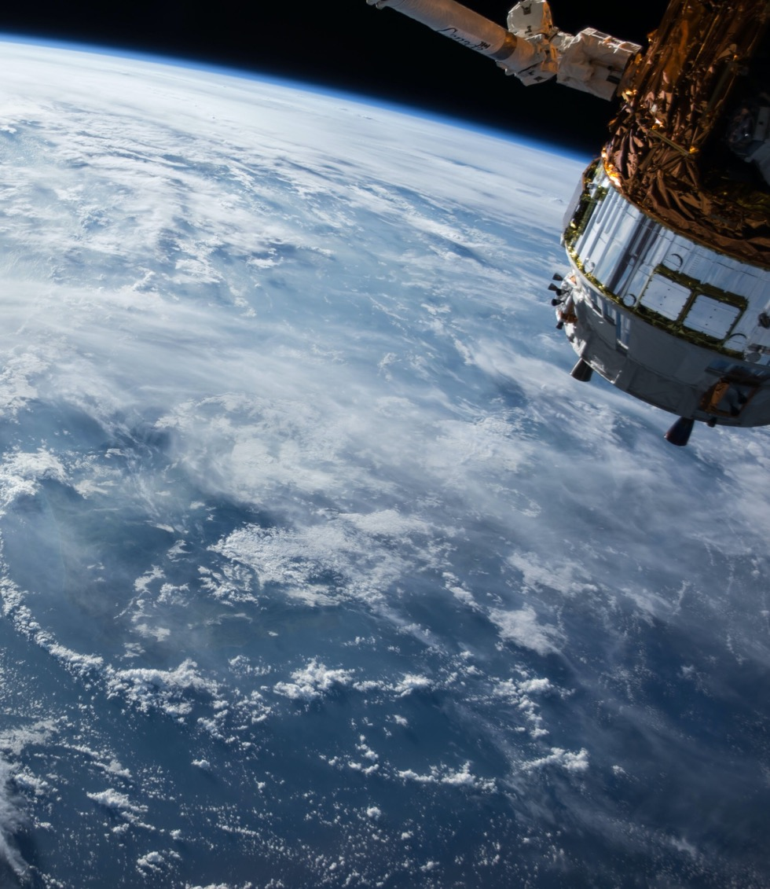
Thank You
Community

