Slide 1
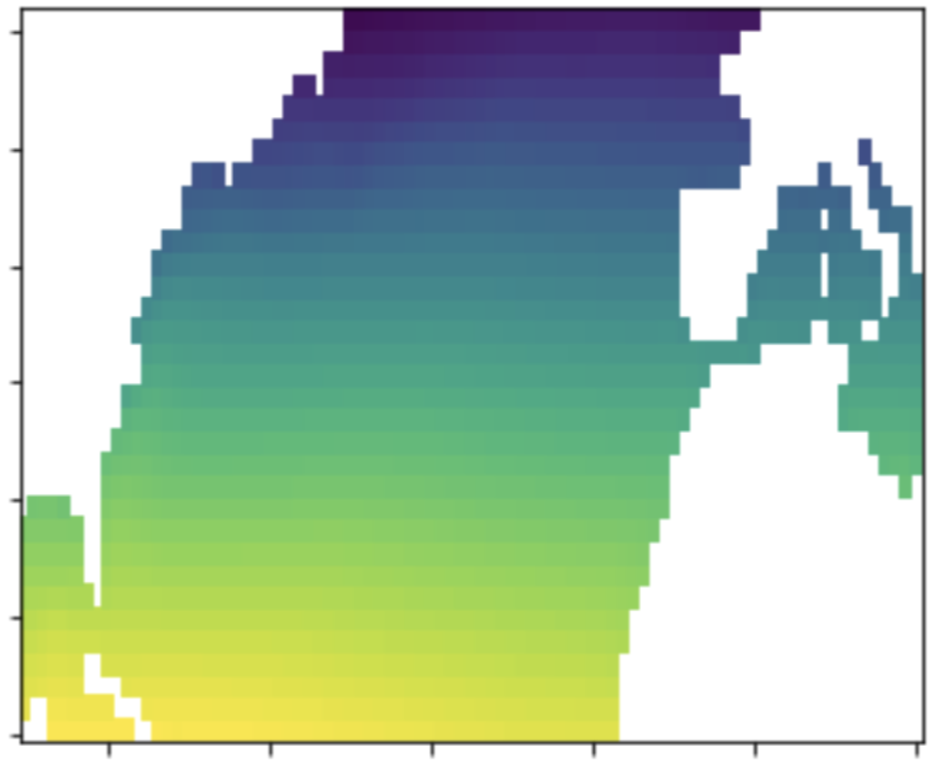
a) FNN architecture
20 neurons
20 neurons
Input
predictor(s)
Prediction
…
…
…
b) CNN architecture
Input predictor(s)
32 feature maps
Flatten
Max pool layer
64 feature maps
64 neurons
Max pool layer
Prediction
…
…
2x3
2x3
3x3
2x3

Slide 2
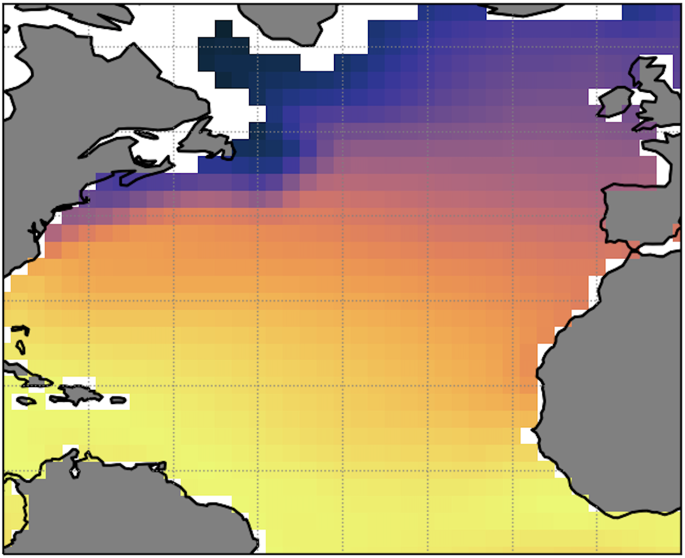
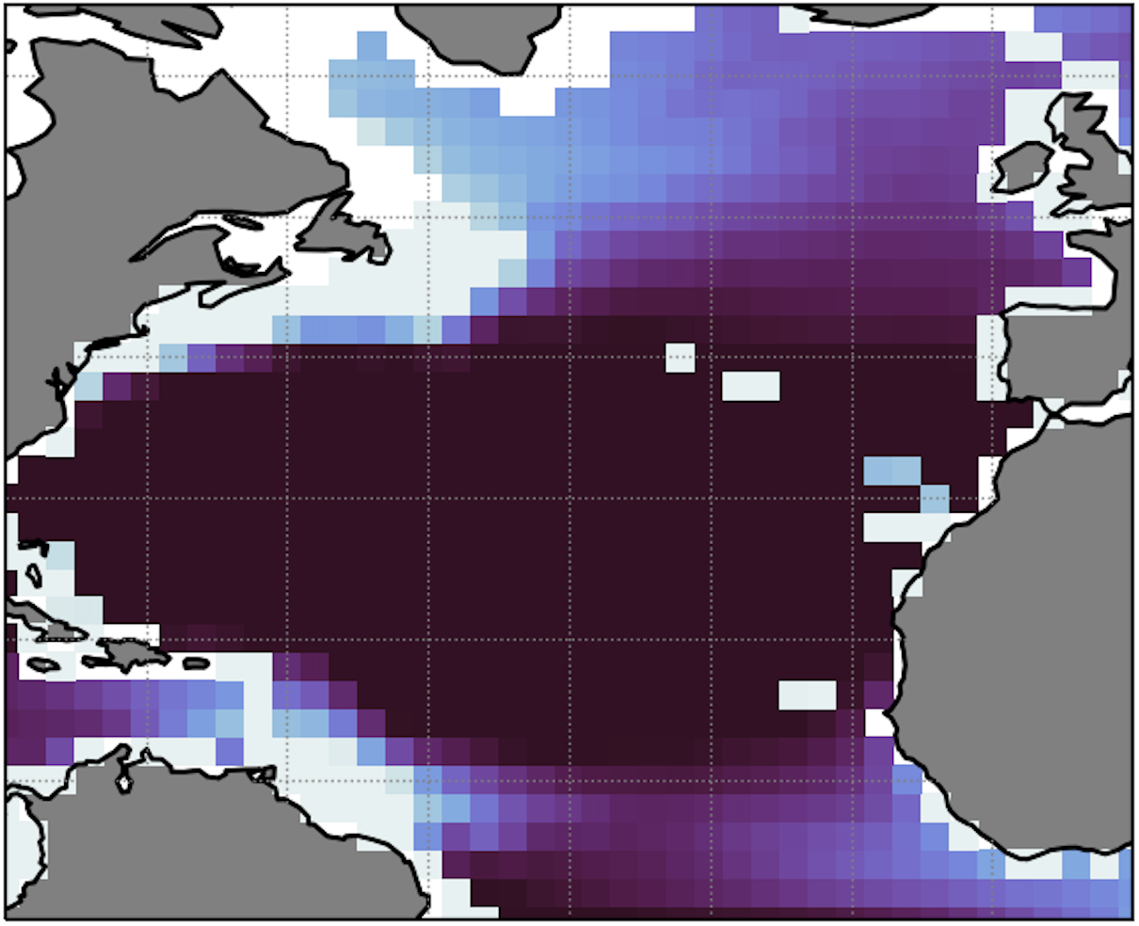
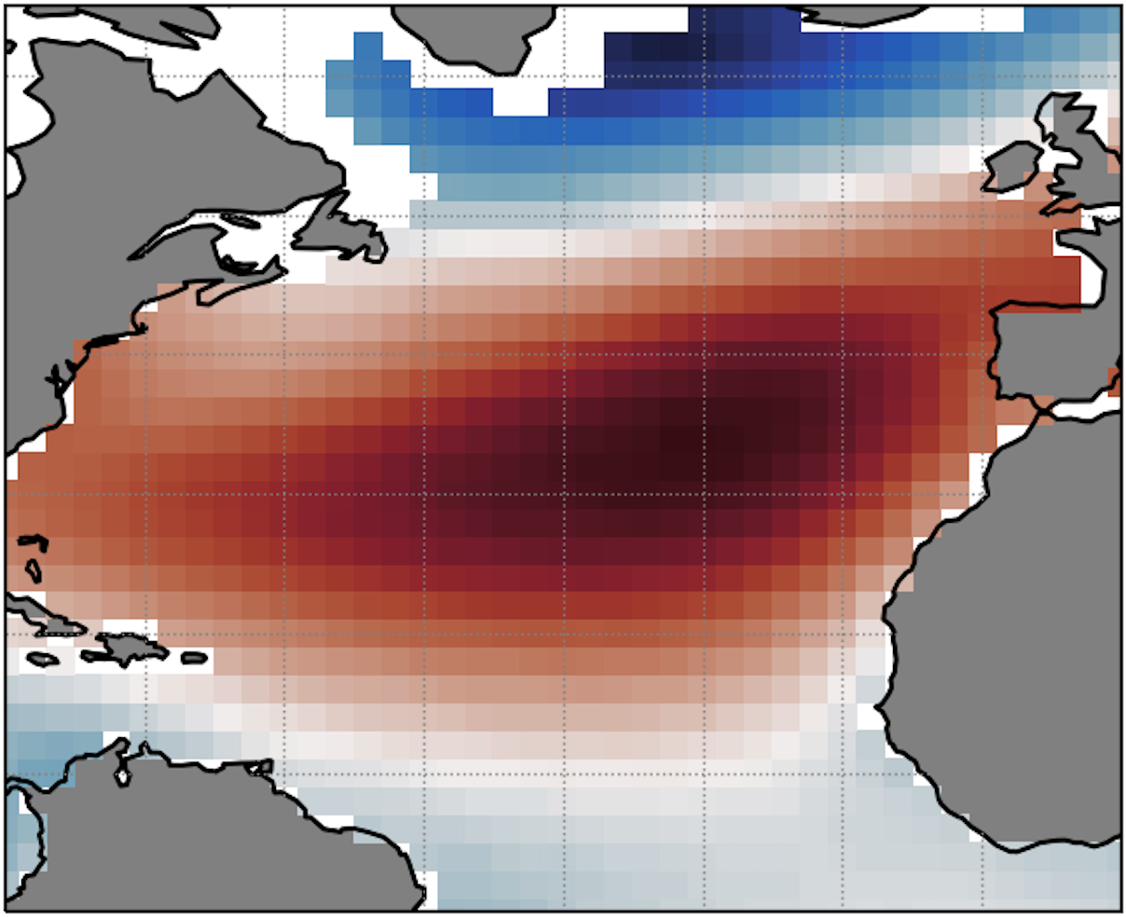
a) FNN2 architecture
20 neurons
20 neurons
Input predictor(s)
Flatten
Prediction
…
…
…
…
b) CNN2 architecture
Input predictor(s)
32 feature maps
Flatten
Max pool layer
64 feature maps
64 neurons
Max pool layer
Prediction
2x3
…
…
2x3
3x3
2x3

