Slide 1
Monitoring User Resource Utilization
Thunderbolt
Amsal Naeem, Parneet Kaur, Vanthana Sachdev

Slide 2
Group project Description
List of Tasks
  Task 1 : Setting up Cloud environment
  It involves setting up and understanding Devstack architecture, configuring the required services and interacting with Devstack services.
  Task 2: Gathering metrics
  Devstack services are used to gather metrics. Mainly used services include heat, ceilometer, nova, neutron. And storing them to SQL database
  Task 3: Web application
  The front end of the web portal will be a user interface created using HTML, CSS and JavaScript (on the front end). Server will be created Node JS.
  Task 4: Integration
  This involves integrating front end application and the under laying metrics collection on cloud.

Slide 3
Project Description (cont.)
Tasks allocation
Parneet 33.33%
Amsal 33.34%
Vanthana 33.33%
Tasks | Assignee | % of work
Cloud setup | Amsal, Vanthana | 35
Web application setup | Parneet, Amsal | 25
Integrating web application and cloud | Parneet, Amsal, Vanthana | 30
Documentation | Parneet, Amsal, Vanthana | 10

Slide 4
Technical Details
Hardware used
  3 Virtual Machines on Thoth lab Cloud
Software used
  Environment: Devstack
  Application Interface: OpenStack API, Python Ceilometerclient API
  Services: Heat, ceilometer, nova, neutron
  Tools: Ububtu server, SQL Database
  Programming Language: Python, HTML, CSS, php, MySQL
  IDEs: Text Editor(Atom)

Slide 5
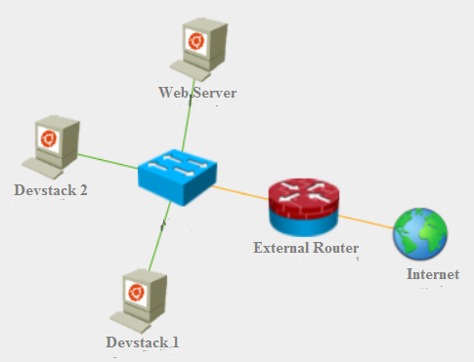
Technical Details
Project setup
CLOUD

Slide 6
Technical Details
Roadmaps of your project (Milestones)
Tasks | Start Date | End Date
Cloud Setup | 09/05/16 | 09/22/16
Web App Setup | 09/23/16 | 10/06/16
Connection | 10/07/16 | 10/20/16
Documentation | 21/10/16 | 10/26/16

Slide 7
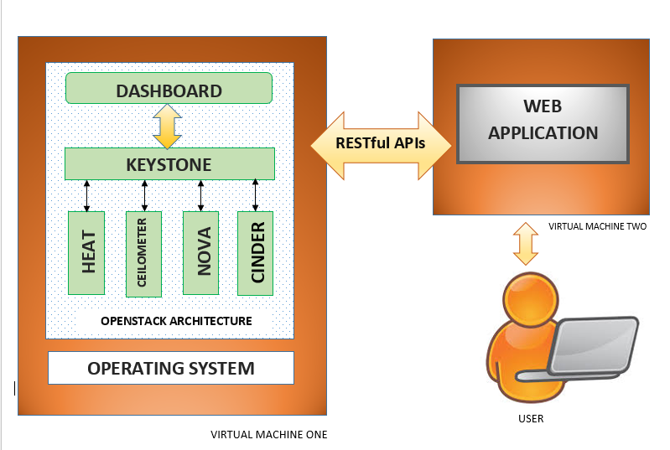
Technical Details

Slide 8
Risks and Benefits
Risks/challenges:
Potential applications and Benefits:
  More Efficient Resource Management.
  Maximized Utilization
  Increase in number of users
Risk Description | Risk | Mitigation Strategy
Network Connectivity | High | Periodically checking n/w connectivity
Machine Overload | High | Use machine with higher configuration
Data Loss | Medium | Implementing a cloud based data backup

Slide 9
Tasks Accomplished by Now
First Phase Documentation
Acquired required resources
Research (ongoing)
Second Phase Documentation.
Set up the cloud infrastructure, along with gathering statistics.
Designed the Front Pages of the Web App.
Set a LAMP Server at the Server End.
Created MySQL database with appropriate tables.
Connected Python to the database to store the data (we are getting from devstack) regarding resource utilization.

Slide 10
Tasks to be accomplished
Connecting the front end of the web application with the client side and connecting the database (We will proceed with creating a web app for multiple users, as we create more instances at the devstack) .
Visualizing the data in the database and giving it a pictorial representation, which is understandable by the user.

Slide 11
Conclusion
The need of the hour is to efficiently and cost effectively utilize limited resources to build and complete tasks in a scalable manner, especially with most companies and institutions offloading their work to Cloud. To address this problem, which is and will in the future gain more notoriety, we are building a Web Application to monitor resource utilization.

