Slide 1
Building Generative UI
with MCP in React
Glenn Reyes
React Alicante · September 24, 2026
Notes:
Welcome. This is a 3.5-hour collaborative workshop. Participants can code manually, pair or use their preferred coding agent. No paid AI account is needed for the exercises. Materials: https://github.com/glennreyes/generative-ui-mcp-workshop

Slide 2
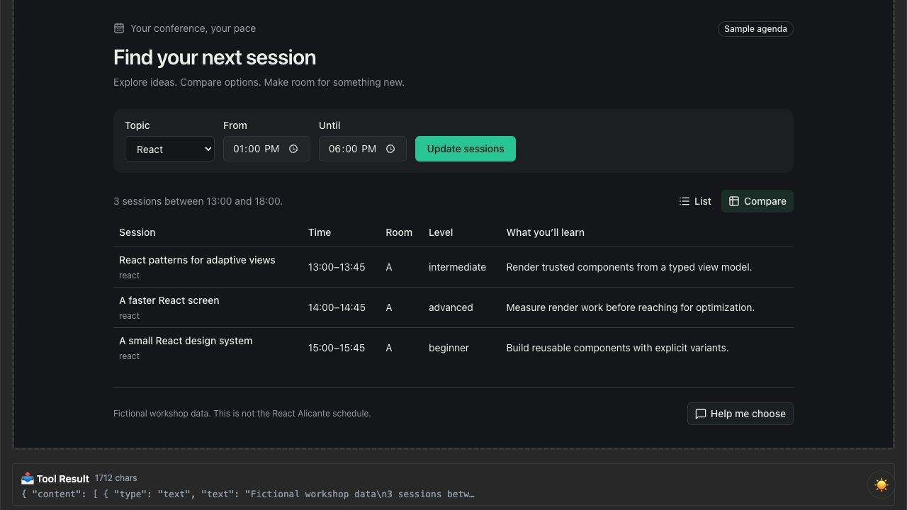
The Conference Agenda Assistant
One tool. Twelve fictional sessions.
A list, a comparison and a filter.
Notes:
Show the completed demo live, then use this actual screenshot as the fallback. State that all sessions are fictional, not the React Alicante schedule. Call show_sessions with topic react, startTime 13:00 and view compare. Three records should appear.

Slide 3
How we’ll work
Predict the result before changing the code.
Build a small change, then read the diff.
Run it and explain what happened.
Manual coding, pairing and agents all work.
Notes:
The coding agent helps build the app. The conversational model later chooses tools in the finished app. These are different roles. Use checkpoints to recover without overwriting participant work. Ask attendees to predict one filter result now.

Slide 4
Intent and presentation
“Show me React sessions this afternoon.”
→ topic: react · startTime: 13:00 · view: list
“Compare them so I can choose.”
→ same filters · view: compare
Notes:
Generative means the model chooses among supported, validated arguments and presentations. React is trusted application code. We are not running model-generated JSX, HTML or JavaScript. The local test host makes the arguments explicit; the instructor demonstrates natural language in a compatible host.

Slide 5
The application flow
Model chooses the tool and arguments
Host calls the MCP server
Server returns data and a UI resource reference
Host loads React in a sandbox
React calls tools through the host bridge
Notes:
Trace this flow in docs/architecture.md. Tools do work; resources supply content. The ui:// identifier is an MCP resource URI, not an HTTP page. Our local host replaces model selection with a tool form. Source: https://modelcontextprotocol.io/extensions/apps/overview

Slide 6
The tool contract
show_sessions({
topic: "react",
startTime: "13:00",
endTime: "18:00",
view: "compare"
})
Zod validates inputs and structured results.
Notes:
Open packages/agenda/src/schema.ts. Defaults live in one schema. Explain the complete-attendance time-window rule. content provides a readable text fallback; structuredContent supplies the typed result. Source: https://ts.sdk.modelcontextprotocol.io/v2/

Slide 7
Exercise 1 · The session tool
Filter by topic and the complete time window.
Return typed data and useful fallback text.
Try a valid empty result and an invalid input.
30 minutes · 00-start → 01-tool
Notes:
Open docs/exercises/01-tool.md. Ask whether the 15:00–15:45 session belongs in a window ending at 15:00. It does not. Expected React 13:00–15:00 result: react-patterns and react-performance. Read the diff and show the actual tool result before moving on. Break follows this block.

Slide 8
Exercise 2 · The React resource
_meta: {
ui: { resourceUri: "ui://agenda/sessions.html" }
}
useApp → ontoolresult → validated React state
35 minutes · 01-tool → 02-react-ui
Notes:
Open docs/exercises/02-react-ui.md and apps/server/src/server.ts. Register the single-file resource using RESOURCE_MIME_TYPE. Explain that the UI handler is installed before connect. Keep content text fallback and CSP metadata. Source: https://apps.extensions.modelcontextprotocol.io/api/documents/migrate-to-v2.html

Slide 9
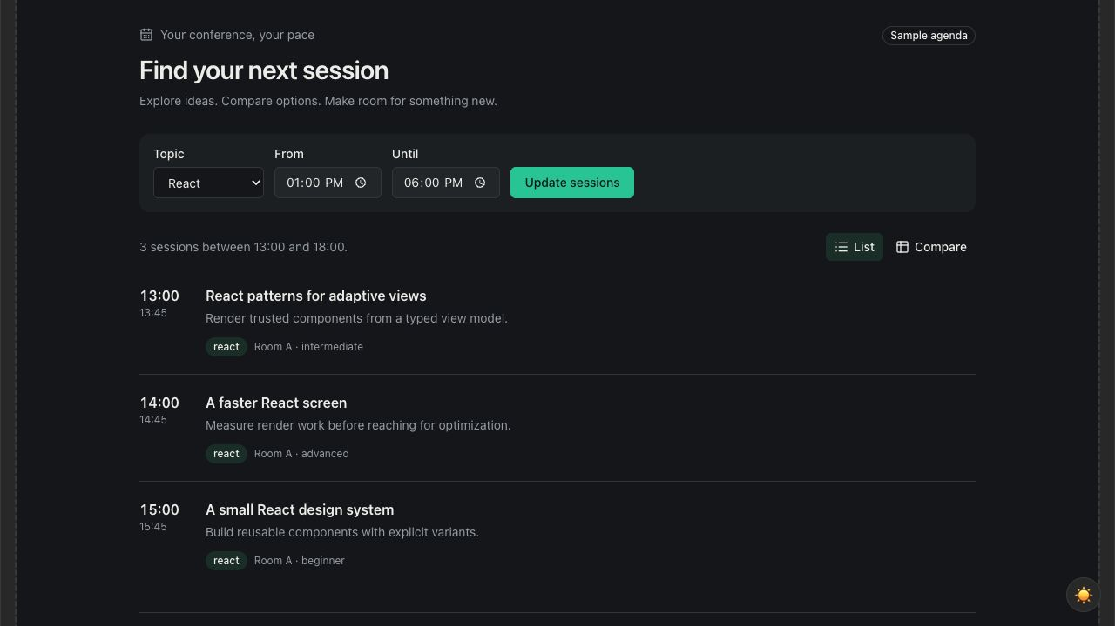
Exercise 3 · Trusted views
The same records, selected by result.view.
25 minutes · 02-react-ui → 03-views
Notes:
Open docs/exercises/03-views.md. Add the comparison Table using the existing shadcn components. Call from the host with view list, then compare. UI buttons are completed in exercise 4. The screenshot shows the actual list rendering. Break follows this block.

Slide 10
Exercise 4 · UI to server
const result = await app.callServerTool({
name: "show_sessions",
arguments: filters
});
return sessionResultSchema.parse(
result.structuredContent
);
30 minutes · 03-views → final
Notes:
Open docs/exercises/04-interaction.md. The snippet shows the data path; the implementation also checks isError and supplies a timeout. A UI-initiated result returns to the caller; do not wait for a new ontoolresult event. Review pending, error and stale-result handling in app.tsx. Source: MCP Apps SDK app.callServerTool documentation.

Slide 11
Context and conversation
updateModelContext shares the current selection.
sendMessage asks the host to continue.
The local host records these messages.
A conversational host can respond.
Notes:
Click Help me choose in the prepared host and inspect Messages. The message contains the visible session IDs and applied filters. Check host capabilities, handle rejection and preserve the main browsing interaction if follow-up is unsupported. Source: https://modelcontextprotocol.io/extensions/apps/overview

Slide 12
Loading, empty results and errors
Keep the last useful result during a request.
Disable duplicate submissions.
Explain an empty result and how to recover.
Validate data on both sides of the bridge.
Keep useful text when a host cannot render UI.
Notes:
Demonstrate an empty 17:00–18:00 window, then a reversed window and recovery. Do not replace working data with a blank screen while loading. Untrusted strings render as text. The sandbox and typed contract have different jobs. A read-only example avoids real booking side effects.

Slide 13
Pair challenge
Add a room filter to schema, server and UI.
Or add a timeline as a new trusted view.
Preserve the other filters. Add one useful test.
20 minutes · Show the actual result
Notes:
Open docs/exercises/05-challenge.md. Prefer the room-filter option if short on time. Ask pairs to show the changed tool argument and output, not just the screen. The timeline is a stretch option; think about simultaneous sessions.

Slide 14
Keep building
github.com/glennreyes/generative-ui-mcp-workshop
Setup · exercises · solutions · slides
Build with Glenn on Discord
discord.gg/8p3uGHNMu
Notes:
Reserve the final fifteen minutes for Q&A and recovery. Ask attendees to name the model, host, tool, resource and React responsibilities. Share the final checkpoint and invite follow-up in #react-alicante-2026. Conference: https://reactalicante.es . Reusable description: docs/workshop.md.

