Slide 1

Negative Wealth Shock & Mortality
Susan Glenn, Jeanne Li, Stewart Kerr, Jingcheng Xu

Slide 2
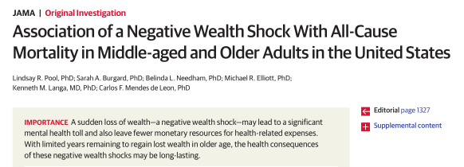
Goal
This paper claims that experiencing a wealth shock (defined as losing 75% of your wealth over a 2-year period) is strongly associated with increased risk of mortality
We aimed to explore the causal effect of experiencing a wealth shock with respect to mortality using risk-set matching

Slide 3
Data
The data for the study comes from the University of Michigan's Health and Retirement Study (HRS), a longitudinal panel study that surveys a representative sample of approximately 20,000 people in America
The JAMA paper looks at people from the first wave of the HRS study
Born between 1931 – 1941, first surveyed in 1992
The study is longitudinal, so there are two types of variables available for study
Baseline (e.g. Gender, birth year, race, etc.)
Time-varying (e.g. Marital status, wealth, job status, health conditions, etc.)
Time-varying covariates were lagged by one period so that they preceded the treatment
1992
1994
1996
1998
2000
2001
Baseline
T.V. Covariates
Wealth Shock
Death

Slide 4
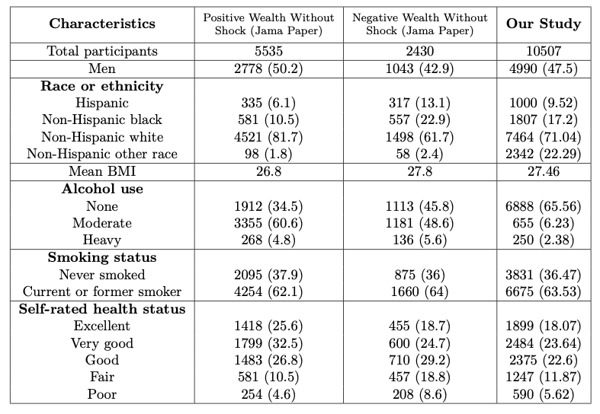
Baseline Characteristics

Slide 5
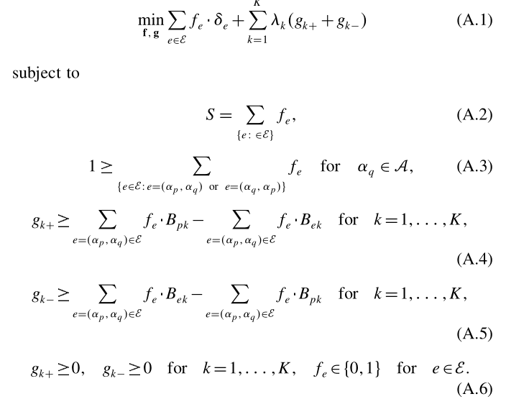


(Balanced) Risk Set Matching
Risk Set Matching is a method proposed by Rosenbaum et al. (2001) to match subjects treated at time t with a control that looks similar up to time t
Control may or may not be treated later
Balanced risk set matching includes an additional penalty to risk set matching which enforces balance on important covariates
Controls
Treated

Slide 6
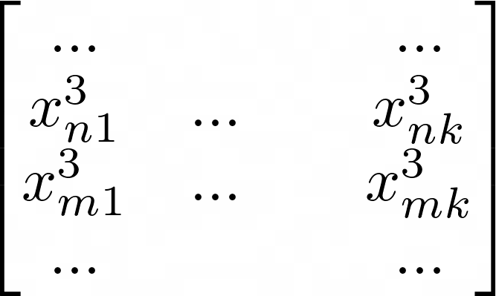
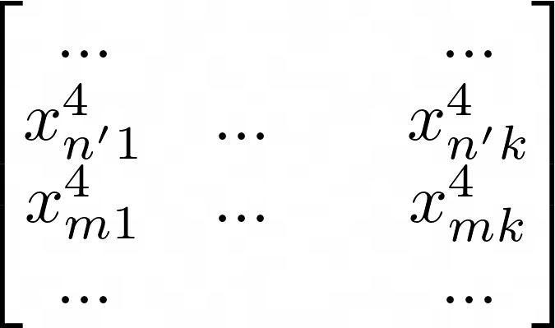
Distance Matrix
Controls
Treated
W3
W4
1992
1994
1996
1998
2000
2001
Baseline
T.V. Covariates
Wealth Shock
Death
...
W3
W4
...

Slide 7
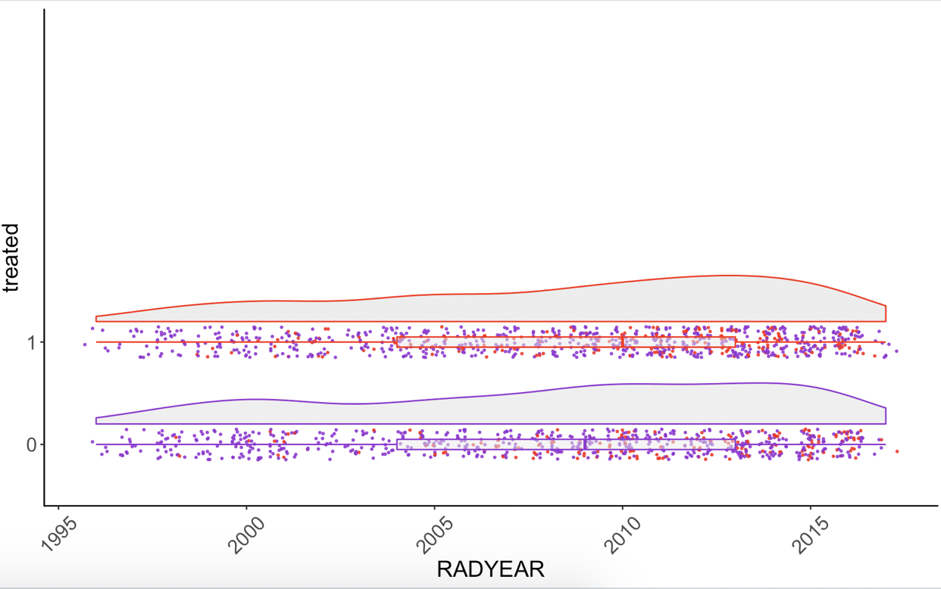
Matching Results & Outcome
2182 pairs in total:
654 treated died first, 571 treated died last, 1225 died in the same wave (or didn't die in the follow-up period)
Binary response: die first = 0 ,die second = 1, Died together = -1
More people who were controls died after people who got the treatment

Slide 8
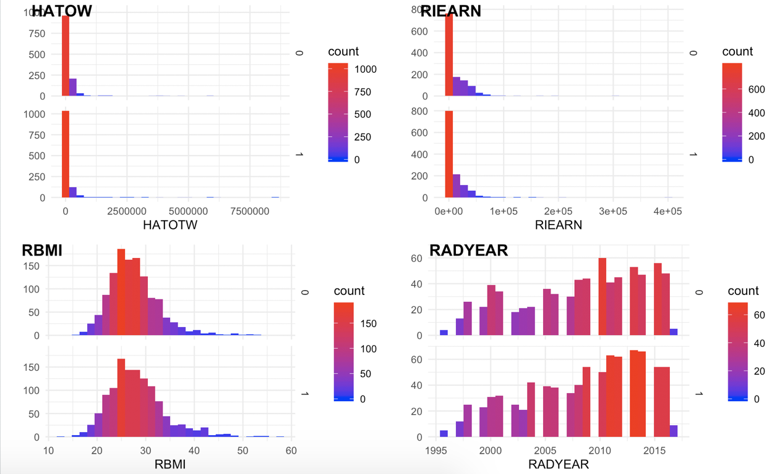
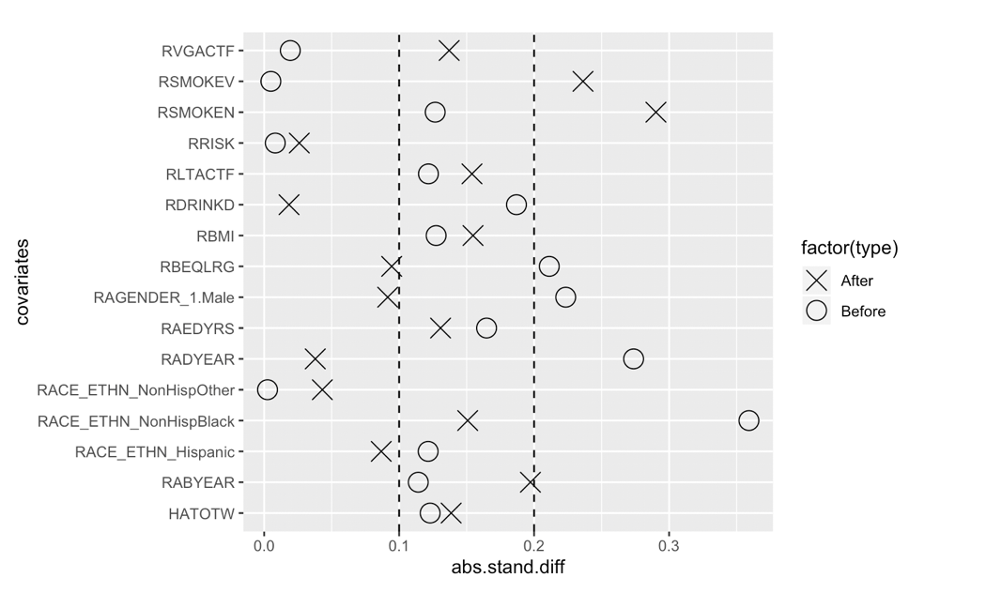
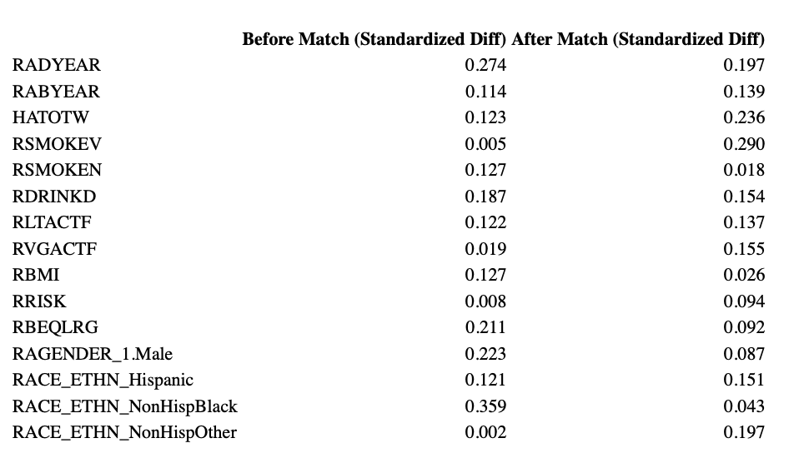
Balance
Checked balance for baseline or covariates which did not vary with time

Slide 9
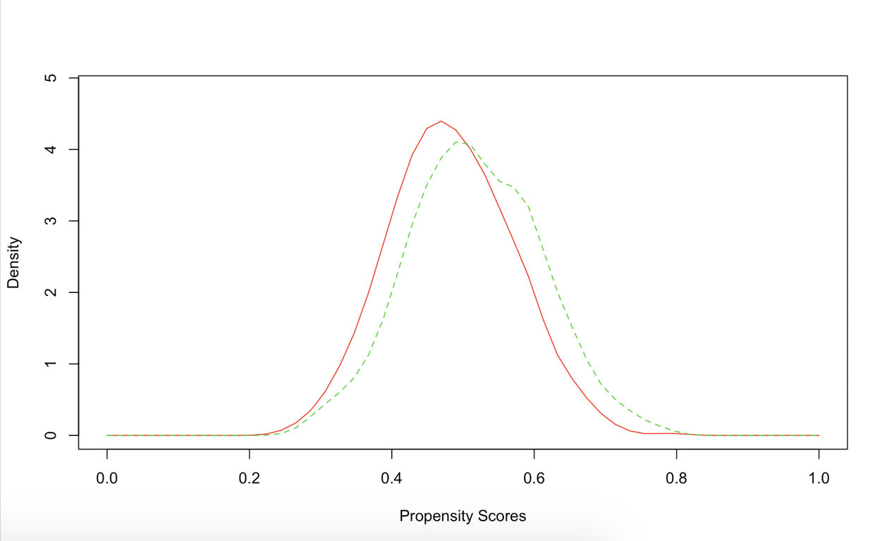
Treatment Effect
Paired T test:
average treated: 0.53 average control: 0.47
the differences between means is -0.068 and the p-value = 0.0177
Wilcoxon Rank Sum test:
p-value = 0.0177
ATE: used IPW -0.06

Slide 10
Sensitivity Analysis
Goal:
Unmeasured confounding covariates
Magnitude of hidden bias
Rosenbaum's R packages:
"sensitivitymw" and "sensitivitymv"
Sensitivity parameter Gamma
Point estimates, confidence intervals
Amplification of sensitivity parameter
H0: There is no treatment effect of wealth shock on mortality.
H1: Having a wealth shock leads to a negative impact on length of life span.

Slide 11
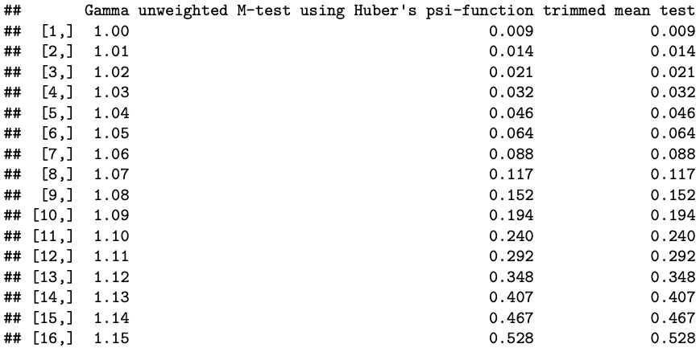
Sensitivity Parameter

Slide 12

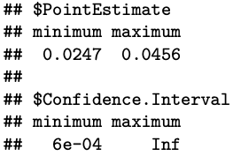

Range of Point Estimates ​ and Confidence Intervals​
Amplification of Sensitivity Parameter Gamma
E-value = 1.33
To overturn our conclusion, an unmeasured confounder needs to have a 1.33 odds of increasing the outcome and treatment
Or Gamma = 1.05

Slide 13
Thank you!

