Slide 1
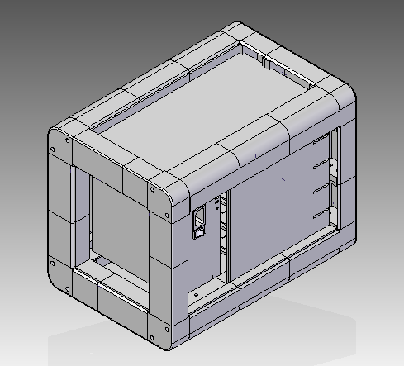
C
A
B

Slide 2
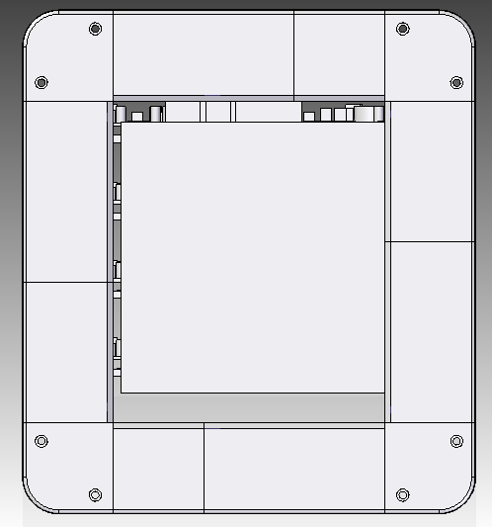
1E
1B
1A
1A
1A – 4 QTY of SideEdge4_100mmSideHJointsv2
1B – 2 QTY OF FanSide_50MM_MF
1C – 2 QTY OF FanSideFemale
1D - 2 QTY OF FanSide_78MM_MM
1E - 2 QTY OF FanSide0012
1D
1C
1C
1D
1A
1B
1E
1A

Slide 3
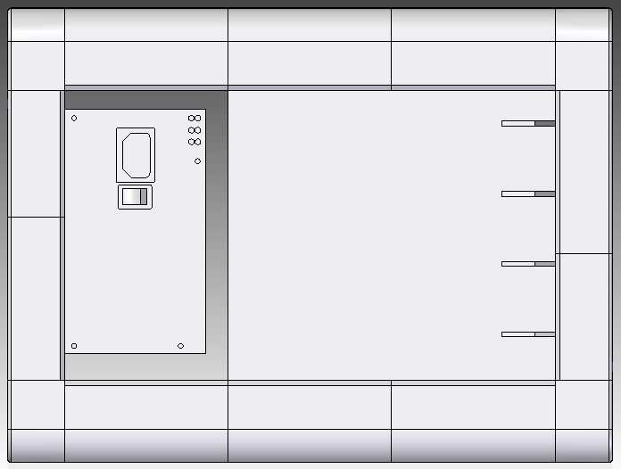
1A
2A
2A
2A
1A
1D
1A ,1C & 1D – Please refer to other slides.
2A – 6 QTY of 100mmSideHJointsv2
1C
1C
1D
1A
2A
2A
2A
1A

Slide 4
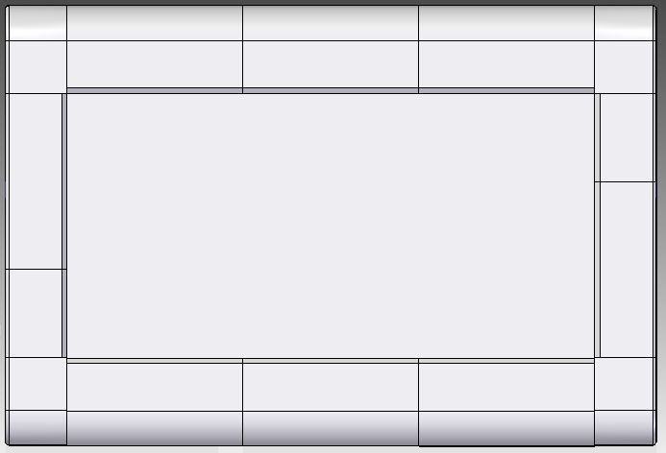
1A
2A
2A
2A
1A
1B
1E
1E
1B
1A
2A
2A
2A
1A

Slide 5
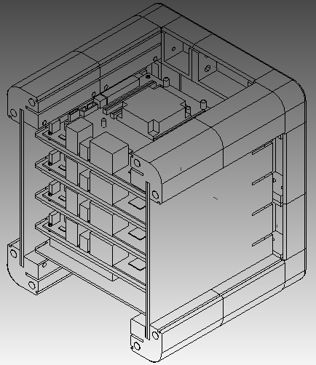
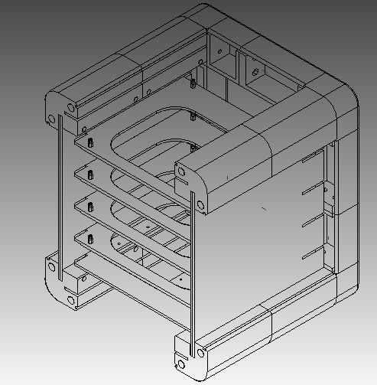
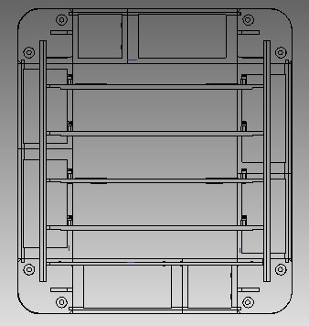
When we a portion of the parts apart.
D
When we removed the harddisk and motherboard.

Slide 6
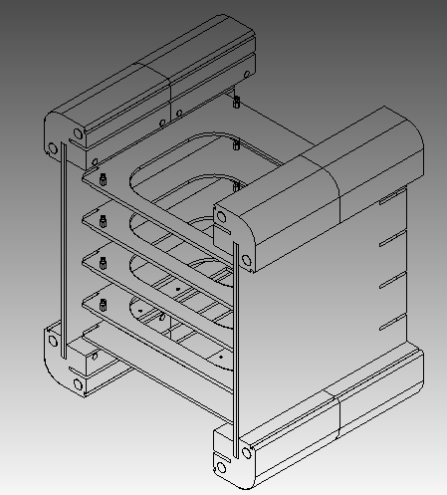
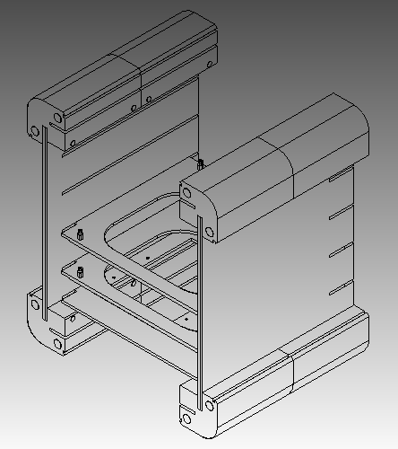
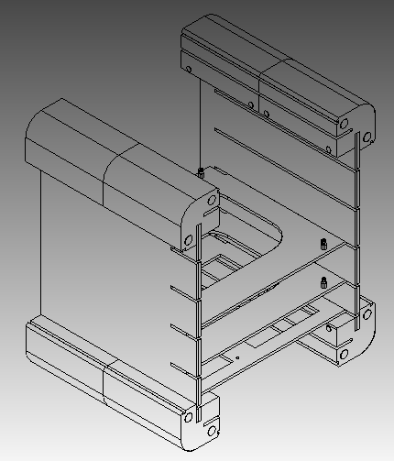
When we removed the fan cover.

Slide 7
3A – ModMBHolder01
3B - ModMBHolder02
3C - motherboard_BASE plate
3D - motherboard_BASE plate_hdd
2A
2A
2A
2A
3B
3C
3A
2A
3D
2A
2A

