Slide 1

Data Driven Applications
RHTE 2014 – Macau
Glenn West

Slide 2
Overview
Hands-on Session
No programming experience needed
Uses:
  Openshift
  Ruby
  Ruby On Rails
  Active Admin

Slide 3
What You Need
Rhel7/Centos 7 (Vm is fine)
System subscribed to channels and up to date
Access to RHN and GitHub and Openshift.com
Openshift Account
A Laptop
Root login

Slide 4
Why?
Need to create a Application Fast?
Don’t want to use Spreedsheet/Excel?
Want to levarge Openshift for your apps?
Don’t know how to code?
Want to learn more about Cloud Applications?

Slide 5
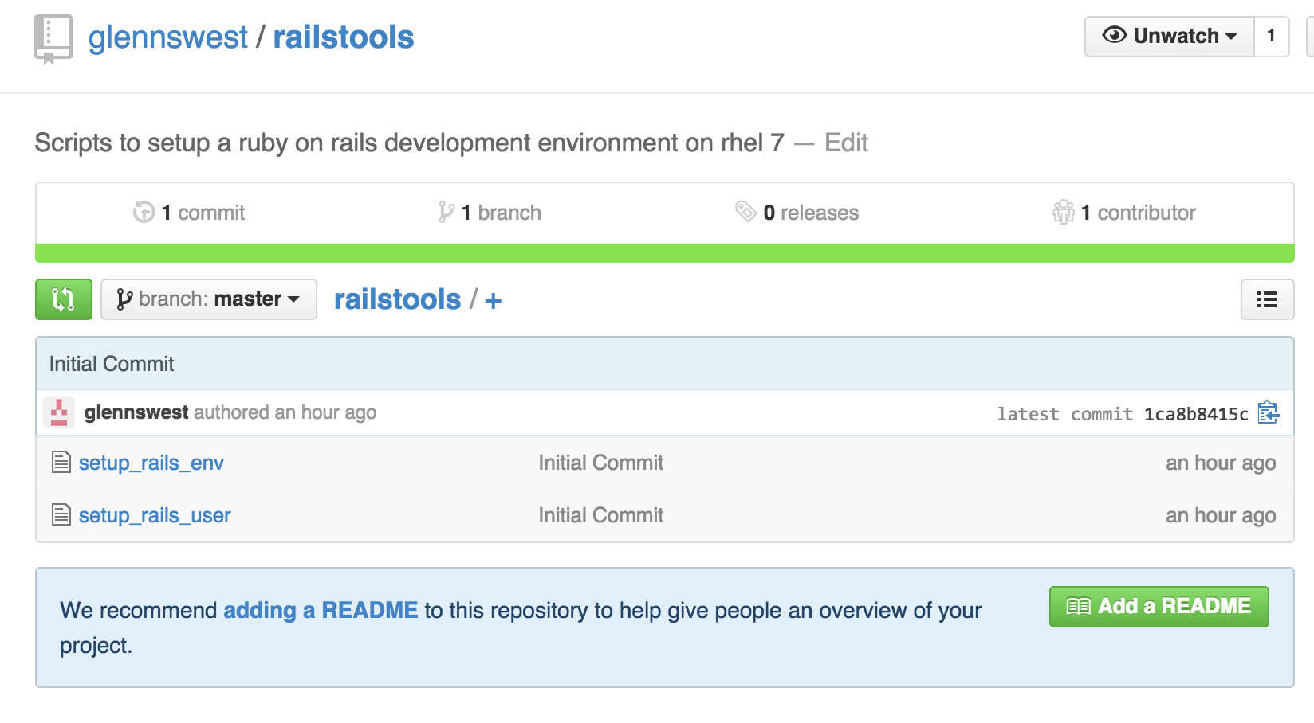
Getting Setup
git clone https://github.com/glennswest/railstools.git

Slide 6
Setup the environment
Su root
yum install git –y
git clone https://github.com/glennswest/railstools.git
./railstools/setup_rails_env

Slide 7
Setup User Env
As your normal user
./railstools/setup_rails_user

Slide 8
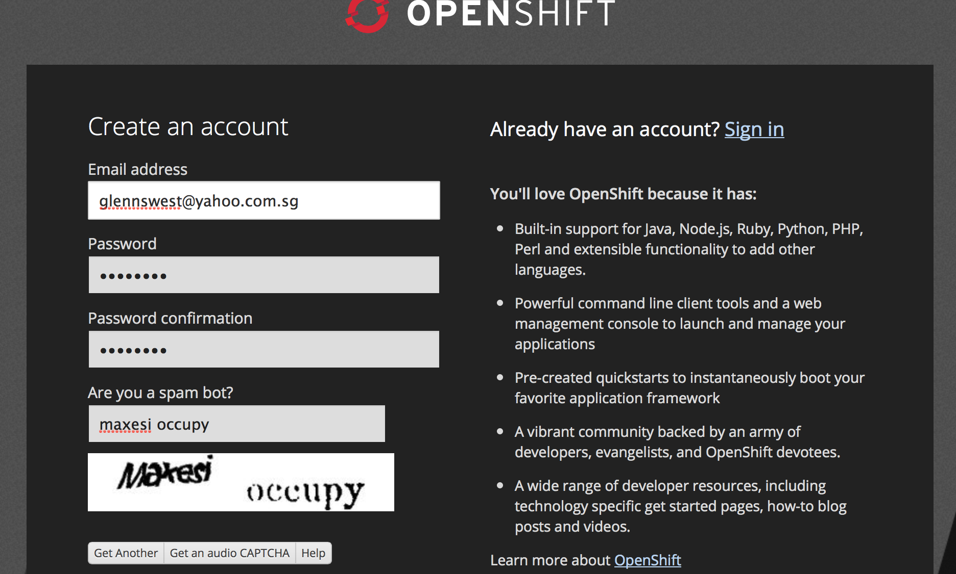
Setup OpenShift Account
https://www.openshift.com/app/account/new

Slide 9
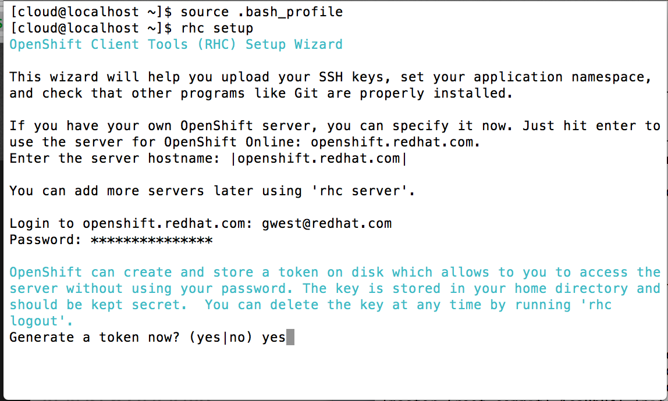
Setup Rhc

Slide 10
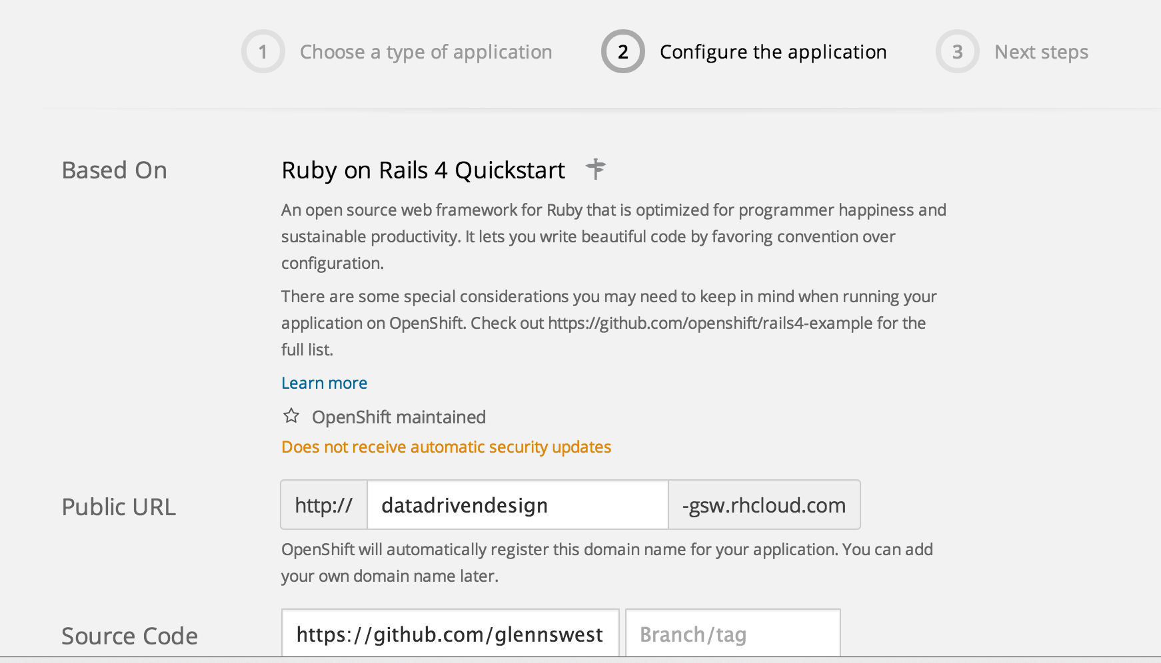
Create a new app
https://github.com/glennswest/datadrivenbase

Slide 11
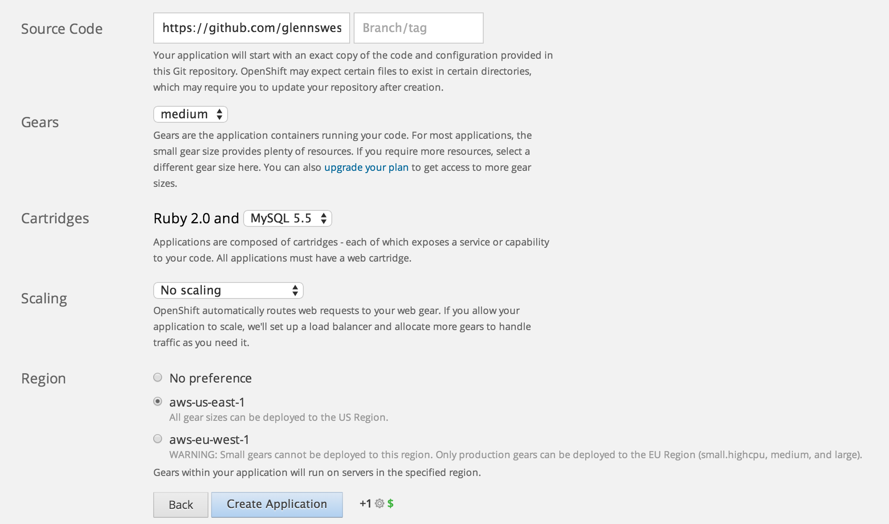
Create a new app

Slide 12
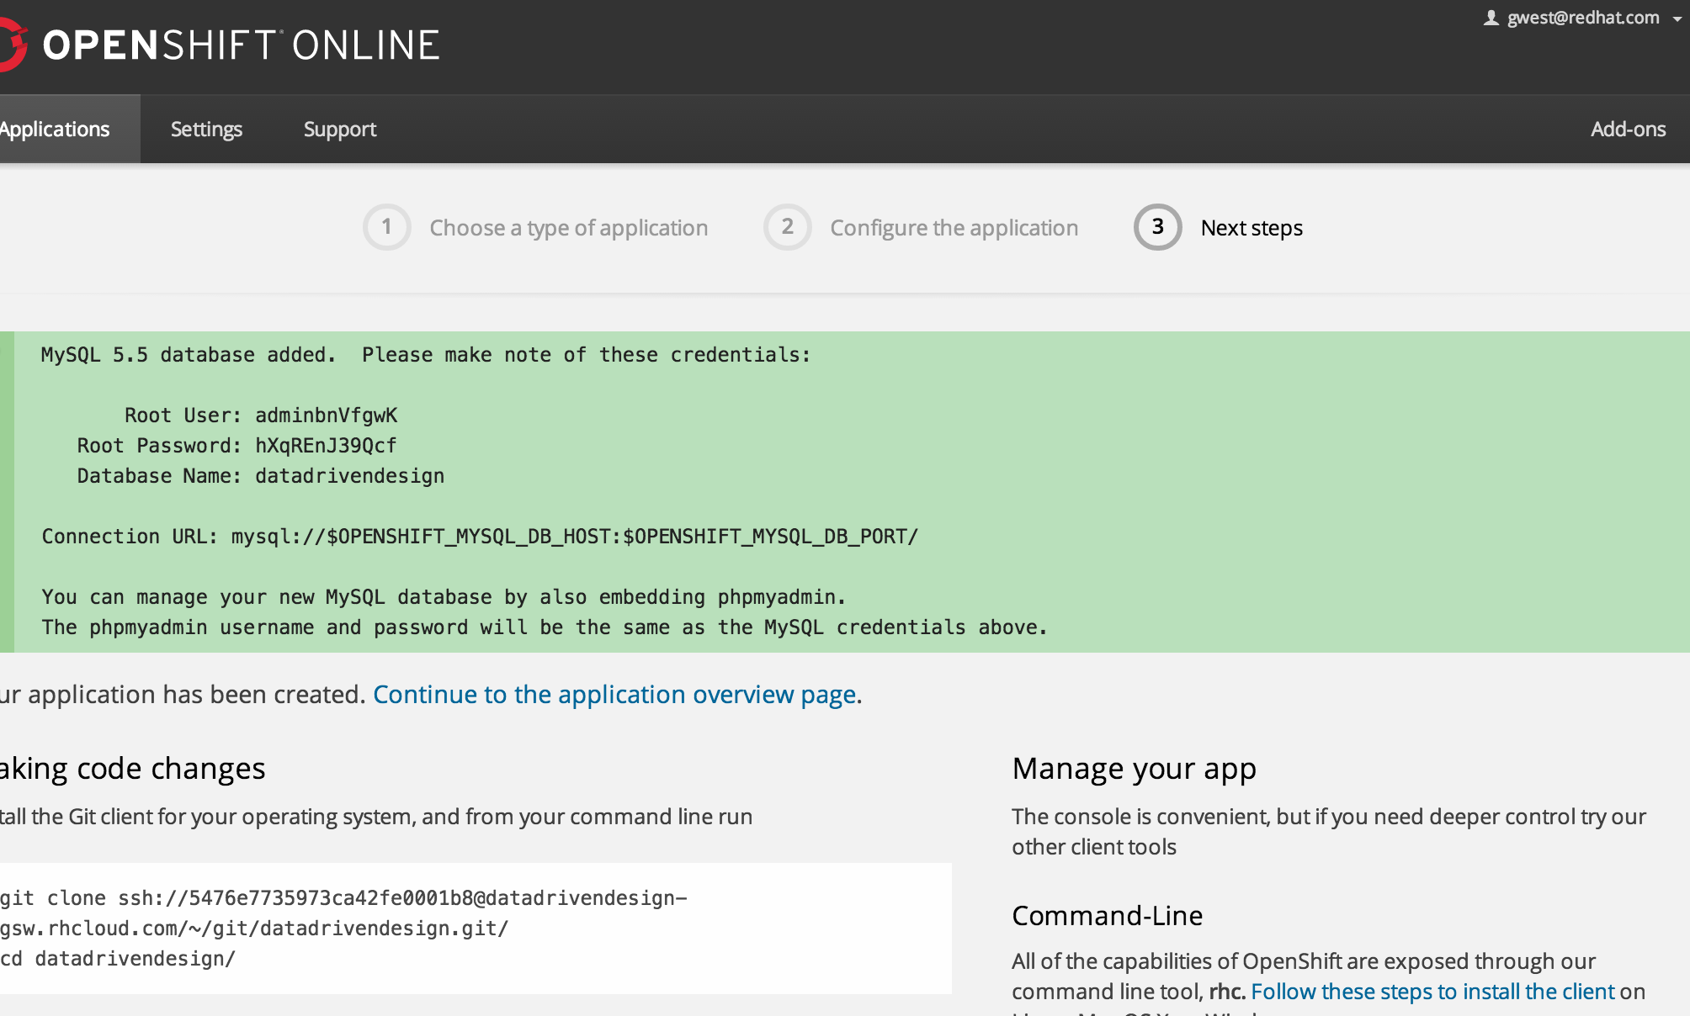
Clone your app

Slide 13
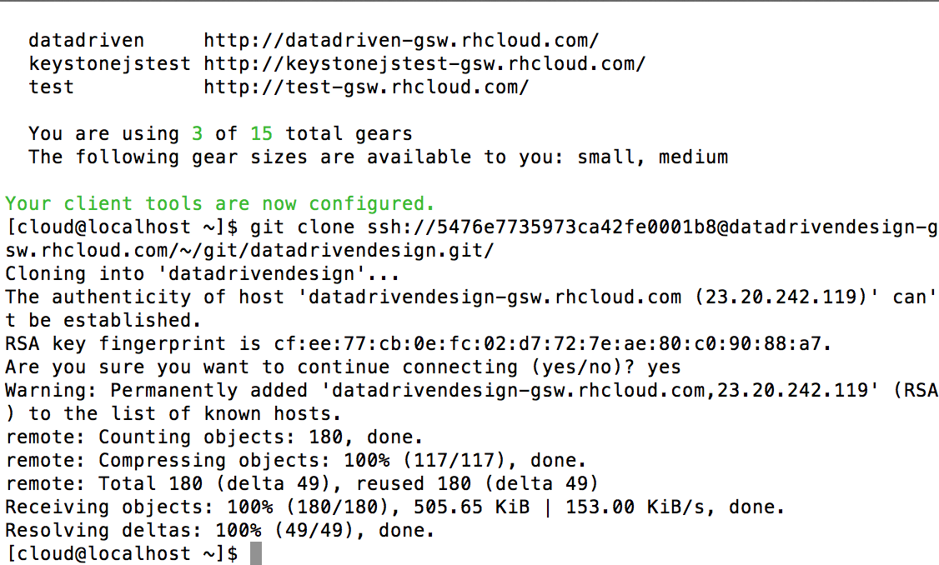
Clone you app

Slide 14
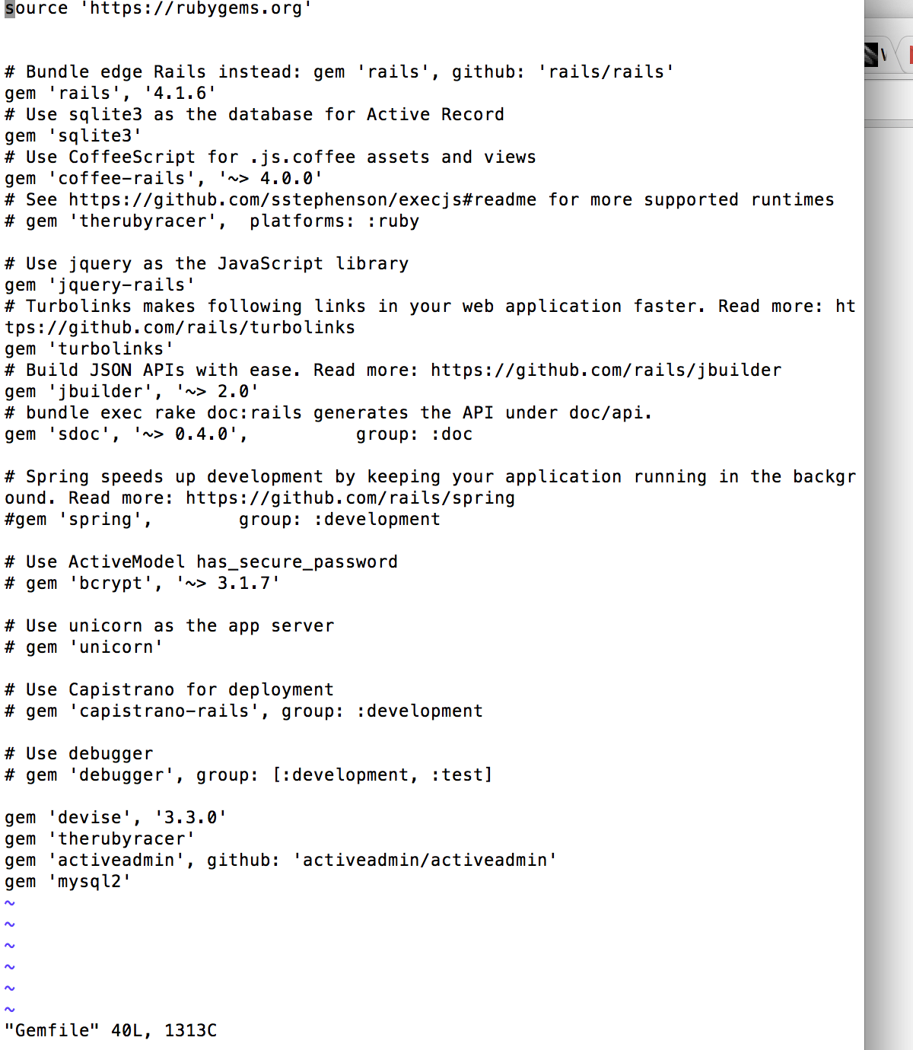
Bundle Install
Execute “bundle install”

Slide 15
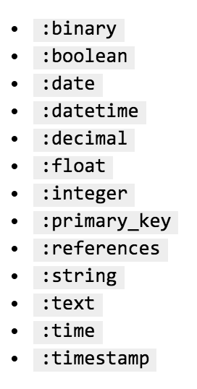
Data Types
[cloud@localhost testit]$ rails generate model product name:string description:text
invoke active_record
create db/migrate/20141203031945_create_products.rb
create app/models/product.rb
invoke test_unit
create test/models/product_test.rb
create test/fixtures/products.yml
[cloud@localhost testit]$

Slide 16
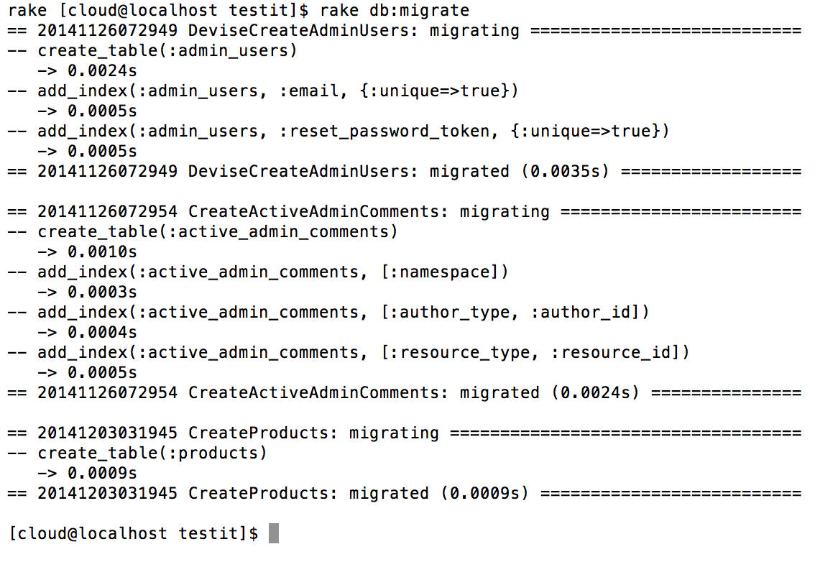
Migration – rake db:migrate

Slide 17
Generate the screen
[cloud@localhost testit]$ rails generate active_admin:resource product
create app/admin/products.rb
[cloud@localhost testit]$

Slide 18
Commit your changes
Execute:
git add –all
git commit –a –m “Add product screen and table”
git push origin master

Slide 19
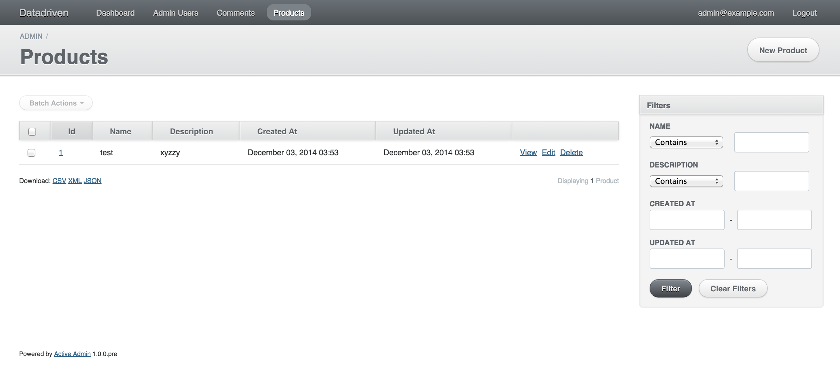
Result

Slide 20
Advanced Reading
Activeadmin – Screens Menus all extensible
Devise – Authentication – Fully customizable
Rails Migrations - http://guides.rubyonrails.org/migrations.html

