Slide 1
The Issue
glennswest@neuralcloudcomputing.com

Slide 2
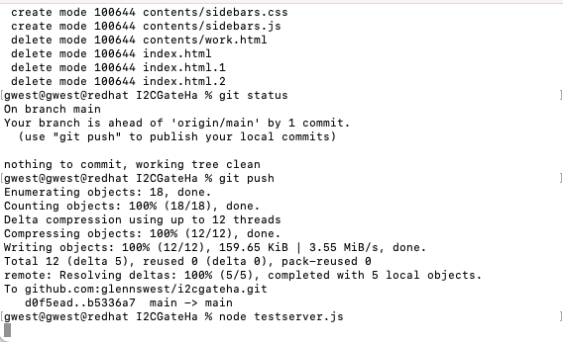
Test environment
Code is at:
https://github.com/glennswest/i2cgateha
In contents directory
To Test:
Node testserver.js

Slide 3
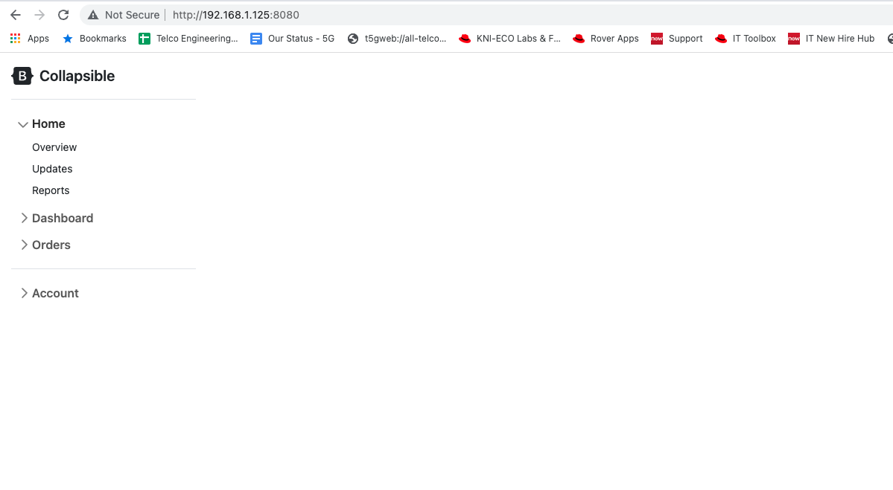
Issue One
Should display overview.html (a table) on initial opening.
Wrong behavior:
Have to Click overview
Menu’s disappeared

Slide 4
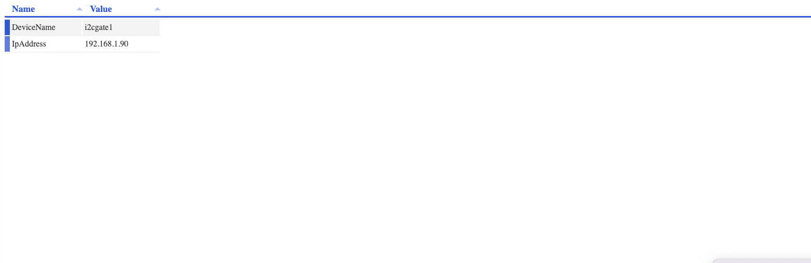
Issue Two
The table should be in a container – ie the bar is too long.
Nice to have a way of stacking multiple tables in multiple containers (A future overview, could have multiple tables)

Slide 5
Things to check
Can switch between two tables

