Slide 1

I2CHaGateWay
A IOT Voyage
Arduino – Rasberry Pi, ESP32 Wifi and MQTT and a bit of the web, on a plate of epaper.
gwest@redhat.com

Slide 2

Extreme Device Slowdown
At one point I noticed that the device was really slow.
Like a messages were taking seconds for things I knew happened instantly.
The DHCP results were the area:
Looking at git commits, and commenting out code I finally found it in logging, my bright new epaper logging display was componsed of a backend, that logged to extended memory, and a display part, separated by a queue/linked list.

Slide 3
Web Server Instability – AsyncTcpServer
Simple 1 page app worked fine
Full Stack crashed every time – device reboot
Went thru multiple different reasons why
Sdfat library didn’t support multiple concurrent access – (It was fine)
Not enough Stack/Heap – (It Was Fine)
It was fixed in another branch (Tried a few)
In the end, it was the last one.

Slide 4
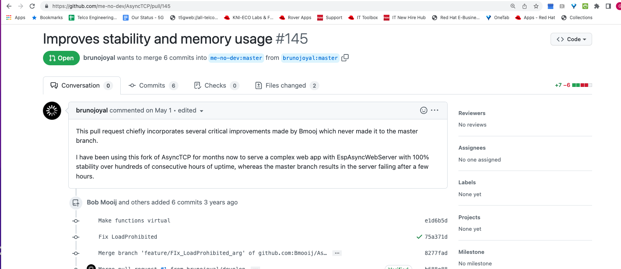
The Golden Ticket
https://github.com/me-no-dev/AsyncTCP/pull/145

Slide 5
Problem was in a lower library
ESPAsyncWebServer – Depends on AsyncTCP
AsyncTCP has some issues, and that was coming back up to “bite” the web server.

Slide 6
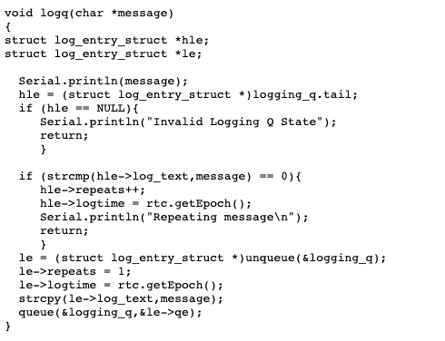
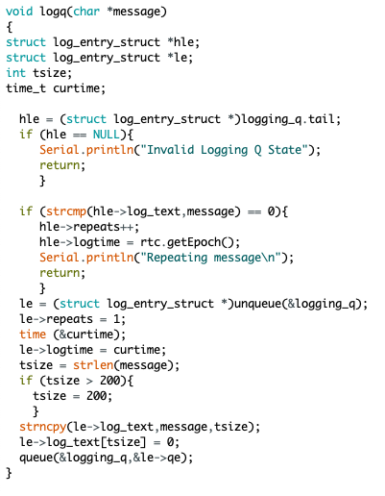
The Bad Stuff – real time clock is sloooooww

Slide 7

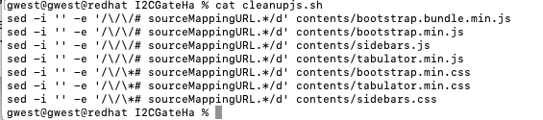
Sooooo much content – getting rid of maps
.map files are used for debugging web apps
Each framework provides them in distribution
There huge: (Worse when our “disk” interface is slow SPI)
Cleanup references, so we don’t waste round trips

Slide 8
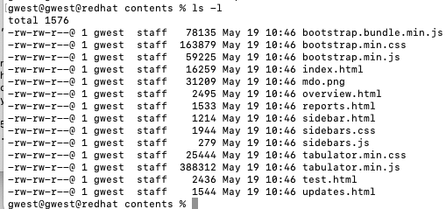
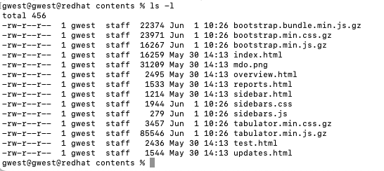
Still not fast enough
While a lot better, its still slow
Decided to gzip the big js and css files
Already had some code to handle (I thought)

Slide 9
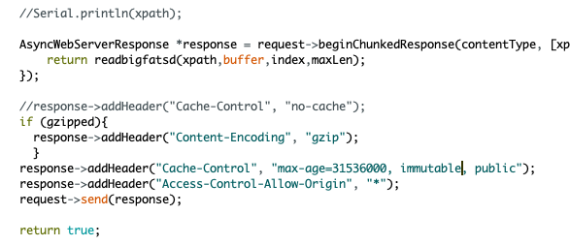
Chrome now hates me
Chrome now says my files are corrupted. ☹
And of course my web ui is not working
There a header for that:

