Slide 1
GOMAXPROC via Cursor
Scaling and Setting GOMAXPROC, leveraging Cursor AI
Presented by: Glenn West (gwest@reedhat.com)
Date: August 2025

Slide 2
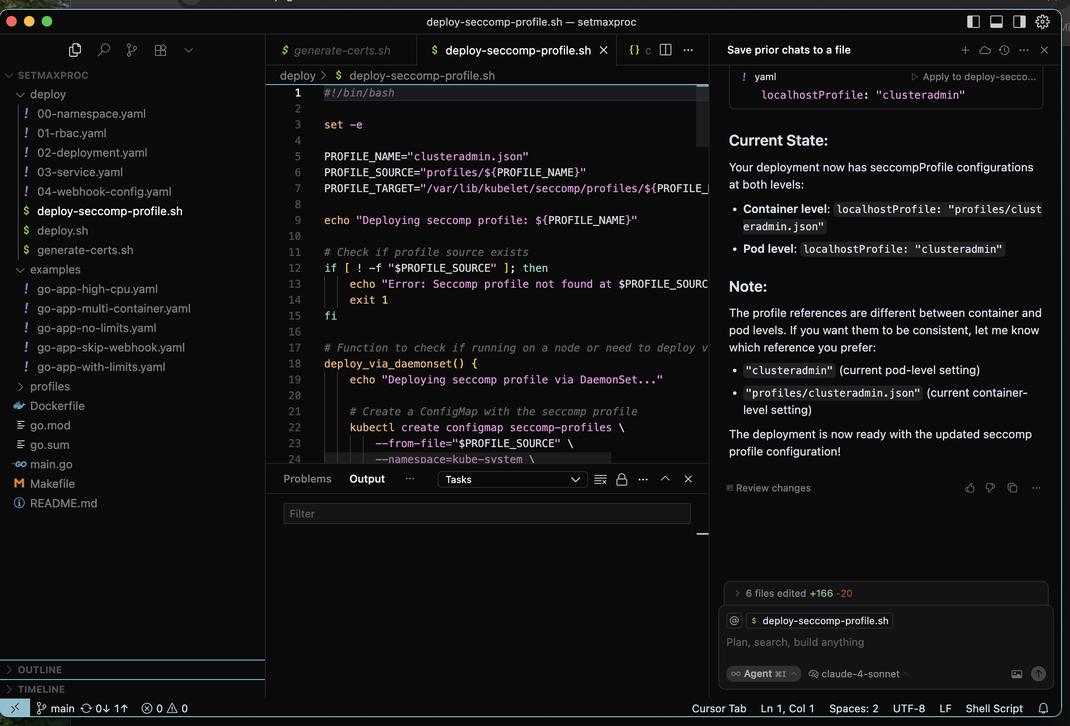
What is Cursor?
• Cursor is an AI-powered code editor based on VS Code
• Integrates advanced AI into the development workflow
• Powered by OpenAI's Codex/GPT models
• Enhances developer productivity through intelligent assistance

Slide 3
Key Features of Cursor
🤖 AI pair programming with in-editor suggestions
💬 Built-in chat for code explanation & generation
🔧 Context-aware refactoring capabilities
🐛 Live debugging assistance
🚀 GitHub Copilot alternative with enhanced features

Slide 4
Cursor: Advantages & Considerations
**Advantages:**
🚀 Accelerated development with AI assistance
💬 Real-time code explanations
🔁 Intelligent refactoring suggestions
🔌 Compatible with VS Code extensions
🔍 Advanced search and symbol resolution
**Considerations:**
📶 Requires internet connectivity for AI features
🔒 Data privacy and security implications
💸 Subscription cost for premium features
🧠 Risk of over-dependence on AI assistance

Slide 5
Ideal Use Cases for Cursor
🏗️ Rapid prototyping and MVP development
📚 Learning new codebases or programming languages
⚡ Generating boilerplate and template code
🔍 Complex debugging and troubleshooting
👥 Solo developers and small agile teams
🎯 Time-sensitive development projects

Slide 6
What are Mutating Webhooks?
🔧 Part of Kubernetes admission controllers
✏️ Modify (mutate) objects during create/update operations
⏰ Execute before objects are persisted to etcd
🛡️ Enable automated policy enforcement and defaults
🔄 Provide dynamic configuration capabilities
Allows the webhook to “overwrite” parameters on the fly!!!

Slide 7
Mutating Webhook Process Flow
1. User submits request to Kubernetes API server
2. Request enters the admission controller pipeline
3. Mutating webhook intercepts the incoming request
4. Webhook analyzes and modifies the object
5. Modified object is returned to API server
6. Final object is validated and persisted to etcd

Slide 8
Mutating Webhook Use Cases
🔌 Auto-injecting sidecars (Istio, Envoy)
🏷️ Adding default labels and annotations
📊 Setting resource limits and requests
🛡️ Enforcing security policies at runtime
🔧 Namespace and RBAC configuration
📝 Compliance and governance automation
In our example: Adjusting golang MAX Proc

Slide 9
Mutating Webhooks: Benefits & Challenges
**Benefits:**
✅ Automated consistency and policy enforcement
✅ Reduced manual intervention and errors
✅ Flexible and powerful operational control
✅ Dynamic configuration capabilities
**Challenges:**
❌ Potential API performance impact if misconfigured
❌ Complex debugging and troubleshooting
❌ Increased operational complexity
❌ Dependency on webhook availability

Slide 10
GoMaxProcs and Openshift
GOMAXPROCS is an environment variable and a function within Go's runtime package that controls the maximum number of operating system threads that can simultaneously execute user-level Go code.
By default, OpenShift Container Platform masters and nodes utilize all available CPU cores on the system they are running on. This behavior is influenced by the Go runtime's GOMAXPROCS environment variable.
In more recent versions of Go (and thus OpenShift components built with Go), GOMAXPROCS defaults to the number of available cores. This means that if GOMAXPROCS is not explicitly set, Go programs will, by default, utilize all detected CPU cores for concurrent execution.

Slide 11
GoMaxProcs and AMD
AMD CPU’s now have a huge number of cores. 192 Cores and 384 Threads.
AMD EPYC 5th Gen – Model 9965
The CPU supports dual sockets, allowing 384 Cores and 768 Threads
Thus the default in a GoLang based application is 768 Threads!!!!!!

Slide 12
Baremetal Defaults Vs Container
For a bare metal golang application, setting this to default to physical cores/threads makes perfect sense
In a container environment, not so much
Developer can set GOMAXPROCS aligned with containers CPU limit
Use a library like uber-go/automaxprocs
Set resource limits in your application manifest

Slide 13
Developers forget~
Customer case – Perfomance issues, where kubelet was taking huge amounts of CPU time
Determined that multiple factors contributed:
AMD EPYC Processor (Didn’t show up on intel)
Application test creating lots of kubelet resource thrashing.
GOMAXPROC set to infinity and beyond.
Kubernetes garbage collection using all the threads.

Slide 14
Quick Proof Of Concept
While kubelet is started by Systemd any other golang based application could hit same problem.
A more tenable default value that is container oriented would be way of avoiding future issues.

Slide 15
SetMaxProc
This webhook app helps optimize Go applications running in containers by automatically setting appropriate GOMAXPROCS values. It prevents Go applications from creating too many OS threads when they don't have access to all the host's CPUs, which can lead to poor performance and increased context switching.

Slide 16
Features
Automatic Detection: Identifies Go applications based on container images and environment variables
Smart Calculation: Sets GOMAXPROCS based on CPU limits/requests
Configurable: Skip webhook for specific pods using annotations
Secure: Uses TLS certificates for secure communication

Slide 17
How It Works
The webhook intercepts pod creation/update requests
Identifies containers that appear to be Go applications
Calculates appropriate GOMAXPROCS value based on CPU resources:
Uses CPU limits if available
Falls back to CPU requests if no limits are set
For containers without resource constraints: uses max(system_cpus / max_pods, 2) where max_pods = 250
Rounds fractional CPU values up to the nearest integer
Minimum value is 1
Adds the GOMAXPROCS environment variable to the container

Slide 18
Default Calculation Logic
For containers without CPU limits or requests, the webhook uses an intelligent default:
GOMAXPROCS = max(system_cpu_count / max_pods_per_node, 2)
Where max_pods_per_node = 250 (typical Kubernetes node limit).
This approach:
Conservative resource allocation: Assumes maximum pod density to prevent over-allocation
Ensures minimum performance: Guarantees at least 2 processes for reasonable concurrency
Node-aware scaling: Considers the realistic maximum workload per node
Prevents resource exhaustion: Avoids setting excessively high GOMAXPROCS on large systems

Slide 19
How it was done
Decided that the quickest universal method to implement this was a webhook. (Yes, I hate them too.)
Used the Cursor “Studio”
Via “Chat” defined what I wanted including the scaling factor and that I wanted a webhook for openshift.

Slide 20
What I got:
Really good doc, and scaling table.
Ask for it to add some more test values to make sure logic was working correctly.
Test cases in example
Deployment configs and script

Slide 21
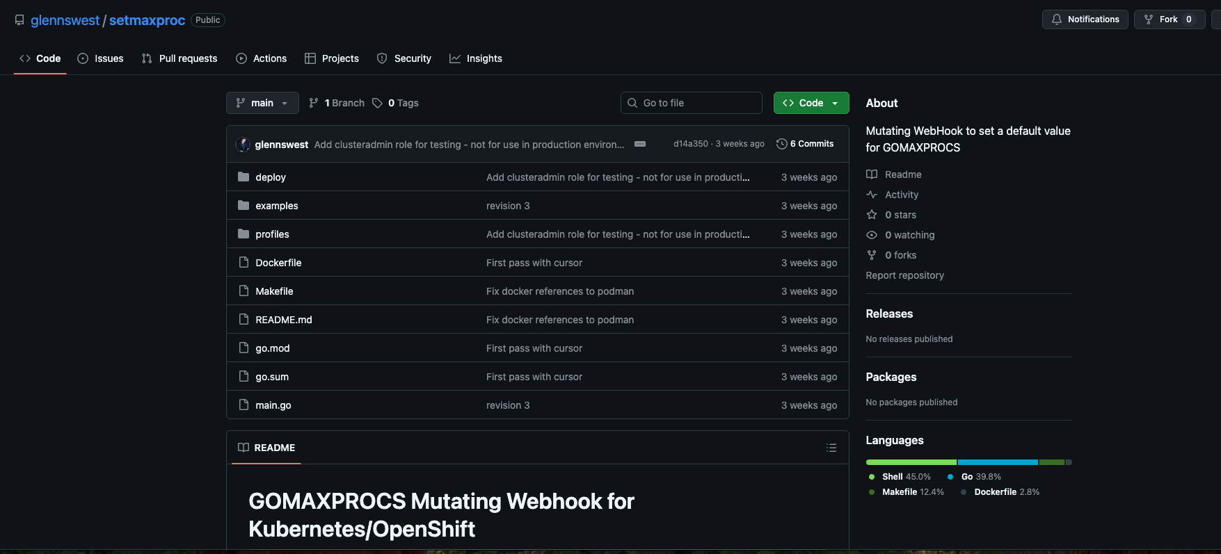
Source of project
https://github.com/glennswest/setmaxproc

Slide 22
The other side of this
The “Cursor” studio is a poor implementation of Microsoft Visual Studio Code.
Should be a plugin like everything else.
History – In ai, there is a need to save the “history” of what you ask, to be able to replicate it. In Cursor this is in a sqlite database, that you will need 3rd party tools to extract.

Slide 23
Additional Features needed:
Implementation as a plugin.
Implementation to save history in format that is readable, and reusable, that can be part of version control.
Including doc in readme or a link

Slide 24
AI Whispering
Random Implementation
Knowing how to phrase your question is important. This is your only control to what you will get.
What version it supports Is totally undefined.
This is a common issue across AI’s, where there is no concept of version ie openshift version included in model. Some are getting better, with a comment to the effect, but still this is a blocker.
AI assumptions may totally be different that your expectations.

Slide 25
New Concept
Debugging gets to be more interesting
Traditional model of stubbing, and working thru each section of code goes away, its “woosh” and your left to find your way thru your completed project.

Slide 26
Conclusion
Great Tool along the way
Still rough around the edges
Huge productivity increase – 2 weeks to 2 hours for development
Debug/Test may have gotten worse, still not enough time to debug it.
Far Better doc
Need to polish further AI whispering.

Slide 27
Code:
https://github.com/glennswest/setmaxproc

