Slide 1


OVN Changes 2h-2021
Glenn West
gwest@redhat.com

Slide 2
NorthD Results
Logical Flow count on 120 node test database from 1.5m to 50k
Southbound DB no longer a bottleneck @ 120 nodes
30% decrease in northd iteration times

Slide 3
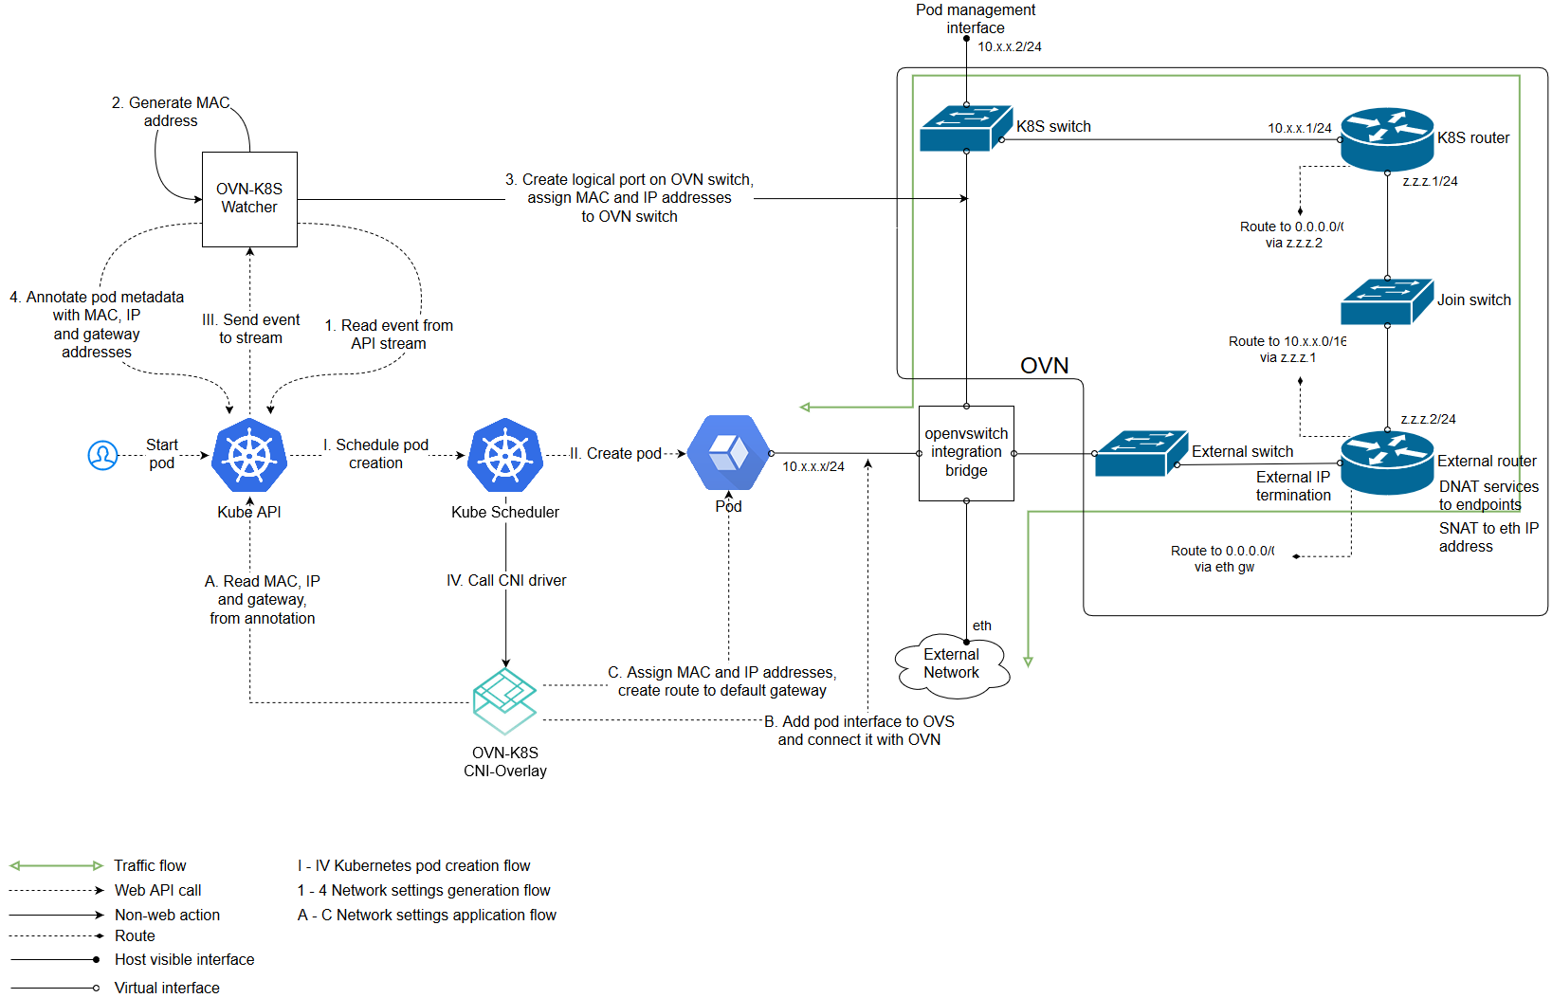
Enhancement and Fixes
15 major Enhancements to NorthD
10 major enhancements to Database
10 major enhancements to ovn-controller
Major Database Architecture change to Database

Slide 4
NorthD – ARP responding for LB Vips
OVN builds too many lflows for ARP responding for load balancer VIPs
In Test cluster with 250 nodes with ovn2.13-20
850K flows are reduced to 350k flows
Reduced Database from 500MB to 200MB
BZ 1945415

Slide 5
NorthD – refactor unreachable Ips lb flows
Refactor code for unreachable IPS for vip load balancers by inverting the logic during the lb flow creation.
Reduce the ovn-nortd loop time of +/- 3 seconds in a production environment
BZ 1988554

Slide 6
NorthD – Use Distributed Gateway Port for ovn-controller scalability
The following changes each show significant performance and scalability improvements:
Remove calculation of ha_ref_chassis
Removes unnecessary get_local_datapath
Don’t Flood fill local datapaths beyond DGP boundary
90% reduction of CPU and Memory
Multiple upstream patches

Slide 7
Northd: Rework and optimize reconciliation of datapath groups
Remove the creation of a new identical datapath group. For a new flow.
Don’t check datapath groups in full if not needed – Saves multiple seconds in production size system for this loop
Multiple upstream patches

Slide 8
NorthD – process load balancer defrag flows once for all routers
Change to creating the matched strings for each LB VIP exactly once, instead of once per datapath, reducing CPU usage in the event processing loop.
In a 120 node system this reduces event processing loop time in northd from 9.5 seconds to 8.5 seconds.

Slide 9
Northd - Don’t merge ARP flood flows for all (unreachable) Ips
Change to install individual flows, one per IP, for managing ARP/NO Traffic flows towards router owned Ips that are on the logical port connecting the switch.
Reduced time to install all releveant openflows for a single pod from +/- 6 seconds to 100msec

Slide 10
NorthD – Fix extremely inefficient usage of lflow hash map
Change the hash table size from a fixed 128 entries to max last seen entries.
Can reduce startup time from > 15 Minutes to 11 seconds
This also could reduce some possible failures due to the long processing time.

Slide 11
Northd Results
Logical Flow count on 120 node test database reduced from 1.5m to 50k
Southbound DB is no longer a bottleneck @ 120 nodes
30% decrease in northd iterations times

Slide 12
Database – RAFT heartbeats during compaction
Frequent southbound DB leader elections in large scale scenario (250 nodes)
Can occur in 100 node cluster
Shows as connection dropped
Note this is in 4.8.z
Alternative fix is to do a controlled change to another master for compaction.
BZ 1943631

Slide 13
Database – Avoid unnecessary re-connections with updating remove
The current implementation can cause a storm of reconnects, as well as reloading database content creating high load on database servers.
Corrected by saving if its still in list of remotes
This should increase stability of cluster reducing load during recovery or network issues.
Upstream patch

Slide 14
Database Results
50% memory usage reduction
75% CPU usage reduction
RAFT cluster stability increases

Slide 15
Database: Two-tier/Relay Architecture
Relay architecture
Multiple database server proxy for a Raft Cluster
Proxy forwards OVSDB transactions between RAFT Members and a subset of clients
Client load is distributed to a arbitrary number of cattle databases
Allows the HA members to be isolated from load
Increases Stability of Cluster
Relay Service Model – see: https://docs.openvswitch.org/en/latest/ref/ovsdb.7/

Slide 16
Ovn-Controller – ovn-controller should update OF rules atomically
Old methodology – Remove old rule, on next cycle add new rule
Caused app dataplane to be down
Caused Packet loss
New methodology – Remove and add new in same cycle
Avoids creating additional version of OF tables
BZ 1947398

Slide 17
OvnController - Result
Huge memory Usage Reducation in ovn-controller and ovs-vswitched
Large reduction in CPU uage in ovn-controller and ovs-vswitched
Large decrease in latency to install flows for OVS

Slide 18
For Further Info:
https://docs.google.com/document/d/1c5eQM4rVTLjns6smkvD1-hpbbNPx5-jJTo8rD3Zz7G8/edit
This document: https://github.com/glennswest/presentations/ovn-2h-2021.pdf

