Slide 1
OCP 4.6 High Partition Saving
GWEST@REDHAT.COM
August 11, 2020

Slide 2
New Install Image
4.6 RHCOS now ships with the root fs and the initrd images separate.
In some pxe enviornments the size of the rootfs caused a slow down.
You can combine the installinitrd and the install root fs, but still will be slow
Or you can add:
coreos.live.rootfs_url=http://tftp.gw.lo/rhcosinstall-rootfs.img
.sig file needed or insecure flag needed
coreos.inst.insecure=yes

Slide 3
Multi Images for PXE Boot
root@GSWSYN:/volume1/tftp/pxelinux.cfg# cat 01-00-50-56-1f-25-25
default coreos
prompt 0
timeout 1
label coreos
kernel rhcosinstall.vmlinuz
append console=ttyS0,115200n8 ip=ens192:dhcp rd.neednet=1 initrd=rhcosinstall-initramfs.img coreos.live.rootfs_url=http://tftp.gw.lo/rhcosinstall-rootfs.img coreos.inst.insecure=yes coreos.inst=yes coreos.inst.install_dev=sda coreos.inst.image_url=http://tftp.gw.lo/rhcos-bios.raw.gz coreos.inst.ignition_url=http://tftp.gw.lo/bootstrap.ign xdata=http://tftp.gw.lo/gs-node.json ignition.config.url=http://tftp.gw.lo/create-datastore.ign create-datastore ignition.platform.id=metal ignition.firstboot coreos.inst.save_partindex=5-

Slide 4
Argument Walk thru of pxeboot
No signature file used – then need coreos.inst.insecure=yes
There is now a initrd, and a root fs in 4.6:
initrd=rhcosinstall-initramfs.img
coreos.live.rootfs_url=http://tftp.gw.lo/rhcosinstall-rootfs.img
Rootfs is loaded using the rhcos-install live image
2 Ignition Files Now – Install Live Image Ignition and Target System Igntion
ignition.config.url=http://tftp.gw.lo/create-datastore.ign create-datastore
ignition.platform.id=metal –Required on bare metal, and also speeds things up

Slide 5
Ignition At Install Time
4.6 now uses a Live RHCOS image
ignition.firstboot – trigger the run of ignition at install time
Uses: ignition.config.url= as install time ignition
Uses of Ignition at install time (Actual Beta Customer Use Case)
Adding data partition if it does not exist
https://gist.github.com/bgilbert/f5a3359b2e2e53d008876798837c933c
Costomer Specific perm system data:
By putting a reference in the install time ignition a file may be added to the resulting system. Beta Customer used it to pass data from there config management system to each physical node. (Originally this was done separately in classic installer)

Slide 6
Timing
Expected Time of boot to shorten, still over 100+ seconds, need to explore why. (Change nic may result in this getting shorter.)
Tested time: 95 seconds for download of root partition

Slide 7
Using Install Time Ignition with Live Image
New Installer is based on a Live RHCOS Image
Can use ignition twice
Once in install time
Once in first boot of Installed image
Example Provided and Should be documented is:
https://gist.github.com/glennswest/f764128cdf7331fa7e79ff2a187412e4

Slide 8
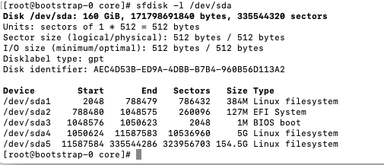
Test Case – Install on clean disk
Ran a PXE Booted clean install – (ie empty disk)
Saw ignition kick off and run provided script
To debug – Turn off the reboot at end of install
Result:

Slide 9

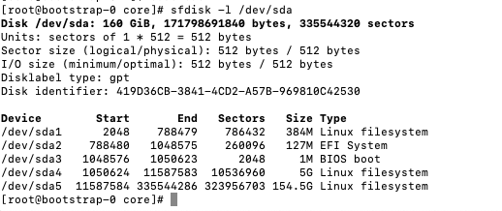
Test Case – Verify partition retention
Delete MBR and all partitions:
Script:
Script and Partition Table Used:
https://gist.github.com/glennswest/77105e67828b345a9d1edf87d5bbcd63
Result:

Slide 10
Test Cases
Verify and Document new separate root/initrd pxe boot works
Verified
Verify and Document new bare metal pxe boot arguments
Verified and Documented
Single Node – Clean Disk, verify new partition 5 is created
Verified and Documented

Slide 11
First Working OCP 4.6
Found a problem with create-datestore example
Change it to default to 100Gig
https://github.com/glennswest/rhcos-datastore-tools
Validated using openshift-sdn

Slide 12
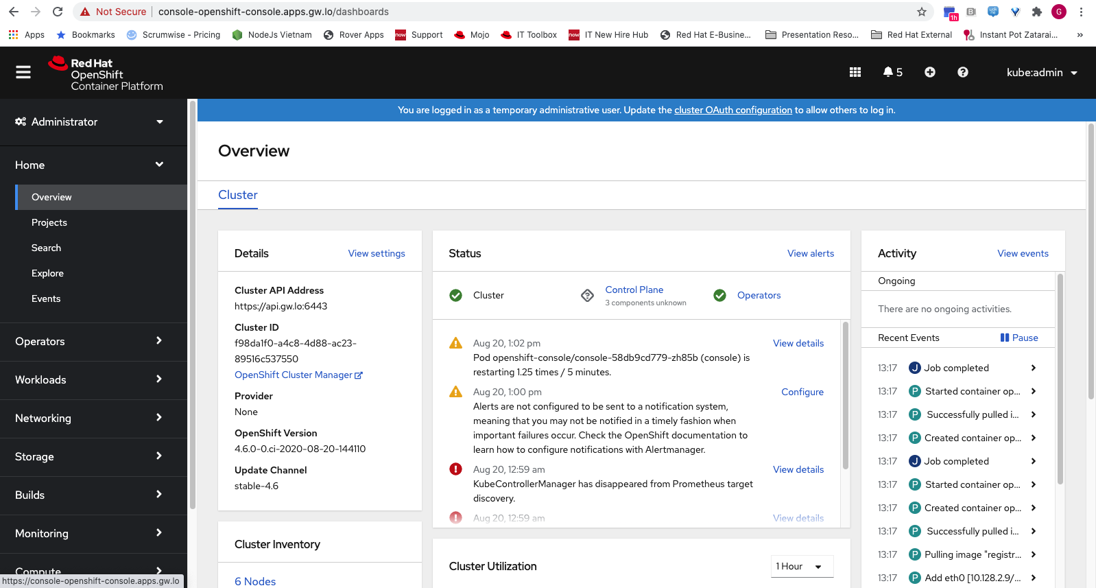

Slide 13
