Slide 1


Pod Restarts – How to get your App to keep going
Glenn West
gwest@redhat.com

Slide 2
Overview
OpenShift defaults to scheduling pod to node one time.
Pod will stay on node thru pod reboot, or node failure. On boot - pod will continue
This is upstream Kubernetes default.
To have a different behavior, settings of application/pod need to be adjusted.

Slide 3
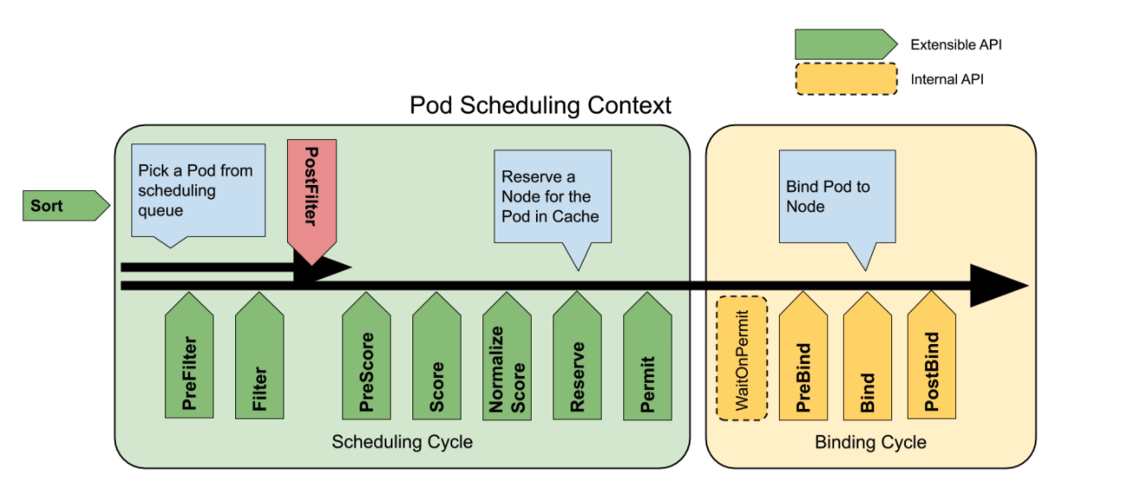
Pod Life Cycle

Slide 4
Test Setup
5 Node Cluster – 3 masters – 2 workers – Bare metal Install – UPI - PXE
Openshift 4.7.24
External “Traffic” manager like load balancer (ie dns level load balancer)

Slide 5
Test Application
Rezex is the test application
Golang Implementation
Simple REST Server
Implemented with a two-stage build – container is 6.52mb (Bare container – NO OS)
Handles Health Checks
Two possible usage models – Simple pod, or With a Replication Controller
Example is at: https://github.com/glennswest/rezex

Slide 6
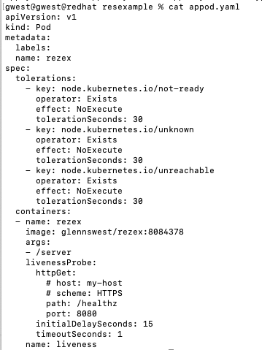

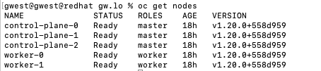

Simple Pod – With Taints

Slide 7

App With Replication Controller

Slide 8
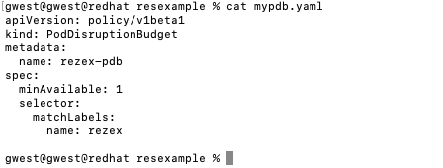
Adding a Pod Disruption Budget

Slide 9
Running Test
run.sh
oc delete project/rezex
sleep 15
oc new-project rezex
oc create -f app.yaml

Slide 10
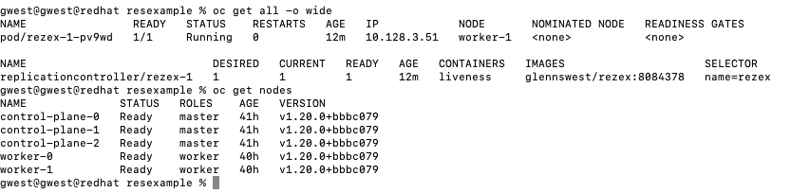
After Run

Slide 11

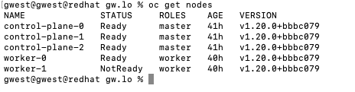
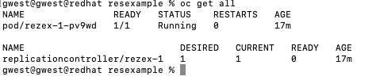
Perform Test

Slide 12
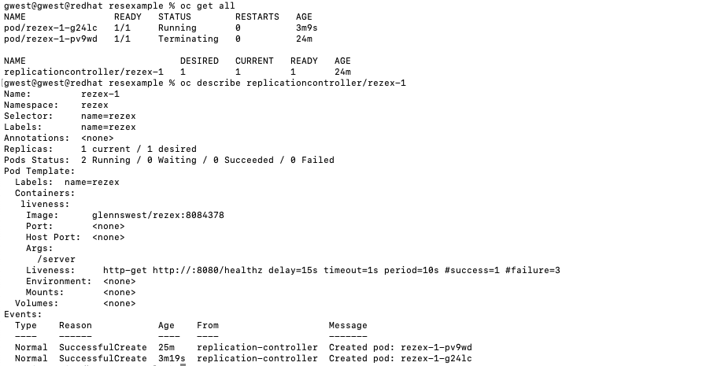
Success State

Slide 13
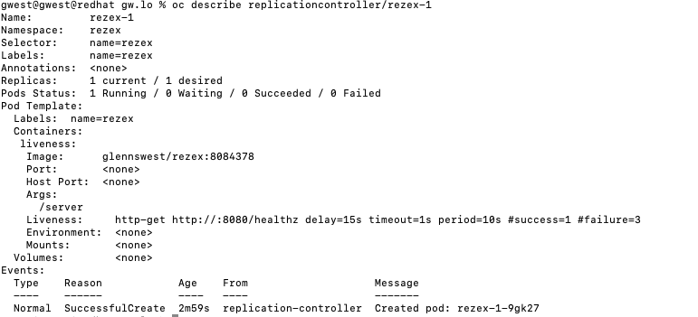
Replication Controller Status

Slide 14
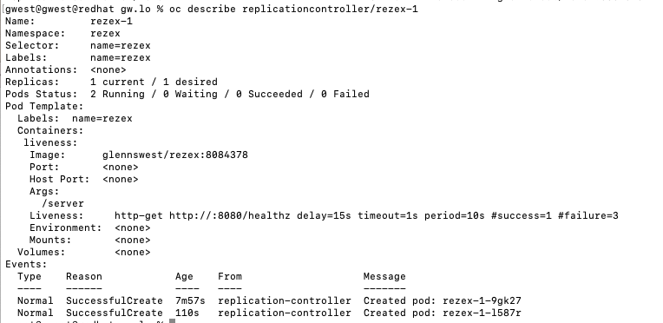
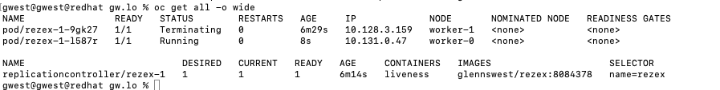
Application Restarted

Slide 15
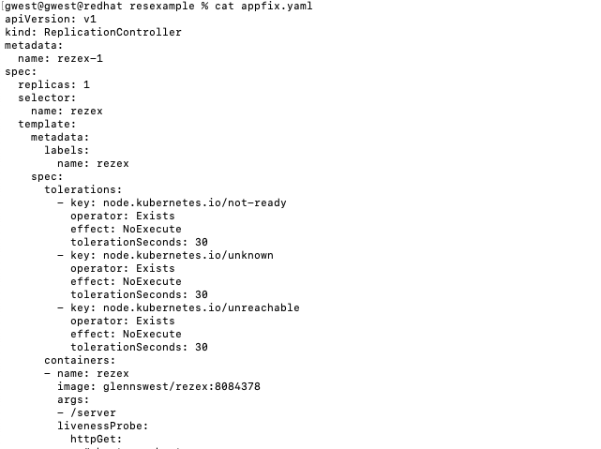
Implement a Replication Controller
Its job is to monitor that you have x pods up. And to reschedule pods based on your configuration.
Replication Controller Doc

Slide 16
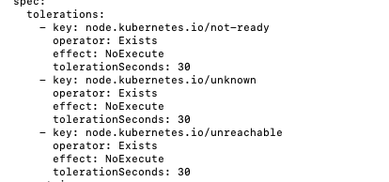
Best Practices - Taints
Add Taints to Apps
Affects Recovery Time
Watch out for recovery times vs transient
Taints and Toleration Doc

Slide 17
For Critical Apps – Pod Disruption Budget
Sets how many pods must be up
Set the minAvailable
oc get poddisruptionbudget --all-namespaces
Pod Disruptrion Budget Doc

Slide 18
Issues and Problems
When using a replication controller – need to make sure nfs mounts mode are set such that the container can use its pvc
Make sure you balance your recovery time with temporary node unavaialbe
Be aware of pod life cycles issues

Slide 19
Pod Life Cycle
In testing, you will notice that the terminating pod stays in a terminating state.
It will fully terminate once the node reboots.
This is a known issue, and is partially resolved in some releases of 4.7 and fully resolved in later 4.8 releases, and all 4.9 releases
https://access.redhat.com/solutions/6331221
https://bugzilla.redhat.com/show_bug.cgi?id=1952224

