Slide 1


Multi-Node Assisted Installer OpenShift
Glenn West
gwest@redhat.com

Slide 2
Prereqs
Install OCM API
DNS Entries
Bios
DHCP
Disk / ISO

Slide 3
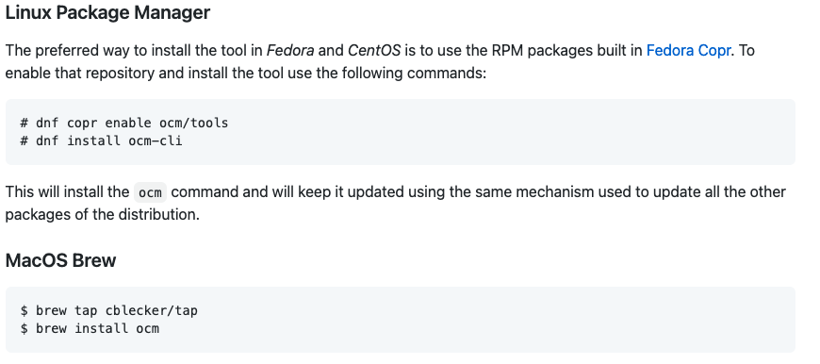
Install OCM Tools
https://github.com/openshift-online/ocm-cli

Slide 4
Create Cluster Manager API Token
Go to https://cloud.redhat.com/openshift/token
Copy token and use it to login:
ocm login --token (with token from https://cloud.redhat.com/openshift/token)

Slide 5
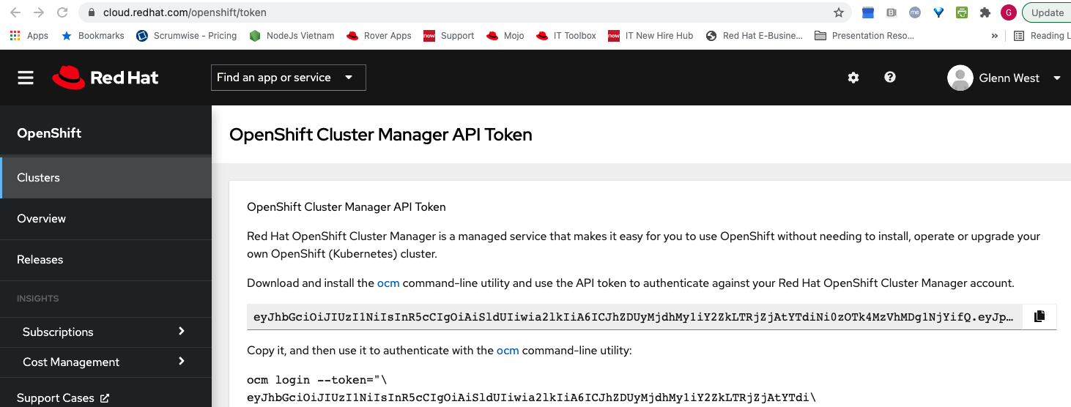

Slide 6
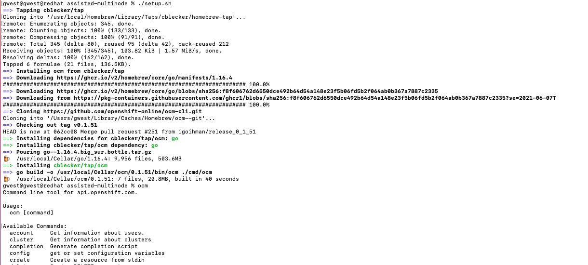

Slide 7
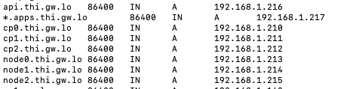
DNS Setup
8 entries
Api entry
Qty 6 Node entry
App wildcard

Slide 8
DHCP Settings
add code=12 name=hostname-cp0.thi.gw.lo value="s'cp0.thi.gw.lo'"
add code=12 name=hostname-cp1.thi.gw.lo value="s'cp1.thi.gw.lo'"
add code=12 name=hostname-cp2.thi.gw.lo value="s'cp2.thi.gw.lo'"
add code=12 name=hostname-node0.thi.gw.lo value="s'node0.thi.gw.lo'"
add code=12 name=hostname-node1.thi.gw.lo value="s'node1.thi.gw.lo'"
add code=12 name=hostname-node2.thi.gw.lo value="s'node2.thi.gw.lo'"
add address=192.168.1.210 dhcp-option=hostname-cp0.thi.gw.lo,dns-dev \
mac-address=02:82:91:DB:07:DF
add address=192.168.1.211 dhcp-option=hostname-cp1.thi.gw.lo,dns-dev \
mac-address=02:0D:FD:A5:30:A5
add address=192.168.1.212 dhcp-option=hostname-cp2.thi.gw.lo,dns-dev \
mac-address=02:F5:5B:52:CA:AE
add address=192.168.1.213 dhcp-option=hostname-node0.thi.gw.lo,dns-dev \
mac-address=02:1D:50:4E:18:57
add address=192.168.1.214 dhcp-option=hostname-node1.thi.gw.lo,dns-dev \
mac-address=02:39:75:BA:78:04
add address=192.168.1.215 dhcp-option=hostname-node2.thi.gw.lo,dns-dev \
mac-address=02:C2:2B:C7:0D:E3

Slide 9
create_cluster.sh
Delete any existing cluster from cloud.redhat.com (using saved id from last run)
Powers off existing Machines
Erases drives on all nodes
Creates Cluster
Customises cluster with VIP’s
Optionally enables OVN
Creates and Downloads Discovery ISO

Slide 10
create_cluster.sh
Move ISO to mount point
Powers on Masters
Wait for them to be discovered
Powers On Workers
Wait for them to be discovered
Wait for cluster to get synced
Start Install

Slide 11
Features
Can work for any version. (Only need version number - latest is automatic)
Only one download – discovery – OS is automatic from there
Any number of nodes from 3 masters to 3 Masters and any number of nodes.

Slide 12
Customizations
Install-config is fully customizable
Manifests may also be modified
Different Network Stacks Supported
Redhat SDN
OVN
Calico
Dual Stack (Coming soon)

Slide 13
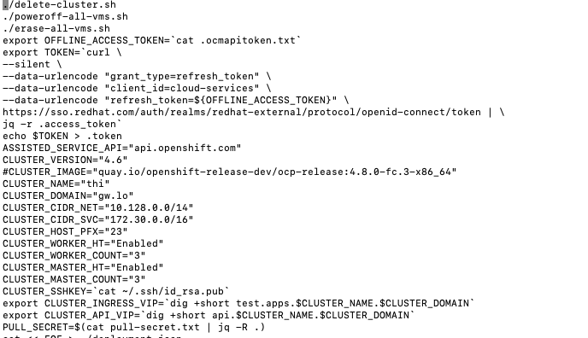

Slide 14
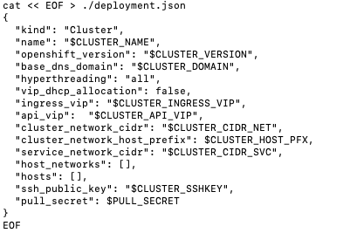

Slide 15
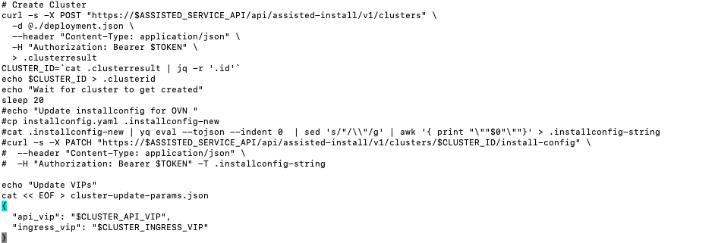

Slide 16
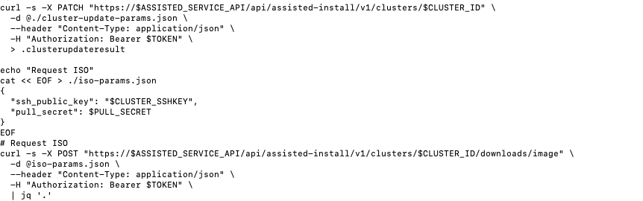

Slide 17
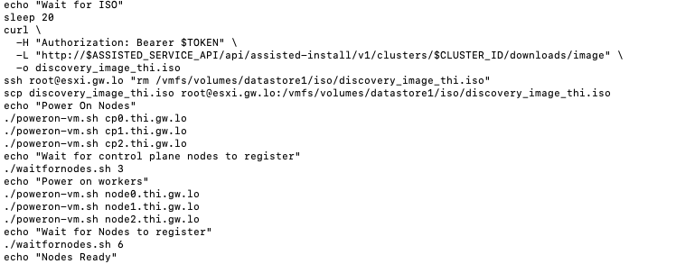

Slide 18
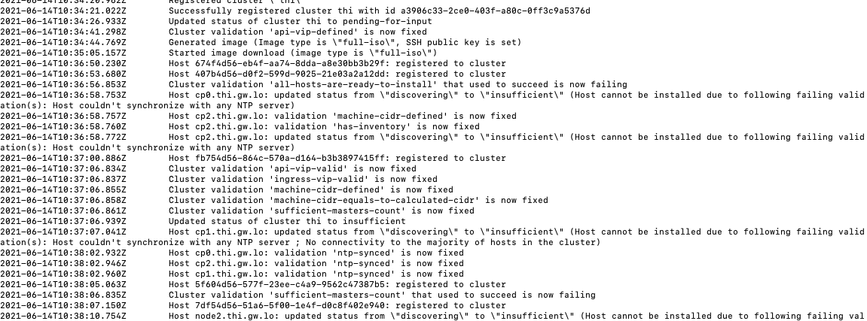

Slide 19
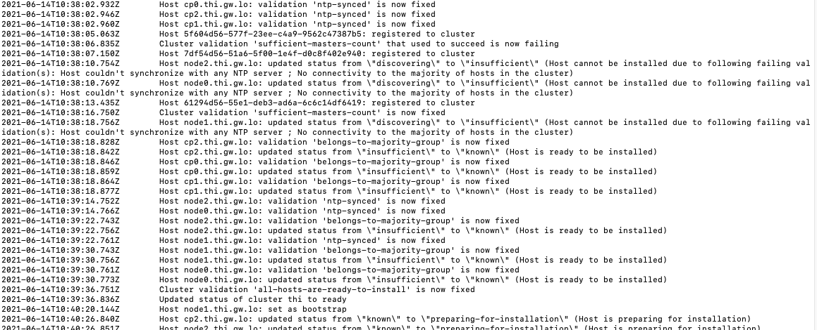

Slide 20
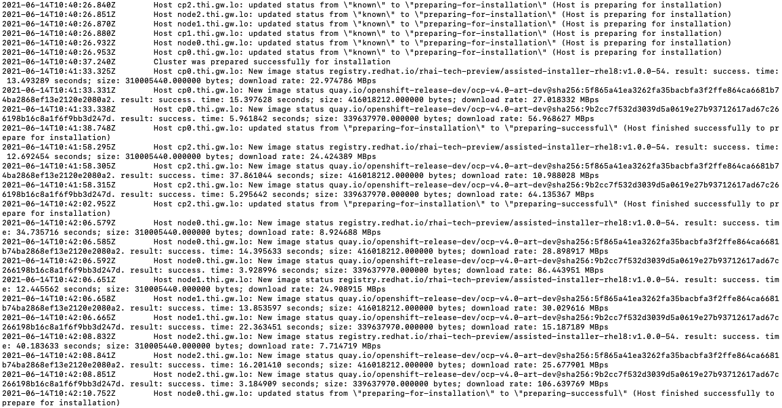

Slide 21
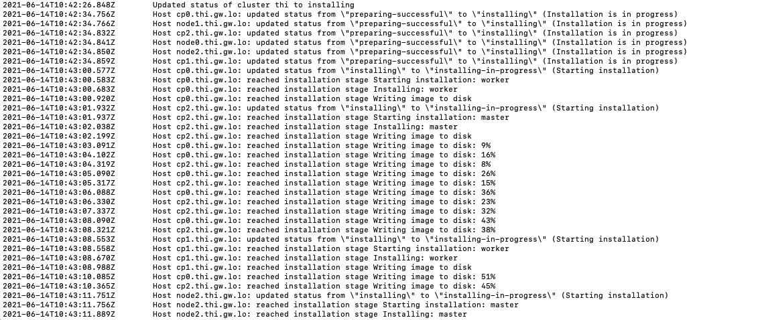

Slide 22
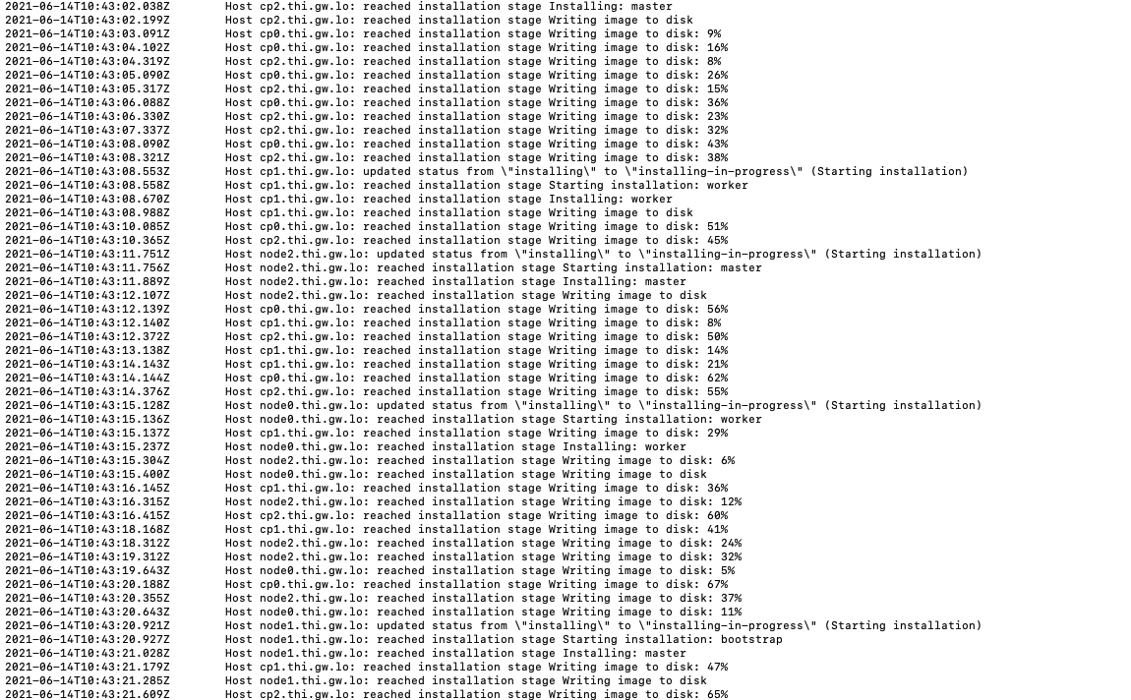

Slide 23
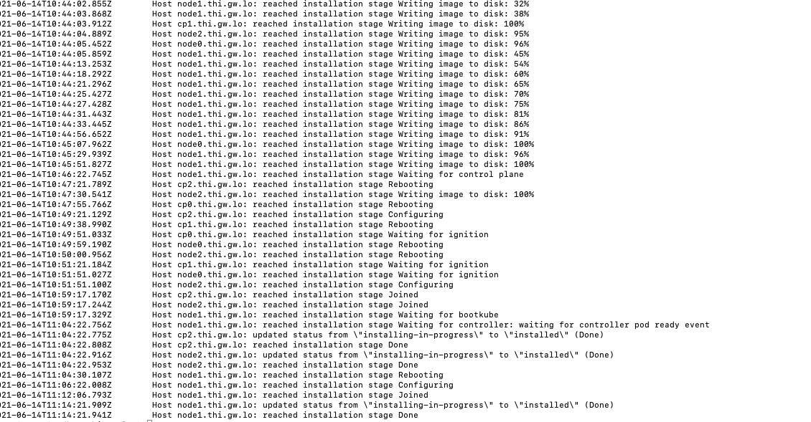

Slide 24
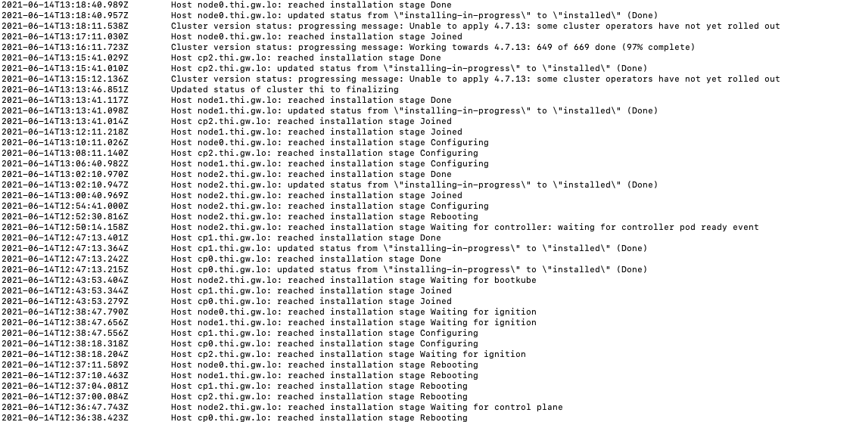

Slide 25
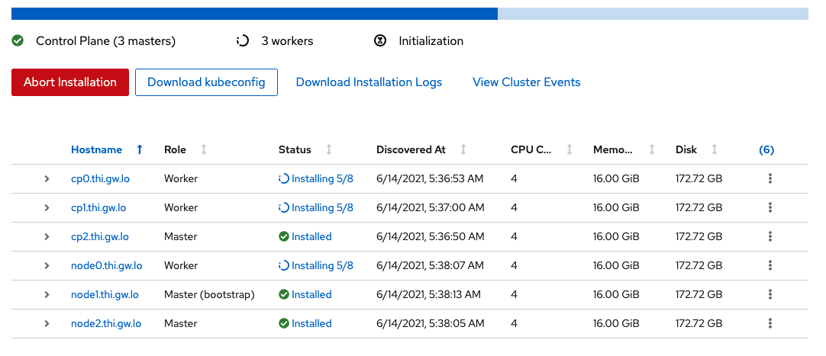

Slide 26
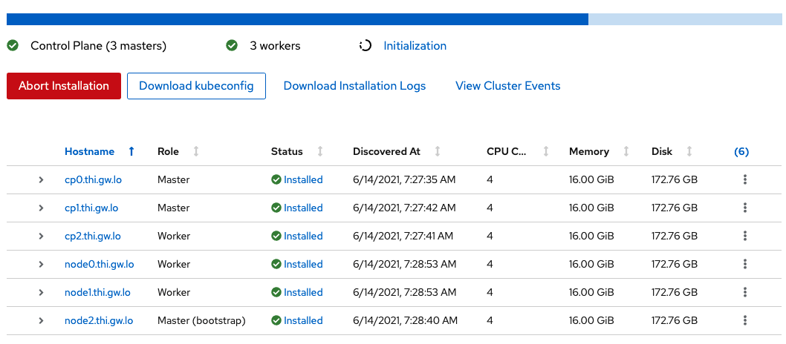

Slide 27
Issues
Must set the roles – Automatic mode is not deterministic
No validation of pull-secret – Just lazy fail after a long time
Must manually set roles – (tbf)
Latest seems not to work
Reboot of worker during install didn’t work – manual one need (tbf)
Further Testing

Slide 28
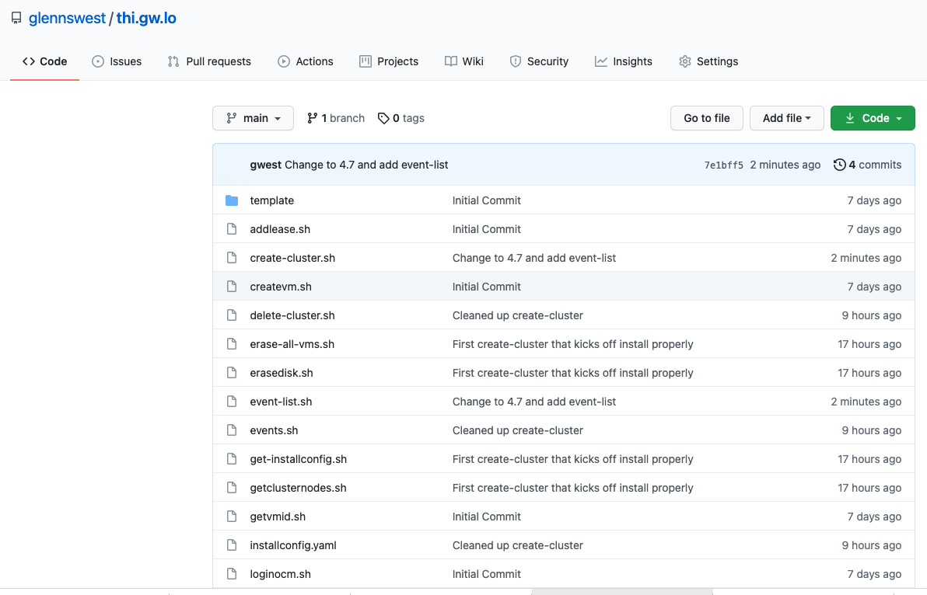
For More Info
https://github.com/glennswest/thi.gw.lo

