Slide 1
COSC 6376 Project An Investigation into AWS File Systems (EC2 and S3)
Daniel Fernandez
Glenn Turner

Slide 2
Motivation
No experience
Block Storage
vs
Object Storage
Elastic Block Store
Simple Storage Service
Data Storage
is critical
Notes:
1. “No experience with storage services presented in class”
2. “Amazon Web Services has a bewildering collection of file system choices”
“AWS offers many choices. We focused on 2 of their storage services”
3. “These seem to be interesting and possibly new ways of manipulating data in storage.”

Slide 3
Experimental Apparatus
Simulate actual work conditions
Fairly large amount of IO operations
Control over the record size
File systems on most computers are block devices
Naïve: Hoped that EBS may offer some additional IO capability
Additionally, retrieving blocks of storage, as objects, by an identifier seems appealing
Notes:
IO operations:
- Write: 2.4+ million records
- Read: 215,000 records
Record sizes: BLOCKSIZE, LRECL, DRECL

Slide 4
Experimental Data
List of registered voters in Harris County (obtained via FOIA request)
2.48 Million records
In apparent random order
List of voters in the county election of 2021
In-person & Mail-in voting
Data in order of votes received (apparent random order)
Used a sample of 215,000 of these voters.

Slide 5
Constructing the Database
Registered voter list: csv file (2.48 Million records).
Python dictionary: Built to keep track of where records are stored.
Key: Voter ID
Value: (Block number, Offset)
Block Storage:
Records are padded
Records embedded into larger physical records
Object Storage:
Records are not padded
1+ voter records embedded into objects
Notes:
“padded to a predetermined length”
“the location of the data record as a physical record number and the offset into that physical record. “

Slide 6
The Data Records
Dictionary Entries
The binary physical records are all the same size.
This is a program parameter.
To save the dictionary the entries are written into the physical records.
Part of the experiments conducted was to examine the size of the physical records
Data Entry

Slide 7
Operations we examined in EBS
Build the Database
Build dictionary
Write dictionary
Build Database
Using the Database
Read dictionary from file
Fetch records in the Database
Heavily dependent on compute power
Mix of compute and IO
Heavily dependent on compute power
Vastly influenced by IO time
Notes:
Fetch records in the database “according to our sample of 215,000 voters (that voted in 2021 Harris county election)”
Build Dictionary and read dictionary from file seem to be slow irrespective of disk speed, they are probably compute intensive due to creating hash codes

Slide 8
First Results
Notes:
What to beat

Slide 9
Instance Types Tested
Designation | Characteristics | Cost
t2 micro | 1 Core, 1 thread,1 GB , 2.5 GHz, 1 MB | Free
t3 large | 1 core, 2 threads, 8 GB, 2.5 GHz, | $0.0832 /hr
d3 xlarge | 2 cores, 4 threads, 32 GB, 2.5 GHz | $0.499 / hr
I4 xlarge | 2 cores, 4 threads, 32 GB, 2.9 GHz | $0.343 / hr

Slide 10
Different Instance Types
This is the most compute intensive task for various instance types
* With a physical record size of 4096

Slide 11
Disk Types Tested
Designation | Measured Speed (buffered read) | Size
GP2 | 81.3 MB /sec | 8 GB
GP3 | 260 MB /sec
IO2 | 330 MB /sec | 10 GB*
D3 | 181 MB /sec | 1.8 TB**
I4 xlarge (Nitro) | 1050 MB / sec | 800 GB**
Speeds determined with the command hdparm –Tt
When Creating an instance the size and type of volume to go with it are selectable with these exceptions
* The 1.8 TB disk is added automatically
**This is a secondary disk automatically added

Slide 12
Different Disk Types
This is randomly retrieving the records T3 large
The keys are stored in an array, so there is no other IO

Slide 13
Different Disk Types
This is randomly retrieving the records
This reading key file

Slide 14
Best Results
Notes:
What to beat

Slide 15

AWS S3: Cloud Storage Service
Scalable
Highly available
Durability: 99.999999999%
Stores and retrieves any type of data via internet
Virtually limitless storage
Most widely used cloud storage service
Used by millions of businesses and organizations worldwide
Notes:
Alright, so S3 as we know is scalable, highly available, absurdly durable, can be used for any type of data, and can store a lot.
Furthermore, it is used by millions of businesses and organizations worldwide
So, we decided to test it out and check its performance.

Slide 16

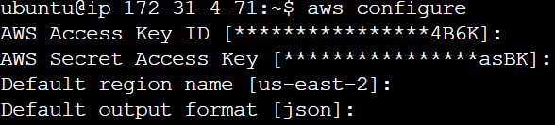
AWS CLI: Programmatic Access to Services
Tool. Helps users interact with AWS services from the command line
e.g., create, update, delete, and controlling access
Supports multiple OS
e.g., Windows, Mac, Linux
For developers and administrators to automate tasks
Notes:
Now, to access this bucket, we used the AWS CLI and python module boto3.
We also used IAM keys with specific permissions for S3 for security best practices and to resemble work conditions.

Slide 17
Comparison of Space Used
S3 uses 76% compared to EBS
 | Record Size (B)
Min | 75
Avg | 97.417
Max | 128
Notes:
Taking a look at the amount of space used by each, we see S3 is much better The reason is quite simple: The average record size is about 97 B, but in block storage, all of them are put in 128 B blocks.

Slide 18
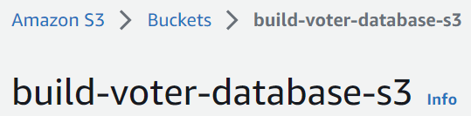
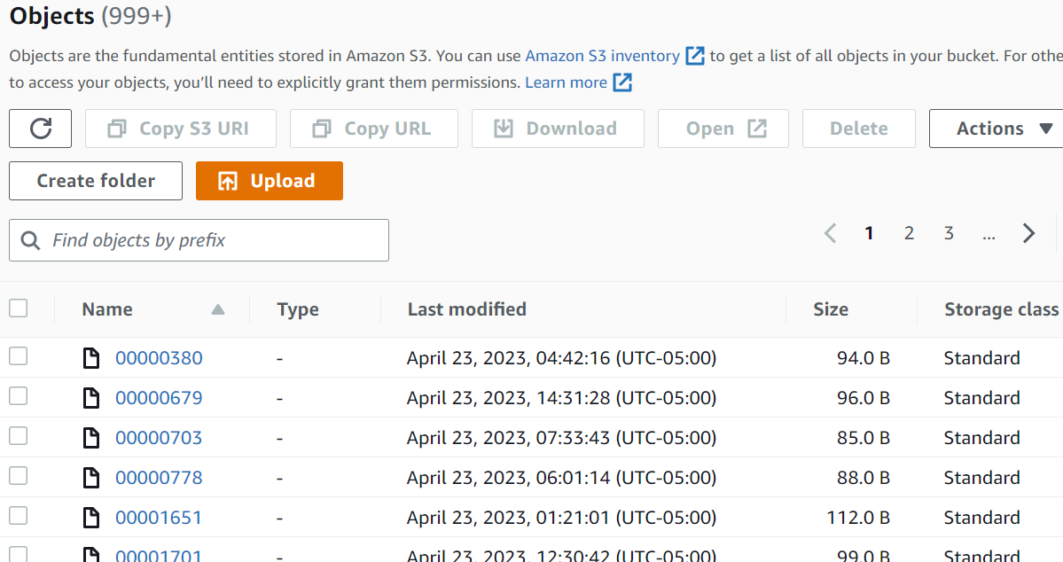
First Attempt
1 record per object
2.48 Million Objects
Build Time: ~15 hours!
Read Time: ~10 hours!
Notes:
Anyway, we first tried to have each object be a voter record (with the filename being the voter id).
And, well, these are impressive numbers.. but not in the right way.
| As such, I tried to reduce this by reducing the number of objects (that is, by increasing the number of records per object).
For this however, we will need to also build a dictionary for each record’s location within the objects.

Slide 19
Location Dictionary
Object
1 object → Many records
Records separated as lines
Voter records are not all the same size.
Dictionary:
Voter id → (Object #, Offset)
Python module linecache
Attempt to optimize random access of a line (voter record)
Voter Record
Notes:
Put simply, this dictionary refers to the object and line number to find the exact record in the S3 bucket.
Additionally, we ended up using linecache to improve random access of a line in a downloaded object.

Slide 20
Different Object Sizes
Average Build & Read process time: both < 10s
Notes:
Between 1, 10, and 100, relatively speaking, there does not appear to be a huge difference.
One might hope that it’s because It grows logarithmically, but once we get 1000 objects, such hopes are no longer plausible.
However, this is not actually the true amount of time that it takes.

Slide 21
Different Object Sizes
Actual Time is in the 100s of seconds!
Build Time: ~28x
Read Time: ~14x
Notes:
The actual time is instead in the 100s of seconds, with the average build time and read time being multiplied by 28 and 14, respectively.
Now, all this additional time is the time it spends waiting for the S3 objects it requested.

Slide 22
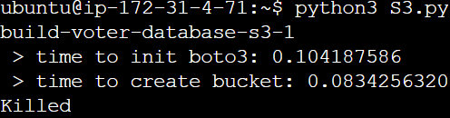
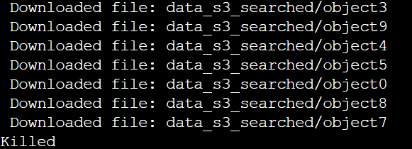
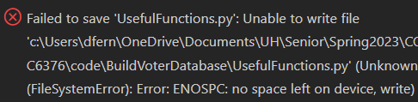
S3 Challenges
Time performance not meant for many operations at a time
Especially with many objects in bucket (even if 1 object → 1 voter record)
Substantial time to get results from experiments
Substantial difference in process time and actual time
Occasionally led to EC2 killing the process
Notes:
Overall, the challenges with S3 were due to the time it took.
And because of the difference between process time and actual time, I’ve had the EC2 instance kill itself multiple times, whereas my laptop works fine.
If time permits: > Now, it gets worse.
The times for S3 I’ve showed you are using a shortcut that the EBS experiments did not use.
With the EBS experiments, the total amount of space required is just a single block.
Whenever the S3 experiments attempted the same thing, they took over 24 hours to complete.
So instead, I had to locally store ALL objects requested until the end of the full request for somewhat decent times.

Slide 23
Conclusions
We didn’t see a lot of difference in the GP2 GP3 and IO2 disks. The disks used in the “I” family are faster.
S3 is not suitable for random access.
The expense is non-trivial. Daily use for a single user would rival or surpass purchase of a desktop computer, of course the cloud instance is automatically upgradable without capital investment.

Slide 24
Future Work
We will install a free key-value database on the I4 instance and compare it’s results to the results so far.
If time permits, we will rewrite the program in C++ to allow for easier and faster manipulation of the data.
Possible attempts to improve S3 times:
.csv files instead of binary/octet-streams → python module pandas.
Remove security restrictions for bucket → No need for IAM keys.

Slide 25
Contributions
Glenn – Program Architecture – rough draft – ran EC2 experiments
Daniel – Program Refactoring – made Separate Program with streamlined Architecture for S3 – ran S3 experiments
Both contributed to the slides for this presentation

Slide 26
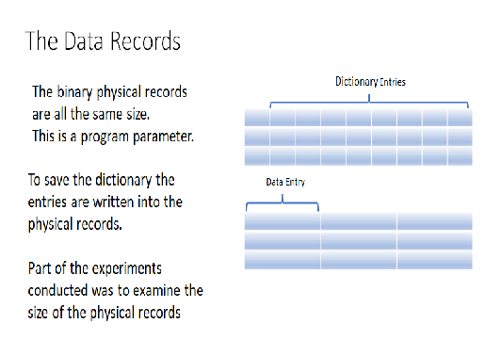
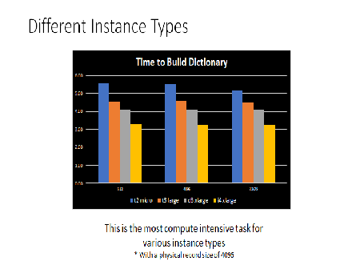
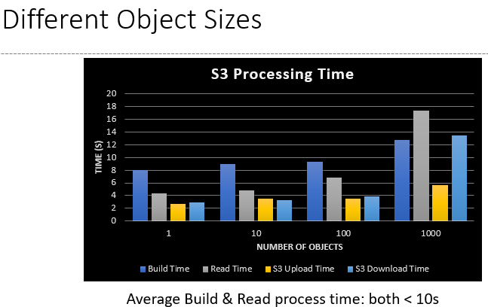
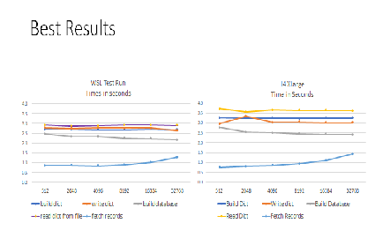
Thank You
Notes:
Change Challenges!

Slide 27
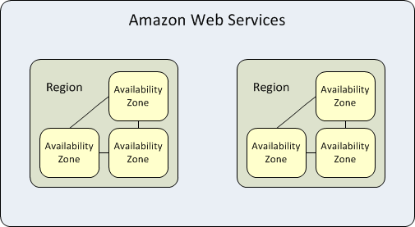
EBS Challenges in Testing
When creating an instance the region may be selected but the Availability zone is not. Volumes may be selected in an Availability zone. A volume created may not be made available to another instance.

