Slide 1
01
Social Media Hate Speech and Toxicity Mining Using NLP
Jigsaw (1.8M) + TweetEval (9K) | 58,954 modeling records | Group 11
WHAT WE BUILT
PROJECT AT A GLANCE
A full NLP pipeline for detecting hate speech and toxicity across social media, covering data acquisition through model evaluation.
7
87.12%
• Two sources: Google Jigsaw Civil Comments (~1.8M forum comments) and TweetEval benchmark (9,000 tweets).
• Final modeling dataset: 58,954 records after stratified sampling and merging.
• Label split: 51.2% non-toxic, 48.8% toxic — reasonably balanced.
• Key challenge: Only 2.6% vocabulary overlap (Jigsaw vs Twitter) creates a cross-platform domain gap.
Models Tested
Best Accuracy
87.39%
4
Best F1 Score
ML Categories
LABEL DISTRIBUTION (MODELING SET)
CROSS-PLATFORM CHALLENGE
Only 2.6% vocabulary overlap — domain gap is the primary generalization obstacle.
Non-Toxic 51.2%
Toxic 48.8%
MEET THE TEAM
HJ
Himanshu Jain
EDA & Clustering
RH
Rahul Hipparkar
Classification & DistilBERT
AJ
Augustine Joy
Feature Engineering & Apriori
GV
Glen Vadakkoott
Regression & Pattern Analysis
GITHUB github.com/glenpaulson/toxicity-mining-nlp
WEBSITE glenpaulson.github.io/toxicity-mining-website
CSCI 5502 Data Mining | Group 11 | University of Colorado Boulder | Spring 2026

Slide 2
02
Models & Methodology — 7 Models Across 4 ML Categories
Jigsaw (1.8M) + TweetEval (9K) | 58,954 modeling records | Group 11
NLP PIPELINE
7 MODELS ACROSS 4 CATEGORIES
1
Contraction Expansion
("don't" → "do not")
CLASSIFICATION
Naive Bayes | LightGBM | DistilBERT | Stacking
REGRESSION
Logistic Regression (also meta-learner)
2
Lowercasing + URL Normalization
@user, hashtag handling
CLUSTERING
KMeans (k=2, Silhouette = 0.0999)
3
Tokenization + Stopword Removal
NLTK english tokens
PATTERN MINING
Apriori (min_support=0.01, min_conf=0.2)
4
TF-IDF Vectorization
50K features, unigrams + bigrams
HYPERPARAMETER TUNING: GridSearchCV for Naive Bayes & LR | Optuna for LightGBM (50), DistilBERT (5), Stacking (30/model)
5
Truncated SVD
50,000 → 200–300 dims
DATA AT A GLANCE
6
StandardScaler Normalization
Zero-mean, unit-variance
Jigsaw
1.77M rows
8.3% toxic | long forum posts
TweetEval
8,954 rows
Balanced | short tweets
Combined
58,954 rows
51.2% / 48.8% split
7
DistilBERT Tokenizer
Raw text → WordPiece (max 128)
DISTILBERT | TRAINER (Optuna)
args = TrainingArguments(learning_rate=trial.suggest_float("lr", 1e-5, 5e-5, log=True), batch_size=batch_size, ...)
trainer = Trainer(model=model, args=args, train_dataset=train_tok, eval_dataset=val_tok, callbacks=[EarlyStoppingCallback(...)])
CSCI 5502 Data Mining | Group 11 | University of Colorado Boulder | Spring 2026

Slide 3
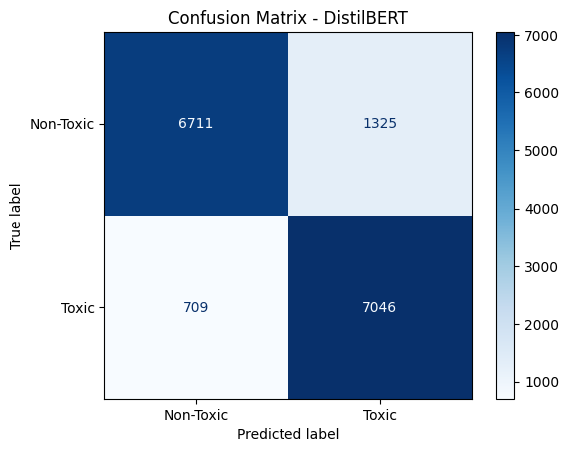
03
Performance Results & Key Conclusions
Jigsaw (1.8M) + TweetEval (9K) | 58,954 modeling records | Group 11
MODEL PERFORMANCE — TEST SET
DISTILBERT | CONFUSION MATRIX (TEST SET)
Model | Acc | F1 | ROC-AUC
DistilBERT | 87.12% | 87.39% | 87.18%
Logistic Regression | 83.90% | 82.71% | 91.49%
Stacking Classifier | 82.29% | 81.54% | 82.24%
Naive Bayes | 77.91% | 77.61% | 77.91%
LightGBM | 76.99% | 75.50% | 76.90%
KEY FINDINGS
01
DistilBERT Dominates
02
Stacking Adds Value
03
Apriori Reveals Patterns
04
KMeans Validates
Context-aware transformer beat all traditional models by 5+ accuracy points.
LR + NB + LightGBM ensemble achieved ROC-AUC 0.898 — beats individuals.
494 toxic vs 454 non-toxic itemsets. Top: {black}→{white}, lift 6.51.
k=2 split (93.5%/6.5%) mirrors class distribution. Confirms binary structure.
✓ DistilBERT (87.12% / 87.39% F1) is the recommended production model.
✓ Cross-platform domain gap (2.6%) — fine-tuning is the next step.
✓ Apriori + classification together provide detection AND interpretability.
CSCI 5502 Data Mining | Group 11 | University of Colorado Boulder | Spring 2026

