Slide 1
Example of MaBoSS use

Slide 2
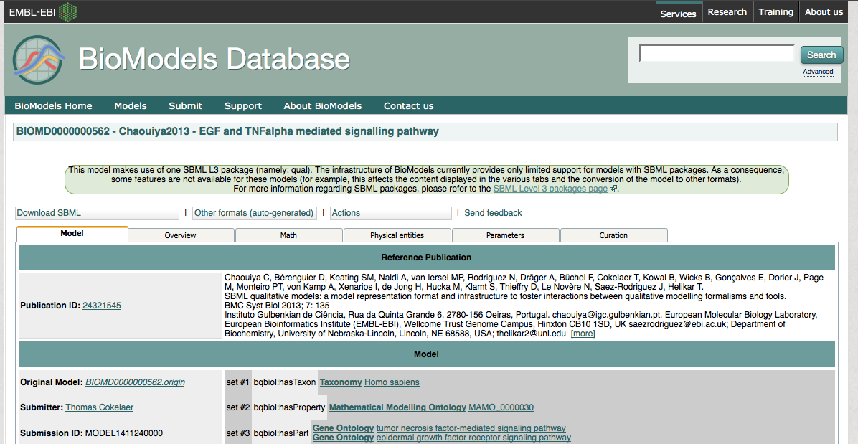
Download a model from BioModels
https://www.ebi.ac.uk/biomodels-main/BIOMD0000000562
Download SBML (L3 V1)

Slide 3
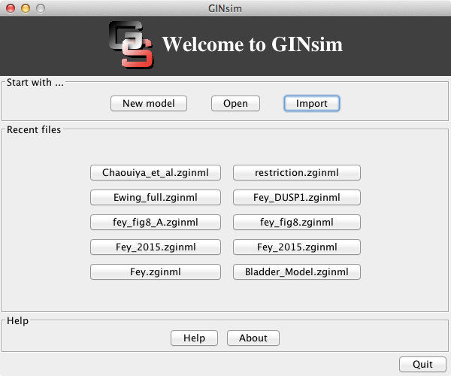
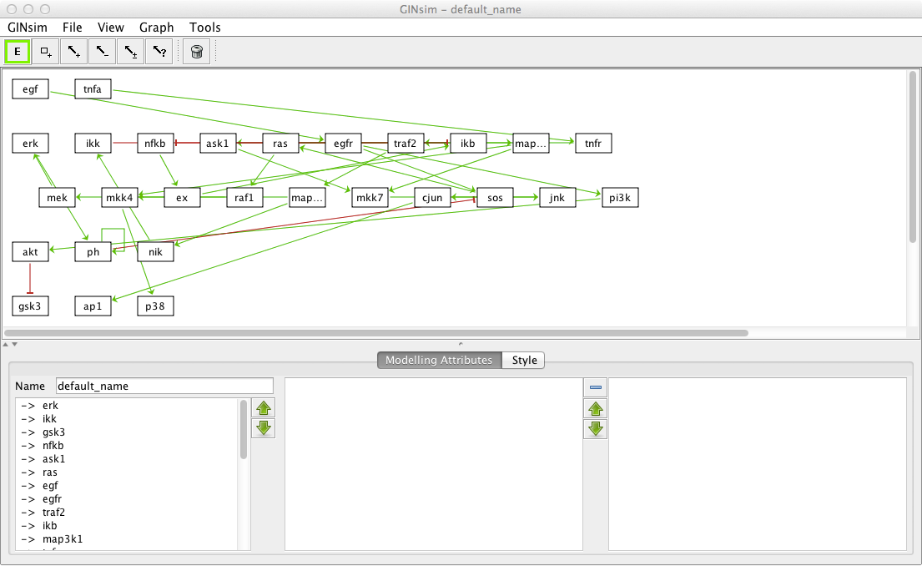
Open the model in GINsim
Open latest version of GINsim
Import => SBML-Qual
Choose BIOMD0000000562.xls
Adapt the layout
(or open Chaouiya_et_al.zginml by selecting File => Open)

Slide 4
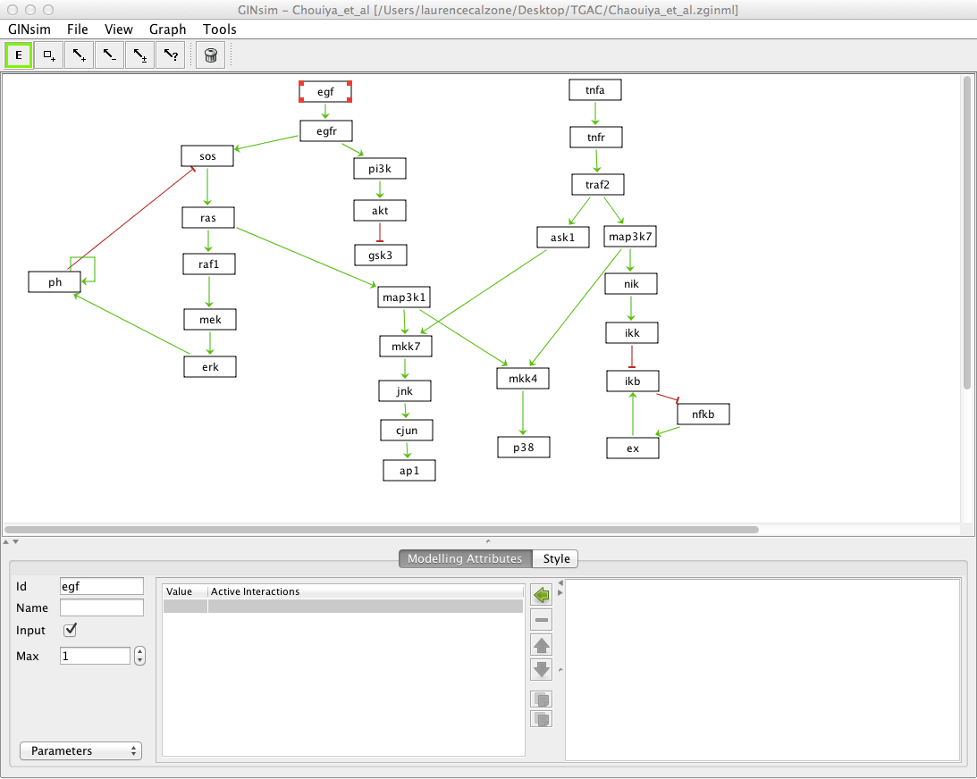
Simulate a model
Select egf and tnfa separately and click on input*
* done for you in Chaouiya_et_al.zginml

Slide 5
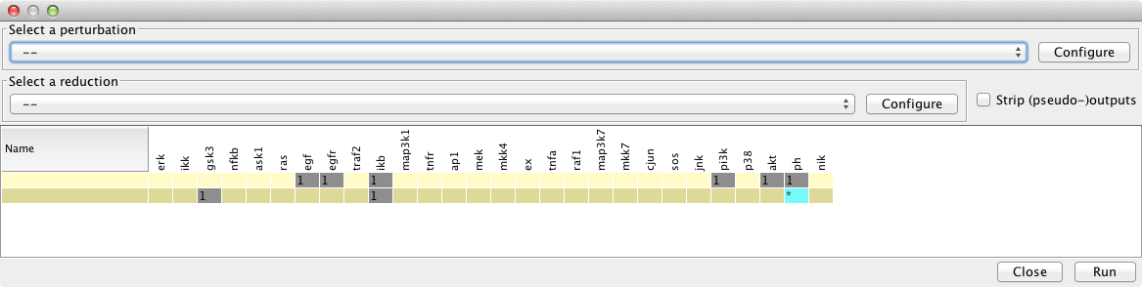
Compute stable state solutions of the wild type
Tools => Compute stable states
Click on Run

Slide 6
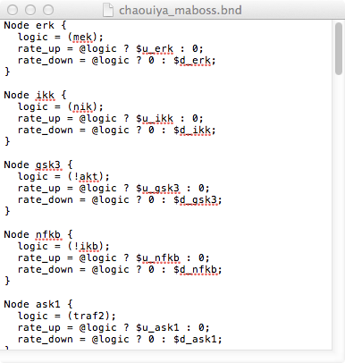
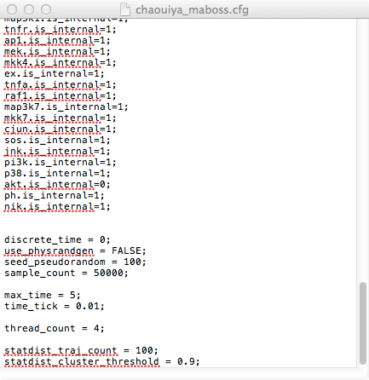
Export to MaBoSS
File => Export => MaBoSS
Choose name of the file “chaouiya_maboss”
Two files are created:
  chaouiya_maboss.bnd chaouiya_maboss.cfg
Definition of the logical rules
Definition of the simulation parameters

Slide 7
Install MaBoSS
Install MaBoSS
$ cd MaBoSS-2.0-env/src
$ make install
- gcc: version 4.0.1 or higher
- bison: version 2.3 or higher
- flex: version 2.5.35 or higher
Set the environement variables for using scripts by command line:
$ cd MaBoSS-2.0-env/
$ source ./MaBoSS.env

Slide 8
Create mutant bnd file
In bnd file, add parameters to simulate mutations:
  For KO:
  rate_up = $node_ko ? 0.0 : (@logic ? 1 ; 0);
  rate_down = $node_ko ? max_rate : (@logic ? 0 ; 1);
  For overexpression:
  rate_up = $node_up ? max_rate : ? (@logic ? 1 ; 0);
  rate_down = $node_up ? 0.0 : (@logic ? 0 ; 1);
Or you can generate the file automatically.
In a terminal, type:
$ MBSS_MutBnd.pl chaouiya_maboss.bnd "akt erk ras pi3k"
Verify that the nodes are recognized
Catch node erk
Catch node ras
Catch node pi3k
Catch node akt

Slide 9
Create mutant cfg file
A new bnd files is created:
chaouiya_maboss_mut.bnd
Create the corresponding cfg file
$ MaBoSS -t chaouiya_maboss_mut.bnd > chaouiya_maboss_mut.cfg
Or use directly the command:
$ MBSS_MutBndCfg.pl chaouiya_maboss.bnd "akt erk ras pi3k"

Slide 10
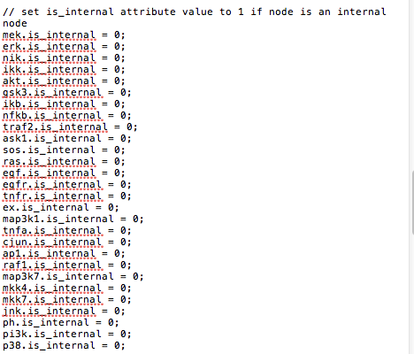
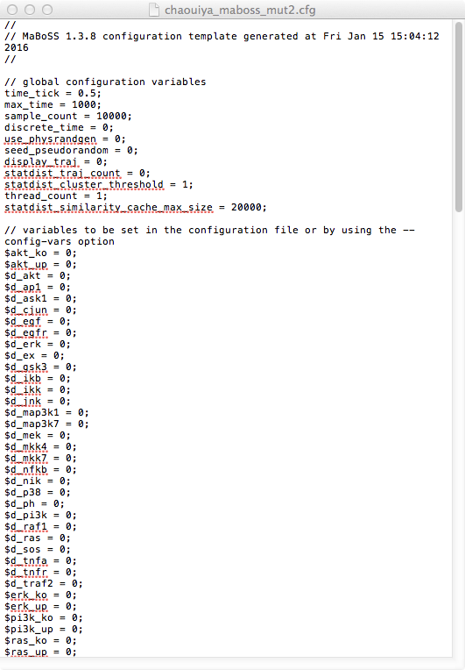
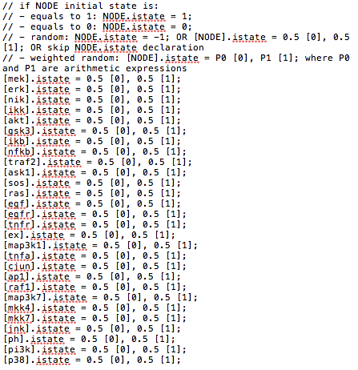
time_tick = 0.5 => 0.1
max_time = 1000 => 60
sample_count =
10000 => 50000
all variables need to be set internal (=1) except for the ones you wish to see in the output (readout)
erk.is_internal=0;
akt.is_internal=0;
ras.is_internal=0;
All parameters for mutant definition need to be set to 0 (default)
initial conditions.
By default = all random
Modify such that:
[tnfa].istate = 1 [0], 0 [1]
[erk].istate = 1 [0], 0 [1]
[akt].istate = 1 [0], 0 [1]
[ras].istate = 1 [0], 0 [1]
Done for you in folder

Slide 11
Simulate the wild type with MaBoSS
Type in a terminal the command:
$ MBSS_FormatTable.pl chaouiya_maboss_mut.bnd chaouiya_maboss_mut.cfg
Visualize the results
  For each simulation, a new folder is created
  In this folder, open chaouiya_maboss_mut_fp.csv
  3 stable states are found with the probabilities associated to each of them
  Verify with the initial publication : OK

Slide 12
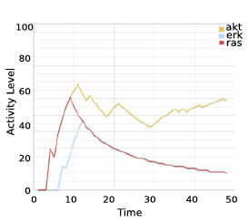
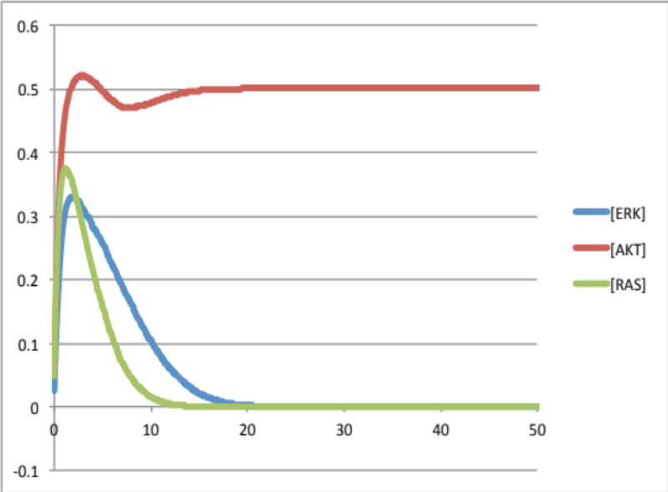
  In this folder, open chaouiya_maboss_mut_probtraj_table.csv
→ plot the sum of the three outputs
NB: to compare with publication, compute sum of each component:
[ERK]=sum(erk)=prob[erk]+prob[erk-ras]+prob[erk-akt]+prob[erk-ras-akt]
→ verify with the initial article

Slide 13
Simulate a mutant with MaBoSS
In cfg file, set parameters to simulate ras gain of function mutations:
  $ras_ko=0; (not modified)
  $ras_up=1;
  [ras].istate = 0 [0], 1 [1];
Save the cfg file as: ras_oe.cfg
Simulate mutant in MaBoSS:
$ MBSS_FormatTable.pl chaouiya_maboss_mut.bnd ras_oe.cfg

Slide 14
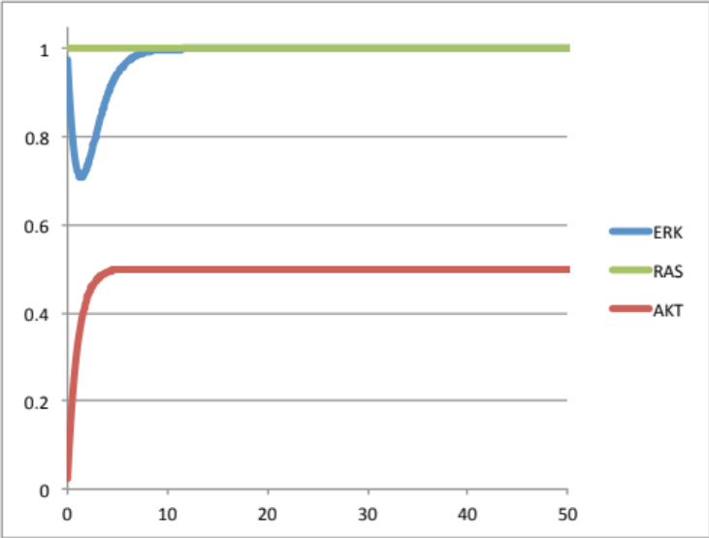
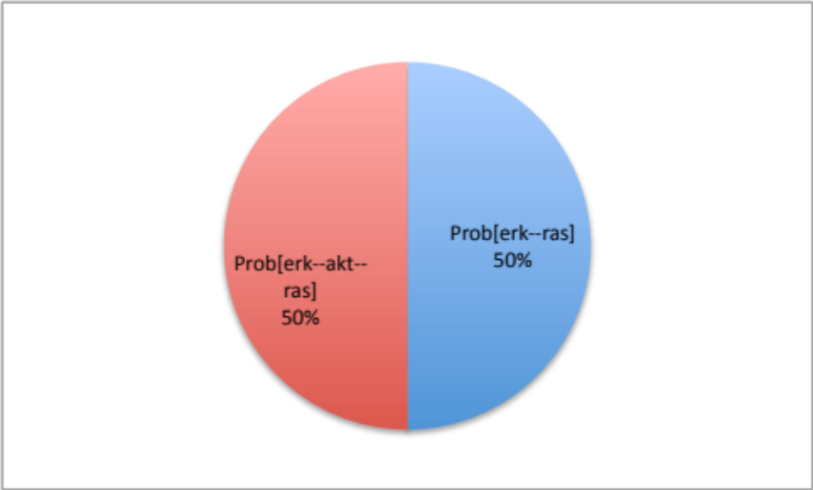
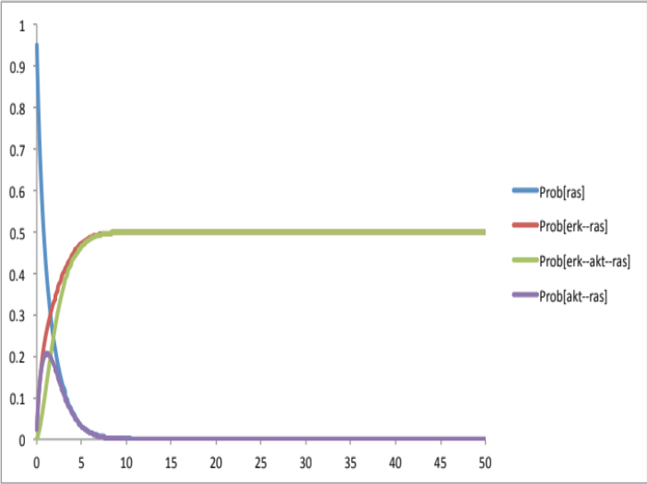
Three ways to visualize the results
1. Stable states:
useful to verify with GINsim, for instance
2. Evolution over time:
3. distribution of asymptotic solutions
interesting if transient behaviours
interesting if presence of limit cycles

