Slide 1
Bunniez
Take your best group selfies

Slide 2
The problem

Slide 3



The problem
Group shots.

Slide 4
The solution

Slide 5
The solution
Decide from which picture to take each face

Slide 6

The solution
Bunniez combines the images into one where everyone looks their best

Slide 7
Demo

Slide 8
Tech stuff

Slide 9
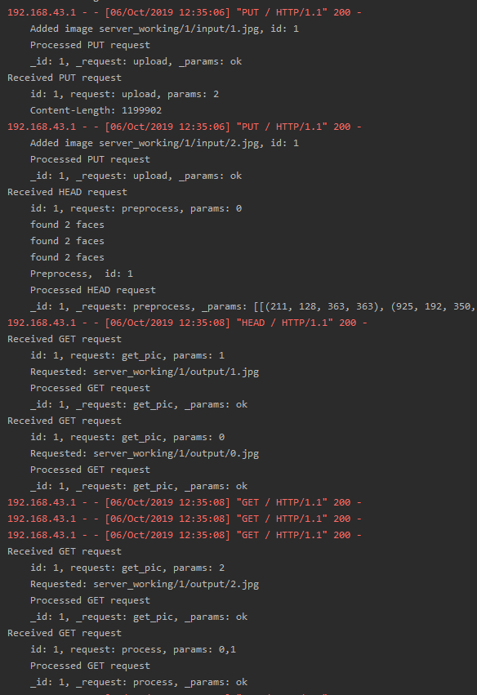
Client - Server
Client-server approach avoids processing large camera images on mobile resources, with a simple HTTP API
Initiate session
Upload images
Preprocess (Alignment, face detection)
Download images
Process (Photomerge)
Close session

Slide 10
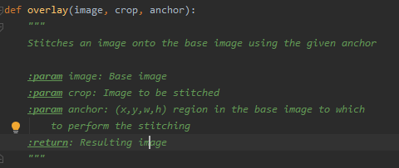
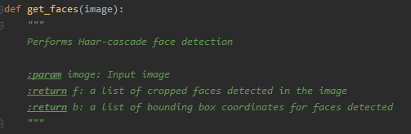
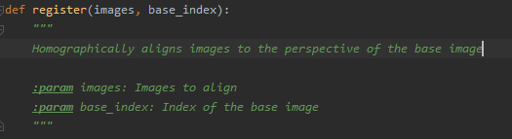
Image Processing
Server runs image processing utility supporting the following three stages:
Alignment, using feature matching to compute homography
Face detection, using Haar cascade
Photomerge

Slide 11
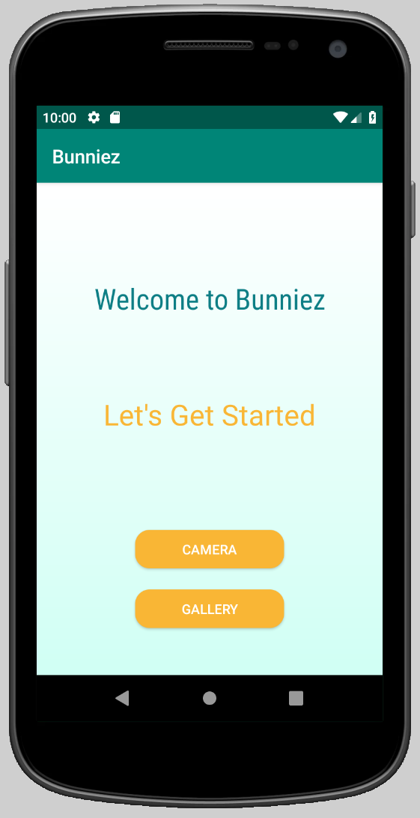
Android
App performs many tasks throughout flow, including:
Taking pictures and selecting multiple images from gallery using Intents and URIs
Async HTTP Communication and file transfer with server using okHTTP
Presenting clickable bounding boxes on ImageView by translating coordinates received from server

Slide 12
Questions?

