Slide 1
Education and Income in Australia
ABS Census 2016 and 2021 | Australian males

Slide 2
Research question and why it matters
How does educational attainment affect personal income for Australian males, and how did that relationship change from 2016 to 2021?
Why it matters:
- Education-income gradients are central to inequality and labour-market policy.
- Governments, students, and employers all rely on returns-to-education evidence.
- The census data let us compare population-level outcomes across two Census years.

Slide 3
Data
Source: ABS Census TableBuilder 2016 and 2021.
Sample: Australian males only; 8 substantive education groups.
Exclusions: Total, Not stated, Not applicable, Supplementary Codes.
Key variables: education group, income bracket, cell counts, year.
Data treatment: harmonised top income brackets and converted bracket values to weekly midpoints.

Slide 4
Empirical strategy
Model: weighted mean income = α + β * education rank + γ * year indicator.
Key coefficient: β is the average weekly income gap per education rank step.
Weights: use cell counts because rows represent different population sizes.
Assumption: this is descriptive, not causal. Education rank is not exogenous to income because age, occupation, hours, and location may differ by education group.

Slide 5
Main results
Headline finding: each one-step increase in education rank is associated with about $196 more per week in weighted mean income.
Controlling for year, 2021 incomes are also about $121/week higher than 2016.
The low-to-high education gap is roughly $1,372/week, or about $71,300/year.
The pattern is visible in every year and is consistent across main groups.

Slide 6
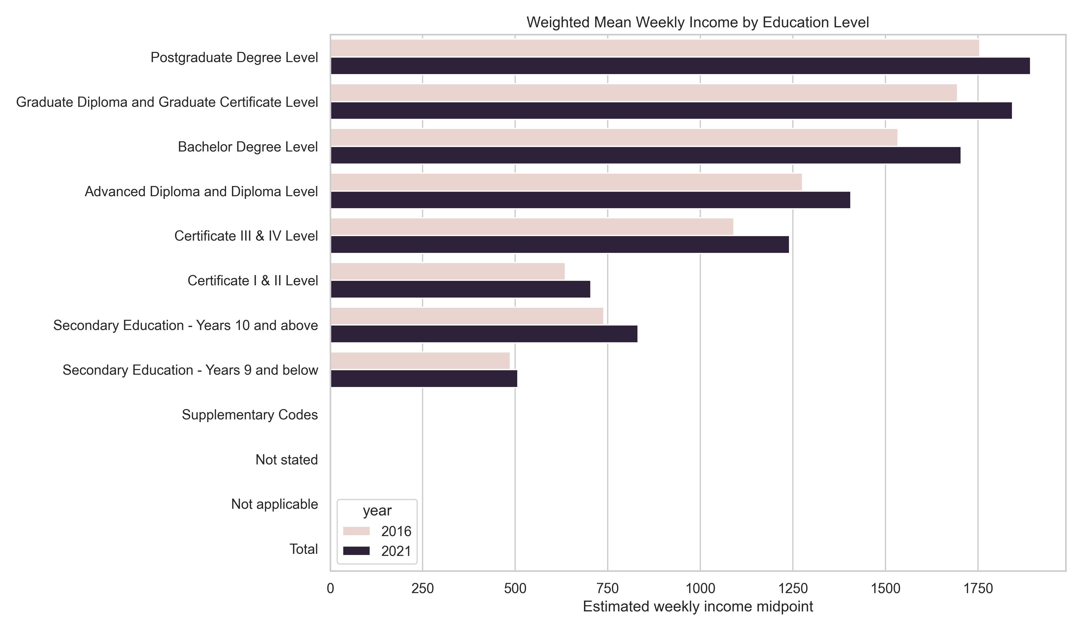
Main results
Headline finding: each one-step increase in education rank is associated with about $196 more per week in weighted mean income.

Slide 7
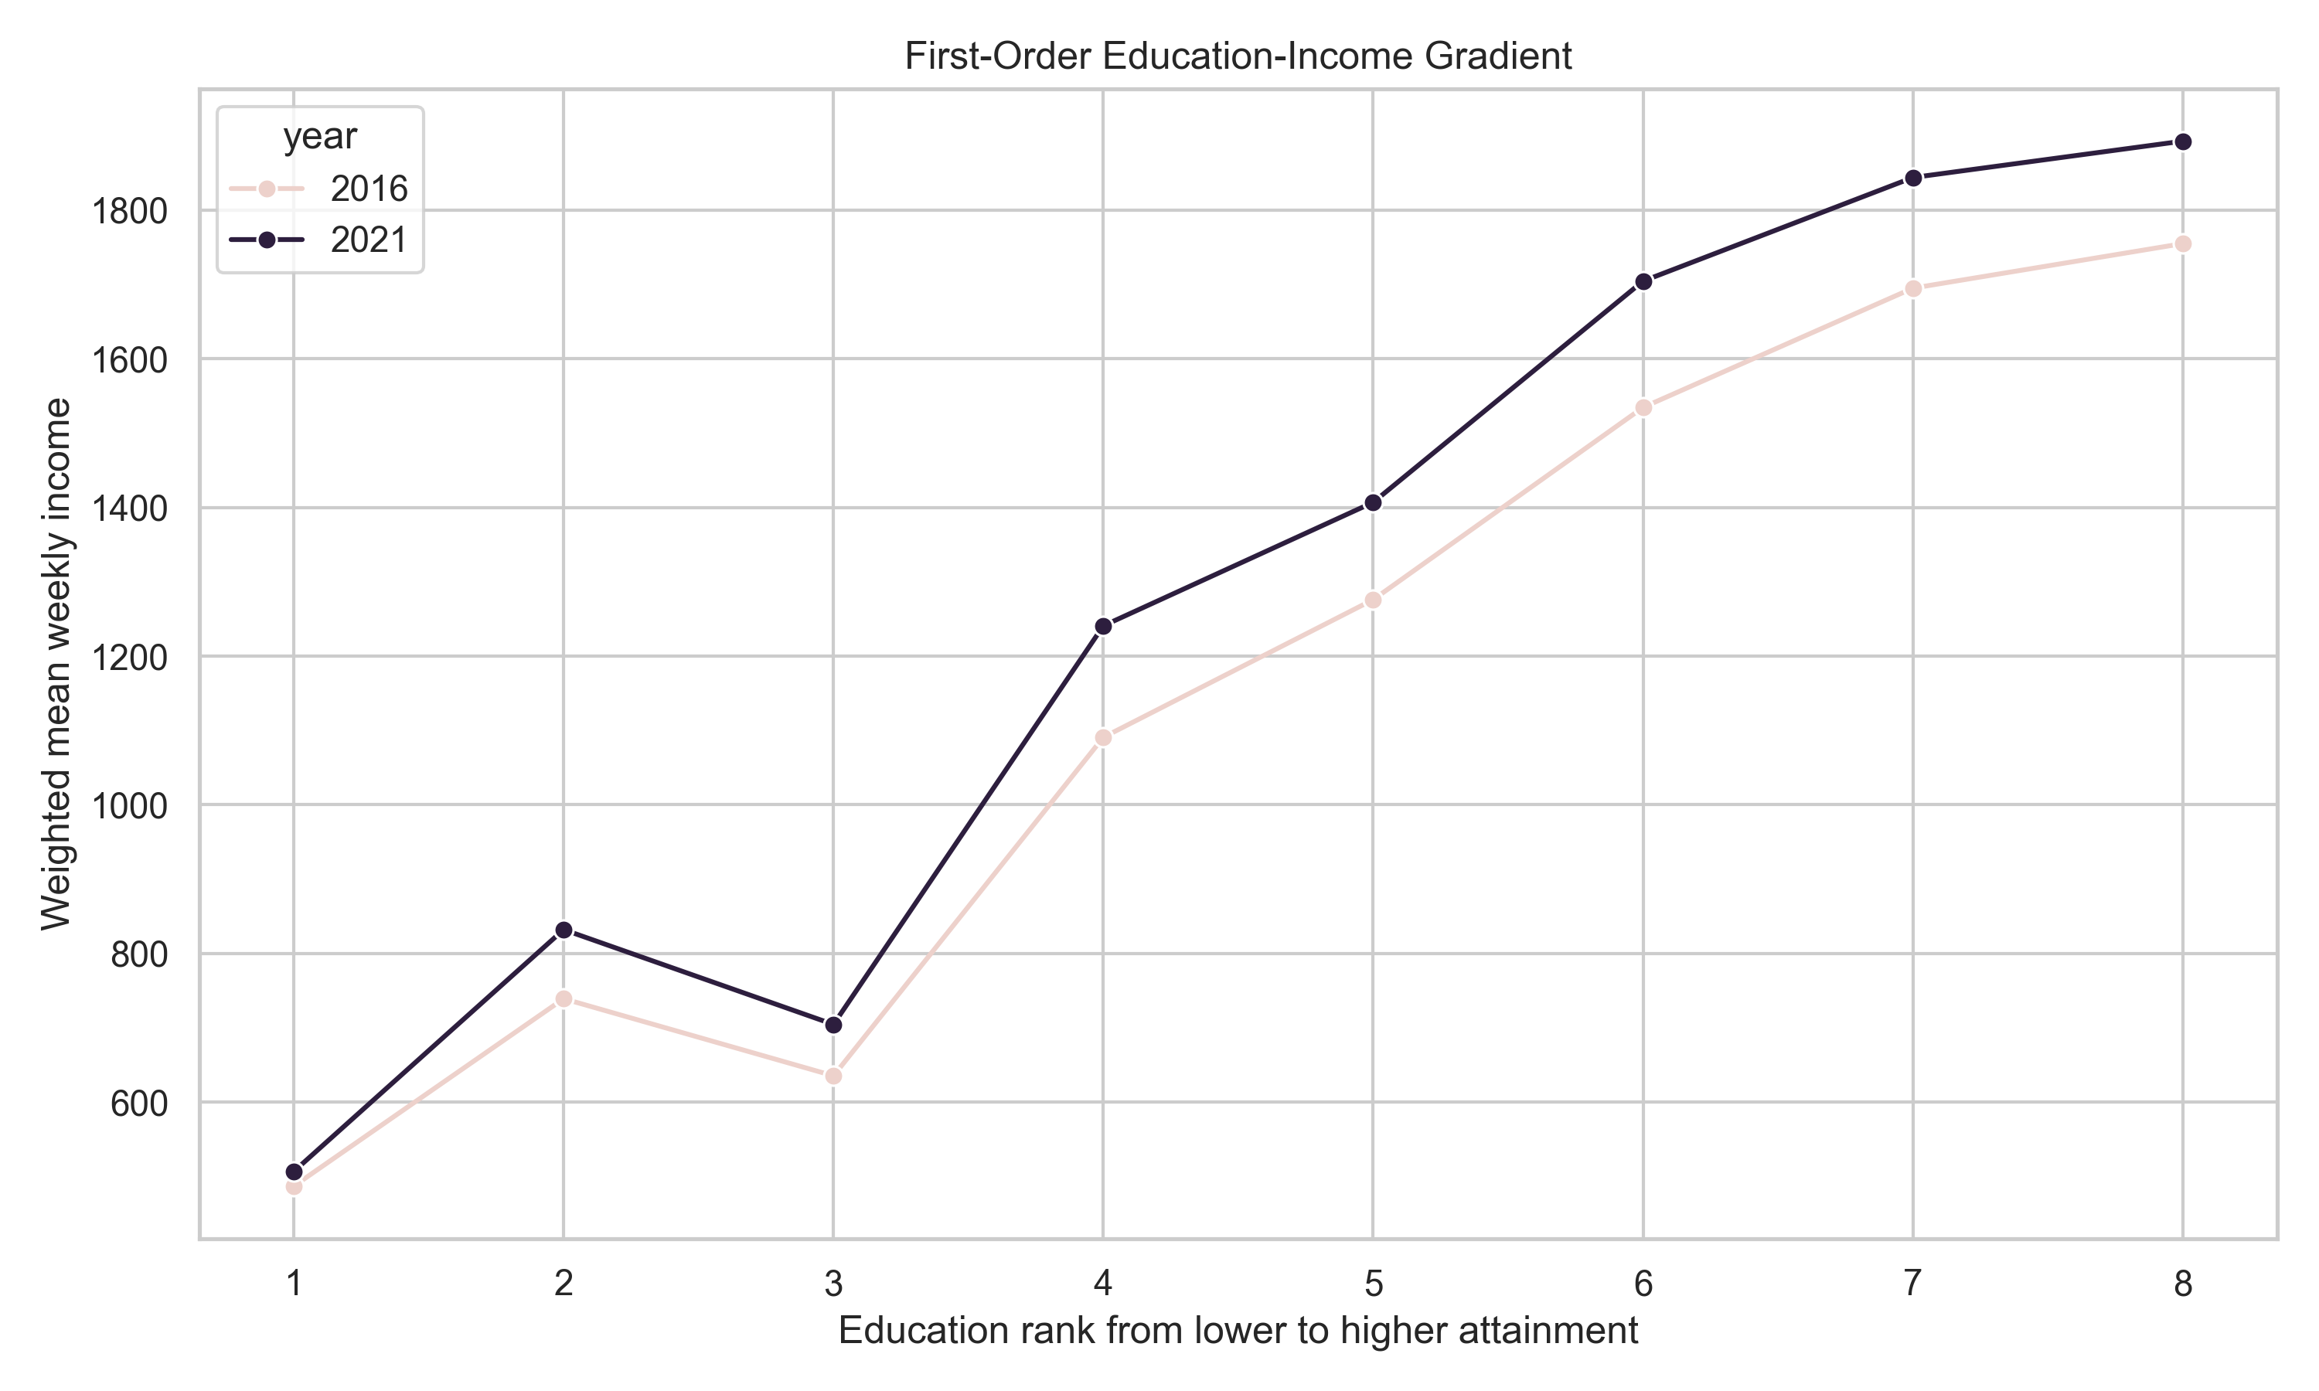

Slide 8
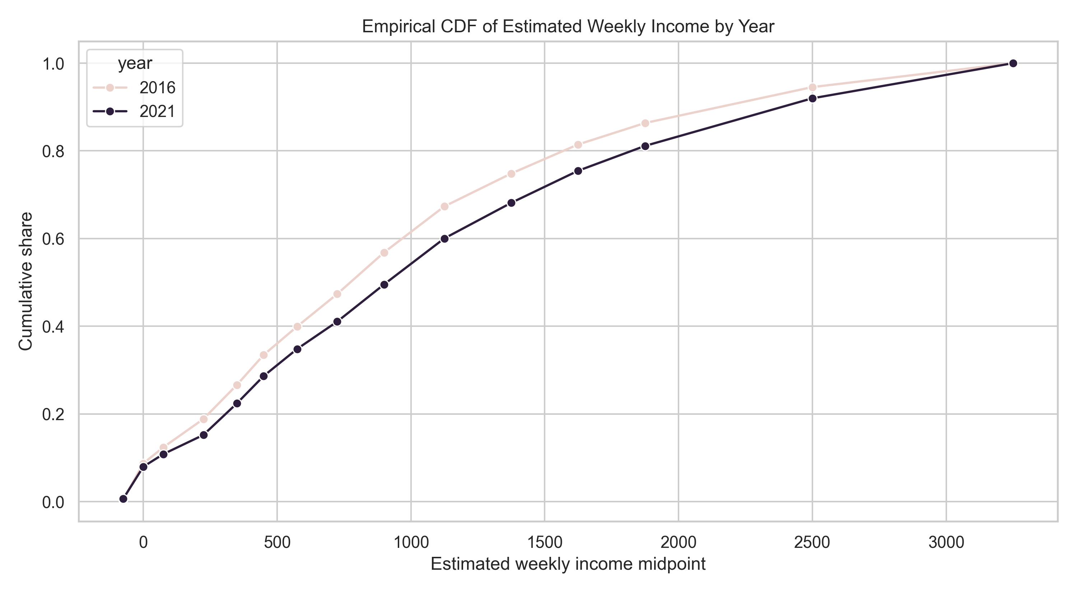

Slide 9
Robustness and limitations
Robustness: the association survives unweighted models, no-year models, alternative income transformations, and year-specific samples.
Limitation: grouped census data lack individual-level controls for age, occupation, hours worked, region, and firm characteristics.
Largest threat: omitted-variable bias from composition differences across education groups and measurement error from income bracket midpoints.

Slide 10
Robustness summary
Specification | β (education rank) | SE | Note
Main | $195.88 | $7.38 | WLS with year control
Drop top bracket | $145.74 | $9.01 | Exclude open-ended top bracket
2021 only | $202.64 | $12.11 | 2021 sample only
2016 only | $187.77 | $7.97 | 2016 sample only
Unweighted OLS | $205.16 | $13.11 | No weighting

Slide 11
Conclusion and next steps
Conclusion: there is a strong descriptive education-income gradient for Australian males in 2016 and 2021 census aggregates.
What we cannot conclude: a causal return to education from this grouped data.
Next step: use individual-level microdata with controls, or seek quasi-experimental variation or longitudinal data to address the main threat.

