Slide 1

Education and Income in Australia
ABS Census 2016 and 2021 | Australian males

Slide 2

Research question and why it matters
How does educational attainment affect personal income for Australian males, and how did that relationship change from 2016 to 2021?
Why it matters:
- Education-income gradients are central to inequality and labour-market policy.
- Governments, students, and employers all rely on returns-to-education evidence.
- The census data let us compare population-level outcomes across two Census years.

Slide 3
Data
Source: ABS Census TableBuilder 2016 and 2021. Sample: Australian males; 8 education groups (Certificate I/II through Postgraduate). Exclusions: Total, Not stated, Not applicable, Supplementary Codes. Income brackets harmonised and converted to weekly midpoints.
Education Group | N (2016) | N (2021) | Ed. Rank (1=lowest)
Secondary Yr 9 and below | 674,970 | 683,386 | 1
Secondary Yr 10 and above | 2,699,216 | 2,869,337 | 2
Certificate I & II | 6,049 | 6,179 | 3
Certificate III & IV | 1,988,369 | 2,132,611 | 4
Advanced Diploma / Diploma | 701,942 | 817,960 | 5
Bachelor Degree | 1,236,667 | 1,552,228 | 6
Grad. Diploma / Certificate | 133,704 | 167,361 | 7
Postgraduate Degree | 459,793 | 658,828 | 8
Total | 7,900,710 | 8,887,890 | —

Slide 4
Empirical strategy
Model: weighted mean income = α + β * education rank + γ * year indicator.
Key coefficient: β is the average weekly income gap per education rank step.
Weights: use cell counts because rows represent different population sizes.
Assumption: this is descriptive, not causal. Education rank is not exogenous to income because age, occupation, hours, and location may differ by education group.

Slide 5
Main results — Education-Income
Headline finding: each one-step increase in education rank is associated with about $196 more per week in weighted mean income.
High Income Share >$2,000
Education Group | Wtd. Mean Income 2016 | Wtd. Mean Income 2021 | High Income Share 2016 | High Income Share 2021
Postgraduate Degree | $1,755 | $1,893 | 38.7% | 44.3%
Grad. Diploma / Cert. | $1,695 | $1,844 | 34.3% | 42.9%
Bachelor Degree | $1,535 | $1,705 | 28.8% | 36.1%
Adv. Diploma / Diploma | $1,276 | $1,407 | 18.3% | 23.6%
Certificate III & IV | $1,091 | $1,241 | 10.3% | 15.4%
Secondary Yr 10+ | $739 | $832 | 5.7% | 7.5%
Secondary Yr 9 and below | $487 | $507 | 1.9% | 2.5%
Top-to-bottom gap | $1,268/wk | $1,386/wk | 36.8 pp gap | 41.8 pp gap
Note: High income share = % earning $1,500+/wk. Source: ABS Census TableBuilder 2016 & 2021. Australian males only.

Slide 6
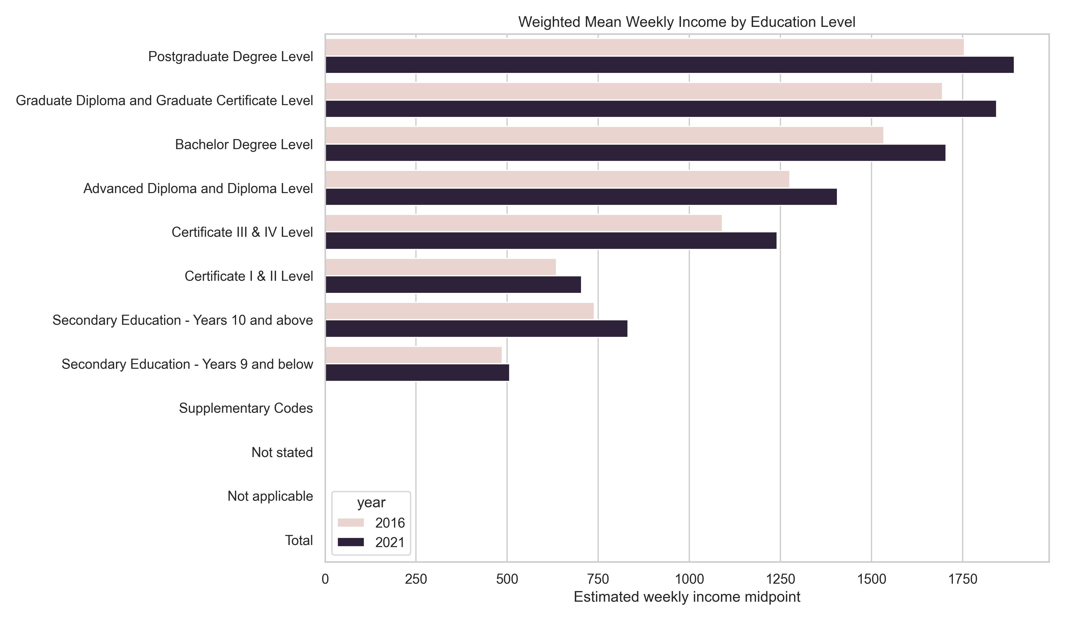

Slide 7
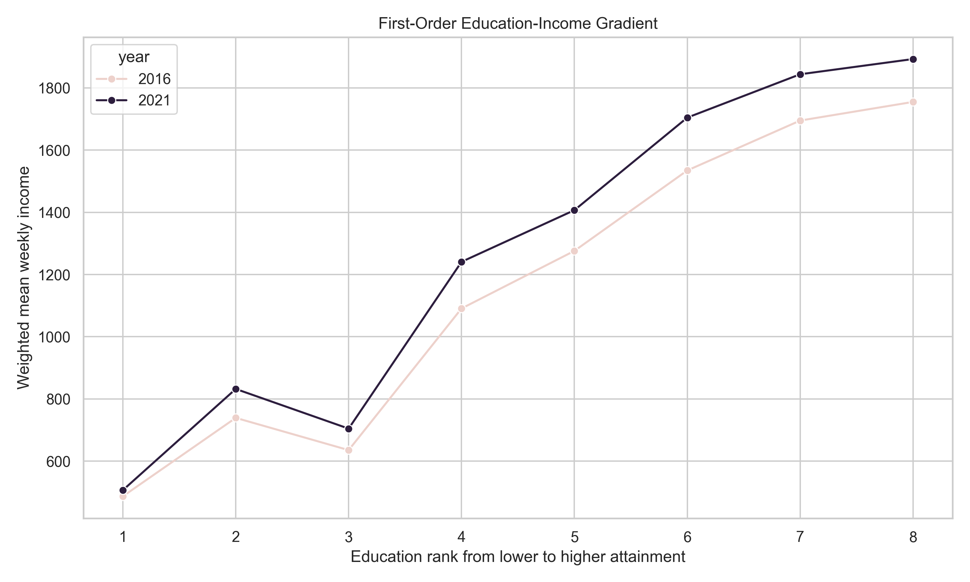
Education-Income Gradient: 2016 vs 2021

Slide 8
Robustness and limitations
Robustness: the association survives unweighted models, no-year models, alternative income transformations, and year-specific samples.
Limitation: grouped census data lack individual-level controls for age, occupation, hours worked, region, and firm characteristics.
Largest threat: omitted-variable bias from composition differences across education groups and measurement error from income bracket midpoints.
Specification | β (education rank) | SE | Note
Main | $195.88 | $7.38 | WLS with year control
Drop top bracket | $145.74 | $9.01 | Exclude open-ended top bracket
2021 only | $202.64 | $12.11 | 2021 sample only
2016 only | $187.77 | $7.97 | 2016 sample only
Unweighted OLS | $205.16 | $13.11 | No weighting

Slide 9
Conclusion and next steps
Conclusion: there is a strong descriptive education-income gradient for Australian males in 2016 and 2021 census aggregates.
What we cannot conclude: a causal return to education from this grouped data.
Next step: use individual-level microdata with controls, or seek quasi-experimental variation or longitudinal data to address the main threat.

