Slide 1
A Predictor of Dota2
王晓晖，杨光，杨溢，卓义伟

Slide 2
Outline
Problem Statement
Find out the key to victory
Insist on or Give up Now
Summary of the work

Slide 3
Problem Statement
Dataset brief Explanation
We start this work based on 100K pieces of match results.
Each piece of dataset consist of 10 player’s 11 items, such as kills, level, gold per minute, of the match, divided into two teams.
The Goal of the Two Works
In the work find out the key to victory, we aim to analyze the data, to find out the most decisive item that we should focus on in the game to win the match.
In the work Insist on or Give up Now, we aim to give a reliable recommendation to surrender after several minutes’ game based on the statistical data of that game since continuing a game that is destined to lose would be frustrating to players.

Slide 4
Outline
Problem Statement
Find out the key to victory
Insist on or Give up Now
Summary of the work
Notes:
Based ..

Slide 5
Find out the key to victory
Use your intuition here: There are many factors that may affect the result, such as the hero familiarity of its controller, the skill of this match, the mistake or accident during the match.
We are asked to used the items of “hero-id” and “level” to predict the winner originally. But whether or not the hero composition and the level of players truly are the most important.
So firstly, we try to figure out how much the items associate with the result individually and which item is the key to victory.
We use the method of SVM to solve this problem.

Slide 6
Find out the key to victory
Step1:Divede 100K pieces of match data into two part (90K for training, 10K for testing)
Step2:Excute like following pseudo-code
Step3:Flow graph of the SvmTrainData function
1. iterator i = 1 : 11
SvmTrainData(i, 1:90000)
SvmTestData(i,90001:100000)

Slide 7
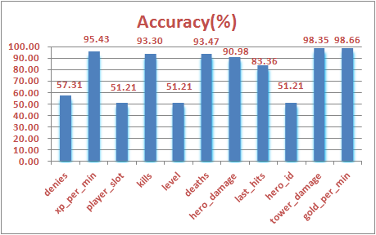
Find out the key to victory
Finally, we get the accuracy of prediction using 11 kinds of items individually, then summarize in a bar graph.
As we can see, the tow key items are “gold_per_min” and “tower_damage” rather than “hero_damage” and “level”. This seems to imply that the more you earn the money and bring damage to your enemy’s tower, the higher property you will win.

Slide 8
Outline
Problem Statement
Find out the key to victory
Insist on or Give up Now
Summary of the work
Notes:
Based ..

Slide 9
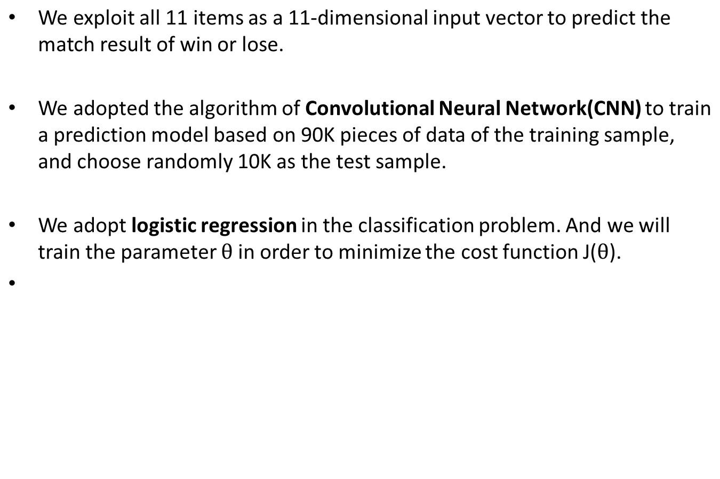


Insist on or Give up Now

Slide 10
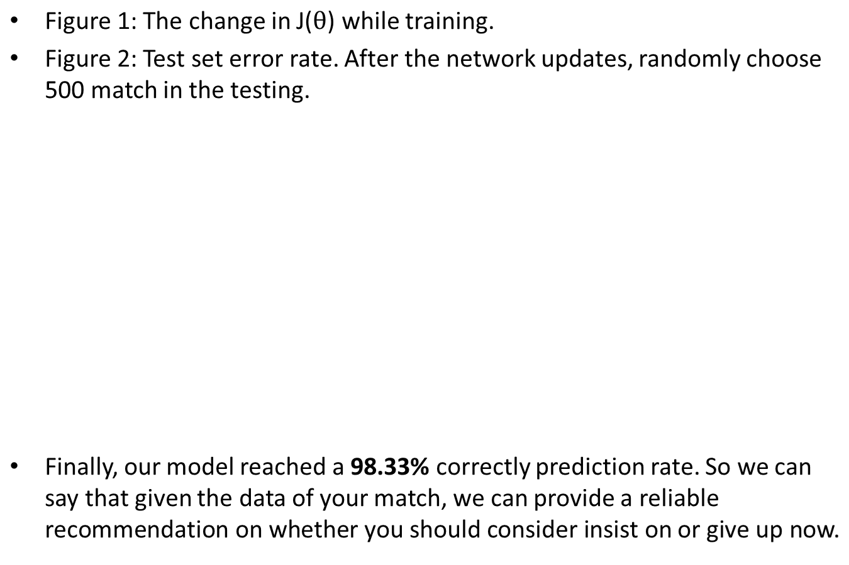
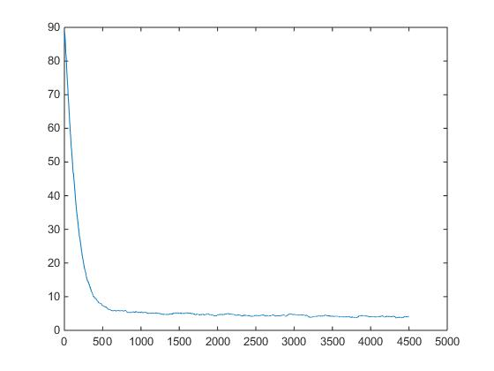
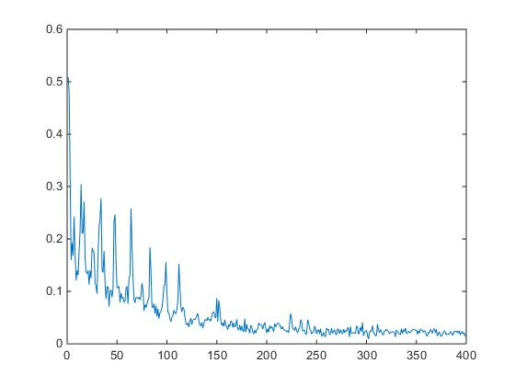
Insist on or Give up Now
Figure 1
Figure 2

Slide 11
Outline
Problem Statement
Find out the key to victory
Insist on or Give up Now
Summary of the work
Notes:
Based ..

Slide 12
Summary of the work
We exploits SVM in finding out the key index in wining a game, and we reached the conclusion of tower damage and gold per minute with a distinguishable testing correctness of the label against other indexes.
We exploits CNN to train a model in order to decide whether you should insist on or give up now given the match information in a game. And by synthesize all the hidden information inside the match data, we reached a 98.33% correctly prediction rate of our CNN model.

