Slide 1
動 物
animals

Slide 2

http://www.flickr.com/photos/95229107@N00/493513976

Slide 3

http://www.flickr.com/photos/92709190@N00/467092631

Slide 4

http://www.flickr.com/photos/11203907@N00/505700155

Slide 5

http://www.flickr.com/photos/50318388@N00/395159747

Slide 6


Slide 7
b

Slide 8
be

Slide 9
bea

Slide 10
bear

Slide 11
bear

Slide 12
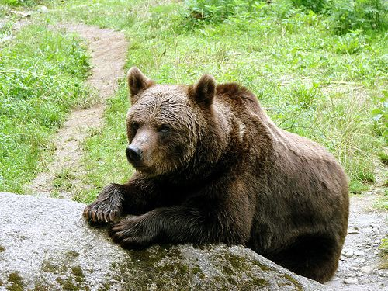
http://www.flickr.com/photos/bzeiss/250780948/

Slide 13
bear

Slide 14
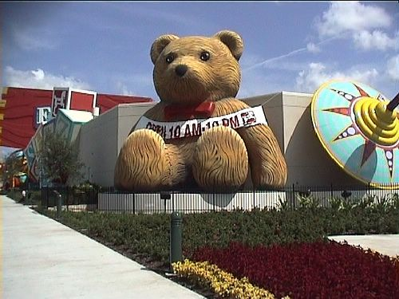
http://www.flickr.com/photos/ingram/339619736/

Slide 15
bear

Slide 16
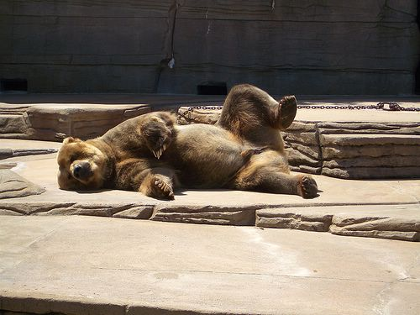
http://www.flickr.com/photos/roadhunter/250293043/

Slide 17
I like bears.

