Slide 1
L e n s K i t . A p p

Slide 2
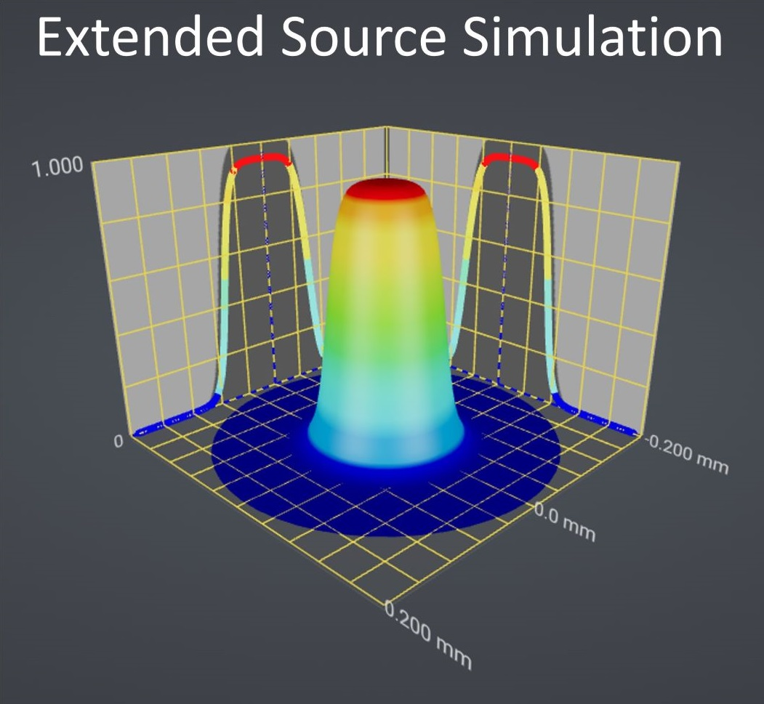
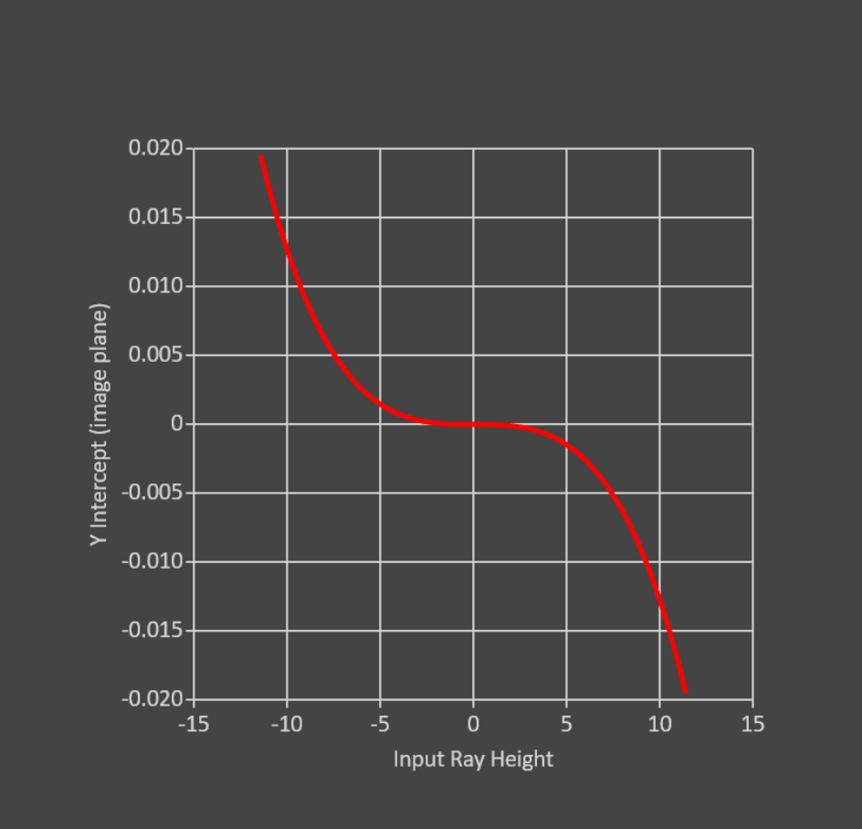
Spherical Aberration Plot

Slide 3
