Slide 1
Stage-1 Calibration: Procurement and Build
The spheres, board and fixtures needed for the depth-sensor calibration captures
Procurement and mechanical build · October 2026
Notes:
This is the first of two decks on the stage-1 calibration captures. It covers what has to be bought and made before a capture session: two matte spheres, a flat board, their mountings on the robot flange, and a three-ball nest, with estimated costs and candidate suppliers. The second deck covers the test procedure itself and what the robot program must do. Both are summaries of the stage-1 capture procedure in docs/procedures, whose section 3a and appendix A hold the full build details.

Slide 2
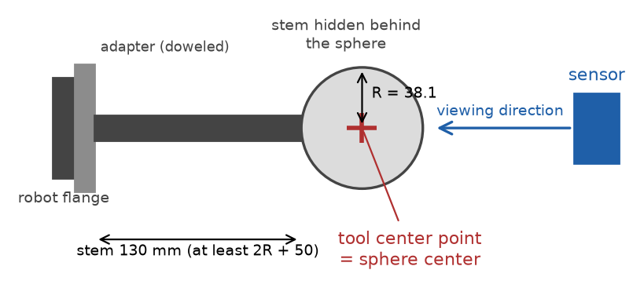


Two spheres and a board carry the known geometry
Sphere A
76.2 mm diameter; used from 300 to 550 mm
Sphere B
152.4 mm diameter; used from 500 to 1,100 mm
Sphere on its stem, side view: the stem points away from the sensor so that the sphere hides it.
Board
200 x 150 mm, at least 6 mm thick, flat to 0.05 mm after painting; tilted 0, 20 and 40 degrees
Notes:
The calibration compares what the sensor measures with targets of known shape held at known poses by the robot. Two sphere sizes are used because the bias from averaging over a curved surface depends on curvature; two radii a factor of two apart let the correction map carry curvature as an input and remove that bias. Both spheres are used around 500 to 550 mm so the two radii overlap. The board supplies zero curvature and controlled tilts. A sphere's orientation does not matter, only its center, which is why the mounting must hold the center fixed rather than aim the sphere precisely.

Slide 3

What must be built
Item | Quantity | Drawing
Sphere A with mounting interface | 1 | SC1-03 (hole detail)
Sphere B with mounting interface | 1 | SC1-04 (interface detail)
Sphere-flange mounts: adapter plates and stems | 2 + 2 | SC1-01 to SC1-04
Flat target (board) | 1 | SC1-05 (outline)
Flat-target mount (board adapter) | 1 | SC1-05
Three-ball bed (nest) | 1 | SC1-06
Run-out fixture: dial indicator on a magnetic base and steel base plate | 1 | none needed
Rigid sensor mount | 1 | existing drawing
Section 1b of the procedure; nothing outside sections 1a to 1f is needed for a session.
Notes:
This is the complete list of apparatus to build before the first session, as section 1b of the procedure gives it. The dimensioned shop drawings are in appendix D of the stage-1 procedure, and as PNG files in docs/procedures/drawings/ of the repository: SC1-01 and SC1-02 adapter plates, SC1-03 and SC1-04 stems with the sphere interfaces, SC1-05 board adapter, SC1-06 nest base. The rigid sensor mount is built from the existing drawing from previous work. The run-out fixture needs no drawing: it is a bought dial indicator on a bought magnetic base, standing on a plain steel plate bolted to the table. Everything already in hand, everything to buy and the preparation tasks are on the following slides and in sections 1a, 1c and 1f.

Slide 4
What must be bought
Item | Purpose | Estimated cost (USD)
Outside micrometers 75-100 and 150-175 mm, with setting standards | Sphere diameters, measured in-house | $405 to $520
Calipers with depth rod, 150 mm | Rough TCP length; board distance D | $30 to $150
Straightedge 300 mm and feeler gauges | Board flatness; stem straightness | $75 to $240
Thermometer | Room temperature at measurement | $15 to $40
Machinist's square | Board x axis | $30 to $80
Torque wrench | Recorded stem and adapter torques | $80 to $250
Consumables | Thread locker, retaining compound, shims, alcohol, padded cases | $50 to $150
A phone camera is enough for the setup photos. Already in hand: sensor, robot, capture computer with its communication software, analysis computer.
Notes:
These are the tools and consumables, section 1c of the procedure. The two outside micrometers replace any laboratory measurement: the sphere diameters are measured in-house after the matte finish, at six or more orientations, and the spread of the readings doubles as the sphericity check. The micrometers come with setting standards, which are used to check them before each measurement. The straightedge with a 0.05 mm feeler leaf checks the board's flatness after painting and after mounting. Items already in hand are the sensor, the robot, the capture computer with its communication software, which also takes the capture trigger from the robot, and the analysis computer.

Slide 5
Building and buying cost about $2,525 to $6,500
Item to build | Estimated cost (USD)
Sphere A with mounting interface | $250 to $550
Sphere B with mounting interface | $500 to $1,500
Sphere-flange mounts: two adapter plates and two stems | $400 to $1,000
Flat target (board) | $50 to $400
Flat-target mount (board adapter) | $250 to $600
Three-ball bed (nest) | $150 to $450
Run-out fixture: dial indicator, magnetic base, steel base plate | $240 to $570
Rigid sensor mount | not estimated
$2,525 to $6,500
bearing-ball sphere A, aluminum sphere B, tools included
$4,375 to $11,950
both spheres made to order, tools included
Tools and consumables $685 to $1,430, included in the totals. Estimates of October 2026, plus or minus 50 percent; sphere B is the least certain.
Notes:
These estimates come from suppliers' list prices where they exist and from typical job-shop rates of about 80 to 150 dollars an hour otherwise. The sphere figures no longer include a laboratory measurement: the diameters are measured in-house with the micrometers on the buy list. The two totals differ only in the spheres: a bearing ball with a bonded stem and a turned aluminum sphere, against both spheres made to order by a ball or ceramics maker. The rigid sensor mount is built from an existing drawing and is not estimated here. Quotes are needed before ordering, and the sphere choice is still to be settled after a canvass of the market.

Slide 6
Purchase specification: target spheres
Requirement | Sphere A | Sphere B
Nominal diameter | 76.2 mm (3 inch) | 152.4 mm (6 inch)
Diameter | Known to 0.025 mm, by micrometer at six or more orientations after finishing | Same; measure at the session's room temperature
Sphericity | 0.02 mm or better | 0.02 mm or better
Material | Bearing-grade steel (52100 or 440C, grade 25 or better) or ceramic | Turned aluminum (6061-T6), solid or hollow with at least 6 mm wall; ceramic as an alternative
Surface | Matte, light, uniform: fine glass-bead blast or thin matte paint | Matte hard anodize, same appearance as sphere A
Mounting interface | Steel: blind hole 10 H7 x 23 mm, stem bonded. Ceramic: maker's M8 insert | M20 x 30 mm tapped hole at a pole, 32 mm spot face
Approximate mass | 0.9 to 1.8 kg | about 5 kg
Procedure section 1d; drawings SC1-03 and SC1-04 show the interfaces.
Notes:
This is the purchase specification of section 1d of the procedure, to hand to a supplier or a machine shop. The diameter requirement is decision D-13: known to 0.025 mm after the matte finish, measured in-house with the outside micrometers; the mean of six or more readings goes in the pose log, and their spread checks the 0.02 mm sphericity. Aluminum grows 0.0035 mm in diameter per degree C at sphere B's size, so it is measured at the temperature of the session. The dimensioned shop drawings are in appendix D of the stage-1 procedure, and as PNG files in docs/procedures/drawings/ of the repository: SC1-01 and SC1-02 adapter plates, SC1-03 and SC1-04 stems with the sphere interfaces, SC1-05 board adapter, SC1-06 nest base.

Slide 7
Purchase specification: flat plate
Requirement | Flat plate (board)
Size | 200 x 150 mm, at least 6 mm thick
Material | Finish-ground aluminum tooling plate (for example MIC-6) or float glass
Flatness | 0.05 mm over the front face, checked with a straightedge and a 0.05 mm feeler leaf after painting and after mounting
Front face | Thin, even matte light-gray paint; do not bead-blast a plate thinner than about 10 mm
Edges | Bottom long edge and left short edge square and clean: they rest on the adapter's edge pins
Documents | Supplier's flatness report, kept with the session notes
Locating edges
Support pads
Procedure section 1d; the board outline is on drawing SC1-05.
Notes:
The board is checked flat after painting and after mounting because that is the state the sensor sees, and the flatness report is the reference for the board-flatness check in the validation. A 6 mm plate sags only about 0.002 mm under its own weight, so thickness is a matter of surviving the finish and the mounting, not stiffness. The bottom and left edges locate the board against the three edge pins of the board adapter, which centers it on the flange axis. The dimensioned shop drawings are in appendix D of the stage-1 procedure, and as PNG files in docs/procedures/drawings/ of the repository: SC1-01 and SC1-02 adapter plates, SC1-03 and SC1-04 stems with the sphere interfaces, SC1-05 board adapter, SC1-06 nest base.

Slide 8



Spheres must be matte and measured, not certified
Finish
Diameter
Mounting
Every bearing ball arrives mirror-bright: unusable
Bead-blast with fine glass bead: removes micrometers
Matte paint is second choice: 0.02 to 0.05 mm per coat
"Chrome steel" is the 52100 alloy, not plating
Known to 0.025 mm, measured after the finish
Measured in-house by outside micrometer at six or more orientations
Aluminum grows 0.0035 mm per degree C: measure at session temperature
The mean goes in the pose log; the spread checks sphericity
Hardened balls cannot be tapped
Steel ball: drilled or EDM blind hole, bonded stem
Aluminum sphere B: thread cut when it is turned
None found stocked above 1.5 inch; custom order only
Notes:
A mirror finish returns one bright highlight from the sensor's projector and almost nothing else, so every sphere must be made matte. Bead-blasting is preferred because it changes the diameter by only micrometers. The diameter requirement is decision D-13: known to 0.025 mm after finishing, which is a radius error of about 0.0125 mm, an eighth of the target at 500 mm; no maker's certificate is needed. The diameter is measured in-house with the outside micrometers; EDM means electrical discharge machining. Bearing-grade balls are hardened to about 60 HRC and cannot be tapped afterwards, which is why steel spheres get a bonded stem.

Slide 9
Candidate suppliers
Item | Candidate suppliers | Notes
Spheres, made to order | Bal-tec; RGP Balls; Industrial Tectonics; Morgan Advanced Materials | 3 and 6 inch matte spheres with a mounting hole are custom items
Matte reference spheres, stock | MetrologyWorks; Rothbucher RSLB10M (Baseline Equipment) | MetrologyWorks: smaller sphere A only. Rothbucher: provisional far-range B only.
Board plate | McMaster-Carr MIC-6 plus a grinding shop; Edmund Optics float glass | Painted matte after grinding; flatness checked after mounting
Nest balls | McMaster-Carr; Bal-tec | Grade-25 bearing balls
Adapters, stems, sphere holes | Local machine shop; EDM shop for hardened balls | Hardened balls cannot be tapped
Diameter measurement | Outside micrometers: Mitutoyo 103-140-10 and 103-143-10, or Starrett | In-house, after the matte finish; setting standards included
Dial indicator and magnetic base | Mitutoyo 2046 series; Noga MG71003 or DG-61003 | For the run-out fixture
From suppliers' web pages, October 2026; not an endorsement. Confirm size, finish, measurement and thread before ordering.
Notes:
This list is appendix A of the procedure in brief. No supplier was found that stocks a precision sphere of the needed sizes with a mounting hole, so the spheres are either made to order or built from a bearing ball by a machine shop. The laser-scanner reference spheres sold in the right sizes generally have form errors of 0.5 to 2 mm, far too coarse; the Rothbucher sphere is the best specified of them. Appendix A limits both stock items: MetrologyWorks spheres (up to 1.5 inch) only if the engineer accepts a smaller sphere A, and the Rothbucher sphere only as a provisional far-range sphere B, measured in-house first; it is not adequate as sphere A or as the final sphere B. The finished diameters are measured in-house with outside micrometers, which is cheaper than buying certified spheres and is what the calibration actually needs.

Slide 10
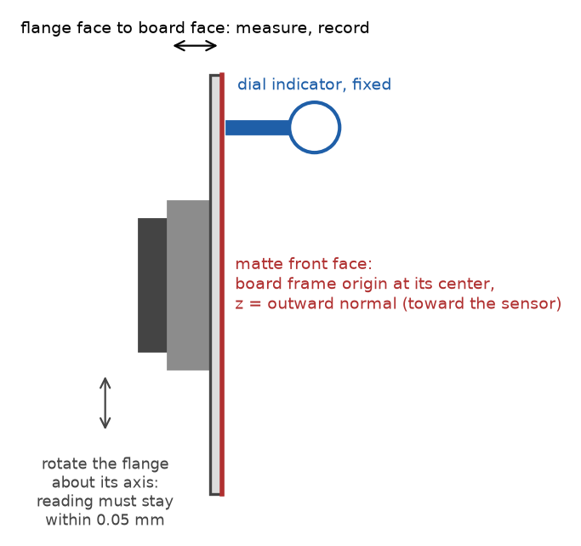




Run-out fixture: dial indicator and its mounting
Dial indicator
0.01 mm graduation, about 10 mm travel; for example Mitutoyo 2046 series, about $50 to $150
Magnetic base
Articulating, with fine adjustment; for example Noga MG71003 or DG-61003, about $140 to $320
Steel base plate
About 150 x 100 x 12 mm, bolted to the cell table with two M8 screws, so the base holds on a non-magnetic table and does not creep
Placement
Where the indicator tip reaches the board's front face about 20 mm from an edge with the robot in its run-out pose
The run-out check: the flange turns, the indicator stays still, the reading must stay within 0.05 mm.
Notes:
The run-out check in deck 2 needs the dial indicator held still while the robot turns the board about the flange axis. A magnetic base alone can creep or fail to hold on an aluminum or stone table, so it stands on a small steel plate bolted to the table. All three items are stocked by McMaster-Carr and the usual tool suppliers. The fixture needs no drawing beyond the plate's size and its two bolt holes.

Slide 11
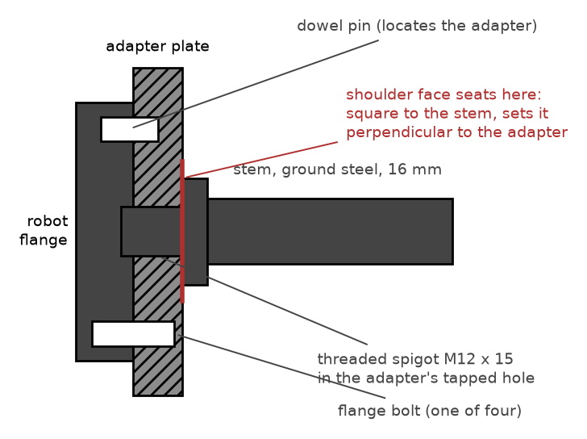
A stiff, repeatable chain from flange to sphere
Adapter located by the flange dowel, so a remount lands in the same place
Ground stem, 16 mm for A and 30 mm for B, keeps sag to 0.02 to 0.05 mm
Stem length at least 2R + 50 mm, so the sphere hides the stem
Witness mark across stem and adapter shows a loosened joint
After any remount, re-check in the nest: readings within 0.1 mm
Adapter on the flange's dowel, with the stem's shoulder seated on the adapter face.
Notes:
Where the sphere center ends up does not need to be known from drawings, because the tool-center-point routine measures it; what matters is that it does not move afterwards. The adapter plate's mounting face, outer face and tapped hole are machined in one lathe setup, located on the flange pilot, so the hole is perpendicular to the face within 0.02 mm over 100 mm. The stems are deliberately thick: a 12 mm stem would let sphere A sag about 0.07 mm, and that sag would change with the robot's orientation. The shoulder on the stem, machined square in the same setup as its thread, sets the stem perpendicular to the adapter. The dimensioned shop drawings are in appendix D of the stage-1 procedure, and as PNG files in docs/procedures/drawings/ of the repository: SC1-01 and SC1-02 adapter plates, SC1-03 and SC1-04 stems with the sphere interfaces, SC1-05 board adapter, SC1-06 nest base. The adapter plates are 63 mm across, 16 mm thick for sphere A and 22 mm for sphere B, with a 31.5 mm centering spigot and one 6 mm dowel for the ISO 9409-1-50-4-M6 flange.

Slide 12
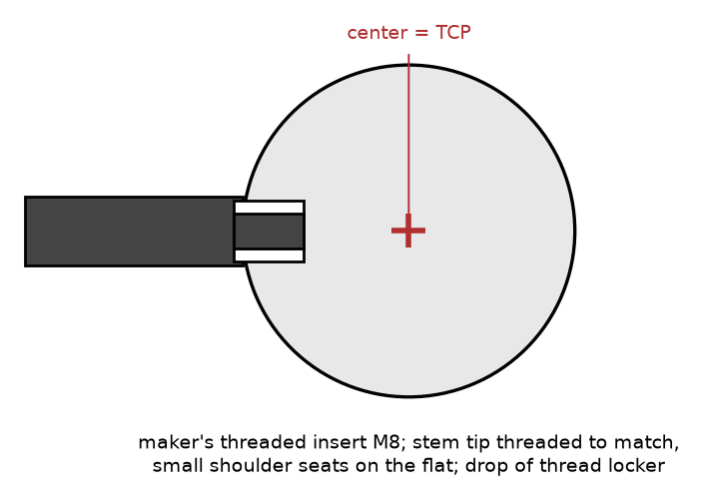
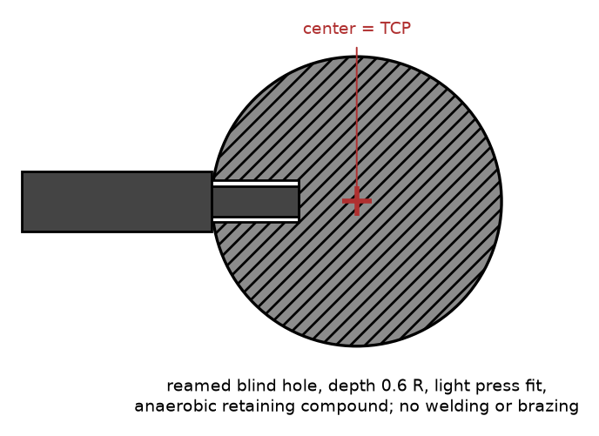
The sphere end: threaded insert or bonded stem
Ceramic sphere: maker's threaded insert
Steel sphere: bonded blind hole
The hole need not be exactly radial: the tool-center-point routine measures the center wherever it ends up.
Notes:
Precision ceramic spheres are sold with a threaded insert bonded in by the maker; the stem tip is turned to a matching thread with a small shoulder that seats on the flat around the insert, with a drop of medium-strength thread locker. Bearing-grade steel balls are hardened to about 60 HRC and cannot be tapped, so a shop makes a blind hole about 0.6 R deep by carbide drilling or electrical discharge machining, sized for a light press fit, and the stem is bonded in with anaerobic retaining compound. Never weld or braze: the heat distorts the sphere. A turned aluminum sphere B can have the stem thread cut into it when it is made. The dimensioned shop drawings are in appendix D of the stage-1 procedure, and as PNG files in docs/procedures/drawings/ of the repository: SC1-01 and SC1-02 adapter plates, SC1-03 and SC1-04 stems with the sphere interfaces, SC1-05 board adapter, SC1-06 nest base.

Slide 13

The board must stay flat after finishing and mounting
Plate
200 x 150 mm, at least 6 mm thick; ground aluminum tooling plate or float glass
Finish
Matte light gray paint on the front face; do not bead-blast a plate thinner than about 10 mm, it bows
Flatness
0.05 mm, checked after painting and mounting, not before; keep the flatness report
Adapter
Three support pads, three edge pins and three clamp fingers hold the board square to the flange axis, centered on it, and in the same place after a remount
Board on its adapter. The runout and frame checks shown here are done at setup (deck 2).
Notes:
Thickness is not a stiffness question: a 6 mm plate sags only about 0.002 mm under its own weight. It only has to survive the finish and the mounting flat. Bead-blasting peens one face and bows a thin plate, so paint over the ground or glass surface instead. Flatness is checked last, after painting and mounting, because that is the state the sensor sees; the flatness report is also the reference for the board-flatness check in the validation. The dimensioned shop drawings are in appendix D of the stage-1 procedure, and as PNG files in docs/procedures/drawings/ of the repository: SC1-01 and SC1-02 adapter plates, SC1-03 and SC1-04 stems with the sphere interfaces, SC1-05 board adapter, SC1-06 nest base.

Slide 14



A three-ball nest holds each sphere at a fixed center
Three hardened balls, 24 mm diameter, bonded into pockets on a 60 mm circle in a 120 mm steel base
Ordinary grade-25 bearing balls are good enough: the nest's quality comes from the balls being rigidly fixed
Bolted to the table where the robot reaches with the wrist down and tilted about 40 degrees to either side
Side view
Top view
Used once per sphere at setup, and after any remount of an adapter or stem
Notes:
A sphere resting on three fixed balls always has its center at the same point in space, whatever direction its stem points. That is what lets the robot's own multi-orientation routine find the sphere's center as its tool center point, which deck 2 describes. The nest is simple to make: a steel base with three pockets, the balls bonded in, and holes to bolt it down. Its position matters only in that the robot must be able to seat the sphere from several directions. The dimensioned shop drawings are in appendix D of the stage-1 procedure, and as PNG files in docs/procedures/drawings/ of the repository: SC1-01 and SC1-02 adapter plates, SC1-03 and SC1-04 stems with the sphere interfaces, SC1-05 board adapter, SC1-06 nest base.

Slide 15


Checks before the fixtures go to the robot cell
Adapter plates, stems, board adapter and nest base made to drawings SC1-01 to SC1-06
Adapter thread square to its stem-side face within 0.02 mm over 100 mm
Each stem straight: check against the straightedge
Both spheres matte, uniform and free of highlights
Each sphere diameter measured by micrometer after finishing, spread within 0.02 mm, temperature recorded
Board flat to 0.05 mm after painting and mounting
Each fixture weighed for its tool load data; witness marks across each stem-adapter joint
Notes:
These are the build checks of sections 1 and 3a of the procedure, gathered in one place. Each one protects something the software cannot repair later: a crooked or bending stem moves the sphere center away from the measured tool center point, a shiny spot gives bad reads, and an unmeasured diameter or a bowed board puts a wrong reference into every observation. The fixture weights feed the robot's tool load data, which its absolute accuracy depends on. The dimensioned shop drawings are in appendix D of the stage-1 procedure, and as PNG files in docs/procedures/drawings/ of the repository: SC1-01 and SC1-02 adapter plates, SC1-03 and SC1-04 stems with the sphere interfaces, SC1-05 board adapter, SC1-06 nest base.

