Slide 1
Stage-1 Calibration Captures
Collecting sphere and board data to correct the depth sensor's range and normals
Procedure overview · October 2026
Notes:
This deck summarizes the stage-1 capture procedure. The procedure tells a robot technician how to collect the data from which the calibration software fits a correction map for the depth sensor's range and surface normals. The full step-by-step procedure, with its appendices on suppliers, software and installation, is the document stage1_capture_procedure in docs/procedures. This deck covers what the session produces, the equipment, the setup, the capture itself, the checks, and the items still open.

Slide 2




The session produces data plus an exact table of poses
186
~2 h
0.1 mm
robot poses, 5 frames each
robot time with fixture changes and checks
accuracy target at 500 mm, scaling with distance
If the pose table is wrong, the calibration is wrong.
Every capture file must be matched to the target that was in view and to exactly where the robot put it. Most of the procedure is about getting that table right.
Notes:
The output of a session is a folder of sensor capture files, one group per robot pose, and a manifest that records for every file which target was in view and exactly where the robot had placed it. The software compares what the sensor measured with the known geometry of the target at that known pose. Any error in the table goes straight into the correction map, so most of the procedure's steps exist to make the table trustworthy. The accuracy target is 0.1 mm at 500 mm, scaling with distance; the robot's own absolute accuracy of 0.1 mm is of the same size, which is why the robot pose must be the reported one, not the commanded one.

Slide 3
The session at a glance
1
2
3
4
Prepare
Mount spheres
Board frame
Locate sensor
Warm up the sensor 30 min; fix exposure and gain; constant light
Doweled adapter and stem; find each sphere's TCP in the nest
Runout check; set the tool frame on the front face
Four sphere captures give a rough sensor position
5
6
7
8
Plan poses
Capture
Manifest
Check
The plan tool writes 186 poses and a picture
Sphere A, then sphere B, then the board
Pose log and files become the manifest
Quick check before the robot and fixtures are put away
Notes:
These are the eight stages of a session, in order; sections 2 to 8 of the procedure correspond to them. Steps 1 to 4 are setup and happen once per session. Step 5 runs the plan tool, which needs the rough sensor position from step 4. Step 6 is the long robot run. Steps 7 and 8 run software on the capture computer or the engineer's laptop, and step 8 should happen while everything is still set up, so a flagged pose can be captured again at once.

Slide 4
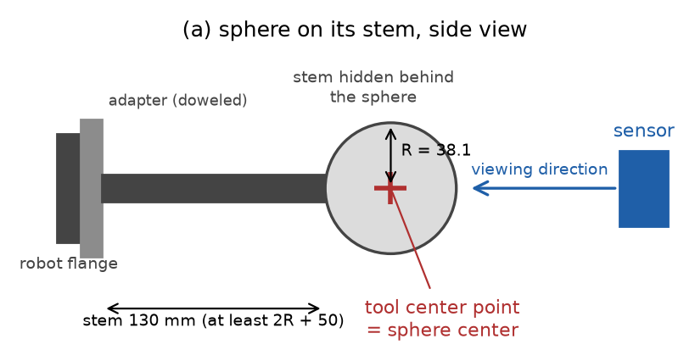


Two spheres and a board carry the known geometry
Sphere A
76.2 mm diameter; used from 300 to 550 mm
Sphere B
152.4 mm diameter; used from 500 to 1,100 mm
Board
200 x 150 mm, at least 6 mm thick, flat to 0.05 mm after painting; tilted 0, 20 and 40 degrees
Sphere on its stem, side view: the stem points away from the sensor so that the sphere hides it.
Notes:
Two sphere sizes are used because the cell-averaging bias on a curved surface depends on curvature; two radii a factor of two apart let the map carry curvature as an input and remove that bias. Both spheres are used around 500 to 550 mm so the two radii overlap. The board supplies zero curvature, the position-dependent fixed pattern, and controlled tilts. The sphere's orientation does not matter, only its center, which is why a sphere needs no rotation in the pose log. A three-ball nest and a dial indicator complete the equipment.

Slide 5
New equipment costs about $1,900 to $5,400
Item | Estimated cost (USD)
Sphere A, bearing ball, bonded stem, blasted, measured | $350 to $850
Sphere B, turned aluminum, anodized, measured | $600 to $1,800
Stems, two | $150 to $400
Adapter plates, two | $250 to $600
Board, glass or ground aluminum, painted | $50 to $400
Board adapter | $250 to $600
Three-ball nest | $150 to $450
Dial indicator with magnetic base | $100 to $300
$1,900 to $5,400
bearing-ball sphere A, aluminum sphere B
$3,550 to $10,250
both spheres made to order
Estimates of October 2026, plus or minus 50 percent; sphere B is the least certain. The sensor, robot and capture computer are in hand.
Notes:
These estimates come from suppliers' list prices where they exist and from typical job-shop rates of about 80 to 150 dollars an hour otherwise. The sphere figures include 100 to 300 dollars for having the diameter measured at a calibration laboratory. The two totals differ only in the spheres: a bearing ball with a bonded stem and a turned aluminum sphere, against both spheres made to order by a ball or ceramics maker. Quotes are needed before ordering, and the sphere choice itself is still open, pending a canvass of the market.

Slide 6



Spheres must be matte and measured, not certified
Finish
Diameter
Mounting
Every bearing ball arrives mirror-bright: unusable
Bead-blast with fine glass bead: removes micrometers
Matte paint is second choice: 0.02 to 0.05 mm per coat
"Chrome steel" is the 52100 alloy, not plating
Known to 0.025 mm, measured after the finish
Micrometer at several orientations, or a CMM
Aluminum grows 0.0035 mm per degree C: measure at session temperature
The measured value goes in the pose log
Hardened balls cannot be tapped
Steel ball: drilled or EDM blind hole, bonded stem
Aluminum sphere B: thread cut when it is turned
No pre-tapped precision sphere exists above 1.5 inch
Notes:
A mirror finish returns one bright highlight from the sensor's projector and almost nothing else, so every sphere must be made matte. Bead-blasting is preferred because it changes the diameter by only micrometers. The diameter requirement is decision D-13: known to 0.025 mm after finishing, which is a radius error of about 0.0125 mm, an eighth of the target at 500 mm; no maker's certificate is needed. CMM means coordinate measuring machine and EDM means electrical discharge machining. Bearing-grade balls are hardened to about 60 HRC and cannot be tapped afterwards, which is why steel spheres get a bonded stem.

Slide 7
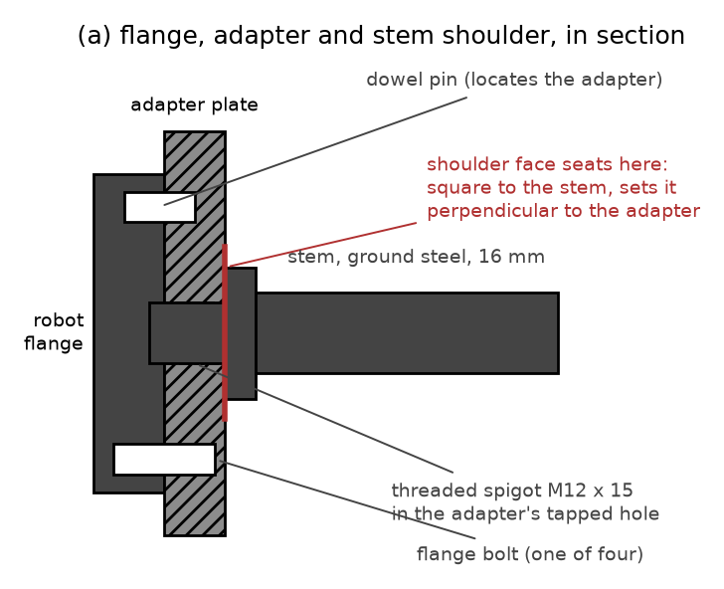
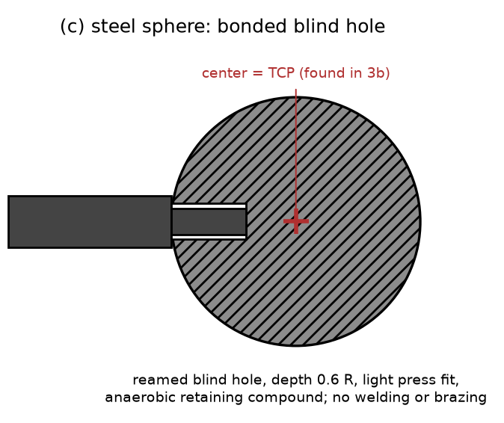
A stiff, repeatable chain from flange to sphere
Adapter located by the flange dowel, so a remount lands in the same place
Ground stem, 16 mm for A and 30 mm for B, keeps sag to 0.02 to 0.05 mm
Stem length at least 2R + 50 mm, so the sphere hides the stem
Witness mark across stem and adapter shows a loosened joint
After any remount, re-check in the nest: readings within 0.1 mm
Left: adapter on the flange's dowel, stem shoulder seated on the adapter face. Right: steel sphere with a bonded blind hole.
Notes:
Where the sphere center ends up does not need to be known from drawings, because the tool-center-point routine measures it; what matters is that it does not move afterwards. The stems are deliberately thicker than a slender rule of thumb: a 12 mm stem would let sphere A sag about 0.07 mm, and that sag would change with the robot's orientation. The shoulder on the stem, machined square in the same setup as its thread, is what sets the stem perpendicular to the adapter. Ceramic spheres come with a maker's threaded insert; steel spheres get a reamed blind hole and retaining compound, never welding or brazing.

Slide 8
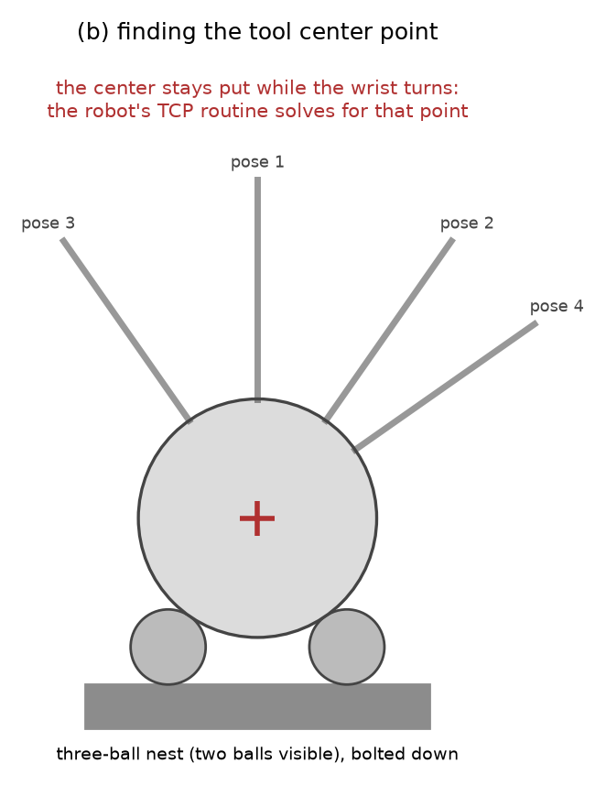
The three-ball nest finds each sphere's center
Enter a rough TCP from caliper measurements
1
Run the robot's multi-orientation TCP routine with at least six seatings: stem up, tilted 40 degrees four ways, one twisted
2
Accept only a routine error of 0.1 mm or less
3
Re-seat at a very different wrist angle: positions agree within 0.1 mm
4
Save TCP_SPHERE_A_76mm and TCP_SPHERE_B_152mm
5
Notes:
The robot cannot see the sphere, so its center is found mechanically. A sphere resting on three fixed balls always has its center at the same point, whatever direction its stem points. The robot's built-in multi-orientation tool-center-point routine finds the one point on the tool that stays still while the wrist turns, and seating the sphere in the nest from several directions makes that point the sphere's center. Lower the sphere gently for the last millimeter; pressing down bends the stem. The usual causes of a large routine error are a sphere not fully seated or a loose adapter.

Slide 9
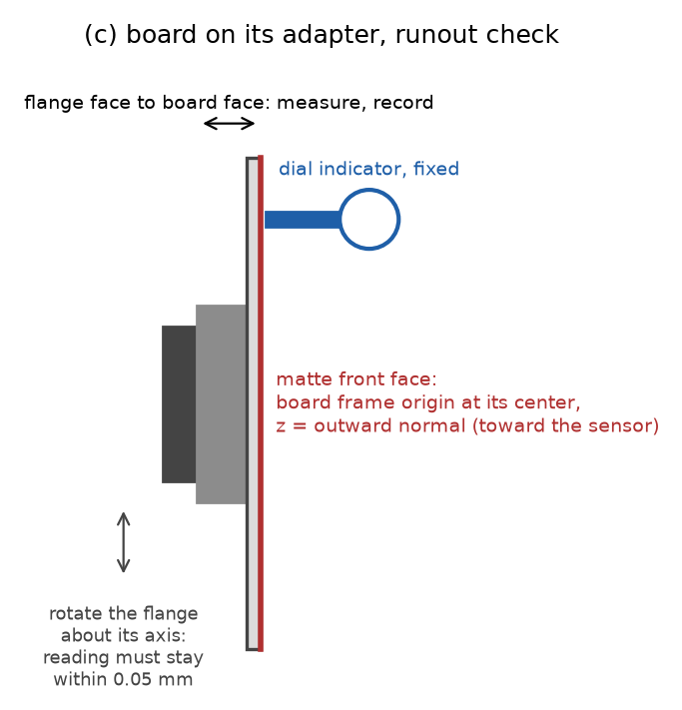

The board's tool frame sits on its front face
Runout: rotate joint 6 through 360 degrees; the dial indicator stays within 0.05 mm
Measure flange-to-face distance D at four places; they agree within 0.05 mm
Tool frame: origin at the face center, z out of the face, x along the long edge
A few degrees of error in x is harmless; an error in z is not
Save as TOOL_BOARD; record D, the runout and the board size
Notes:
The board's pose is commanded, not fitted, so its frame must be right. The runout check tests whether the board face is perpendicular to the flange axis; if the reading wanders more than 0.05 mm over a full turn, shim the adapter and repeat. D is the distance from the flange face to the board's front face. Because the board is symmetric, an error of a few degrees in the x direction does no harm, but a tilt of the z axis puts a false slope into every board observation. The board's half-sizes go into the pose log.

Slide 10
Four captures locate the sensor well enough to plan
boot03
boot01
boot02
boot04
Sensor
About 500 mm in front, near the image center
About 150 mm to the left
About 150 mm up
About 250 mm farther away
Record the robot's reported TCP position for each
The check tool fits the sphere centers; the plan tool fits the sensor position
Residuals of a few millimeters are fine; tens of millimeters mean a copying error or a wrong TCP
Notes:
The software determines the sensor's exact position from the full capture set; this step only needs a rough position so that the planned poses land inside the field of view. Four positions not on a line are enough to solve for the sensor's position and orientation. The check tool fits the sphere center in each bootstrap capture, the engineer writes these and the robot positions into boot.json, and the plan tool solves for the sensor and prints the residual of each pair. A residual of tens of millimeters almost always means a position was copied wrongly or the TCP is wrong.

Slide 11
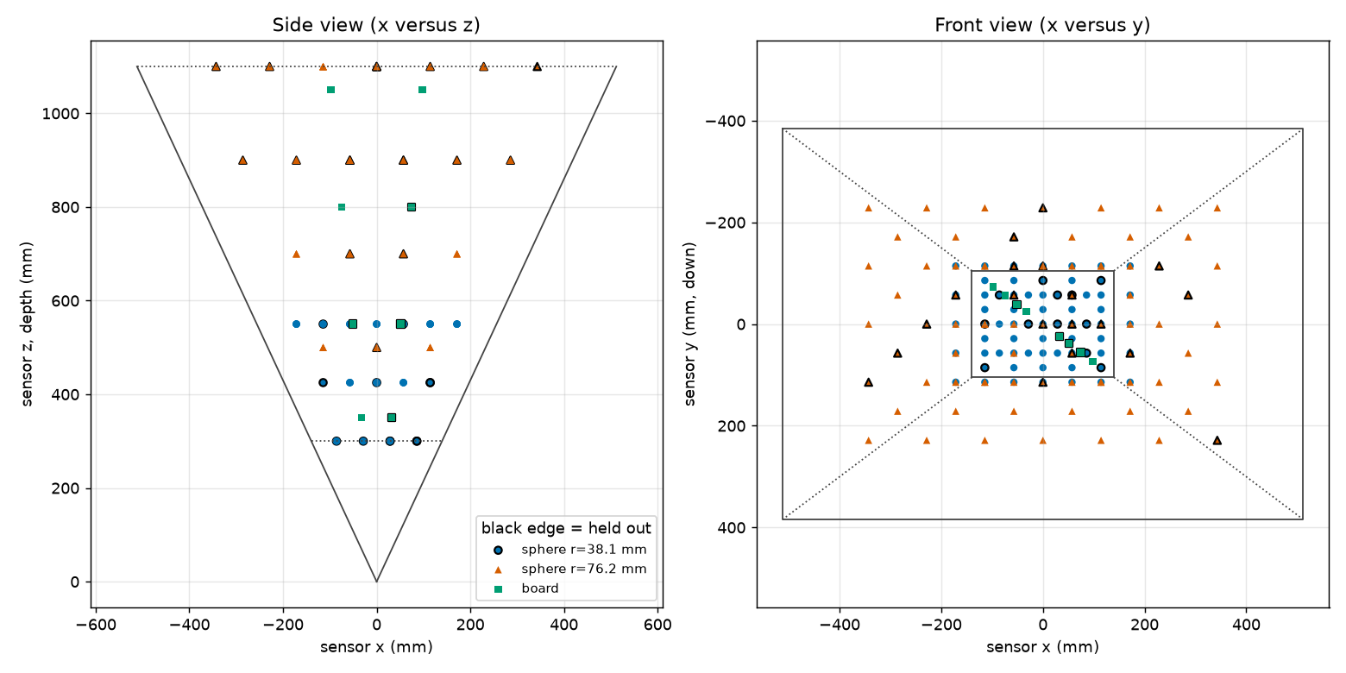
The plan spreads 186 poses through the volume
90
sphere A poses at 300, 425 and 550 mm
57
sphere B poses from 500 to 1,100 mm
39
board poses at 4 depths, tilted 0, 20 and 40 degrees
About 20 percent of poses are held out to test the fit; they are captured like all the others.
Notes:
The plan tool writes poses.csv, a summary, and the picture shown here, which plots the planned sphere and board centers in the sensor's frame: a side view on the left and a front view on the right, with the field of view drawn. Sphere A covers the near range on a grid 1.5 radii apart, sphere B the far range, and both appear at 500 to 550 mm. Board poses that would leave the field of view are dropped automatically. A handful of the outermost sphere poses may touch the image border; the check flags them and they are left out of the fit. Poses with a black edge in the picture are the held-out ones.

Slide 12

Every pose runs the same short robot loop
1
2
3
4
Approach
Settle
Capture
Log
Joint move to 100 mm short along the stem axis, then a linear move onto the pose
Wait 1.5 seconds for vibration to die out
Five frames: <pose_id>_Index00 to _Index04
Read the REPORTED TCP pose and append it to the pose log
Order: all sphere A poses, then sphere B, then the board. Never move the sensor in between.
~8 s
~25 min
per pose
robot time for 186 poses
Notes:
The approach is the same every time so that any small hysteresis in the robot is the same for every pose. The settle time lets vibration from the move die out before the sensor captures. The pose that goes in the log is the one the robot reports after it has arrived, not the one it was commanded to; with a robot of 0.1 mm absolute accuracy the difference matters. Remember to activate the right tool frame at each fixture change: TCP_SPHERE_B_152mm for sphere B and TOOL_BOARD for the board.

Slide 13



Poses are recorded in the file header or in a pose log
Option A: in the file header
Option B: pose log and manifest
The capture software writes robotPose, a 4 x 4 matrix, tool to base
No separate log needed beyond the target sizes
Use it if the capture software supports it
The robot program appends one CSV line per pose
Orientation in the controller's own form: KUKA A, B, C or FANUC W, P, R, quaternion, rotation vector, matrix
make_manifest matches files to poses and names every mismatch
Recommended as a backup even with option A
s038_z0425_017,sphere,38.10,,,812.40,-33.21,455.02,none,,,,
Notes:
Both options are supported by the software. In option B the pose log columns are the pose id, the target kind, the radius or the board half-sizes, the reported position, the rotation type and up to four rotation values; the example line is a sphere pose, which needs no rotation. The manifest tool converts every orientation form to a matrix and complains by name about any pose without files, any file without a pose, and any missing size. A pose log is worth keeping even when the headers carry the pose, because it is the only independent record.

Slide 14

Check the captures before the robot is put away
Low valid fraction
below 50 percent of frames
Target not read: check exposure, or the target was outside the field
Touches the image border
valid pixels at the edge
Target partly out of view: the pose is unusable; re-plan it slightly inward
Sphere center off
more than 2 mm
One pose: position copied wrongly. One sphere: wrong TCP. Growing across the volume: base frame or robot accuracy
Board normal off
more than 2 degrees
Board tool frame orientation wrong, or the rotation type in the log is misnamed
Re-capture a flagged pose under a new id, for example s038_z0425_017r; never delete lines from the log.
Notes:
The check tool prints one line per pose and a verdict, and its exit code is 0 when nothing is flagged, 1 when something is, and 2 when it cannot read the manifest. Running it while the fixtures are still mounted means a bad pose can be captured again in minutes instead of setting everything up again another day. The pattern of the sphere-center flags tells you the cause: one pose, one sphere, or a trend across the volume.

Slide 15

Without a ball bar, two shape checks stand in
Sphere shape
Board flatness
Each held-out sphere is fitted with its radius free
After correction the fitted radius should match the measured radius
Judge each error against its standard error, which is large for a small or distant sphere
Each held-out board is fitted with its own plane
After correction the spread should fall toward the plate's flatness
Sees only errors that bend the board; mainly catches the fixed pattern
Neither check tests the scale of the volume or a smooth robot error; those rest on the robot's 0.1 mm accuracy.
Notes:
Decision D-14: no certified two-sphere bar is available, so nothing in the session has a geometry known independently of the robot. These two checks use no robot positions at all; the fit's report computes them on the held-out poses, so nothing extra is captured. The technician's part is to make the references good: measure the sphere diameters carefully and keep the board's flatness report. A uniform range-scale error of 0.1 percent changes sphere A's fitted radius by only 0.04 mm, so scale is checked mainly by the held-out sphere centers against the robot. If a coordinate measuring machine becomes available, two spheres on a rigid bar measured on it would restore the full check.

Slide 16







Seven things that spoil a session
Moving or bumping the sensor: everything after it is a new session
Fingerprints or gloss: wipe the targets with isopropyl alcohol
Changing exposure, gain or the base frame mid-session
Letting the stem point toward the sensor: the sphere must hide it
Logging the commanded pose instead of the reported pose
Mixing up the two spheres' radii in the pose log
A loose adapter or a bent stem: roll the stem on a flat surface first
Notes:
These are the failures that cannot be repaired afterwards in software. The first two change the sensor itself mid-session, which invalidates the comparison between early and late captures. The third and seventh put wrong numbers into the pose table. The others damage the measurement: a joint that moves shifts the sphere center away from the TCP that was measured, a shiny spot returns a highlight and a bad read, and a visible stem corrupts the sphere fit.

Slide 17


What to hand over at the end of the session
captures/ with every .mc file, named <pose_id>_Index<nn>.mc
Software
pose_log.csv, or confirmation that the headers carry robotPose
plan_poses, make_manifest and check_captures in sphcal/cli
Install and self-test: procedure appendix C
Every tool prints its options with --help
captures/manifest.csv, built without errors
captures/check.json with no flags, or a note on each
plan/ files as used, boot.json and the bootstrap captures
session_notes.txt: sensor serial, warm-up, exposure and gain, base frame, TCPs, board D and runout, sphere diameters, temperature
Photos of the sensor mount, each fixture on the flange, and the nest
Notes:
The checklist is section 10 of the procedure. The session notes matter as much as the data: the fit needs the measured sphere diameters, and the notes are the only record of warm-up time, temperature and fixture changes if a result looks wrong later. The three command-line tools come with the repository; appendix C of the procedure walks through installing Python, creating an environment, installing the package and running the self-test, on Windows or Linux.

Slide 18

Open items and next steps
Open
Decided
Next steps
Sphere procurement awaits a canvass of the market
D-13: sphere diameters known to 0.025 mm after finishing
1
Canvass the sphere market and order
2
Machine the adapters, stems, board and nest
Candidate provisional far-range sphere B: Rothbucher RSLB10M, 145 mm, sphericity 0.3 mm
D-14: no ball bar; shape checks stand in
3
Dry run: TCPs, board frame, bootstrap
4
Stage-1 session, about two hours
5
Fit, read the held-out results, decide on stage 2
Notes:
The one open decision is which spheres to buy; the pose plan stays as it is until that is settled. If the Rothbucher sphere were used as a provisional far-range sphere B, sphere B would start at 700 mm instead of 500 mm, because its 0.3 mm form error is acceptable only where the distance-scaled target is 0.2 mm or more. Stage 1 is a few hundred poses; its held-out results decide whether stage 2, a few thousand poses, is needed and where in the volume the extra poses should go.

