Slide 1
Sensor Registration: Test Procedure and Robot Program
Running the two capture runs and what the robot program must do
Test procedure · October 2026
Notes:
This is the second of two decks on the registration captures. The first covers what must exist before the session. This one covers the session itself: the board's tool frame, the rough sensor location, the pose plan, the two sub-procedures that drive the robot to the same poses in two different ways, how poses are recorded, the checks, and what to hand over. It follows sections 2 to 10 of the registration capture procedure in docs/procedures of the plane_plane_registration repository, which gives every step in full.

Slide 2




What we are testing, and why
The method
What is unproven
What the session answers
Register a 3D sensor to the robot from plane-to-plane correspondences
One flat board on the flange, viewed at many poses; no 2D images, no spheres
The sensor measures the board plane; the robot reports where the board is; the transform that maps one onto the other is the registration
Everything so far was verified on synthetic data
Whether the board is found and the planes fit cleanly on real captures
Whether the robot's pose errors or the sensor's plane errors dominate
How much gear backlash shifts the result
The sensor-to-robot transform and its residuals on real data
Residual maps that point at the robot or at the sensor
Set A against set B: a constant backlash offset or random scatter
Real residuals to set the tools' thresholds, which are placeholders today
A few hundred poses decide whether a run of 1,000 or more is needed; that second run is planned only from this one's analysis.
Notes:
This slide orients the audience before the procedure: what is being tested and why the session is shaped the way it is. The method under test registers the sensor into the robot's base frame from plane-to-plane correspondences: the sensor fits a plane to the board in each capture, the robot's reported tool frame gives the same plane in the base frame, and the transform that maps the sensor's planes onto the robot's is the registration, solved in closed form. Its claimed advantage is that one flat target and no 2D images are needed. The solver and the tools were verified on synthetic sessions only. This first real session answers four questions: does the method recover the transform on real captures; which error dominates, the robot's pose accuracy or the sensor's plane measurement, which the residual maps of the analysis show; how much backlash matters, which is why the same poses are captured twice, straight (A) and via a standardized approach (B); and what the thresholds should be, since every gate in the tools is a placeholder until real residuals set it. The specification review in docs/registration_review and the procedure's introduction give the background.

Slide 3




Two capture sets and an exact log of poses
235
~3 h
2,350
robot poses, visited twice, 5 frames each
with setup and checks; about 80 minutes of robot time
capture files, about 25 GB
If the pose log is wrong, the registration is wrong.
Every capture file must be matched to exactly where the robot had put the board. The two capture sets come from one plan, driven straight to each pose and then via a standardized approach, so that the effect of gear backlash can be measured.
Notes:
The output of a session is two folders of sensor capture files, one group per robot pose, each with a manifest that records for every file where the robot reported the board. The registration software fits the sensor-to-robot transform from each folder. The two folders come from the same list of poses driven in two ways: sub-procedure A moves straight to each pose, sub-procedure B approaches every pose with the same final move so that backlash is taken up the same way each time; comparing the two tells whether backlash matters. The counts are for the default plan on a 640 x 480 sensor (section 5); the plan tool prints the exact ones. The purpose of this first session is to learn whether the robot's pose errors or the sensor's plane errors dominate, and to set the thresholds of the tools from real residuals; a larger run of 1,000 poses or more is planned only if the analysis calls for it.

Slide 4
The session at a glance
1
2
3
4
Prepare
Board frame
Locate sensor
Plan poses
Warm up the sensor 30 min; fix exposure, gain and SGM parameters
Mount the board; run-out check; measure D; set TOOL_BOARD
Six hand-jogged captures give a rough sensor position
The plan tool writes poses.csv, a summary and a picture
5
6
7
Capture A
Capture B
Hand over
Straight to each pose; manifest and check
Via the approach pose; manifest and check
Folders, pose logs, manifests, checks, notes, photos
Notes:
These are the seven stages of a session, in order; sections 2 to 9 of the procedure correspond to them. Steps 1 to 4 are setup and happen once. Steps 5 and 6 each run over the whole plan, and each ends with the manifest and the quick check before the other starts, while the board is still mounted and flagged poses are cheap to re-capture. The sensor and the board are not touched between the two runs; moving either makes everything after it a new session. The software commands are listed in one table in section 2 of the procedure, with the section that explains each.

Slide 5



Preparation before the first session
Robot
Sensor and computers
Cell
Check the documented absolute accuracy: 0.1 mm or better
Weigh the board with its adapter; enter its tool load data
Write the robot program; note where it writes the pose logs
Dry-run every pose at reduced speed, in both sub-procedures
Safety review of the new program
Capture software set for the trigger and the <pose_id>_Index<nn> file names
Exposure, gain and SGM parameters set and recorded: smoothing filters off, installation patch size
At least 25 GB free for the default plan
Both software packages installed and self-tested
Layout study: board centers 550 to 950 mm from the sensor, tilted up to 30 degrees, inside the robot's reach
Run-out base plate bolted to the table
Robot base frame identified and recorded
The board, the adapter and the tools themselves are in the procurement and build deck, and in section 1 of the procedure.
Notes:
This is section 1f of the procedure: everything to prepare before the first session, beyond the hardware. The robot's absolute accuracy is taken from the maker's specification sheet; repeatability alone is not enough, because every pose is used as a known position. Tool load data matter because a wrong mass or center of gravity shifts every reported pose. The dry run covers both sub-procedures, including the 40 mm approach retreat of B, so that no pose collides with the sensor or its cables. The sensor settings are the stage-1 ones: the same depth sensor with its SGM parameters recorded, smoothing filters off and the installation patch size. The disk figure is 10 GB per 1,000 frames for about 2,350 frames.

Slide 6

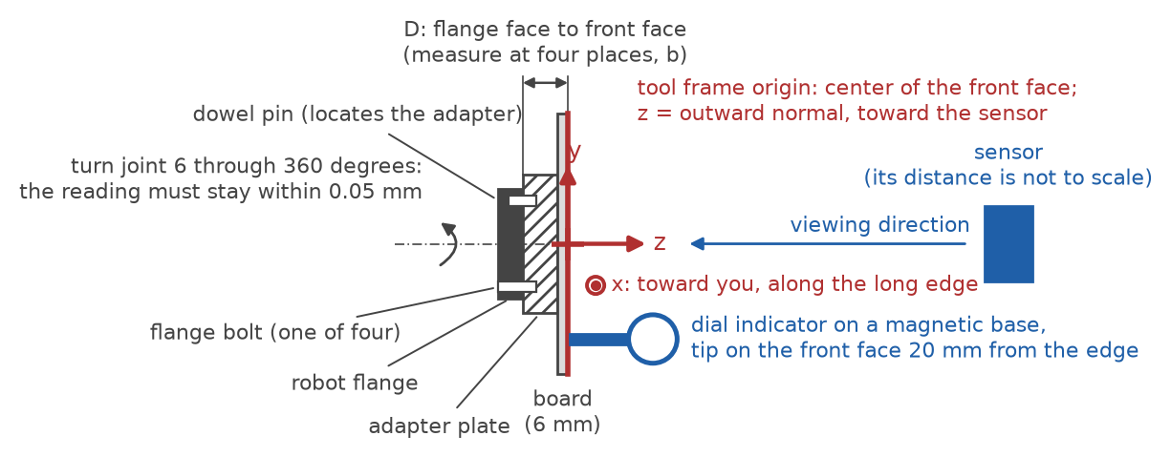
The board's tool frame sits on its front face
Run-out: turn joint 6 through 360 degrees; the dial indicator stays within 0.05 mm
Measure the flange-to-face distance D at four places; they agree within 0.05 mm
Tool frame: origin at the face center, z out of the face toward the sensor, x along the long edge
A few degrees of error in x is harmless; an error in z is not
Save as TOOL_BOARD with its load data; record D, the run-out and the board size
After any remount: run-out and D again, and the saved reference pose captured again (procedure section 3)
Notes:
The board's pose is reported by the robot, not fitted, so its frame must be right: the registration takes the reported frame's z axis as the board normal and its origin as a point on the front face. The run-out check tests whether the board face is perpendicular to the flange axis; if the reading wanders, the adapter is shimmed. D is the distance from the flange face to the front face, measured at four places; the tool frame is defined at (0, 0, D) from the flange. An error in x only rotates the frame within the board plane, which the registration does not use; an error in z tilts the normal and shows as a residual on every pose. If the controller cannot define a tool frame, the flange pose is logged instead and the tools are given D with the target-offset option (procedure section 3). A remount is verified, not assumed (section 3, remount check): the run-out and D measurements are repeated, and the first bootstrap pose, saved on the controller as a named position, is captured again so that the bootstrap shows the before-and-after residuals side by side. A tilt or a change of D matters; a shift within the board's own plane does not. A remount between the two sub-procedures is recorded, because their comparison assumes an unchanged board.

Slide 7
Six captures locate the sensor roughly
About 600 mm in front, near the picture center, facing the sensor squarely
Tilted about 20 degrees, top edge toward the sensor
Tilted about 20 degrees, bottom edge toward the sensor
boot01
boot02
boot03
Sensor
Tilted about 20 degrees, left edge toward the sensor
Tilted about 20 degrees, right edge toward the sensor
About 250 mm farther away, facing squarely
boot04
boot05
boot06
Log the robot's reported tool pose for each; one capture per pose
The bootstrap tool finds the board in each capture and registers the six poses
Residuals of a fraction of a degree and a millimeter or two are fine; several degrees or tens of millimeters mean a copying error or a wrong tool frame
Notes:
The software determines the sensor's exact position from the full capture set; this step only needs a rough position so that the planned poses land inside the field of view and so that the software knows where to look for the board in each capture. Six hand-jogged poses, tilted in four directions and at two distances, are enough; the bootstrap also reports the normal spread of the six, which must reach 0.05 and is about 0.2 with these tilts. The result, boot.json, is read by the plan tool and the check tool. Procedure section 4 gives the steps and the commands; the words it uses for what the software reports, segmentation, plane residual, normal and offset residual, are defined there with figure 2.

Slide 8
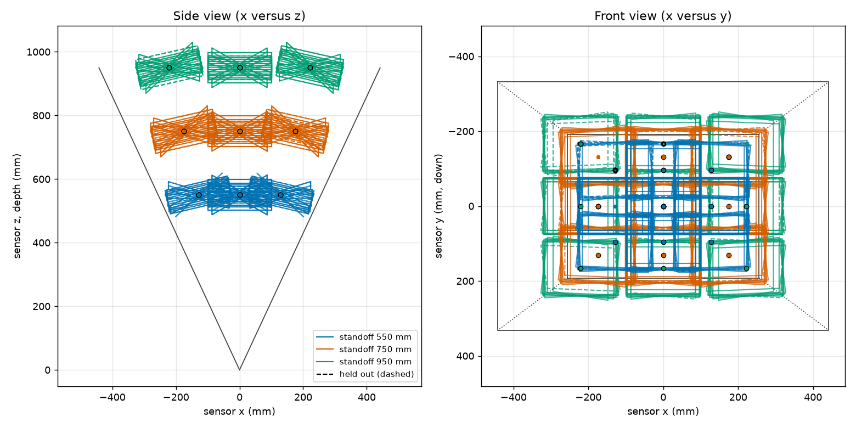
235 poses spread through the volume
3
standoffs: 550, 750 and 950 mm
9
orientations per position: facing, and tilted 15 and 30 degrees toward four edges
3 x 3
About 20 percent of poses are held out to test the fit; they are captured like all the others. Tilted boards that would leave the field are dropped automatically.
grid of positions over half the field at each standoff
Notes:
The plan tool writes poses.csv, a summary, and the picture shown here, which plots the planned board centers in the sensor's frame: a side view on the left and a front view on the right, with the field of view drawn; one color per standoff, held-out poses outlined. Each pose is described by its standoff, tilt and azimuth, which section 5 of the procedure defines. The summary reports how many poses were planned, dropped and kept at each standoff and tilt, the normal spread of the set, and the registration error to expect if the sensor's planes are good to 0.2 degrees and 0.2 mm. Every row of poses.csv carries the target pose in three orientation forms and the approach pose for sub-procedure B; section 5 lists the columns.

Slide 9



What the robot program must do
Inputs
Behavior
Outputs
poses.csv from the plan tool: base-frame position and orientation of every target pose, as a matrix, a quaternion and a rotation vector, plus the approach pose in the same forms
The tool frame TOOL_BOARD
Sub-procedure A: one joint move straight to the target
Sub-procedure B: joint move to the approach pose, then the same linear final move onto every target
Settle 1.5 seconds; same speed settings in both; never change the base frame
Trigger five frames per pose through the communication software, named <pose_id>_Index00 to _Index04
Append the REPORTED tool pose and, if available, the joint angles to pose_log_A.csv or pose_log_B.csv; note where the files are written
Once the robot model and controller are settled, the robot program can be written with Claude Code.
Notes:
The robot program is small: it reads the plan, moves, waits, triggers the sensor, and logs what the robot reports. Its interface is fixed by the files on either side: poses.csv coming in (section 5 of the procedure), the trigger through the capture computer's communication software, and the pose log going out (section 7). The one thing it must never do is log the commanded pose instead of the reported one. For sub-procedure B it also logs the joint angles at the approach pose when the controller reports them, so that the check tool can confirm that each joint's final motion had the same direction at every pose. Both sub-procedures are in section 6.

Slide 10

Sub-procedure A: straight to every pose
1
2
3
4
Move
Settle
Capture
Log
One joint move to the target pose, from wherever the robot is
Wait 1.5 seconds for vibration to die out
Five frames through the communication software: <pose_id>_Index00 to _Index04, into captures_A/
Read the REPORTED tool pose and the joint angles; append them to pose_log_A.csv
Then build the manifest and run the check before starting B. Do all of A, then all of B; never move the sensor or remount the board between them.
~8 s
~30 min
per pose
robot time for 235 poses
Notes:
Sub-procedure A ignores backlash: the robot goes to each pose by whatever path the controller chooses, so each joint arrives from a different direction at different poses and the dead band of its gears is taken up differently each time. Whatever scatter that produces appears in the residuals of this set. The approach columns of poses.csv are not used. When the last pose is done, the manifest of captures_A is built and the quick check run while the board is still mounted, so that flagged poses can be re-captured cheaply (procedure sections 6 to 8). The time per pose is a rough figure, not a measurement.

Slide 11
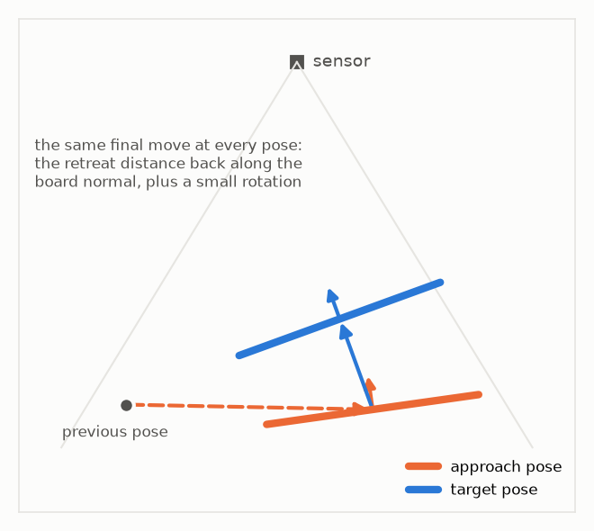
Sub-procedure B: the same final move
Joint move to the approach pose: the target moved back 40 mm along the board normal and turned 3 degrees about its long edge
1
2
Wait 0.5 seconds
Linear move onto the target at the same speed every time, without stopping or reversing; use the exact-stop mode if the controller has one
3
4
Settle 1.5 seconds; capture five frames into captures_B/
5
Log the REPORTED tool pose and the joint angles at the target and, if available, at the approach pose
Notes:
Gear backlash lets the flange sit on either side of a small dead band after a move, depending on which way each joint last moved. Approaching every target with the same final move makes the last motion of each joint the same at every pose, as far as the geometry allows, so the dead band is taken up the same way each time and its effect is constant instead of random. A constant offset is absorbed into the registered transform; a random one shows as scatter. Comparing set B with set A therefore separates the two. The approach pose is in every row of poses.csv. The joint angles at the approach pose let the check tool report, per joint, the fraction of poses whose final motion had the majority direction. The figure is the right panel of figure 4 of the procedure, with the approach rotation exaggerated.

Slide 12



Poses are recorded in a pose log
What the log holds
Rotation forms the tools accept
The pose id from poses.csv, which also starts the file names
The board half-sizes
The REPORTED tool position in the base frame
The orientation in the controller's own form, named by its rotation type
The joint angles at the target and, in B, at the approach pose
quaternion_wxyz (ABB) or quaternion_xyzw
euler_zyx_deg: KUKA A, B, C
fixed_xyz_deg: FANUC W, P, R
rotvec_deg: Universal Robots, converted from radians to degrees
matrix: nine numbers, row by row
make_manifest converts them all and names every file or pose that does not match
b_z0650_t24_a090_05,board,,100.0,75.0,850.11,-12.70,470.55,euler_zyx_deg,-91.3,19.8,0.4,,
Notes:
The capture software writes the sensor data; the robot's pose is recorded separately by the robot program, in a CSV file with one header line and one line per pose. Section 7 of the procedure lists the columns and the rotation types with their controller examples; naming the form wrongly makes every pose disagree with the solution, which the check reports. After each sub-procedure, make_manifest matches every file to its pose id, converts the orientation to the standard matrix form, and complains by name about any pose without files, any file without a pose and any missing size. Writing the pose into the file header as well is an optional cross-check; it does not replace the log. The example line is one pose; the joint-angle columns follow it in the file.

Slide 13
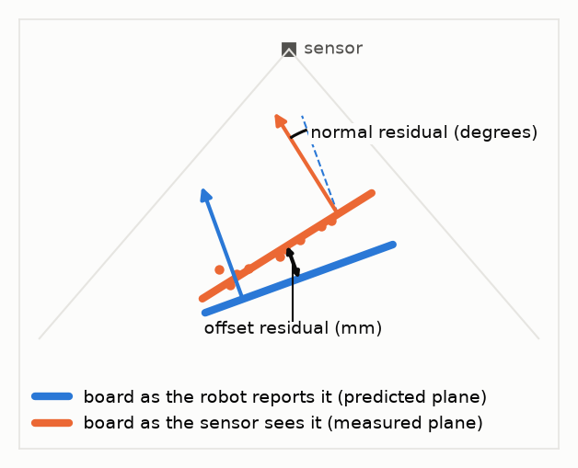
Two numbers are reported for every pose
The software finds the board in each capture and fits a plane to it: the plane residual says how flat the board read
From the logged robot pose and the sensor's position it predicts where the board plane should be
Normal residual: the angle between predicted and measured plane, in degrees
Offset residual: the distance between them at the board's center, in millimeters
A pose logged wrongly stands out by a large residual; one tilt direction off means the tool frame's z axis is wrong
Notes:
These two residuals are how every tool in the procedure reports agreement between the robot and the sensor: the bootstrap for the six hand-jogged poses, the check for each capture set against its own registration, and the analysis maps afterwards. The predicted plane comes from the logged robot pose and the current sensor-to-robot transform; the measured plane from the sensor's points. Once the transform has been solved from all the poses, each pose's residuals say how well it agrees with the solution. Section 4 of the procedure defines the words and shows this figure as figure 2.

Slide 14

Check each capture set before the next run
Board not found or too small
not found; valid fraction below 50 percent; at the border; under 1,000 pixels
Copied wrongly, something flat closer than the board, out of the field, or exposure. Too small: drop the pose
Plane residual
above 1 mm
The board did not read flat: a shiny spot, a dirty board, or an exposure problem
Normal or offset residual
above 1 degree or 1 mm
One pose: copied wrongly. Every pose of one tilt direction: tool frame z axis or a misnamed rotation type. Growing across the volume: base frame or robot accuracy
Joint sign consistency
far below 100 percent (B only)
The approach move did not standardize that joint's backlash over part of the workspace; tell the engineer
Re-capture a flagged pose under a new id, for example b_z0650_t24_a090_05r; never delete lines from the log. Exit code 0 means nothing flagged.
Notes:
The check tool prints one line per pose and a verdict, and writes a JSON report; its exit code is 0 when nothing is flagged, 1 when something is, and 2 when it cannot read the manifest. It runs on each folder as soon as its captures are complete, while the robot and the board are still set up, because that is when a flagged pose can be re-captured. It also reports the normal spread of the set, which should not fall below 0.05 with the plan's defaults. Section 8 of the procedure lists every flag and what it means. The thresholds are placeholders until the first real session sets them. A board image of fewer than 1,000 pixels, typically the far standoff at the largest tilt, gives a noisy plane; the check flags it as too small and suppresses its residual flags, and the right response is to drop the pose from the plan rather than re-capture it. The 1,000 is a placeholder.

Slide 15






Seven things that spoil a session
Moving or bumping the sensor: everything after it is a new session, both sub-procedures repeated
Fingerprints or gloss on the board: wipe with isopropyl alcohol
Changing exposure, gain, the base frame, the speed settings or the backlash compensation mid-session or between the runs
Something flat and large closer to the sensor than the board: keep the foreground clear
In B, stopping or reversing on the final move, or skipping the approach pose; or capturing B into the A folder
Logging the commanded pose instead of the reported pose
A loose adapter, or a remount that did not go back: do the remount check after any remount
Notes:
These are the failures that cannot be repaired afterwards in software. The first two change the sensor or the robot mid-session, which invalidates the comparison between the two runs. A commanded pose in the log hides exactly the robot error the session is meant to measure. The foreground matters because the software, when it has no better information, takes the closest large flat surface to be the board. The last item defeats sub-procedure B: every pose must get the same final move, and the two folders must not be mixed. Section 10 of the procedure gives the full list.

Slide 16


What to hand over at the end of the session
captures_A/ and captures_B/ with every .mc file, named <pose_id>_Index<nn>.mc
Software
pose_log_A.csv and pose_log_B.csv, with the joint-angle columns when the controller reports them
plan_poses, bootstrap and check_captures in planereg.capture; make_manifest in sphcal.cli
Install and self-test: procedure appendix C
Every tool prints its options with --help; appendix B quotes them
captures_A/manifest.csv and captures_B/manifest.csv, built without errors
captures_A/check.json and captures_B/check.json with no flags, or a note on each
plan/ files as used, boot.json, boot_pose_log.csv and the bootstrap captures
session_notes.txt: sensor serial, warm-up, exposure, gain and SGM parameters, pose log location, base frame, backlash setting, board D and run-out, TOOL_BOARD, temperature, speed settings, run order and times
Photos (a phone camera is fine) of the sensor mount, the board on the flange, and the workspace as the sensor sees it
Notes:
The checklist is section 9 of the procedure. The session notes matter as much as the data: the analysis needs D, the tool frame values and the backlash compensation setting, and the notes are the only record of the order the runs were made in and of anything unusual. The four software tools are summarized in one table in section 2 of the procedure, with the section that gives each full command; appendix B quotes their help output and appendix C says how to install them.

