Slide 1

BANGALORE INSTITUTE OF TECHNOLOGY
DEPARTMENT OF ARTIFICIAL INTELLIGENCE AND MACHINE LEARNING
PROJECT PRESENTATION ON
“CREDIT CARD FRAUD DETECTION”
UNDER THE GUIDANCE OF :
MRS. SUBHA MEENAKSHI S
PRESENTED BY:
SANSKAR SINHA (1BI20AI061)
SHIVAM YADAV (1BI20AI062)

Slide 2
ABSTRACT
Credit card fraud is a significant concern in today's digital world, leading to financial losses and compromised user security. Detecting fraudulent transactions in real-time is critical to mitigating these risks. This project proposes an advanced credit card fraud detection system utilizing machine learning algorithms.
The ultimate objective is to develop an accurate and efficient credit card fraud detection system that can effectively distinguish between genuine and fraudulent transactions, thus enhancing financial security and trust in digital transactions.

Slide 3
CONTENTS
Introduction
Literature Survey
Proposed System
Problem Statement
Objective
System Architecture
Dataset
Libraries Used
Implementation (Code)
Outcome of the Project
Conclusion

Slide 4
PROPOSED SYSTEM
The proposed credit card fraud detection system utilizes machine learning for effective fraud identification. The system begins with the collection of a well-balanced dataset, including legitimate and fraudulent transactions. After preprocessing and feature engineering, various machine learning algorithms, such as logistic regression, decision trees, and neural networks, are trained and evaluated using metrics like precision and recall. Ensemble methods are employed for enhanced accuracy, and the system incorporates real-time monitoring with alert mechanisms for prompt detection. Upon deployment, the model is integrated into transaction processing systems, and continuous improvement involves regular updates based on evolving fraud patterns. The system prioritizes explainability, implements security measures, adheres to regulatory compliance, and emphasizes ongoing monitoring for a robust and reliable fraud detection solution.

Slide 5
LITERATURE SURVEY
Sl. No. | Title | Author | Year | Contributions & Drawbacks
1 | Fraudulent Transaction Detection | Zareapoor et al. | 2012 | Determine the best model in detecting fraudulent transactions based on accuracy, speed, and cost. Expensive models built; varying accuracy, speed, and cost implications.
2 | Credit Card Fraud Detection | Alenzi & Aljehane | 2020 | Achieve high accuracy in detecting credit card fraud using Logistic Regression. Sensitivity to dataset distributions not extensively discussed.

Slide 6
Sl. No. | Title | Author | Year | Contributions & Drawbacks
3 | Classification Algorithms for Imbalanced Datasets | Tanouz et al. | 2021 | Utilize Naïve Bayes, Logistic Regression, Random Forest, and Decision Tree on strongly imbalanced datasets, displaying varying accuracies among models.
4 | Genetic Algorithm-Based Feature Selection | Saheed et al. | 2020 | Apply Genetic Algorithm for feature selection, comparing Naïve Bayes, SVM, and Random Forest, revealing Random Forest's highest accuracy. Achieve high accuracy in detecting credit card fraud using Logistic Regression. Sensitivity to dataset distributions not extensively discussed.

Slide 7
INTRODUCTION
In recent years, the proliferation of digital transactions has revolutionized the way we conduct financial activities. Credit card usage has become ubiquitous, providing convenience and efficiency in financial transactions. However, this convenience has also given rise to a significant challenge - credit card fraud. Fraudulent activities, such as unauthorized transactions and identity theft, pose a substantial threat to both cardholders and financial.
Credit card fraud detection is a critical area of research and development aimed at identifying and preventing unauthorized or fraudulent transactions.

Slide 8
Traditional rule-based systems are no longer sufficient to counter the evolving sophistication of fraudulent activities. As a result, advanced technologies and machine learning algorithms have gained prominence in effectively addressing this issue.
The objective of this project is to design and implement a robust credit card fraud detection system that leverages the power of machine learning. The system will analyze historical transaction data, extract meaningful patterns, and utilize these patterns to detect suspicious or fraudulent activities in real-time. By doing so, it aims to reduce financial losses for both consumers and banks, as well as enhance overall security and trust in digital financial transactions.

Slide 9
PROBLEM STATEMENT
Credit card fraud is a rising concern due to increasing digital transactions. Conventional rule-based detection systems struggle to keep up with evolving fraud techniques. This project aims to develop an accurate credit card fraud detection system using advanced machine learning. Challenges include imbalanced data and balancing detection accuracy without inconveniencing genuine users. We will explore various machine learning models and feature engineering to build an efficient, scalable solution, contributing to a more secure financial landscape.

Slide 10
OBJECTIVES
Develop an Efficient Fraud Detection Model.
Optimize Detection Performance.
Real-time Fraud Monitoring and Alerting.
Interpretability and Explain ability

Slide 11
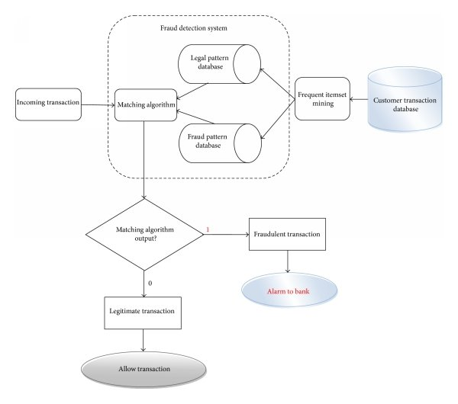
SYSTEM ARCHITECTURE

Slide 12
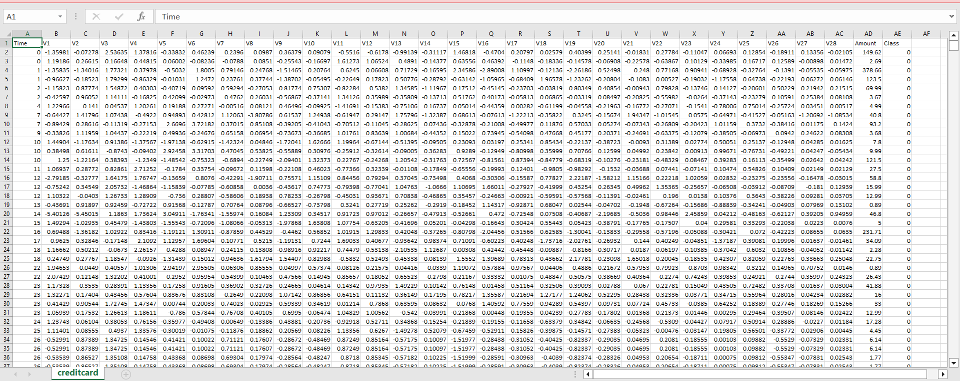
DATASET

Slide 13
LIBRARIES
NumPy (for Numerical Analysis)
Pandas (for handling data files)
Matplotlib(for data visualization)
Seaborn(for data visualization)

Slide 14
IMPLEMENTATION
Import Libraries
import numpy as np
import pandas as pd
import matplotlib.pyplot as plt
import seaborn as sns
from matplotlib import gridspec
dataset = dataset.drop('ID',axis=1)
Load and Prepare Data
data=pd.read_csv(r"C:\Users\SanjanaVijay\Desktop\creditcard.csv")
data.head()
print(data.shape)
print(data.describe())

Slide 15
Exploratory Data Analysis fraud=data[data['Class']==1] valid=data[data['Class']==0] outlierFraction=len(fraud)/float(len(valid)) print(outlierFraction) print("Fraud class: {}".format(len(fraud))) print("Valid class: {}".format(len(valid))) # Check Class variables that has 0 value for Genuine transactions and 1 for Fraud print("Class as pie chart:") fig, ax = plt.subplots(1, 1) ax.pie(data.Class.value_counts(),autopct='%1.1f%%', labels=['Genuine','Fraud'], colors=['yellowgreen','r']) plt.axis('equal') plt.ylabel('') print("Amount of details for the fraudulent transactions") fraud.Amount.describe()import matplotlib.pyplot as plt print("Amount of details for the normal transactions") valid.Amount.describe() corrmat=data.corr() fig=plt.figure(figsize=(12,9)) sns.heatmap(corrmat,vmax=0.8,square=True) plt.show() x=data.drop(['Class'],axis=1)

Slide 16
y=data['Class'] print(x.shape) print(y.shape) x_data=x.values y_data=y.values #plot Time to see if there is any trend print("Time variable") data["Time_Hr"] = data["Time"]/3600 #convert to hours print(data["Time_Hr"].tail(5)) fig, (ax1, ax2) = plt.subplots(2, 1, sharex = True, figsize=(6,3)) ax1.hist(data.Time_Hr[data.Class==0],bins=48,color='g',alpha=0.5) ax1.set_title('Genuine') ax2.hist(data.Time_Hr[data.Class==1],bins=48,color='r',alpha=0.5) ax2.set_title('Fraud') plt.xlabel('Time (hrs)') plt.ylabel('#transactions') #let us check another feature Amount fig, (ax3,ax4) = plt.subplots(2,1, figsize = (6,3), sharex = True) ax3.hist(data.Amount[data.Class==0],bins=50,color='g',alpha=0.5) ax3.set_yscale('log') # to see the tails ax3.set_title('Genuine') # to see the tails ax3.set_ylabel('# transactions')

Slide 17
ax4.hist(data.Amount[data.Class==1],bins=50,color='r',alpha=0.5) ax4.set_yscale('log') # to see the tails ax4.set_title('Fraud') # to see the tails ax4.set_xlabel('Amount ($)') ax4.set_ylabel('# transactions') Model Development from sklearn.model_selection import train_test_split x_train,x_test,y_train,y_test =train_test_split(x_data,y_data,test_size=0.2,random_state=42) import seaborn as sns from sklearn.ensemble import RandomForestClassifier rfc=RandomForestClassifier() rfc.fit(x_train,y_train) y_pred=rfc.predict(x_test) Model Evaluation from sklearn.metrics import classification_report, accuracy_score from sklearn.metrics import precision_score, recall_score from sklearn.metrics import f1_score, matthews_corrcoef from sklearn.metrics import confusion_matrix n_outliers = len(fraud) n_errors = (y_pred != y_test).sum()

Slide 18
print("The model used is Random Forest classifier") acc = accuracy_score(y_test, y_pred) print("The accuracy is {}".format(acc)) prec = precision_score(y_test, y_pred) print("The precision is {}".format(prec)) rec = recall_score(y_test, y_pred) print("The recall is {}".format(rec)) f1 = f1_score(y_test, y_pred) print("The F1-Score is {}".format(f1)) MCC = matthews_corrcoef(y_test, y_pred) print("The Matthews correlation coefficient is{}".format(MCC)) LABELS = ['Normal', 'Fraud'] conf_matrix = confusion_matrix(y_test, y_pred) plt.figure(figsize =(12, 12)) sns.heatmap(conf_matrix, xticklabels = LABELS, yticklabels = LABELS, annot = True, fmt ="d");

Slide 19
plt.title("Confusion matrix") plt.ylabel('True class') plt.xlabel('Predicted class') plt.show() Implementing Other Algorithms 1)Naïve Bayes Algorithm from sklearn.naive_bayes import GaussianNB model = GaussianNB() model.fit(x_train, y_train) yPredNB=model.predict(x_test) n_outliers = len(fraud) n_errors = (yPredNB != y_test).sum() print("The model used is Naive Bayes classifier") acc1 = accuracy_score(y_test, yPredNB) print("The accuracy is {}".format(acc1)) prec1 = precision_score(y_test, yPredNB) print("The precision is {}".format(prec1)) rec1 = recall_score(y_test, yPredNB) print("The recall is {}".format(rec1)) f11 = f1_score(y_test, yPredNB) print("The F1-Score is {}".format(f11))

Slide 20
MCC1 = matthews_corrcoef(y_test, yPredNB) print("The Matthews correlation coefficient is{}".format(MCC1)) 2)Decision Tree Classifier from sklearn.tree import DecisionTreeClassifier clf = DecisionTreeClassifier() clf = clf.fit(x_train,y_train) yPredDC = clf.predict(x_test) n_outliers = len(fraud) n_errors = (yPredDC != y_test).sum() print("The model used is Decision Tree classifier") acc2 = accuracy_score(y_test, yPredDC) print("The accuracy is {}".format(acc2)) prec2 = precision_score(y_test, yPredDC) print("The precision is {}".format(prec2)) rec2 = recall_score(y_test, yPredDC) print("The recall is {}".format(rec2)) f12 = f1_score(y_test, yPredDC) print("The F1-Score is {}".format(f12)) MCC2 = matthews_corrcoef(y_test, yPredDC) print("The Matthews correlation coefficient is{}".format(MCC2))

Slide 21
3)Linear Regression from sklearn.linear_model import LinearRegression lr=LinearRegression() lr.fit(x_train, y_train) yPredLR=lr.predict(x_test) from sklearn.metrics import mean_squared_error, r2_score mse = mean_squared_error(y_test, yPredLR) print("Mean Squared Error:", mse) r2 = r2_score(y_test, yPredLR) print("R-squared:", r2)

Slide 22
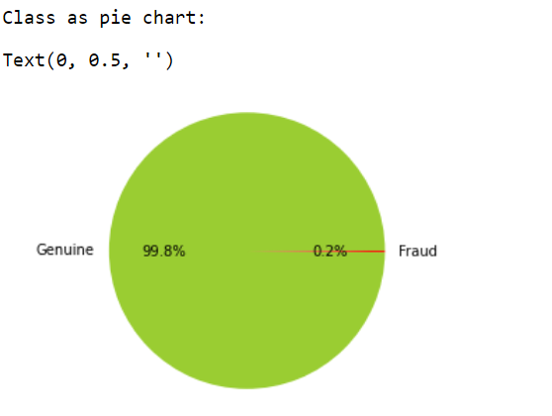
SNAPSHOTS

Slide 23
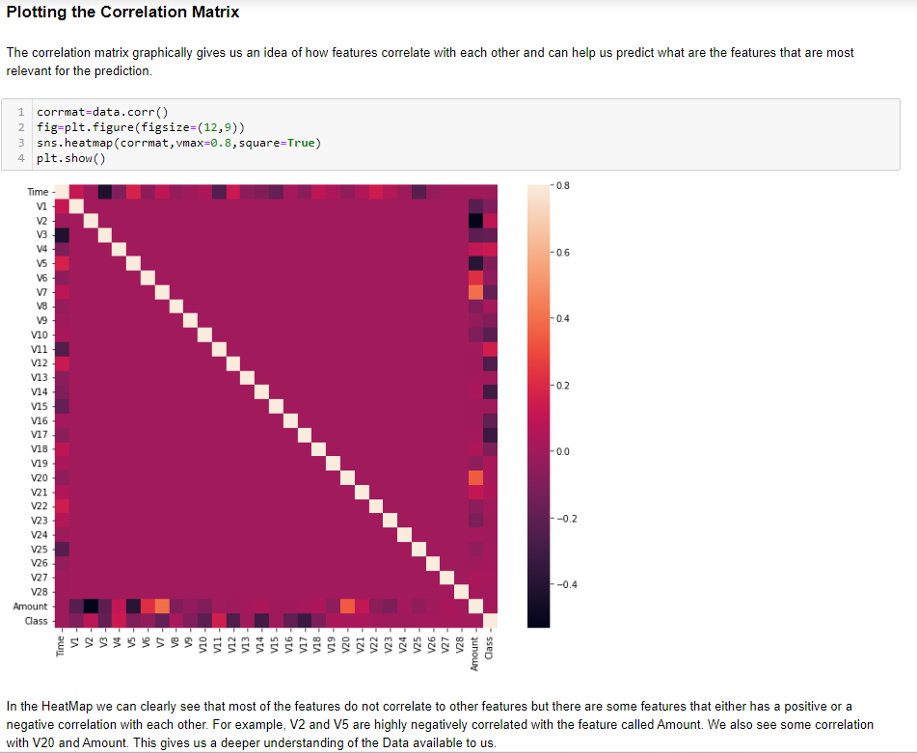

Slide 24
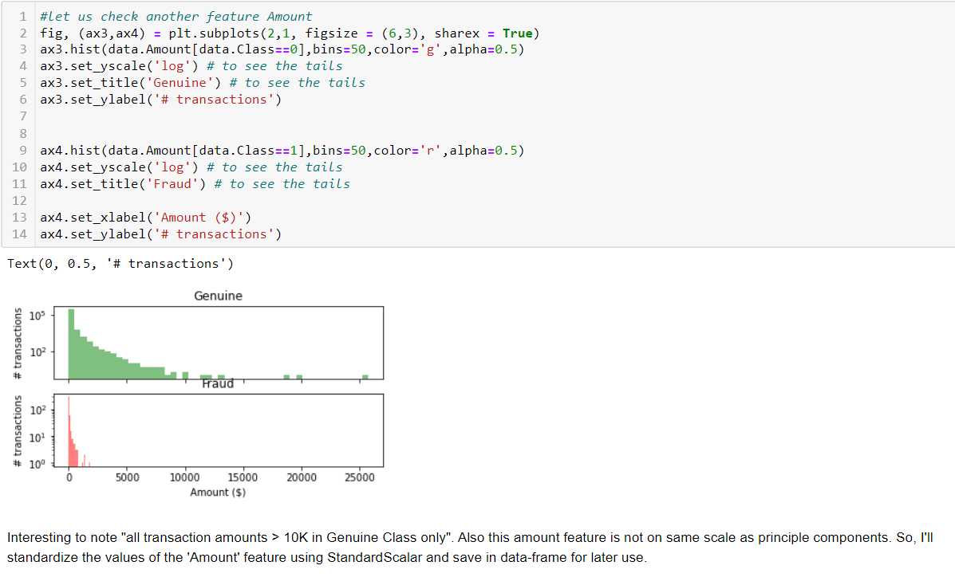

Slide 25
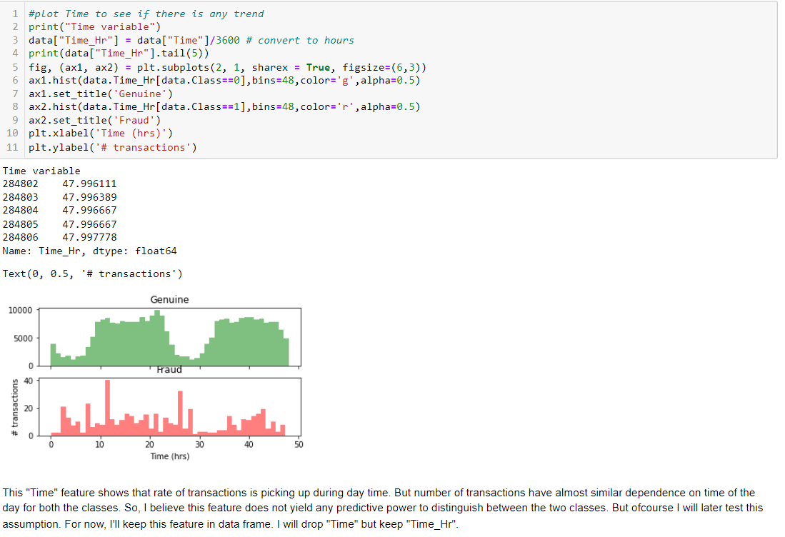

Slide 26
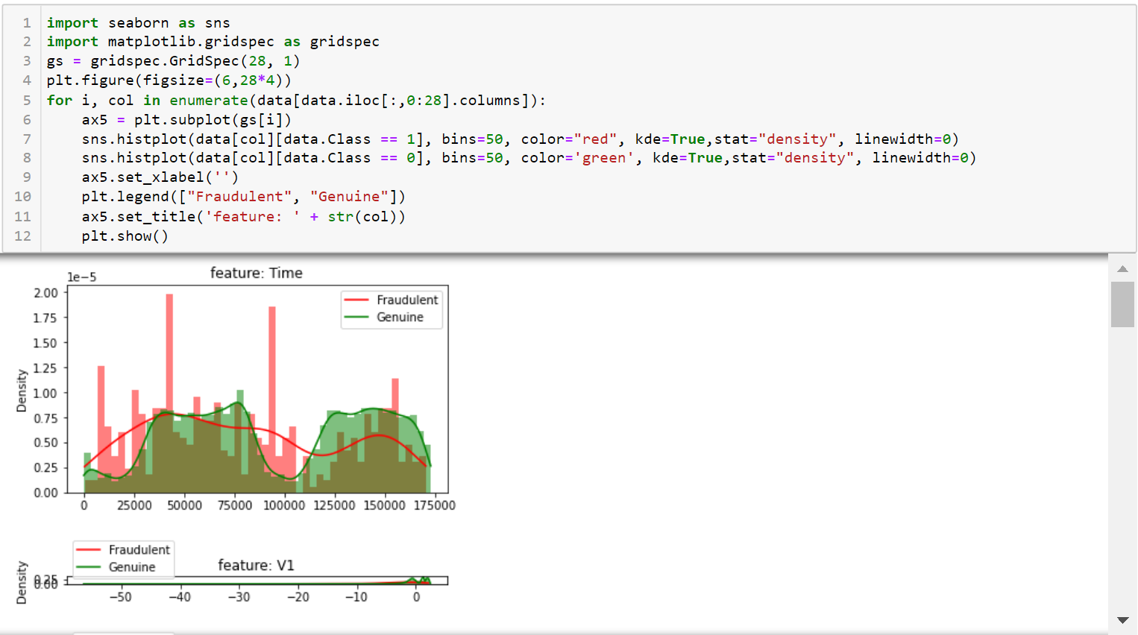

Slide 27
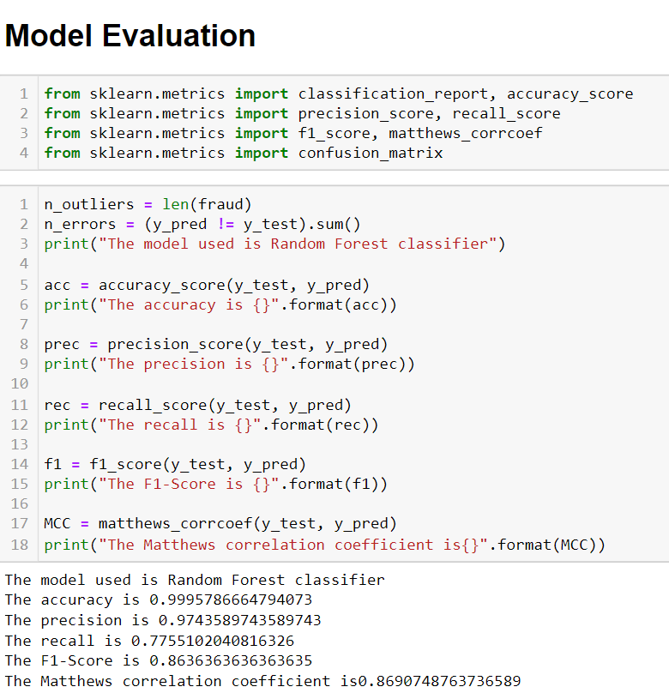

Slide 28
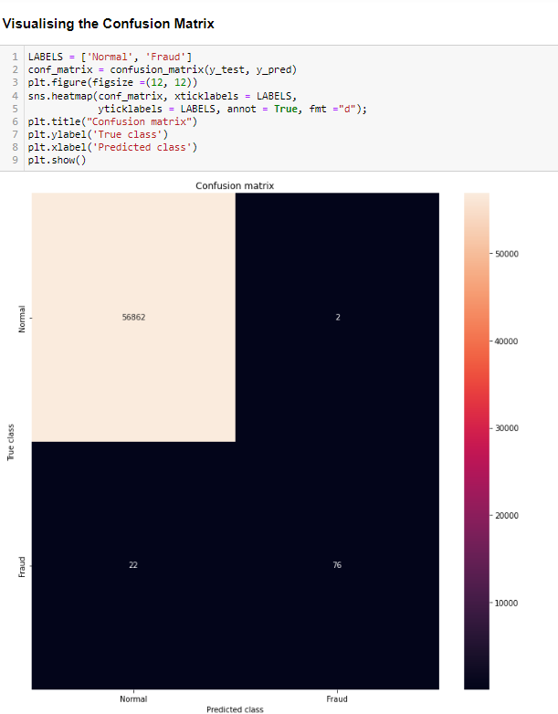

Slide 29
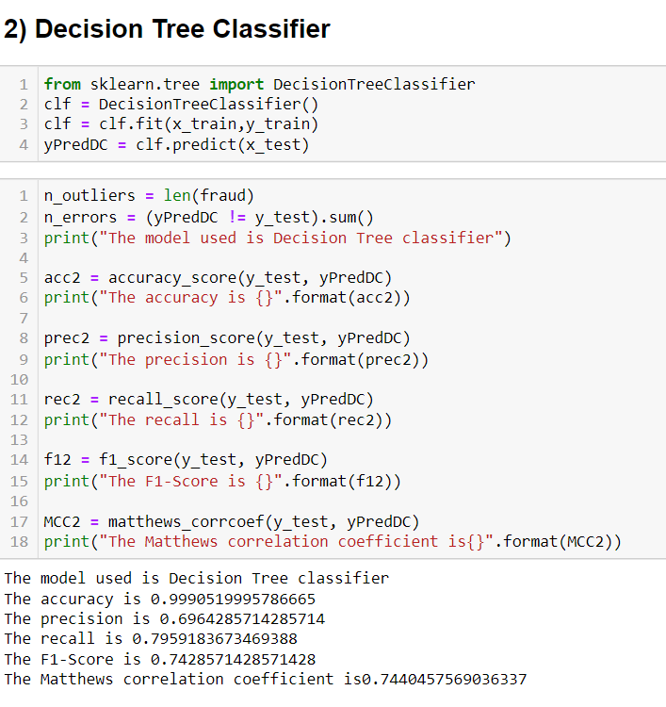

Slide 30
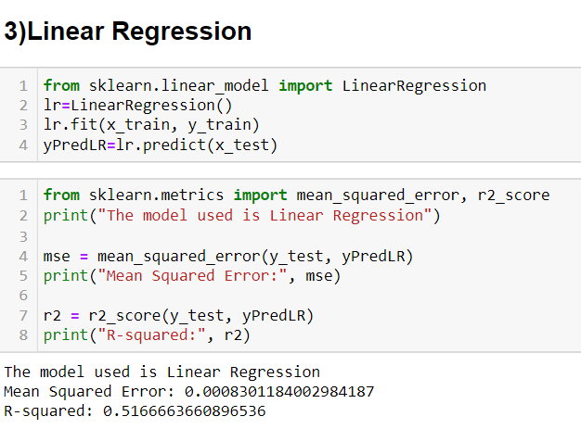

Slide 31
CONCLUSION
The "Credit Card Fraud Detection System" stands as a robust and pivotal solution in the realm of financial security. By harnessing the potential of machine learning and advanced analytics, it addresses the pressing need to identify and prevent fraudulent credit card transactions. Through real-time monitoring and accurate detection, it significantly enhances the safety and trustworthiness of electronic transactions, fostering a secure digital financial ecosystem. The system's regular updates, detailed reporting, and seamless integration further contribute to its effectiveness and relevance in today's dynamic and evolving financial landscape.

Slide 32
THANK YOU

