Slide 1
Interpretable Machine Learning
Christoph Molnar, Parul Pandey, & Rebecca Vickery

Slide 2

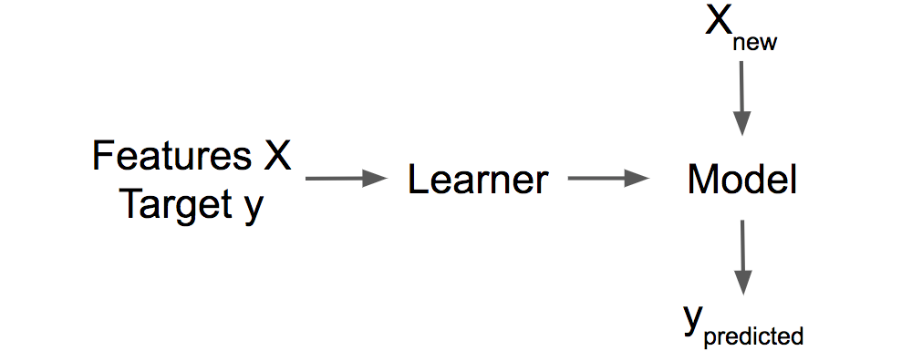
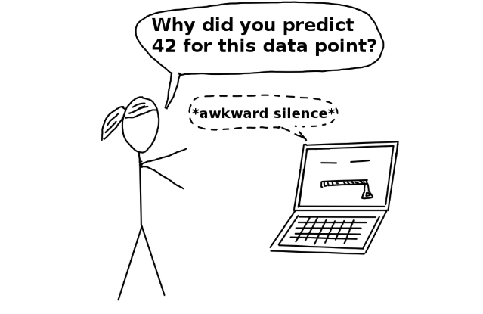
What or Why in Machine Learning
What is predicted?
Why is the prediction made?
Notes:
- The model itself becomes the source of knowledge instead of the data

Slide 3
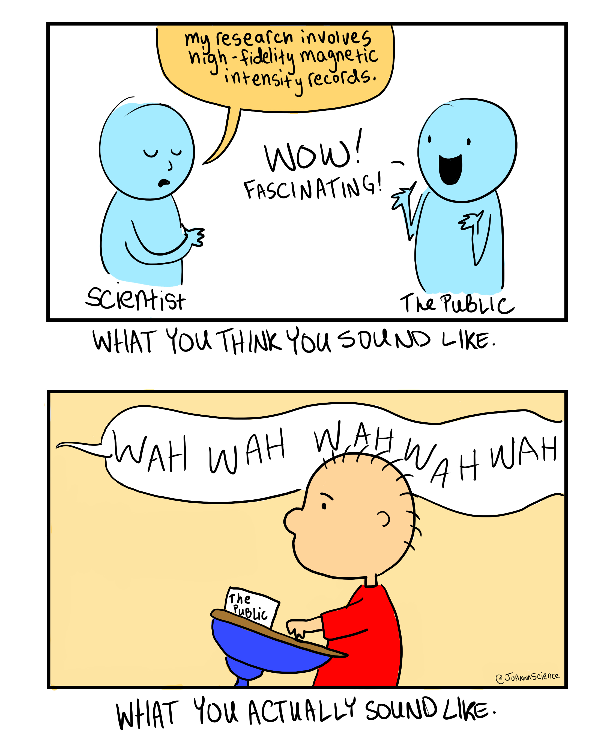
Definition of Interpret
Explain the meaning of (information, words, or actions).
Interpretability is the ability to explain or to present in understandable terms to a human
https://joannawendelcomics.com/

Slide 4
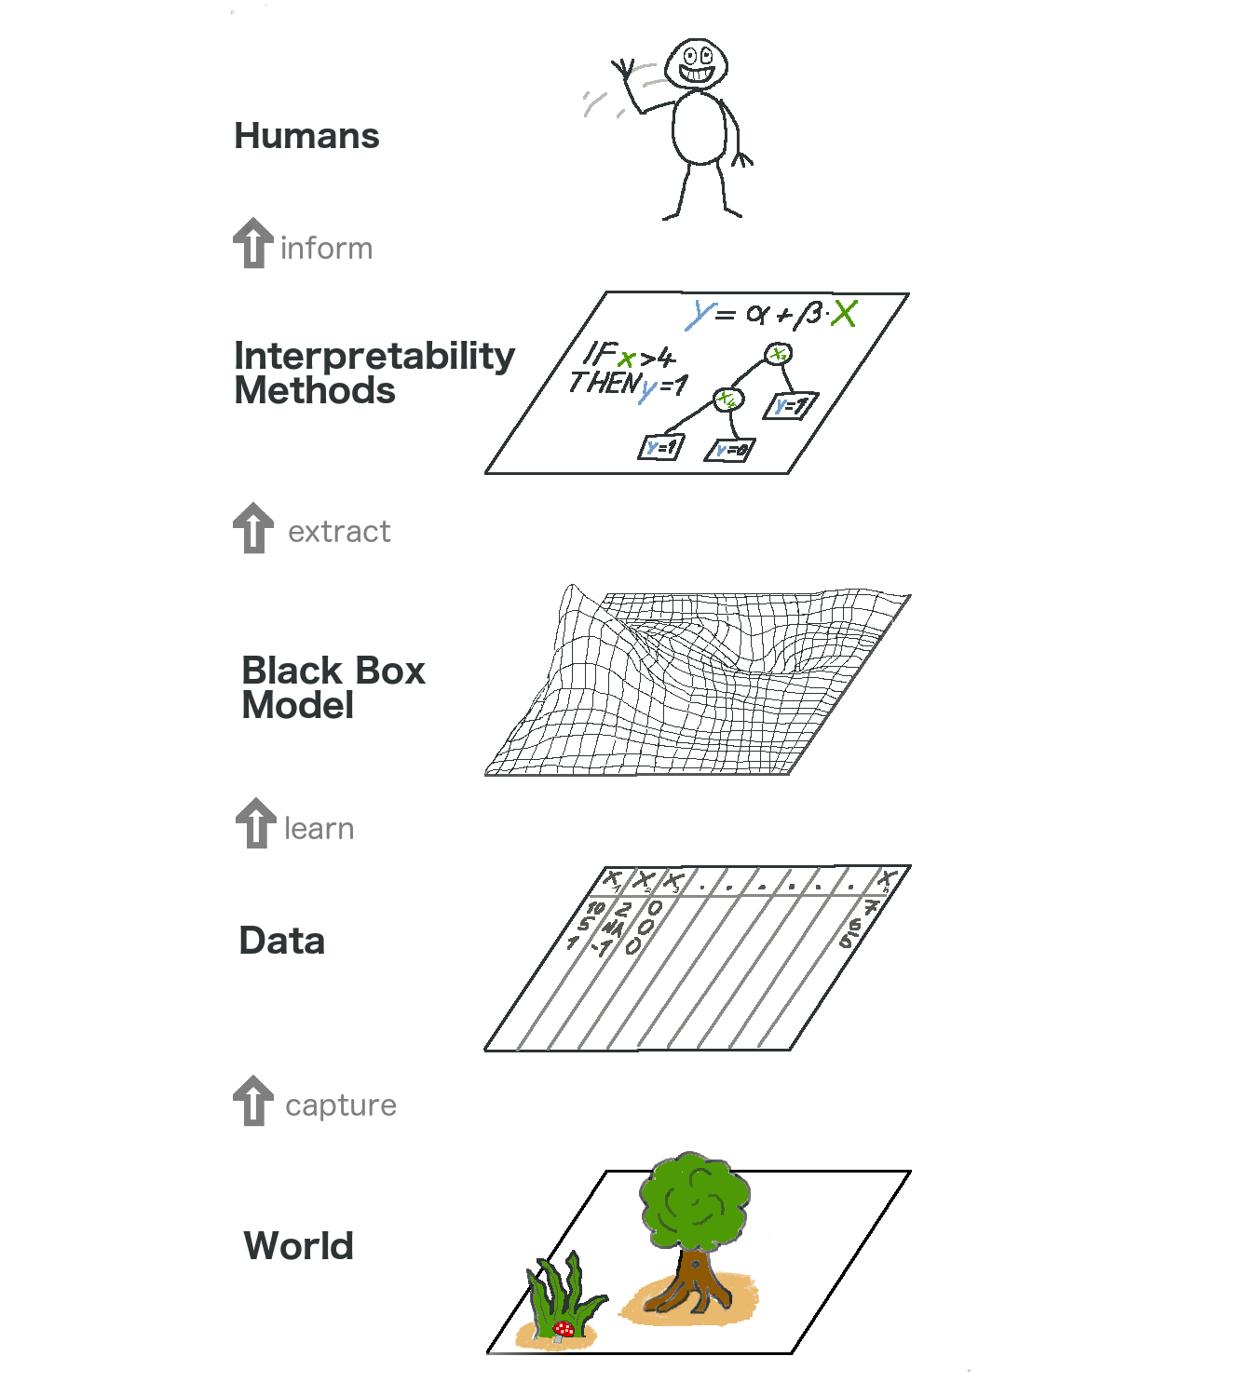
Notes:
Benefit of Intreptability Informing human decision-making

Slide 5
Other Benefits of Interpretability
Reliability (detecting bias)
Debugging
Informing feature engineering
Directing future data collection
Building trust (increase social acceptance)
Notes:
Physicists (latent biases)

Slide 6
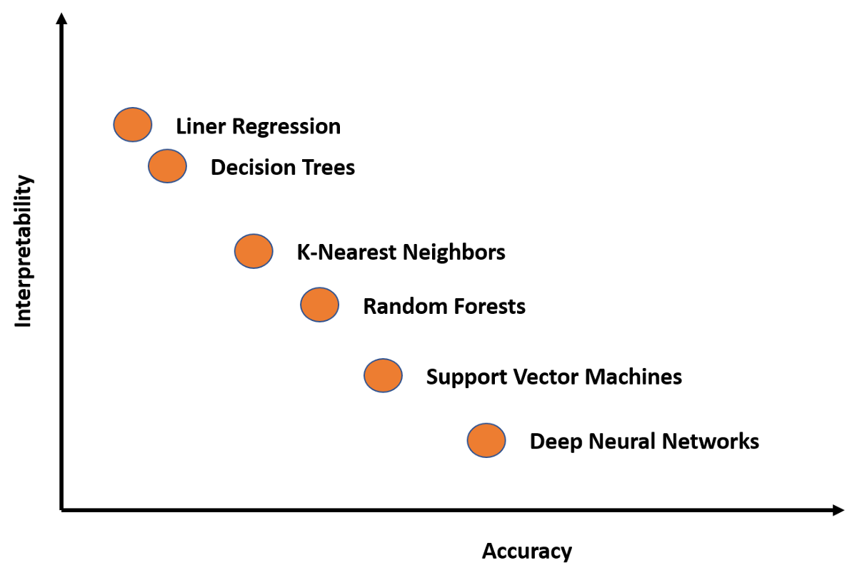
Model Flavors of Interpretability

Slide 7
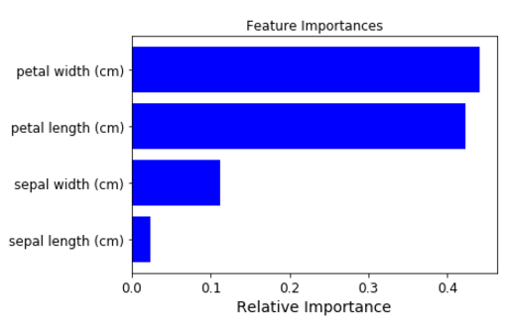
Features of Importance
Find features that contribute to overall performance of model
Tool Examples
Eli5
PDP
Lime
Shap

Slide 8
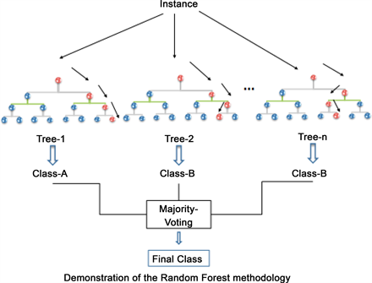
Eli5 Permuted Importance
Notes:
Adds random noise to a column and performs classification, measuring drop-off from baseline model with all features

Slide 9

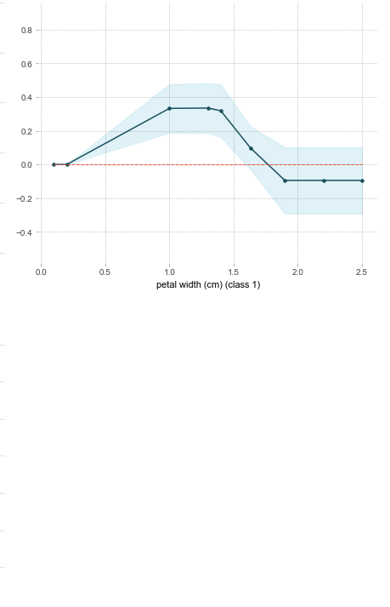
Partial Dependence Plots (PDP)
Shows the effect of one or two features on the predicted outcome of a model
Can show whether the relationship between the target and a feature is linear or more complex.
PDP?

Slide 10
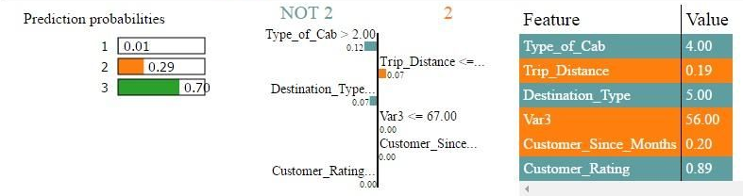
Local Interpretable Model-Agnostic Explanations (Lime)
Based off local surrogate model
LIME tests what happens to the predictions when you give variations of your data into the machine learning model

Slide 11
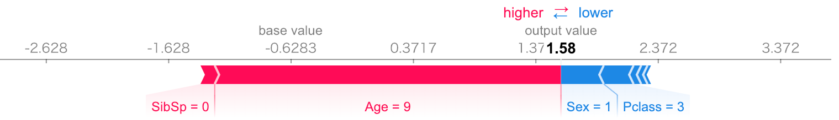
Shapley additive explanation (SHAP)
It is based on Shapley values, a technique used in game theory to determine how much each player in a collaborative game has contributed to its success
Average prediction for an instance compared to average prediction of all instances

