Slide 1
Biological Data Analysis Service Gang Li

Slide 2
Introduction
In this project, we will design and implement a cloud service providing data analysis specifically designed for biological and medical researchers, namely BioDa Service. This service will automate manual steps of current DNA/Protein searches and result analysis, including but not limited to, sequence data processing and storage, search algorithm optimization, report and result visualization.

Slide 3
BioDa Features
Data loading, format-conversion, and storage
Guaranteed updated DNA/Protein DNA sequences, both public and authorized private library
Realtime and batch searching
Blast search optimization based on result
Data Visualization
Search result visualization
Collaboration with data sharing, email, and online-chat

Slide 4
Use Cases
A user would like to perform blast(n) search against a human genome with large number of DNA/Protein sequence samples.
A user would like to find a specific DNA pattern within existing genome, e.g. a certain mutation distribution among different races
DNA profiling (fingerprinting) for forensic purpose and parentage testing, such as Short Tandem Repeats (STR) profiling
Proprietary DNA Sequence Storage.

Slide 5
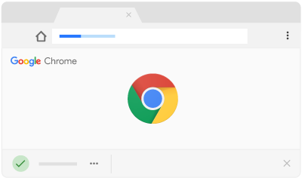


Architecture
Compute (EC2 VM)
Data Storage
Web Portal
RDS DB
Rest API
Public DNA Seq
BR
Pub Protein
Private
Sequences
SQS Job Q
Public DNA/Protein Libraries (NCBI, etc)
Data Sync-up
Daemon
Private DNA/Protein Sequence

Slide 6
Technologies
Computer Sciences
Relational Database, AWS RDS
Message Queue, Rabbit MQ, SNS/SQS
Container, K8S
Android App and/or iOS App
AWS VM
Git, Code Review, Cloud Deployment
UI with javascript
Batch job
Python and Java
Computational Biology
DNA and Protein sequence library
Blast search algorithm

Slide 7
Future Direction
Social aspect of the app: user group chat
Application of the platform on other areas, such as stock analysis

Slide 8
Team – Roles are tentative
Gang Li (Architect, Project Manager)
Hongbing Zhang (Biological Science Advisor)
Andrew Zhang (Software Engineer)
Alayna Li (Software Engineer)
Michael Li (UX Designer and Tester)
We will also recruit others to join the effort.

Slide 9
Project Schedule
Week 1: Understand the technology
Set up git, code review, and cloud deployment
Set up AWS account, understand how VM, Container, RDS, and SQS works
Understand Bioda system architect
Pick the areas
Week 2-3: Create a Working POC on a standalone workstation
Download DNA and Protein sequences
Set up deamon to periodically sync with public source
Create a simple WebUI to load DNA/Protein Sequence for sequence search
Week 4 and later
Android APP development
Move the app to the cloud

