Slide 1
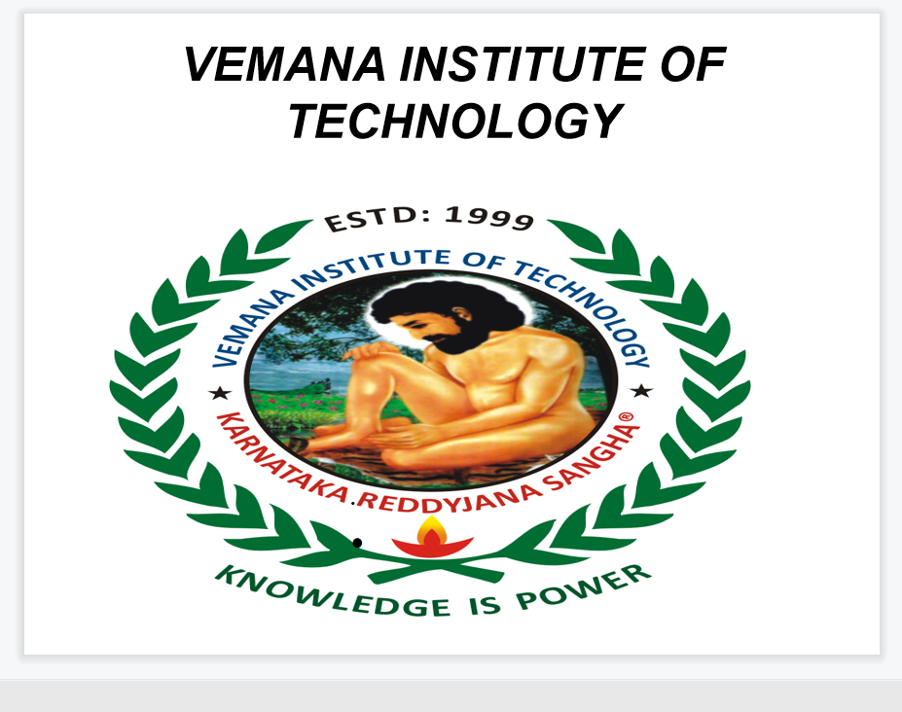

Slide 2
MINI PROJECT
TOPIC :-
ONLINE NEWS PORTAL
TEAM MEMB
G. LIKHITH KUMAR REDDY

Slide 3
INTRODUCTION
News Portal is an online communication medium for internet users which are read all over the world. ... The news portal development allows to publish publications, press releases, columns, articles, blogs and other news related content.
A news portal is an access point to news;This is generally thought of as a Internet connection to a news source but the definition
of a “Portal” would include a newspaper,
magazine or any other access to news.A web portal is any access point to the Internetwebsite development that will servenews
portalrequirements,will actually be the online presence of a newspaper,a magazine or a channel that cover the local, national or
global range. By using this package you will be able to upload news and authors' posts about politics, economics, culture, sports, the
environment and enjoy having visitors from all over the world.

Slide 4
News Portal is the ultimate magazine theme with creative design and powerful features that allow you to quickly and easily create a style to suit your needs. It is completely built on Customizer which allows you to customize most of the theme settings easily with live previews.
Online News Sites play a vital role in educating and informing Mass with latest updates, current happenings around the globe. People don't have much more time to read the Printed newspaper with yesterday's happening, so they always follow web portals or Electronic Media for getting latest News

Slide 5
PURPOSE
1.News sites offer the information to the public, political,
social, sports, health, entertainment etc.
2. Instant & latest news from all over the world.
3. Easier accessibility.
4. Fastest and Latest news updates as per the interest.
5. Live coverage of Events, Cricket matches and other sports etc.
6. A reader can easily give his/her comments on any issue.
7. Breaking News can update Minute-to-minute.
8. Pictures of specials news events.
9.Advertiser gets the details of people who read their ad,
this facility cannot offer by Print or Electronic media.

Slide 6
OBJECTIVE
The main objective of a good online news portal is mentioned as such :
Publish news about town/city, state, national, international and sports
The registered user could upload the news from any device- mobile, laptops, tablets, etc. at any time.
Provides all type of news to the user and they could read

Slide 7
ADVANTAGES OF NEWS PORTAL
Enrich Your Knowledge :
With every story or article that is read, the reader acquires knowledge about the events taking place across the world.
News reading is the quickest and most concise way to gather knowledge about state and global affairs. Since news agencies cover all subjects of interest like Politics, Fashion, Lifestyle, Sports, Entertainment, and more, the reader is constantly updated about all these facets.
Stay Connected With The World :
No matter where you live, news works like strands of threads that weave the urban and rural population together. It is possible to constantly stay informed about the events of a city, town, village. With access to e-papers and e-magazines, the reader doesn’t have to struggle too much to get his hands on the news— with real-time updates.
Strengthen your Language skills and Enhance your Vocabulary :
News reading not only builds knowledge but also contributes in other ways to an individual’s development. Voracious and dedicated news reading can help one build on their language and enhance their vocabulary. It can also help one connect the dots to form the larger picture and understand how the economy, politics, environment and everything is interlinked

Slide 8
Be Part of a Larger Conversation :
It is highly essential to be a responsible and active citizen of the country. This entails being actively involved in the development and progress of the nation, even if it’s through dialogue or conversation. Reading the news makes it easier for one to associate and draw parallels when people have conversations about current events and politics. This way as an
informed and responsible citizen, one can be part of the larger conversations that require important discussions about the state and nation.
Be Informed About the Latest Discoveries and Innovations :
Reading news can help you acquire a knowledge base about the different things like Politics, Sports, Entertainment, Science, etc. You can be in the loop about the latest discoveries made in a certain field, for example, if Science were to come up with a cure for diabetes. Through news reading, you’re constantly updated and involved.

Slide 9
FEATURES OF NEWS PORTAL
Responsive news portal design
News portal developers must note this very distinctive feature; responsive design. A responsive news website design makes your portal look nice on the screen of any device from laptops, tablets, and mobile phones. It enables the readers to access your content and view it the way they love to do.
Integration with social media
In today’s world, online news portals or websites cannot even exist without social media integration. Exclusive and breaking news spread more on social media like Facebook and Twitter than news portals. By integrating with social media, news websites can reach a large audience in a blink of an eye.
Colour scheme
In news portal development, readability is the most important feature. Most news portal websites use dark text on a white background. The contrast of colours facilitates the readability of the content and that is why the ‘black on white’ scheme is the most suitable for news portals and websites.

Slide 10
Grid-based news portal design :
News portal websites are commonly built with grid-based designs. This design is a popular choice not only because of the sharp and impressive look it creates but also it is one of the most effective ways to manage and organize a large amount of content. The grid-based design allows you to break the content into comprehensive blocks; thereby engage users to read your content.
White space maximization :
Don’t try to fill all the white space with your content and bore the readers. Embracing maximum white space is important to s how the reader where they should focus their attention. White spaces are what make your website more readable and simple, even though it is filled with an excessive number of content items
Easy to navigate design :
News portal designs which are easy to navigate are more likely to be visited by readers than those without them. The navigation menu should be simple and in the right position. Most news websites put their primary navigation menu just below the header and above the content.

Slide 11
Frequent news updates :
Frequent content update is essential for the existence of your news portal. Without frequent updates, your website will not attract an audience. Frequent content affects your results in search engines as well. If more people visit a website regularly then more likely Google like it.
Advertisement spaces :
In news portal development, monetary features are as important as content and service features. Integrating advertisement in the right part of the design is crucial for the monetary benefits of the news portal. You must be able to use ads without turning readers away from your website. The right places for banner ads are sidebar, both left and right, header or footer
Style matters :
News portal development is a work of creativity as well. Creating the portal or website with a stylish and up-to-the-minute design is an absolute process of art and creativity. You have to know the audience and design for them. I have many online news apps on my mobile and I go for the most attractive one. I believe most of the readers also tend to do so.

Slide 12
Customised news portal design :
Online news portal development should provide readers with the possibility to customize their hope page giving them the power to choose sections, contents, topics of their interest. If the design fails to offer this personalized reader experience, visitors are more likely to leave the portal looking for some others which offer them that.
Breaking News :
This is another important distinctive feature of an awesome news portal website development. Instant breaking news updates with unfolding stories of popular interest are powerful enough to keep the portal dragging readers all day. If your portal is the one that brings breaking and shaking news to the readers in the first place, then they are more likely to visit your news portal looking for something that shakes them

Slide 13
CONCLUSION
The present system involves all the clerical work which is a cumbersome And a complicated job. In todays fast life it is difficult to get news in their daily life. And this system can be of great idea because anyone can read it in their internet at anytime in their daily life at any point in when ever they have time.
It is a very cost-effective and time-saving Online News portal project in Java. One does not need to go away to buy the newspaper. He/she can read the news relevant to his/her choice at a single click and in a very little time stamp.
let’s understand that news reading can have several benefits that are interlinked and can open up avenues to increasing knowledge, decreasing illiteracy and in turn creating a more informed and responsible society.

Slide 14
THANK YOU!!!

