Slide 1
R and sequence quality Bioinformatics Applications (PLPTH813)
Sanzhen Liu
2/14/2019

Slide 2
Package installation
install.packages('ggplot2')
or
install.packages('ggplot2', repos='http://cran.rstudio.com/')
### before using it, run:
library('ggplot2')

Slide 3
Scatter plot
# data
area <- state.x77[, "Area"]
pop <- state.x77[, "Population"]
# scatter plot
plot(area, pop, main="US States 1977")
# label points
state.max.area <- which.max(area)
points(area[state.max.area],
pop[state.max.area],
col="red", lwd=2)
points(area["Kansas"], pop["Kansas"],
col="purple", lwd=2)

Slide 4
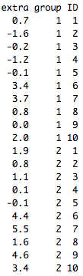
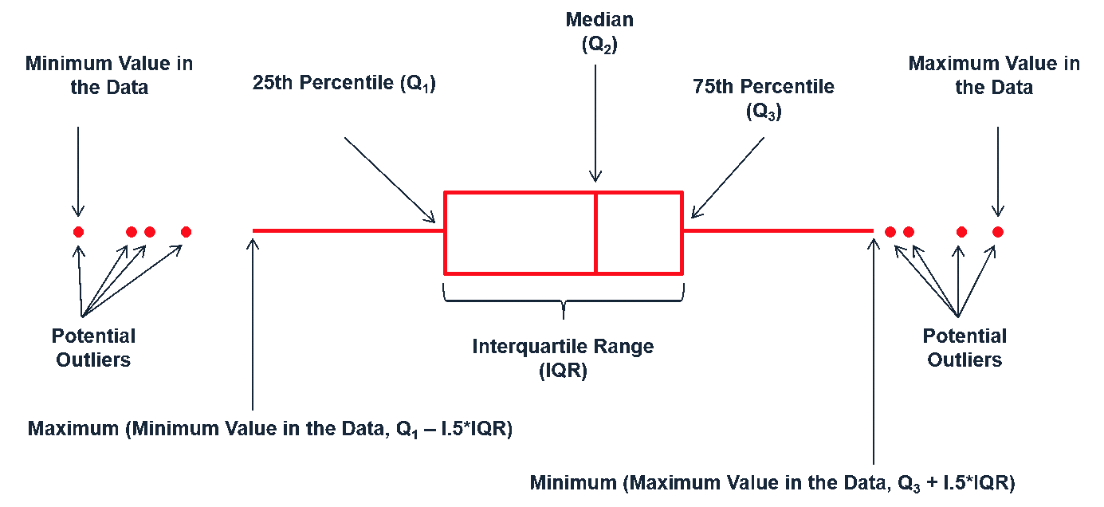
Boxplot
data: sleep
plot(extra ~ group, data = sleep)
boxplot(extra ~ group, data = sleep)

Slide 5
Histogram
hist(pop, main="US States 1977 Population")
hist(pop, ylab="Number of states", main="US States 1977 Population")

Slide 6
ggplot2 - I
dsmall <- diamonds[sample(nrow(diamonds), 100), ]
qplot(carat, price, data = dsmall)
qplot(carat, price, data = dsmall, colour = color)
qplot(carat, price, data = dsmall, shape = cut)

Slide 7
ggplot2 - geom to control plot type
qplot is not limited to scatterplots, but can produce almost any kind of plot by varying the geom.
geom has many options:
"point" draws a scatterplot. This is the default.
"smooth" fits a smoother to the data
"boxplot" produces a box-and-whisker plot
"line" draw lines between the data points.
"histogram" draws a histogram
"bar" makes a bar chart
# Adding a smooth line or a fitted line
qplot(carat, price, data = dsmall, geom = c("point", "smooth"))

Slide 8
String operations
# data of “cvec”
# "google" "hello" "the" "world”
cvec <- c("google", "hello", "the", "world")
# nchar()
nchar(cvec)
# grep()
grep("o", cvec)
# sub()
sub("o", "O", cvec)
# gsub()
gsub("o", "O", cvec)

Slide 9
apply
### data of diamonds
carat cut color clarity depth table price x y z
1 0.23 Ideal E SI2 61.5 55 326 3.95 3.98 2.43
2 0.21 Premium E SI1 59.8 61 326 3.89 3.84 2.31
3 0.23 Good E VS1 56.9 65 327 4.05 4.07 2.31
4 0.29 Premium I VS2 62.4 58 334 4.20 4.23 2.63
5 0.31 Good J SI2 63.3 58 335 4.34 4.35 2.75
0.24 Very Good J VVS2 62.8 57 336 3.94 3.96 2.48
…
# apply()
apply(diamonds[, c("carat", "price")], 2, mean)
apply(diamonds[, c("x", "y", "z")], 1, sum)
rowSums(diamonds[, c("carat", "price")])
rowMeans
colSums
colMeans

Slide 10
tapply
# tapply()
Applying a function to each element of a vector given by the category of each element, provided by the other vector.
### data of diamonds
carat cut color clarity depth table price x y z
1 0.23 Ideal E SI2 61.5 55 326 3.95 3.98 2.43
2 0.21 Premium E SI1 59.8 61 326 3.89 3.84 2.31
3 0.23 Good E VS1 56.9 65 327 4.05 4.07 2.31
4 0.29 Premium I VS2 62.4 58 334 4.20 4.23 2.63
5 0.31 Good J SI2 63.3 58 335 4.34 4.35 2.75
0.24 Very Good J VVS2 62.8 57 336 3.94 3.96 2.48
…
tapply(diamonds$price, diamonds$cut, mean)

Slide 11
table
# table(): determining counts for each category
table(diamonds$cut)
table(diamonds$cut, diamonds$color)

Slide 12
Write your own function
Define a function
name <- function(arg_1, arg_2, ...) expression
# example 1
threetimes <- function(x) {
y <- 3*x
y
}
# example 2
threetimes <- function(x) {
3*x
}
threetimes(6)
threetimes(29)

Slide 13
Problem
Write a function to randomly select a gift for yourself from a gift store on the valentine's day and output the result as:
"Here is my Valentine's surprise: xxx"
# example store gifts
store <- c("chocolate", "rose", "diamond", "iphone", "nanopore flowcells")
# randomly select
sample
# print
cat or print

Slide 14
Data
Sequence quality scores from three platforms
Illumina
Ion Torrent (Proton)
PacBio
Data file: quality.txt

Slide 15
Data importing
data.url <- "https://raw.githubusercontent.com/liu3zhenlab/teaching/master/PLPTH813Bioinformatis/2019/data/quality.txt"
qual0 <- read.delim(data.url)
qual <- read.delim(data.url, sep="\t", comment.char="~",
nrow=3, as.is=T, stringsAsFactors=F, quote="~")

Slide 16
Data checking
qual
nrow(qual)
dim(qual)
colnames(qual)
nchar(qual$Quality)

Slide 17
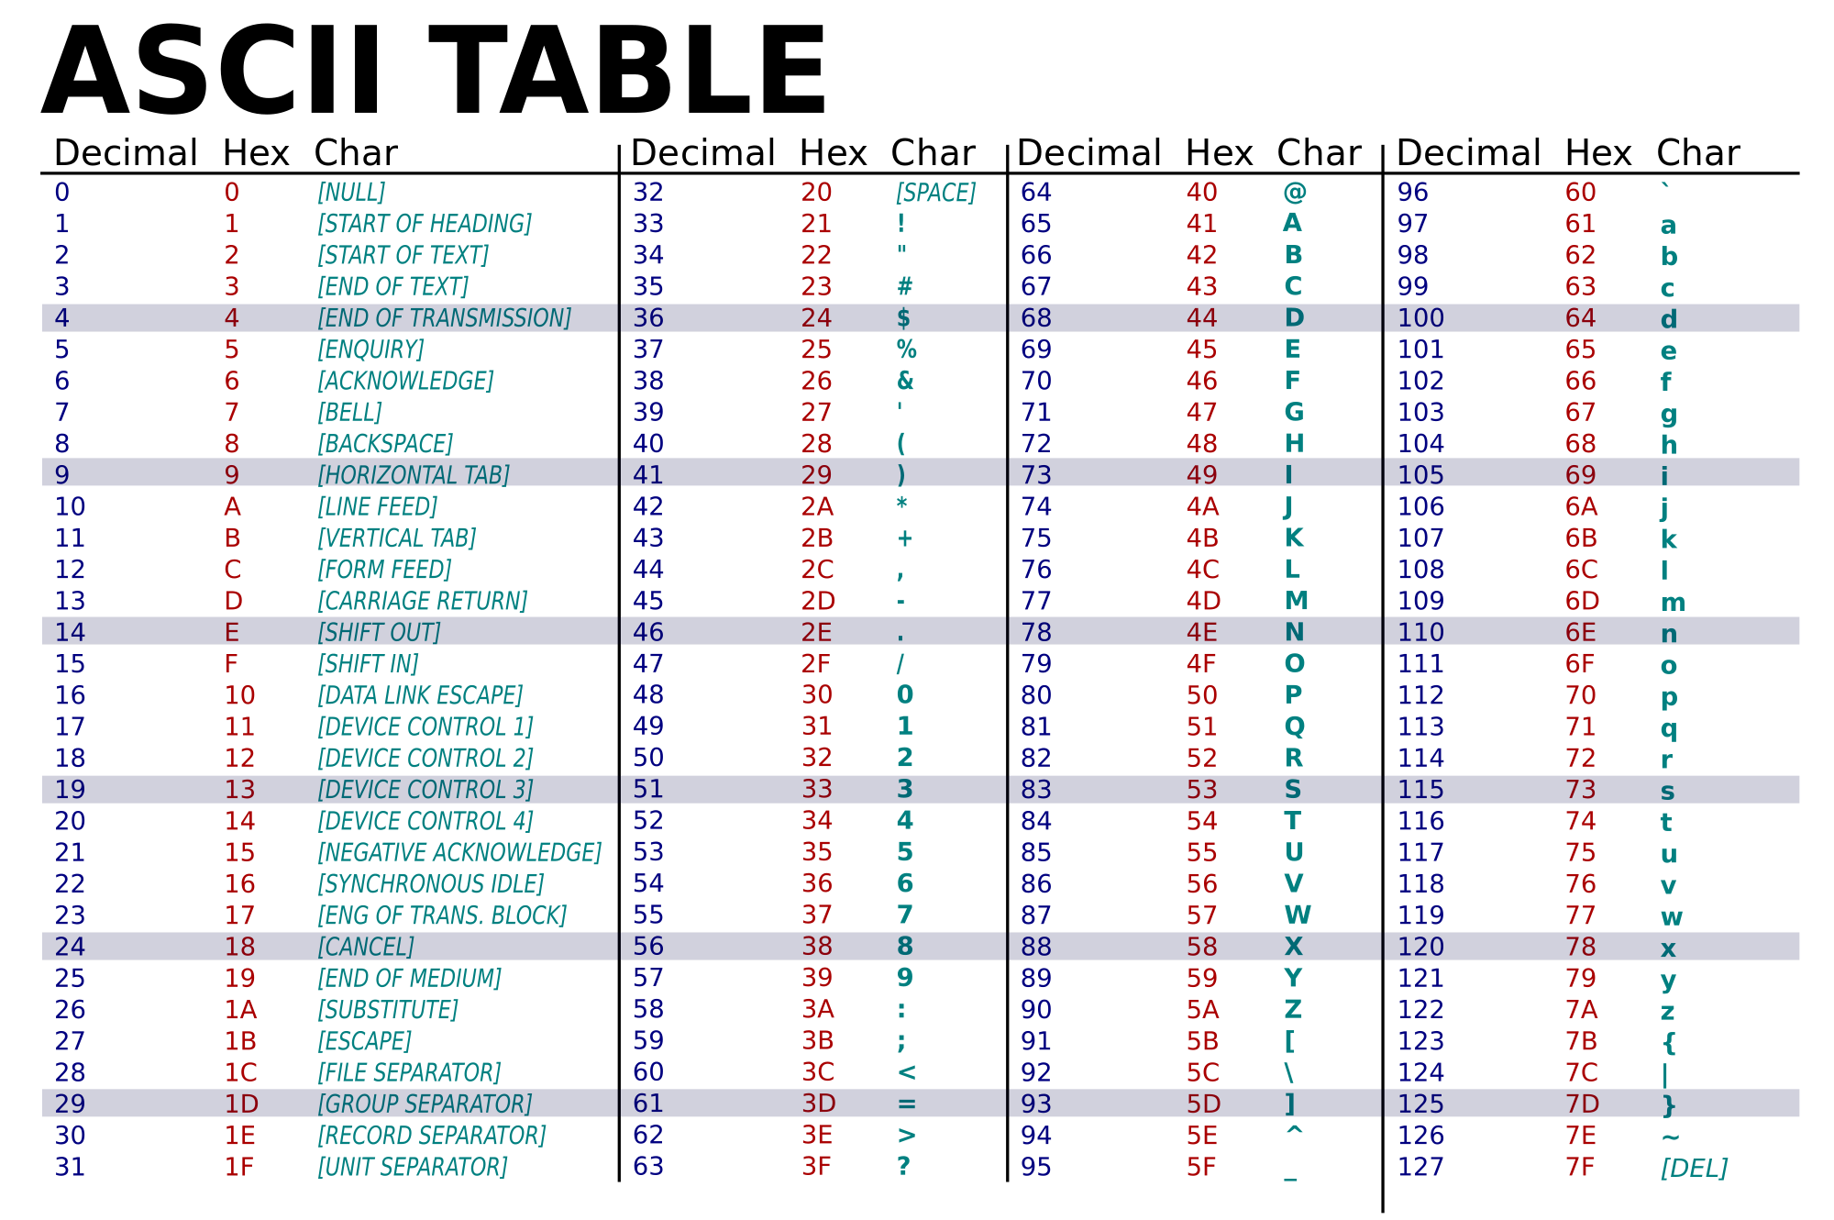
Convert quality score to numbers
charToRaw("[")
as.numeric(charToRaw("["))
charToRaw(as.character(qual[1, 2]))

Slide 18
Convert quality codes to quality scores
illumina <- as.numeric(charToRaw(as.character(qual[1, 2]))) - 33
proton <- as.numeric(charToRaw(as.character(qual[2, 2]))) - 33
pacbio <- as.numeric(charToRaw(as.character(qual[3, 2]))) - 33

Slide 19
Plotting
### Illumina quality
plot(1:nchar(qual[1, 2]), illumina, pch=19, cex=0.2, main="Illumina", xlab="Pos on read", ylab="Quality", ylim=c(0, 41))
### Proton quality
plot(1:nchar(qual[2, 2]), proton, pch=19, cex=0.2, main="Proton", xlab="Pos on read", ylab="Quality", ylim=c(0, 41))
### PacBio quality
plot(1:nchar(qual[3, 2]), pacbio, pch=19, cex=0.2, main="PacBio", xlab="Pos on read", ylab="Quality", ylim=c(0, 41))

Slide 20
Plotting three in one plot
par(mfrow=c(1, 3))
### Illumina quality
plot(1:nchar(qual[1, 2]), illumina, pch=19, cex=0.2, main="Illumina", xlab="Pos on read", ylab="Quality", ylim=c(0, 41))
### Proton quality
plot(1:nchar(qual[2, 2]), proton, pch=19, cex=0.2, main="Proton", xlab="Pos on read", ylab="Quality", ylim=c(0, 41))
### PacBio quality
plot(1:nchar(qual[3, 2]), pacbio, pch=19, cex=0.2, main="PacBio", xlab="Pos on read", ylab="Quality", ylim=c(0, 41))

Slide 21
Write a plotting function
qual.plot <- function(qual.data, label="") {
### plot quality scores against base positions
qual.vals <- as.numeric(charToRaw(as.character(qual.data))) - 33
plot(1:length(qual.vals), qual.vals, pch=19, cex=0.2, main=label,
xlab="Pos on read", ylab="Quality", ylim=c(0, 41))
}

Slide 22
Plot three sets of quality scores using a newly written function
### plotting
par(mfrow=c(1, 3))
qual.plot(qual.data = qual[1, 2], label = "Illumina")
qual.plot(qual.data = qual[2, 2], label = "Proton")
qual.plot(qual.data = qual[3, 2], label = "PacBio")

Slide 23
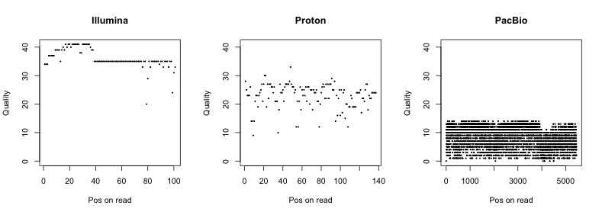
RESULT

