Slide 1
Genomic variants Bioinformatics Applications (PLPTH813)
Sanzhen Liu
3/21/2019

Slide 2
Goal of today’s lab
GATK: variant discovery
tview to visualize variants
Cyberduck for data transferring
IGV to visualize SNPs

Slide 3
directories
# create a new directory for today's practice
mkdir Lab08_variants
cd Lab08_variants
mkdir GATK
mkdir references
mkdir data

Slide 4
To-do analysis
Discover variants of two E.coli strains DH10B and MG1655 relative to a reference genome
Reference genome: E.coli K-12 MG1655
Illumina data sets: DH10B and MG1655

Slide 5
Make links to data
# E.coli K-12 MG1655 reference
cd references
ln -s /homes/liu3zhen/teaching/datasets/variants/references/* .
cd ..
# Alignment data:
cd data
ln -s /homes/liu3zhen/teaching/datasets/variants/data/* .
cd ..
# DH10B.parse.bam
# DH10B.parse.bam.bai
# MG1655.parse.bam
# MG1655.parse.bam.bai

Slide 6
BWA alignment (show scripts)
######################################
### index
bwa index MG1655.fasta
######################################
######################################
### alignment
######################################
### specify input files
ref=MG1655.fasta
pe1=x.pair1.fq
pe2=x.pair2.fq
### alignment
# bwa mem -T 40 $ref $pe1 $pe2 1>aln.sam 2>aln.log
bwa mem -T 40 –R '@RG\tID:S1\tSM:DH10B' $ref $pe1 $pe2 1>aln.sam 2>aln.log

Slide 7
Examine alignments
module load SAMtools/1.8-foss-2017beocatb
samtools flagstat ./data/DH10B.parse.bam
samtools flagstat ./data/MG1655.parse.bam
936747 + 0 in total (QC-passed reads + QC-failed reads)
0 + 0 secondary
2 + 0 supplementary
0 + 0 duplicates
936747 + 0 mapped (100.00%:-nan%)
936745 + 0 paired in sequencing
471775 + 0 read1
464970 + 0 read2
933933 + 0 properly paired (99.70%:-nan%)
934412 + 0 with itself and mate mapped
2333 + 0 singletons (0.25%:-nan%)
0 + 0 with mate mapped to a different chr
0 + 0 with mate mapped to a different chr (mapQ>=5)
tips: samtools flags 147
PAIRED,PROPER_PAIR,REVERSE,READ2

Slide 8
Prior to GATK, the reference genome needs to be indexed
In the directory of "references"
### index 1
module load Java/1.8.0_192 # load java module
java -jar /homes/liu3zhen/local/jars/picard.jar \
CreateSequenceDictionary \
R=Ecoli_k12_MG1655.fasta \
O=Ecoli_k12_MG1655.dict
### index 2
module load SAMtools/1.8-foss-2017beocatb
samtools faidx Ecoli_k12_MG1655.fasta
Check the output

Slide 9
GATK
gatk=/homes/liu3zhen/software/GATK/gatk4/gatk-4.1.0.0/gatk
$gatk --list

Slide 10
HaplotypeCaller of GATK4
USAGE: HaplotypeCaller [arguments]
Call germline SNPs and indels via local re-assembly of haplotypes
Version:4.1.0.0
Required Arguments:
-I:String BAM/SAM/CRAM file containing reads.
-O:String File to which variants should be written.
-R:String Reference sequence file.

Slide 11
GATK to SNP discovery
In the directory of "GATK"
### using HaplotypeCaller from GATK to call SNPs&INDELs.
module load Java/1.8.0_192
cd GATK
$gatk HaplotypeCaller \
--java-options '-Xmx8G' \
-R ../references/Ecoli_k12_MG1655.fasta \
-I ../data/DH10B.parse.bam \
-I ../data/MG1655.parse.bam \
-ploidy 1 \
-O variants.raw.vcf &>variants.log
Notes:
4-5 min to finish

Slide 12
Notes
9 ##INFO=<ID=AC,Number=A,Type=Integer,Description="Allele count in genotypes, for each ALT allele, in the same order as listed">
10 ##INFO=<ID=AF,Number=A,Type=Float,Description="Allele Frequency, for each ALT allele, in the same order as listed">
11 ##INFO=<ID=AN,Number=1,Type=Integer,Description="Total number of alleles in called genotypes">
12 ##INFO=<ID=BaseQRankSum,Number=1,Type=Float,Description="Z-score from Wilcoxon rank sum test of Alt Vs. Ref base qualities">
13 ##INFO=<ID=DP,Number=1,Type=Integer,Description="Approximate read depth; some reads may have been filtered">
14 ##INFO=<ID=DS,Number=0,Type=Flag,Description="Were any of the samples downsampled?">
15 ##INFO=<ID=ExcessHet,Number=1,Type=Float,Description="Phred-scaled p-value for exact test of excess heterozygosity">
16 ##INFO=<ID=FS,Number=1,Type=Float,Description="Phred-scaled p-value using Fisher's exact test to detect strand bias">
17 ##INFO=<ID=InbreedingCoeff,Number=1,Type=Float,Description="Inbreeding coefficient as estimated from the genotype likelihoods per-sample when compared against the Hardy-Weinberg expectation">
18 ##INFO=<ID=MLEAC,Number=A,Type=Integer,Description="Maximum likelihood expectation (MLE) for the allele counts (not necessarily the same as the AC), for each ALT allele, in the same order as listed">
19 ##INFO=<ID=MLEAF,Number=A,Type=Float,Description="Maximum likelihood expectation (MLE) for the allele frequency (not necessarily the same as the AF), for each ALT allele, in the same order as listed">
20 ##INFO=<ID=MQ,Number=1,Type=Float,Description="RMS Mapping Quality">
21 ##INFO=<ID=MQRankSum,Number=1,Type=Float,Description="Z-score From Wilcoxon rank sum test of Alt vs. Ref read mapping qualities">
22 ##INFO=<ID=QD,Number=1,Type=Float,Description="Variant Confidence/Quality by Depth">
23 ##INFO=<ID=ReadPosRankSum,Number=1,Type=Float,Description="Z-score from Wilcoxon rank sum test of Alt vs. Ref read position bias">
24 ##INFO=<ID=SOR,Number=1,Type=Float,Description="Symmetric Odds Ratio of 2x2 contingency table to detect strand bias">

Slide 13
Variant filtering
$gatk SelectVariants \
-R ../references/Ecoli_k12_MG1655.fasta \
-V variants.raw.vcf \
-select 'QD >= 10.0' \
-select 'DP >= 10.0' \
--restrict-alleles-to BIALLELIC \
-select-type SNP \
-O selected.snp.vcf &>selected.log
INFO:
AC=1;AF=0.500;AN=2;BaseQRankSum=1.125;DP=39;FS=16.048;MLEAC=1;MLEAF=0.500;MQ=60.00;MQRankSum=0.000;QD=29.53;ReadPosRankSum=-0.506;SOR=1.023
for example: QD: Variant Confidence/Quality by Depth
Notes:
-select-type:Type
Select only a certain type of variants from the input file This argument may be specified
0 or more times. Default value: null. Possible values: {NO_VARIATION, SNP, MNP, INDEL,
SYMBOLIC, MIXED}
10.0 worked but 10 did not work; strang
--restrict-alleles-to:NumberAlleleRestriction
Select only variants of a particular allelicity Default value: ALL. Possible values:
{ALL, BIALLELIC, MULTIALLELIC}

Slide 14
VCF to table
# Working directory: xxx/Lab08_variants/GATK
$gatk VariantsToTable \
-V selected.snp.vcf \
-R ../references/Ecoli_k12_MG1655.fasta \
-F CHROM -F POS -F REF -F ALT -F AC -F AF \
--genotype-fields "GT" \
-O selected.snp.txt &>var2table.log
# Input: VCF
# Output: a table format
# Fields: CHROM POS REF ALT AC AF DH10B.GT MG1655.GT
# AC(allele counts) AF(Allele frequency)

Slide 15
tview to check SNPs
samtools tview ./data/DH10B.parse.bam \
./references/Ecoli_k12_MG1655.fasta \
-p U00096:1643679
samtools tview ./data/MG1655.parse.bam \
./references/Ecoli_k12_MG1655.fasta \
-p U00096:1643679
try more sites:
1. U00096:1357202
2. U00096:4296380
Notes:
--fields,-F:String The name of a standard VCF field or an INFO field to include in the output table This
argument may be specified 0 or more times. Default value: null.

Slide 16
use Beocat version's samtools
module load SAMtools/1.8-foss-2017beocatb
st=/opt/software/software/SAMtools/1.8-foss-2017beocatb/bin/samtools
# tview
$st tview ./data/DH10B.parse.bam \
./references/Ecoli_k12_MG1655.fasta \
-p U00096:1643679

Slide 17
IGV installation
Download the software:
https://software.broadinstitute.org/software/igv/download
Cyberduck for data transferring
- reference genome
- bam (bam.bai) files
- vcf files

Slide 18
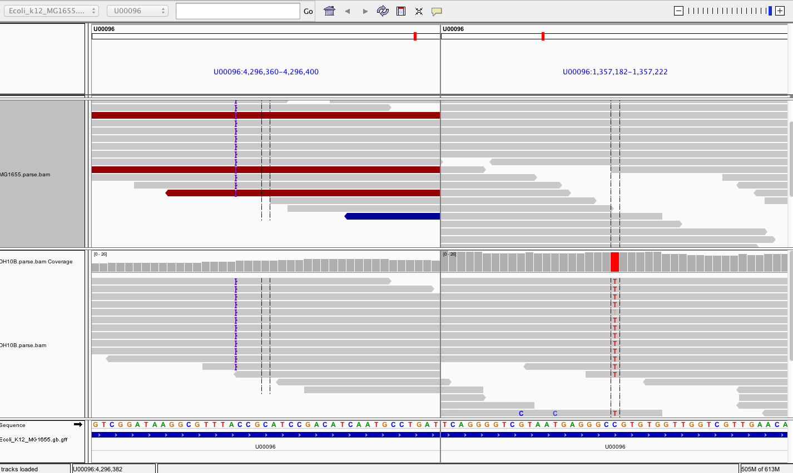
IGV to check SNPs
U00096:xxxxxx U00096: xxxxxxx (separated by a blank space)

