Slide 1
Phylogenetic tree practice
Bioinformatics Applications (PLPTH813)
Sanzhen Liu
3/23/2021

Slide 2
Outline
Introduction about Covid-19
Build a tree through Multiple Sequence Alignment
Built a tree through SNP discovery and R package ape

Slide 3
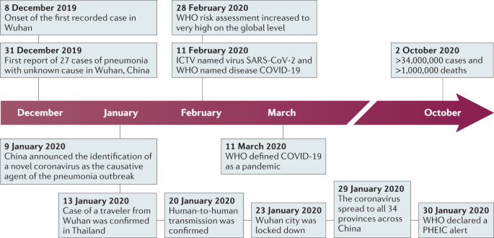
COVID-19
Area | Cases | Deaths
World | 123 M | 2.71 M
US | 29.8 M | 542 K
* as of 3/21/2021

Slide 4
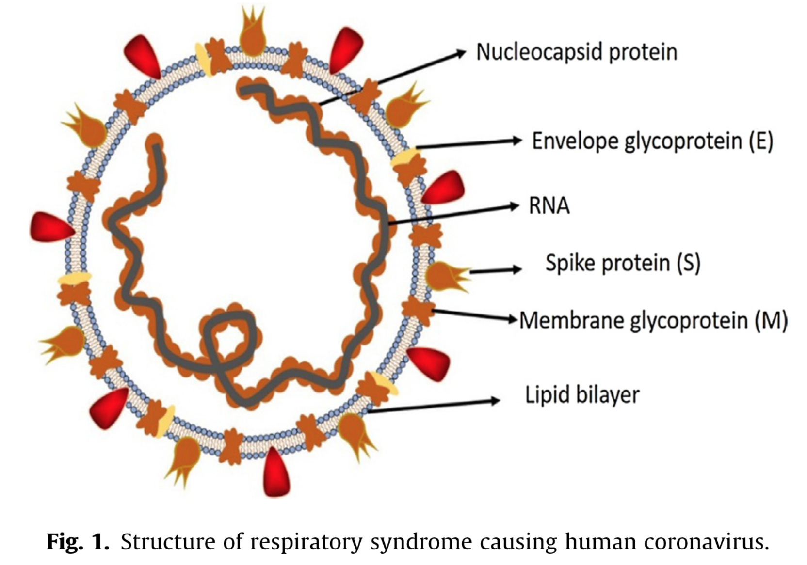
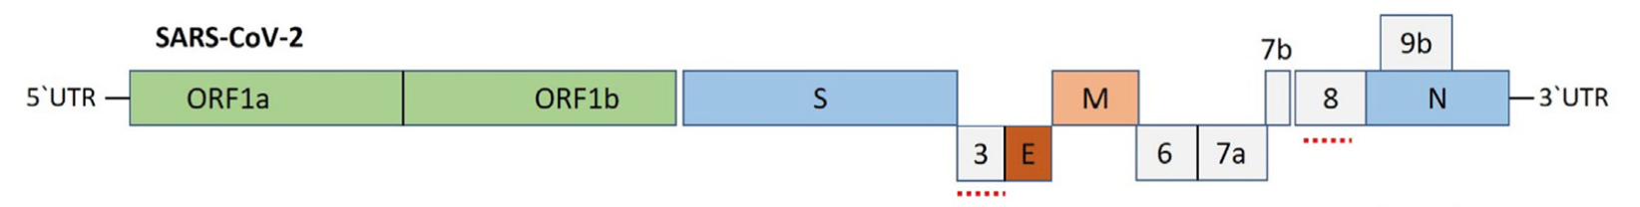
Severe acute respiratory syndrome coronavirus 2 (SARS-CoV2)

Slide 5
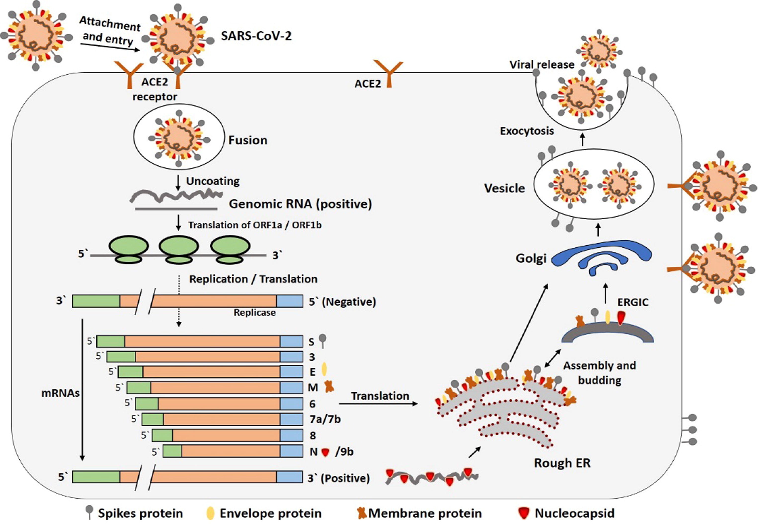
Infection and replication
Notes:
Fig. 3. The life cycle of SARS-CoV-2 in host cells; begins its life cycle when S protein binds to the cellular receptor ACE2. After receptor binding, the conformation change in the S protein facilitates viral envelope fusion with the cell membrane through the endosomal pathway. Then SARS-CoV-2 releases RNA into the host cell. Genome RNA is translated into viral replicase polyproteins pp1a and 1ab, which are then cleaved into small products by viral proteinases. The polymerase produces a series of subgenomic mRNAs by discontinuous transcription and finally translated into relevant viral proteins. Viral proteins and genome RNA are subsequently assembled into virions in the ER and Golgi and then transported via vesicles and released out of the cell. ACE2, angiotensin-converting enzyme 2; ER, endoplasmic reticulum; ERGIC, ER–Golgi intermediate compartment.

Slide 6
Reference genome
ASM985889v3
Organism name: Severe acute respiratory syndrome coronavirus
Date: 2020/01/13
Genbank assembly accession: GCA_009858895
Assembly method: Megahit v. V1.1.3
Sequencing technology: Illumina
~29.9 Kb
1 fragment
11 genes

Slide 7
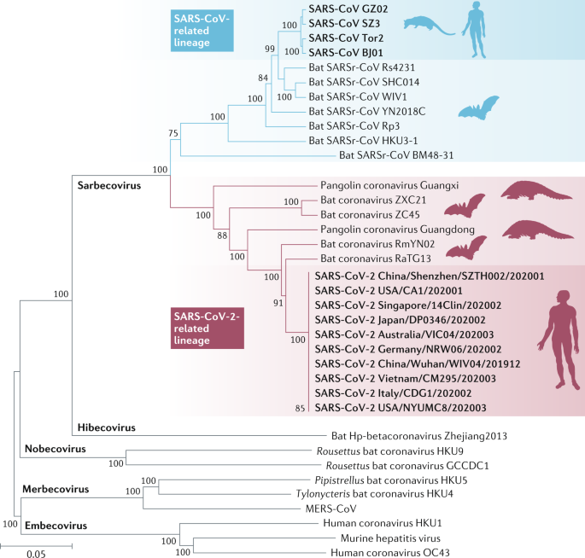
Genetic relationship with other virus
Genomic comparison
SARS-CoV-2 shares 79% with SARS-CoV
SARS-CoV-2 shares 50% with MERS-CoV

Slide 8
Genomes downloaded
Reference_CN_Wuhan_Jan012020.fasta
MT192773_VN_HCM_Jan222020.fasta
MT422807_US_UF_Mar272020.fasta
MW241178_US_UT_Oct012020.fasta
MW776944_US_NC_Feb142021.fasta

Slide 9
MSA: multiple sequence alignment
The publication of ClustalW, a MSA algorithm, is at the 10th most cited scientific papers of all time.
MSA applications:
domain analysis
motif finding
phylogenetic reconstruction
…

Slide 10
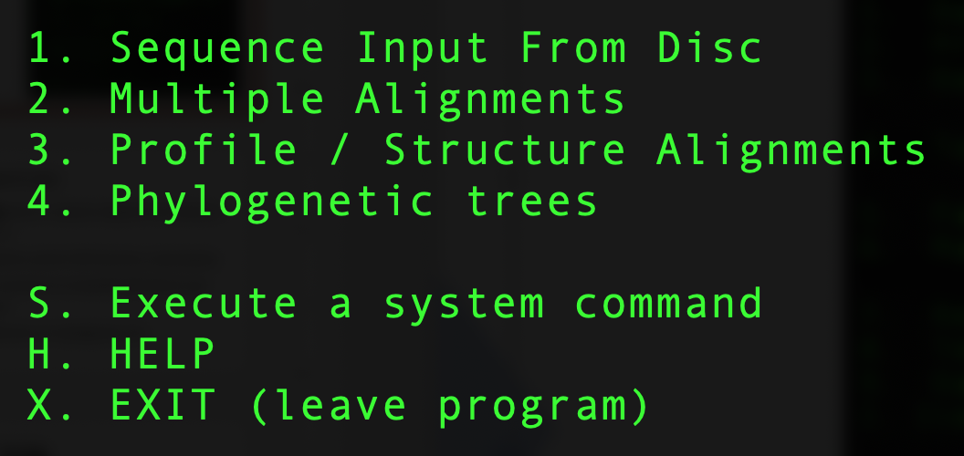
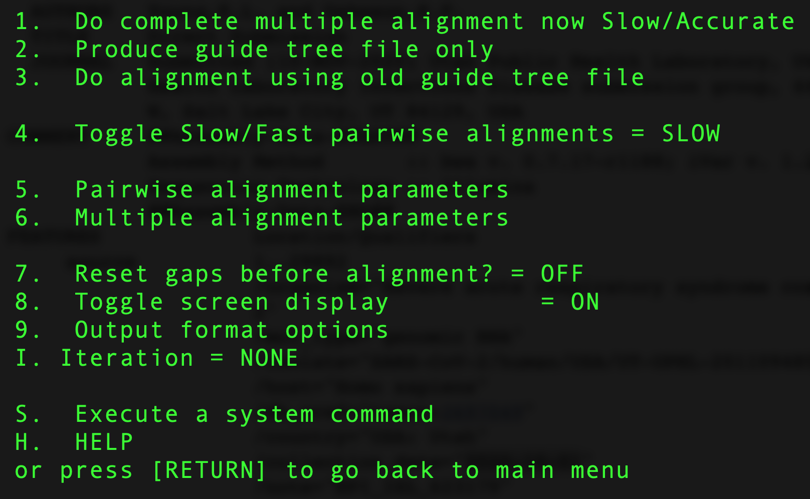
Clustalw (/homes/liu3zhen/software/clustalw/clustalw/clustalw2)
SARS_CoV2_isolates.fasta

Slide 11
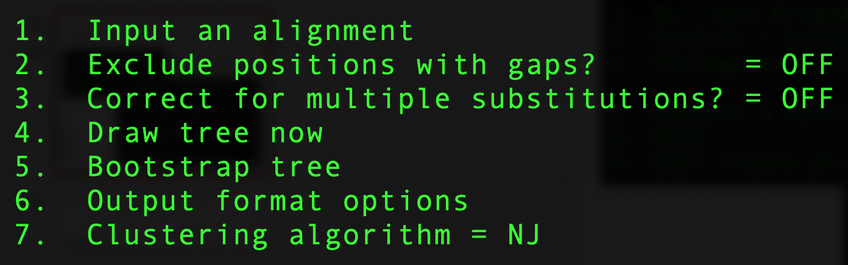
Clustalw (/homes/liu3zhen/software/clustalw/clustalw/clustalw2)
SARS_CoV2_isolates.fasta

Slide 12
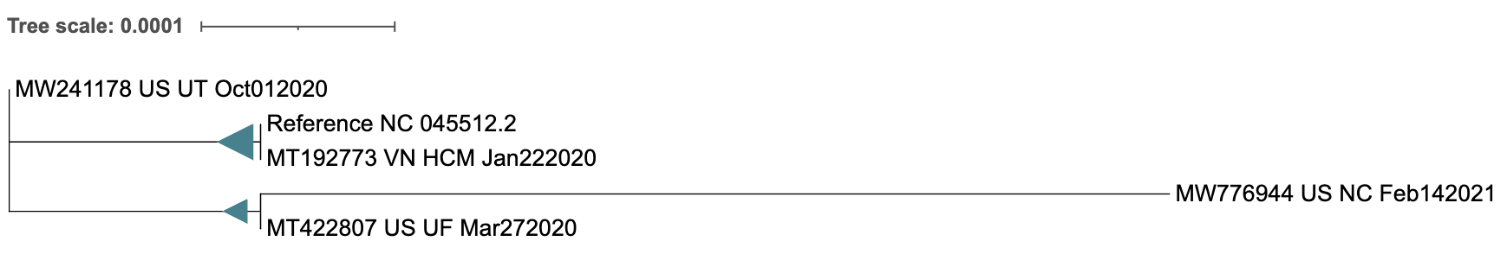
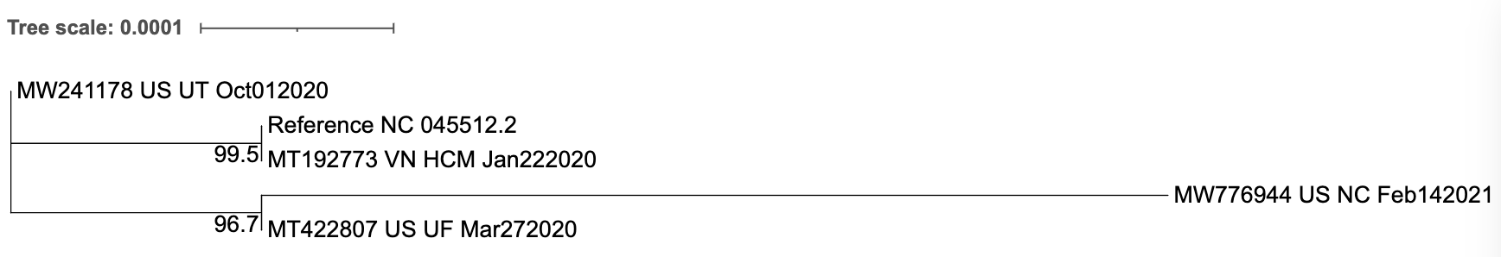
Output and visualization
Output tree: SARS_CoV2_isolates.phb
Visualization at itol

Slide 13
Alignment to a reference, discovery of SNP, and tree construction with ape
Each genome or sequence aligned to the reference genome
Alignments used for SNP discovery, or genotyping
Data conversion to compatible SNP data for ape analysis
Construction of a phylogenetic tree using ape

Slide 14
References
Hu et al., Characteristics of SARS-CoV-2 and COVID-19, 2020, Nature Review Microbiology, 19: 1410154
Shereen et al., COVID-19 infection: Emergence, transmission, and characteristics of human coronaviruses, 2020, Journal of Advanced Research, 24:91-98

