Slide 1
Unix Bioinformatics Applications (PLPTH813)
Sanzhen Liu
1/29/2019

Slide 2
Review
Flat file
Two types of line feed (LF, \n) and carriage return (CR, \r)
Excel functions (average, vlookup, ...)
Regular expression
e.g., 1) T{10,12} 2) ^$
vi has two modes:
insert mode
command mode

Slide 3
Today
What is Unix?
Why do we need to learn Unix?
Useful commands

Slide 4

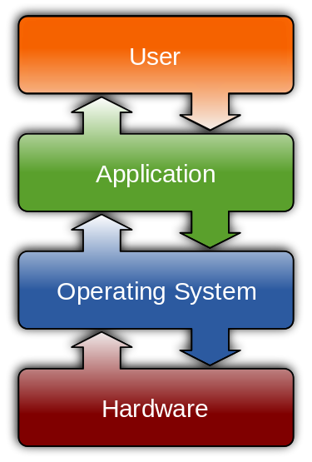
Unix is one of Operating Systems (OSs)
wikipedia.com
Control Hardware
Run Applications
Manage Data
www.cj-computers.com
OS, Linux, Window

Slide 5

Parts of Unix OS
kernel (k) - provides the basic software connection to the hardware, managing memory, schedules, and input/output.
shell - as an interpreter to translate commands and pass them to the kernel for execution.
build-in commands - are the built-in system utilities that provide users basic functions, such as content listing (ls), file copying (cp).
applications - are additional application programs.
applications
build-in
commands
shell
k

Slide 6
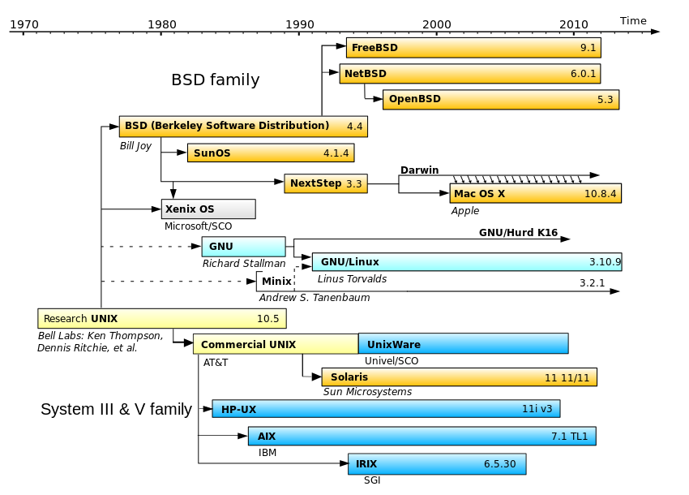
Evolution of UNIX-based Operating Systems
en.wikipedia.org/wiki/Unix-like

Slide 7

Linux Distributions
Liu lab
Ubuntu
VERSION=18.04.1 LTS
ID_LIKE=debian
Beocat
CentOS
VERSION=7
ID_LIKE=rhel fedora
cpagnews.com/
Change the following three file names to file names ended up with .fasta
a.txt b.txt c.txt
Ubuntu:
rename 's/txt/fasta/' *txt
gentoo:
rename 'txt' 'fasta' *txt

Slide 8
Why do we need to learn Unix?
To perform efficient and reproducible data analyses
To use advanced tools in research projects (most genomic software packages are run in the Unix system)
To access to powerful computer servers ( e.g., to enable to handle large data)
... maybe, easier to find a job

Slide 9
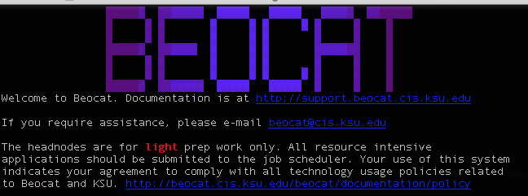
The terminal emulator
A terminal emulator allows users to access to a computer or server.
Mac OS X:
Terminal
iterm2
Linux:
Linux console
Microsoft Windows:
PuTTY
AbsoluteTelnet
Mintty
xterm

Slide 10
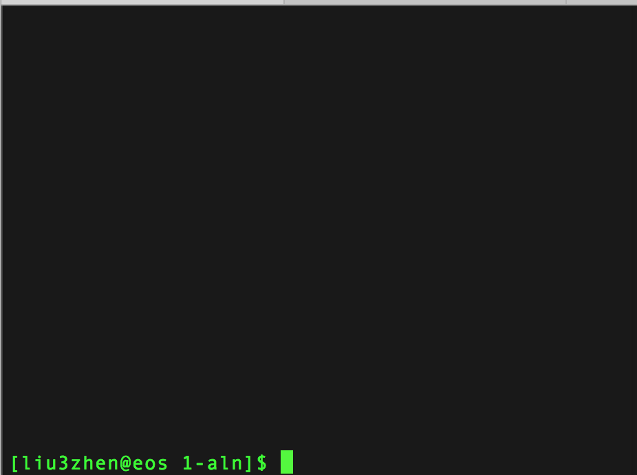
Imaging ...
If you are working on data using an OS platform, what basic operations are needed?
Notes:
directory / files

Slide 11
file systems

Slide 12
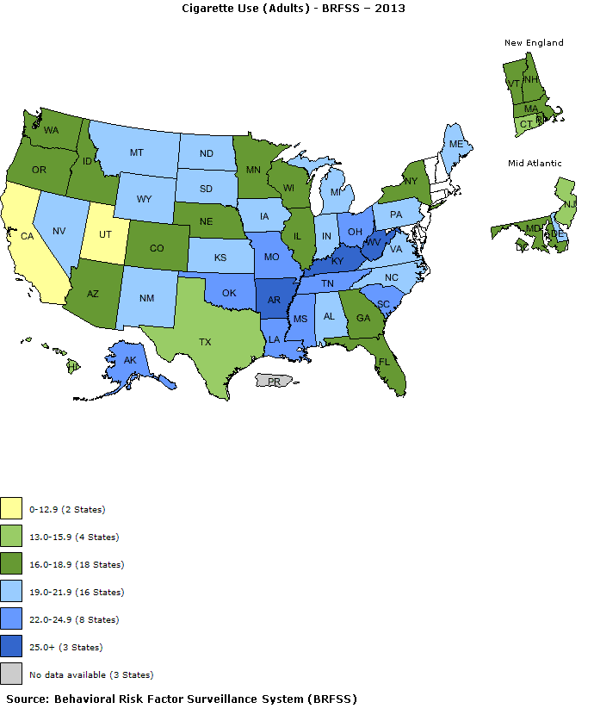
Example datasets
adult.txt
youth.txt

Slide 13

Directories and files
Under the directory:
/homes/liu3zhen/teaching/BA19
Absolute path
/homes/liu3zhen/teaching/BA19
Relative path
. (current directory)
.. (parental directory)
~ (home directory, e.g., /homes/liu3zhen)

Slide 14
cd, mkdir, pwd
Directory: /homes/liu3zhen/teaching/BA19/datasets
cd - change the working directory
% cd /homes/liu3zhen/teaching/
% cd ..
% cd ~
% cd ~/teaching/BA19/datasets/
mkdir - make directories
% mkdir xxx
pwd - print name of current working directory
% pwd

Slide 15
ls
ls – list directory contents
% ls
Adult.txt youth.txt
% ls -1
Adult.txt
Youth.txt
% ls -la
# -la = -l & -a, long format and list all files
Total 4
drwxr-xr-x 2 liu3zhen liulab 4096 Jan 1 15:44 .
drwxr-xr-x 3 liu3zhen liulab 4096 Jan 1 13:51 ..
-rw-r--r-- 1 liu3zhen liulab 887 Jan 1 14:03 adult.txt
-rw-r--r-- 1 liu3zhen liulab 869 Jan 1 14:03 youth.txt

Slide 16
File information
drwxr-xr-x 2 liu3zhen liulab 4096 Jan 1 15:44 .
drwxr-xr-x 3 liu3zhen liulab 4096 Jan 1 13:51 ..
-rw-r--r-- 1 liu3zhen liulab 887 Jan 1 14:03 adult.txt
-rw-r--r-- 1 liu3zhen liulab 869 Jan 1 14:03 youth.txt
# directories + files
group
size
date of last modification
user
Position | Meaning
1 | "d" if a directory, "-" if a normal file
2, 3, 4 | read, write, execute permission for user (owner) of file
5, 6, 7 | read, write, execute permission for group
8, 9, 10 | read, write, execute permission for other (world)
drwxr-xr-x
-r-xr-xrwx

Slide 17
chmod
chmod - change the access permissions to files and directories
-rw-r--r-- 1 liu3zhen liu3zhen_users 887 Jan 1 14:03 adult.txt
% chmod g+w adult.txt
-rw-rw-r-- 1 liu3zhen liu3zhen_users 887 Jan 1 14:03 adult.txt
% chmod ug-w adult.txt
-r--r--r-- 1 liu3zhen liu3zhen_users 887 Jan 1 14:03 adult.txt
% chmod u+w,go-r adult.txt
-r-------- 1 liu3zhen liu3zhen_users 887 Jan 1 14:03 adult.txt
u (user), g (group), o (other), a (all)
Operators: + (add), - (remove), = (specify the exact mode)

Slide 18
cp, mv, rm
cp - copy files and directories
cp <oldfile> <newfile>
% cp adult.txt adult.tmp.txt
mv - move (rename) files
mv <oldfile> <newfile>
% mv adult.tmp.txt adult.second.txt
rm - remove files or directories
rm <filename>
rm <directory> -r
% rm adult.second.txt

Slide 19
contents of files

Slide 20
head/tail
head - output the first part of files
% head adult.txt
# Cigarette Usage (Adult 2013)
# Source: Behavioral Risk Factor Surveillance System
# http://apps.nccd.cdc.gov/statesystem
State Adult Cigarette Use (%)
Alabama 21.5
Alaska 22.6
Arizona 16.3
Arkansas 25.9
California 12.5
Colorado 17.7
tail - output the last part of files
% tail adult.txt
South Dakota 19.6
Tennessee 24.3
Texas 15.9
Utah 10.3
Vermont 16.6
Virginia 19
Washingon 16.1
West Virginia 27.3
Wisconsin 18.7
Wyoming 20.6
-n <number of lines>

Slide 21
more/less
more and less display contents of large files page by page or scroll line by line up and down.
less ("less is more") a bit more smart than more:
% less filename
To display line numbers:
% less -N filename
% more adult.txt
% less adult.txt

Slide 22
cat, paste
cat - concatenate files and print on the standard output
% cat adult.txt youth.txt > two.cat.txt
# “>” redirect the output
paste - merge lines of files
% paste adult.txt youth.txt > two.merge.txt
State | Adult Cigarette Use (%) | State | Youth Cigarette Use (%)
Alabama | 21.5 | Alabama | NA
Alaska | 22.6 | Alaska | 10.6
… | … | … | …

Slide 23
wc
wc - print line, word, and byte counts for each file
% wc adult.txt
55 133 887 adult.txt
% wc -l adult.txt
55 adult.txt
% wc -l two.cat.txt
110 two.cat.txt

Slide 24
grep
grep - print lines matching a pattern
grep <pattern> filename
% grep "Kansas" adult.txt
Kansas 20
% grep "#" adult.txt
# Cigarette Usage (Adult 2013)
# Source: Behavioral Risk Factor Surveillance System
# http://apps.nccd.cdc.gov/statesystem
Notes:
STOP HERE 1/24

Slide 25
grep examples using regular expression
% grep -e Kansas -e Alaska adult.txt
Alaska 22.6
Kansas 20
% grep -v -e Kansas -e Alaska adult.txt
% grep “^>” fasta.file
% grep “^>” fasta.file -c
% grep “^>” fasta.file -v
http://www.thegeekstuff.com/2009/03/15-practical-unix-grep-command-examples

Slide 26
grep examples using regular expression
% grep -e Kansas -e Alaska adult.txt
Alaska 22.6
Kansas 20
% grep -v -e Kansas -e Alaska adult.txt
% grep “^>” fasta.file # names of sequences
% grep “^>” fasta.file -c # number of sequences
% grep “^>” fasta.file -v # sequence lines
http://www.thegeekstuff.com/2009/03/15-practical-unix-grep-command-examples

Slide 27
cut
cut - select sections from each line of file
State | Adult Cigarette Use (%) | State | Youth Cigarette Use (%)
Alabama | 21.5 | Alabama | NA
Alaska | 22.6 | Alaska | 10.6
… | … | … | …
% cut two.merge.txt -f 2
Adult Cigarette Use (%)
21.5
22.6
…
% cut two.merge.txt -f 1,2,4
State | Adult Cigarette Use (%) | Youth Cigarette Use (%)
Alabama | 21.5 | NA
Alaska | 22.6 | 10.6
… | … | …

Slide 28
The concept of “pipe”
Pipe is a method of inter-process communication
Pipe collects the output of one program on the left side and inputs the collected data to the program on right side
| is the pipe symbol
Combining programs with different functions into one to tackle more complicated tasks
Pipe
program 1
program 2
…
head input -n 10 | tail -n 1
10th line of the input

Slide 29
Problem
Please apply grep, head, and tail to extract the 4th line that is not started with “#” from the file of “adult.txt”.
% head adult.txt
# Cigarette Usage (Adult 2013)
# Source: Behavioral Risk Factor Surveillance System
# http://apps.nccd.cdc.gov/statesystem
State Adult Cigarette Use (%)
Alabama 21.5
Alaska 22.6
Arizona 16.3
Arkansas 25.9
California 12.5
Colorado 17.7
Notes:
grep “^#” -v | head -n 3 | tail -n 1
hash sign

Slide 30
Pipe example
State | Adult Cigarette Use (%) | State | Youth Cigarette Use (%)
Alabama | 21.5 | Alabama | NA
Alaska | 22.6 | Alaska | 10.6
… | … | … | …
% paste adult.txt youth.txt | grep "#" -v | cut -f 1,2,4 | head
State | Adult Cigarette Use (%) | Youth Cigarette Use (%)
Alabama | 21.5 | NA
Alaska | 22.6 | 10.6
Arizona | 16.3 | 14.1
Arkansas | 25.9 | 19.1
California | 12.5 | NA
Colorado | 17.7 | NA
Connecticut | 15.5 | 13.5
Delaware | 19.6 | 14.2
District of Columbia | 18.8 | NA

Slide 31
sort - sort lines of text files
cat fruit.txt
orange 8
apple 6
peach 12
banana 5
sort fruit.txt
apple 6
banana 5
orange 8
peach 12
sort -k 2 fruit.txt
peach 12
banana 5
apple 6
orange 8
sort -k 2n fruit.txt
banana 5
apple 6
orange 8
peach 12
sort -k 2nr fruit.txt
peach 12
orange 8
apple 6
banana 5
sort -k 1,2 fruit.txt
apple 6
banana 5
orange 8
peach 12
http://www.theunixschool.com/2012/08/linux-sort-command-examples.html

Slide 32
find - search for files in a directory hierarchy
find [pathnames] [conditions]
# Finding files >10M
find . -size +10M
# Finding files <10M
find . -size -10M
# find a file
find -name "fruit.txt"
# find a file in the current directory
find -maxdepth 1 -name "fruit.txt"

Slide 33
find - II
# find files containing a specific word in its name
find -name "fruit*"
# find files whose name are not "fruit.txt"
find -not -name "fruit.txt"
# find files modified within 30 minutes
find . -mmin -30
# find files modified within 1 day
find . -mtime -1
# find files accessed within 1 hour.
find . -amin -60
http://www.folkstalk.com/2011/12/101-examples-of-using-find-command-in.html

Slide 34
sed - a stream editor used for modifying files in unix
fruit.txt
orange 8
apple 6
peach 12
banana 5
sed 's/apple/strawberry/' fruit.txt
orange 8
strawberry 6
peach 12
banana 5
sed 's/apple/strawberry/g' fruit.txt
orange 8
strawberry 6
peach 12
banana 5

Slide 35
sed - II
fruit.txt
orange 8
apple 6
peach 12
banana 5
sed 's/apple/{&}/' fruit.txt
orange 8
{apple} 6
peach 12
banana 5
sed '/12/ s/peach/kiwi/' fruit.txt
orange 8
apple 6
kiwi 12
banana 5

Slide 36

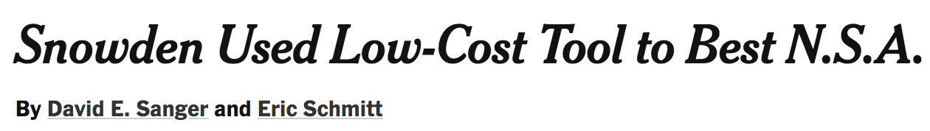
wget
wget <url link to a file>
wget <a ftp link>
example:
wget http://129.130.89.83/tmp/public/sequence.cost.png

Slide 37

date, cal, sleep
date - print or set the system date and time
% date
cal - displays a calendar
% cal Feb 2014
sleep - delay for a specified amount of time
% sleep 2 #2 seconds pause
% sleep 1h

Slide 38
history, clear
history - document of command lines
% history
clear - clear the terminal screen
% clear

Slide 39
scp
scp user@hostname:directory/remotefile localfile
scp <eid>@beocat.cis.ksu.edu:<path/files> .
*For mac users who transfer data between the server and the laptop

Slide 40

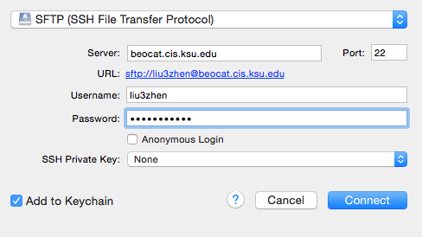
Cyberduck

Slide 41
man
Manual Pages
% man grep
Detailed information about each command
Could be too detailed to find the answer
Sometime it is more efficient to …
Google “how-to”
Ask questions

