Slide 1
Genomic variants Bioinformatics Applications (PLPTH813)
Sanzhen Liu
2/26/2019

Slide 2
Schedule
week 6 | 26-Feb | variants
 | 28-Feb | phylogeny
week 7 | 5-Mar | Oral presentation_1_NGS technology and visualization tools
 | 7-Mar | Mid-term exam

Slide 3
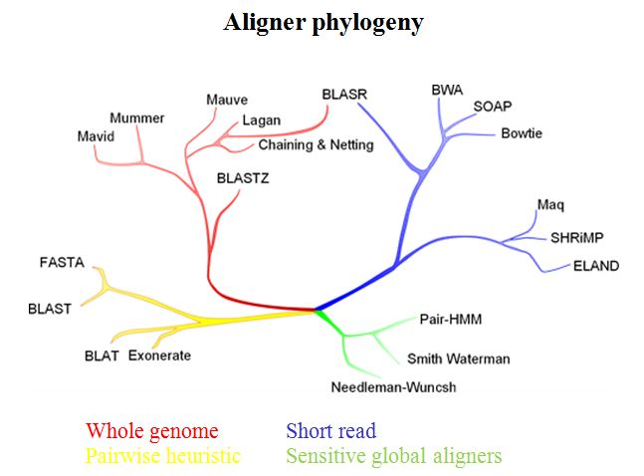
Alignment algorithms
review
BWT
“sorted or indexed” genome
Genome sequences
memory
one by one
reads
alignments
bwa index
bwa mem
evomicsorg.wpengine.netdna-cdn.com/wp-content/uploads/2014/01/alignCompare2.jpg

Slide 4
SAM and BAM alignment format
review
SAM is a generic alignment format for storing read alignments against reference sequence.
BAM is the binary representation of SAM.
SAMtools is a generic and modular approach for analysis of genomic sequencing data.
File type | Storage usage
SAM | 313 M
BAM | 97 M
Notes:
Example of extended CIGAR and the pileup output.
(a) Alignments of one pair of reads and three single-end reads.
(b) The corresponding SAM file. The ‘@SQ’ line in the header section gives the order of reference sequences. Notably, r001 is the name of a read pair. According to FLAG 163 (=1 + 2 + 32 + 128), the read mapped to position 7 is the second read in the pair (128) and regarded as properly paired (1 + 2); its mate is mapped to 37 on the reverse strand (32). Read r002 has three soft-clipped (unaligned) bases. The coordinate shown in SAM is the position of the first aligned base. The CIGAR string for this alignment contains a P (padding) operation which correctly aligns the inserted sequences. Padding operations can be absent when an aligner does not support multiple sequence alignment. The last six bases of read r003 map to position 9, and the first five to position 29 on the reverse strand. The hard clipping operation H indicates that the clipped sequence is not present in the sequence field. The NM tag gives the number of mismatches. Read r004 is aligned across an intron, indicated by the N operation.
(c) Simplified pileup output by SAMtools. Each line consists of reference name, sorted coordinate, reference base, the number of reads covering the position and read bases. In the fifth field, a dot or a comma denotes a base identical to the reference; a dot or a capital letter denotes a base from a read mapped on the forward strand, while a comma or a lowercase letter on the reverse strand.

Slide 5
CRAM
CRAM uses a genomic reference to describe differences between the aligned sequence fragments and the reference sequence.
CRAM files typically vary from 30 to 60% smaller than BAM.

Slide 6
SAMtools
SAMtools is a popular open-source software package for sequence alignment manipulation. It is a reliable tool for almost all bioinformatists who work on NGS data.
-- File operations
collate shuffle and group alignments by name
cat concatenate BAMs
merge merge sorted alignments
mpileup multi-way pileup
sort sort alignment file
split splits a file by read group
fastq converts a BAM to a FASTQ
fasta converts a BAM to a FASTA
-- Statistics
bedcov read depth per BED region
depth compute the depth
flagstat simple stats
idxstats BAM index stats
phase phase heterozygotes
stats generate stats (former bamcheck)
-- Viewing
flags explain BAM flags
tview text alignment viewer
view SAM<->BAM<->CRAM conversion
Usage: samtools <command> [options]
Commands:
-- Indexing
dict create a sequence dictionary file
faidx index/extract FASTA
index index alignment
-- Editing
calmd recalculate MD/NM tags and '=' bases
fixmate fix mate information
reheader replace BAM header
targetcut cut fosmid regions
addreplacerg adds or replaces RG tags
markdup mark duplicates

Slide 7
Conversion between SAM and BAM
For efficient computation and storage, SAM is often converted to BAM. Sorting and indexing the alignment facilitate the following analyzing procedures.
converting:
samtools view aln.sam -o aln.bam
sorting:
samtools sort aln.bam alnsort
indexing:
samtools index alnsort.bam

Slide 8
Visualization
samtools tview alnsort.bam ref.fasta
1st line: the genome coordinates
541 551 561 571 581 591
ATGCCGAACGTATTTTTGCCGAACTTTTGACGGGACTCGCCGCCGCCCAGCCGGGGTTCCCGCTGGCGC
.....................................................................
... ,,,,,,,,,,,,,,,,,,,,,,,,,,,,,,,,,,,,,,,,,,,,,,,,,,,,,,,,,,,,,,,,,
,,,, ,,,,,,,,,,,,,,,,,,,,,,,,,,,,,,,,,,,,,,,,,,,,,,,,,,,,,,,,,,,,,,,
,,,,,, ,,,,,,,,,,,,,,,,,,,,,,,,,,,,,,,,,,,,,,,,,,,,,,,,,,,,,,,,,n
,,,,,,,,,,,,,,,,,,,,,,,,,,, ,,,,,,,,,,,,,,,,,,,,,,,,,,,,,,,,
................................................... C................
,,,,,,,,,,,,,,,,,,,,,,,,,,,,,,,,,,,,,,,,,,,,,,,,,,,,,t ,,,,,,,
2nd line: reference sequence
3rd line: the consensus sequence, . indicates the identical sequence to the reference genome
the rest of lines: alignment details
Notes:
In this view, the first line shows the genome coordinates, the second line shows the reference sequence, and the third line shows the consensus sequence determined from the aligned reads. Throughout tview, a . indicates a match to the reference genome.

Slide 9
Integrative Genomics Viewer (IGV)
The Integrative Genomics Viewer (IGV) is a visualization tool for interactive exploration of large, integrated genomic datasets.
James T. Robinson, et al., Nature Biotechnology 29:24–26 (2011)
Helga Thorvaldsdóttir, et al., Briefings in Bioinformatics 14:178-192 (2013)
www.broadinstitute.org/igv

Slide 10
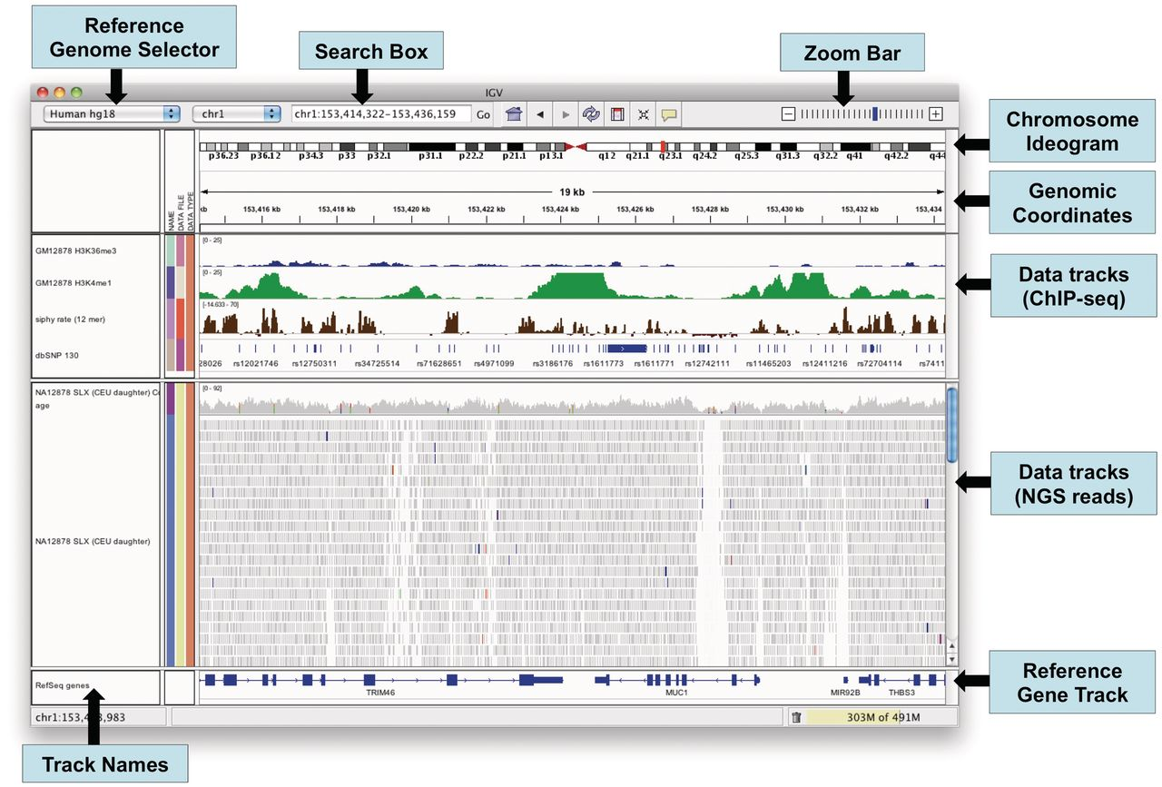
IGV window
Notes:
The IGV application window.

Slide 11
Data for IGV
Reference genomes (build-in or external references)
Data format:
Non-indexed formats: GFF, BED and WIG.
Indexed formats: BAM (sequence alignments)
For example:
A reference genome: .fasta
A genome annotation file: .gff3 (optional)
An alignment file: .bam (plus .bai index file)

Slide 12
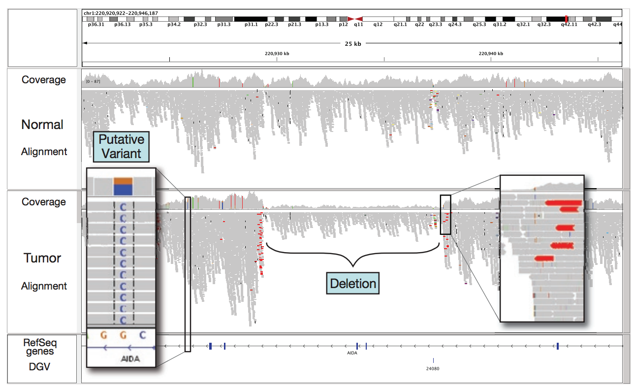
IGV example
Loci with mismatches with the reference are flagged by color.
Alignments with unexpected insert sizes are indicated by color.
Evidence for a ~10-kb deletion in the tumor sample not present in the normal.

Slide 13
Outline
Overview of genomic variants
Data for variant discovery
Bioinformatics of variant discovery
the methods for variant (SNP) validation

Slide 14
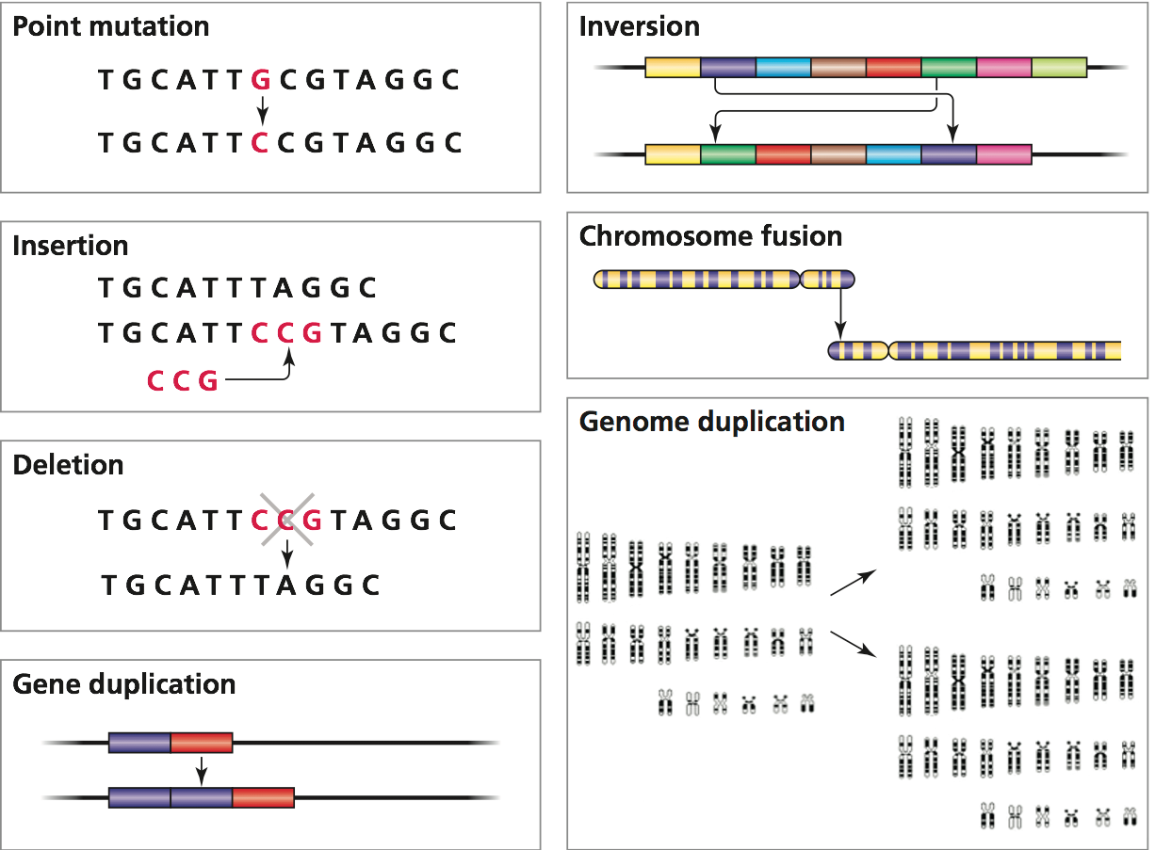
Genomic variants (ploymorphism)
1. SNP
2. INDEL
3. genomic structural variation
copy number variation (presence-absence variation)
other re-arrangements

Slide 15
Genomic variants - SNPs
SNP stands for single nucleotide polymorphism.
Frequencies of SNPs are depended on species. For example, millions of SNPs have been discovered in human.
Most SNPs are bi-allelic. (mutation rate per site is about 10⁻⁸)
Most have no effects on cell function but some could have important phenotypic consequence.

Slide 16
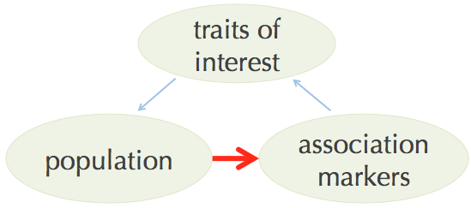
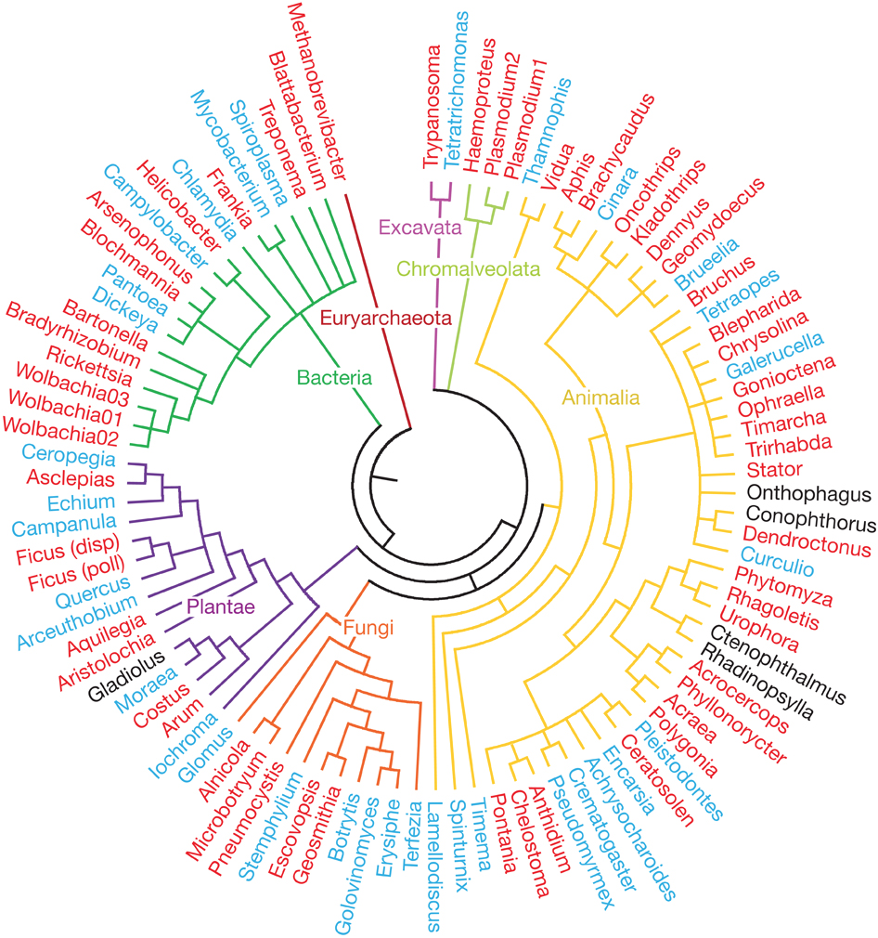
Applications of SNPs
Genetic markers to map the genetic controlling of traits (quality traits, quantitative traits, gene expression, etc)
Genetic markers to construct genetic maps
Markers to construct phylogenetic trees

Slide 17
Next-Generation Sequencing to generate data for variant discovery
GATCTGCGTCATACGGAAT
GATCTGCGTGATACGGAAT
GATCTGCGTCATACGGAAT
GATCTGCGTGATACGGAAT
GATCTGCGTGATACGGAAT
GATCTGCGTGATACGGAAT
GATCTGCGTCATACGGAAT
GATCTGCGTCATACGGAAT
GATCTGCGTGATACGGAAT
GATCTGCGTCATACGGAAT
--------C/G--------
Notes:
The revolution of sequencing allows for affordable genotyping.

Slide 18
Approaches for data generation
Whole genome sequencing (WGS): high genome coverage but costly for large genomes
Exome-capture sequencing: target on genic regions but still expensive to perform large number of samples
RNA sequencing (RNA-Seq): obtain data on genic regions and provide expression information
Genotyping-By-Sequencing (GBS): cost-efficient and high-throughput approach

Slide 19
Data to variant (SNP) discovery
Data: sequencing reads
Reference-based approach
Alignment-based SNP discovery (standard)
Assembly-based SNP discovery
Reference-free approach
Usually used in the sequencing projects with sequencing data from multiple individuals

Slide 20
Alignment-based SNP discovery
…GATCTGCGTCATACGGAAT… (reference)
GATCTGCGTGATACGGAAT
GATCTGCGTCATACGGAAT
GATCTGCGTGATACGGAAT
GATCTGCGTGATACGGAAT
GATCTGCGTGATACGGAAT
GATCTGCGTCATACGGAAT
GATCTGCGTCATACGGAAT
GATCTGCGTGATACGGAAT
GATCTGCGTCATACGGAAT
--------------------C/G--------------------
reads

Slide 21
Alignment-based SNP discovery, cont.
General procedure
Reads cleanup (adaptor, quality trimming, e.g., trimmomatic)
Reads aligned to the reference genome with aligners
1. BWA, Bowtie (DNA-Seq reads)
2. HISAT2, STAR, GSNAP, Tophat (RNA-Seq reads)
Post-alignment filtering and convert SAM (alignment file) to BAM
SNP calling with software packages: Samtools, GATK, VarScan2
Use population information or some criteria to filter SNP sets
an example of the alignment of a RNA-Seq read using GSNAP
HISEQ:163:C4YWTACXX:1:1101:8654:2286 16 chromosome_1 1765703 40 16M97N85M * 0 0 TGGCAACATTGTTAAGCTCTGGCGTGATAAATTGCCCTGTCAGCAAGCAGATGGCAGGCAATGTGCAATAGGCGAAGAGCGGGATAGATGTCCAAGGGTAT DDDDDDDDDDDDDDDDDDDBDDCEEEFEFFFFFHHHJJIJJJJJJJJJJJJJJJJJJJJJJJJJJIJJJJJJHEJJJJJJJJJJJJJJHHHHHFFFFFCCC MD:Z:73C27 NH:i:1 HI:i:1 NM:i:1 SM:i:40 XQ:i:40 X2:i:0 XO:Z:UU XS:A:- PG:Z:A

Slide 22
Interpretation of the BWA alignment
SAM output:
HWI-ST897:104:C015GACXX:6:1101:12678:20443 163 U00096 1888286 60 64M1D20M = 1888358 170 GCCAACAGCCGCGACTTCCTGTACGCCAGGATGCTGCATGACGACATCTTCAATCTCGTTGGGAAGACGTTAAAAACGGAAACC CCCFFFFFHHFHHJJJJJJJ JHIJHIJIIJIJJJJJIJJJJIJJHHFFFFFFEEEEEEDDDDDDA5,53,8<?CC(50?8BD3? NM:i:2 AS:i:72 XS:i:0 RG:Z:S1
CIGAR: 64M1D20M
NM: edit distance
edit distance is a way to quantify the dissimilarity of two strings (e.g., words) by counting the minimum number of edits (substitution, insertion, and deletion) required to transform one string into the other.
fact -> fit (2)
AACCT -> AAACT (1)
Notes:
2

Slide 23
edit distance
AACCT -> ACCTA (?)
AATCCT -> ATCAT (?)

Slide 24
Polymorphism based on Alignment + reference genome
SAM output (BWA):
HWI-ST897:104:C015GACXX:6:1101:12678:20443 163 U00096 1888286 60 64M1D20M = 1888358 170 GCCAACAGCCGCGACTTCCTGTACGCCAGGATGCTGCATGACGACATCTTCAATCTCGTTGGGAAGACGTTAAAAACGGAAACC CCCFFFFFHHFHHJJJJJJJ JHIJHIJIIJIJJJJJIJJJJIJJHHFFFFFFEEEEEEDDDDDDA5,53,8<?CC(50?8BD3? NM:i:2 AS:i:72 XS:i:0 RG:Z:S1
mapping position and CIGAR determine the alignment
Query 1 GCCAACAGCCGCGACTTCCTGTACGCCAGGATGCTGCATGACGACATCTTCAATCTCGTT 60
||||||||||||||||||||||||||||||||||||||||||||||||||||||||||||
Sbjct 1888286 GCCAACAGCCGCGACTTCCTGTACGCCAGGATGCTGCATGACGACATCTTCAATCTCGTT 1888345
Query 61 GGGA-AGACGTTAAAAACGGAAACC 84
|||| ||||||||||| ||||||||
Sbjct 1888346 GGGATAGACGTTAAAACCGGAAACC 1888370

Slide 25
Alignment-based SNP discovery: GATK (1)
The Genome Analysis Toolkit (GATK) is a software package developed at the Broad Institute to primarily focus on variant discovery and genotyping.
Input data: BAM files and reference genome
Required tools: Picard and Samtools
Code example:
java –jar GenomeAnalysisTK.jar \
-T UnifiedGenotyper \
-R your_reference \
-I your_bam \
-glm BOTH
### BOTH = SNP + INDEL

Slide 26
GATK (2)
VCF (Variant Call Format) output
https://samtools.github.io/hts-specs/VCFv4.2.pdf
isolate 1
isolate 2
#CHROM | POS | ID | REF | ALT | QUAL | FILTER | INFO | FORMAT | DH10B | MG1655
ref1 | 89089 | . | C | A | 782.76 | . | … | GT:AD:DP:GQ:MLPSAC:MLPSAF:PL | 1:0,18:18:99:1:1.00:781,0 | 0:27,0:27:99:0:0.00:0,1149
ref1 | 89103 | . | G | C | 690.76 | . | … | GT:AD:DP:GQ:MLPSAC:MLPSAF:PL | 1:0,16:16:99:1:1.00:689,0 | 0:29,0:29:99:0:0.00:0,1253
ref1 | 89143 | . | A | G | 448.76 | . | … | GT:AD:DP:GQ:MLPSAC:MLPSAF:PL | 1:0,11:11:99:1:1.00:447,0 | 0:27,0:27:99:0:0.00:0,1165
ref1 | 89145 | . | G | T | 405.76 | . | … | GT:AD:DP:GQ:MLPSAC:MLPSAF:PL | 1:0,10:10:99:1:1.00:404,0 | 0:28,0:28:99:0:0.00:0,1215
GT: AD : DP: GQ: MLPSAC: MLPSAF: PL
1 : 0,18: 18: 99: 1 : 1.00 : 781,0
GT=Genotype (0 or 1)
AD=Allelic depths for the ref and alt alleles
DP=Approximate read depth
GQ=Genotype Quality
MLPSAC=Maximum likelihood expectation (MLE) for the alternate allele count
MLPSAF=Maximum likelihood expectation (MLE) for the alternate allele fraction
PL=Normalized, Phred-scaled likelihoods for genotypes
Prob(0) = 10^(-781/10) = 7.9e-79 Prob(1) = 10^(-0/10) = 1

Slide 27
GATK (3)
GATK can be used to filter SNPs.
java GenomeAnalysisTK.jar \
-T SelectVariants \
-R your_reference \
--variant your_vcf \
-select 'DP >= 3.0' \
--restrictAllelesTo BIALLELIC \
--selectTypeToInclude SNP
Filter variants based on the experimental purpose and genetic features

Slide 28
Falsely discovered SNPs
Can you think about what could result in falsely discovered SNPs using alignment-based SNP methods?
Notes:
Sequence errors
Reference errors
Alignment issues

Slide 29
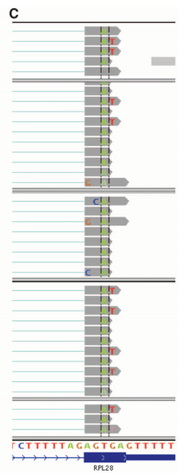

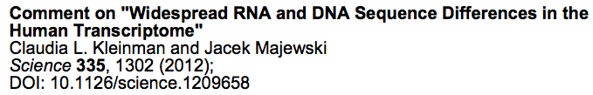
Alignment-based SNP discovery: alignment issues
Misalignments
Genome duplications
Highly divergent regions
Examples:
The misalignments of RNA-Seq data or DNA-Seq data led to this discovery

Slide 30
Assembly-based SNP discovery
Cortex (Iqbal et al., 2012 Nature Genetics)
de novo assembly and graphic comparison for variant discovery
Fermi (Li H, 2012 Bioinformatics)
de novo assembly to unitigs* and then alignment to the reference genome for variant discovery
(Conceptually, unitigs are confident contigs)
Discovar (Neil et al., 2014 Nature Genetics)
Region de novo assembly to contigs and then alignment to the reference genome for variant discovery

Slide 31
Variant annotation
Gene coding regions
Synonymous: changes that do not alter the encoded amino acid
Non-synonymous
Missense: changes that alter encoded amino acid
Nonsense: changes that produce a stop codon from an amino acid codon, resulting in a shortened protein
Frameshift (caused by insertion/deletion)
Splicing sites
Of an intron, a donor site (5' end of the intron) and an acceptor site (3' end of the intron) are required for splicing.

Slide 32
Variant annotation - SnpEff
SnpEff is a variant annotation and effect prediction tool. It annotates and predicts the effects of variants on genes.
Input data:
Genome annotation database
Variant data: VCF file
Running:
java -jar snpEff.jar GRCh37.75 my.vcf
Cingolani P, et al., DM. Fly (Austin). 2012 Apr-Jun;6(2):80-92.

Slide 33
Detailed effect list from SnpEff
Effect | Note
INTERGENIC | The variant is in an intergenic region
UPSTREAM | Upstream of a gene (default length: 5K bases)
UTR_5_PRIME | Variant hits 5′UTR region
UTR_5_DELETED | The variant deletes an exon which is in the 5′UTR of the transcript
START_GAINED | A variant in 5′UTR region produces a three base sequence that can be a START codon.
SPLICE_SITE_ACCEPTOR | The variant hits a splice acceptor site (defined as two bases before exon start, except for the first exon).
SPLICE_SITE_DONOR | The variant hits a Splice donor site (defined as two bases after coding exon end, except for the last exon).
START_LOST | Variant causes start codon to be mutated into a non-start codon.
SYNONYMOUS_START | Variant causes start codon to be mutated into another start codon.
CDS | The variant hits a CDS.
GENE | The variant hits a gene.
TRANSCRIPT | The variant hits a transcript.
EXON | The vairant hist an exon.
EXON_DELETED | A deletion removes the whole exon.
NON_SYNONYMOUS_CODING | Variant causes a codon that produces a different amino acid
SYNONYMOUS_CODING | Variant causes a codon that produces the same amino acid
FRAME_SHIFT | Insertion or deletion causes a frame shift
CODON_CHANGE | One or many codons are changed
CODON_INSERTION | One or many codons are inserted
CODON_CHANGE_PLUS_CODON_INSERTION | One codon is changed and one or many codons are inserted
CODON_DELETION | One or many codons are deleted
CODON_CHANGE_PLUS_CODON_DELETION | One codon is changed and one or more codons are deleted
STOP_GAINED | Variant causes a STOP codon
SYNONYMOUS_STOP | Variant causes stop codon to be mutated into another stop codon.
STOP_LOST | Variant causes stop codon to be mutated into a non-stop codon
INTRON | Variant hist and intron. Technically, hits no exon in the transcript.
UTR_3_PRIME | Variant hits 3′UTR region
UTR_3_DELETED | The variant deletes an exon which is in the 3′UTR of the transcript
DOWNSTREAM | Downstream of a gene (default length: 5K bases)
INTRON_CONSERVED | The variant is in a highly conserved intronic region
INTERGENIC_CONSERVED | The variant is in a highly conserved intergenic region

Slide 34
Sequencing independent genotyping
Large-scale (thousands to approximate 1 million)
Illumina Beadchip (beads hybridization based)
Affymetrix SNP array (microarray-hybridization-based)
Medium-scale (hundreds of markers)
Fluidigm (Microfluidic-based)
Sequenom iPLEX (mass spectrometry method)
Small-scale
High Resolution Melt (HRM (melting))
KASP
Taqman

Slide 35
Summary
The strategy to generate data for SNP discovery is depended on experimental purpose, genetic features of the population, timetable, and budget.
A standard approach for SNP discovery is through mapping reads to the reference sequences, thereby identifying variants between reads and reference. The most popular method is GATK.
More flexible and cost-efficient SNP validation approaches need to be developed to leverage variant discovery.

