Slide 1
Genome annotation Bioinformatics Applications (PLPTH813)
Sanzhen Liu
4/2/2019

Slide 2
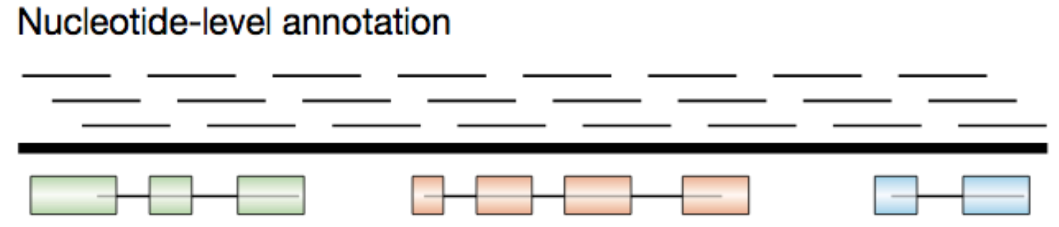
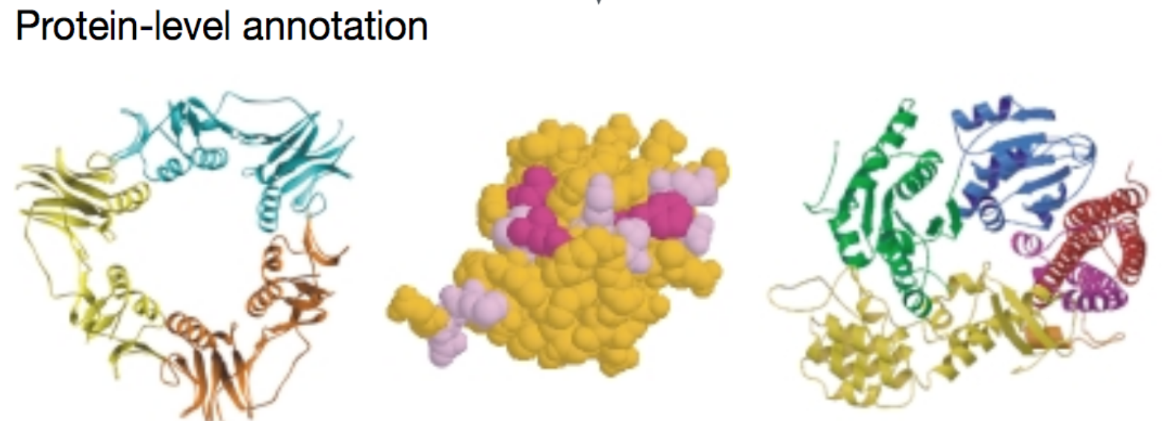
Nucleotide- and protein level annotation

Slide 3
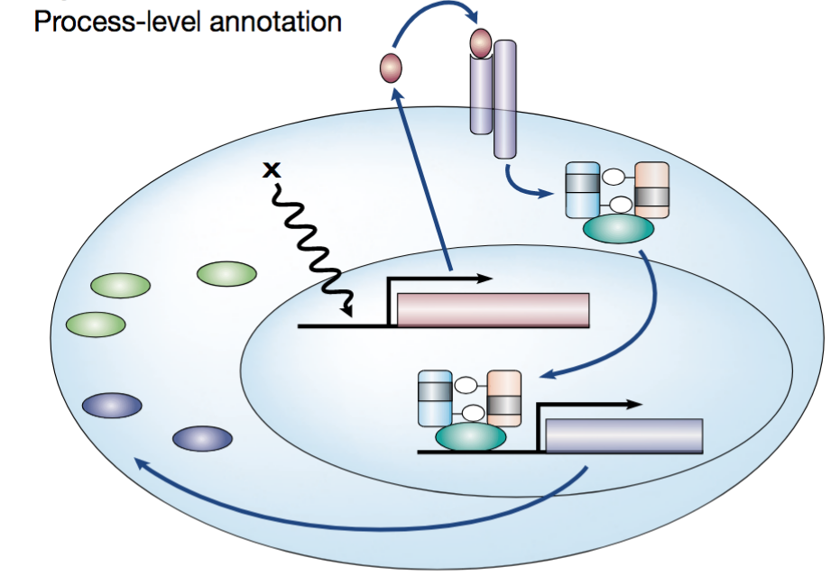
Process-level annotation

Slide 4
Gene prediction in eukaryotic genomes
Gene prediction from genomic DNA sequences:
to predict the exon-intron structures of the protein-encoding portions of transcripts (open reading frames or ORFs) and untranslated regions (UTR).

Slide 5
Gene prediction approaches
ab initio gene prediction (Hidden Markov Model)
to assign probability scores to many potential coding exons, and then join consecutive high-scoring exons with consistent reading frames to form high-scoring exon–intron structures
Evidence-based gene prediction (RNA sequencing)

Slide 6
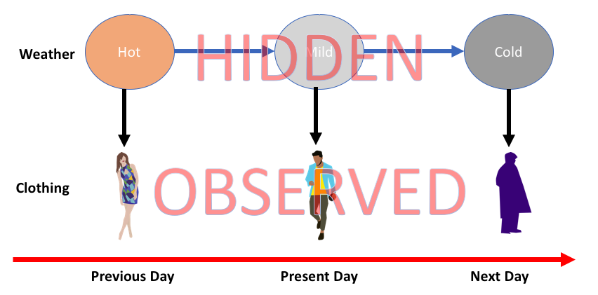
Hidden Markov Model (HMM)
Hidden states
HMM is a class of probabilistic graphical model that is used to predict a sequence of unknown (hidden) variables from observed variables.
https://medium.com/@postsanjay/hidden-markov-models-simplified-c3f58728caab

Slide 7
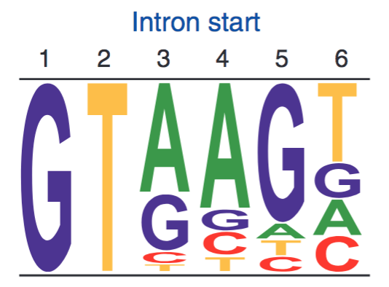
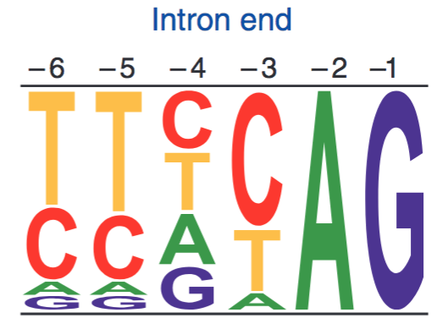
Exon-intron structure
Sequence logos representing weight matrices for the first six bases of an intron (left) and the last six bases of an intron (right). In plants and animals, ~99% of introns begin with GT.
exon
intron
exon
GT
AG
genomic sequence patterns: splice donor and acceptor sites and translation initiation and termination sites.

Slide 8
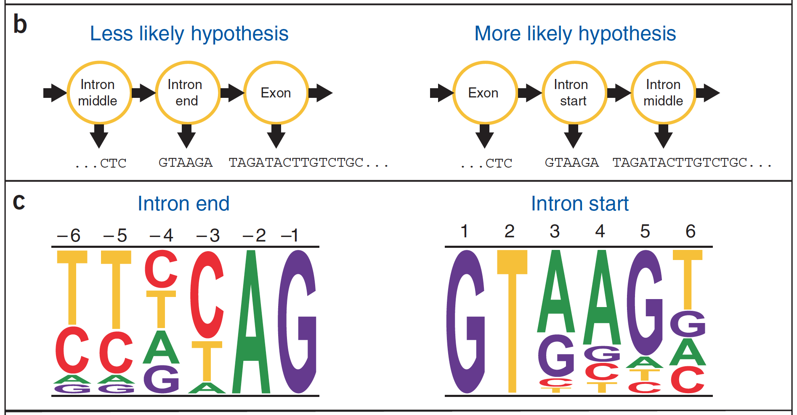
Generalized Hidden Markov Model (GHMM)

Slide 9
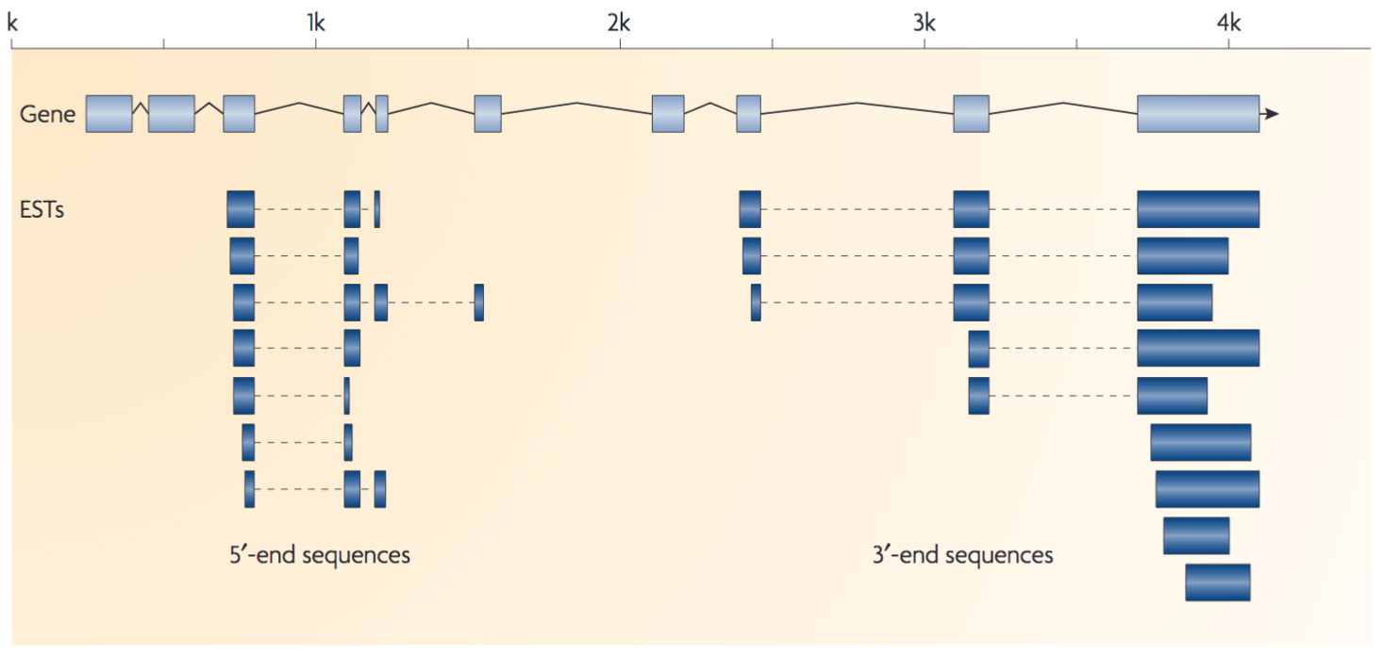
Evidence-driven approaches
Ideally, full-length cDNA sequences of all genes are collected for evidence-based genome annotation.

Slide 10
evidence and limitations
full-length cDNAs
Expression sequence tags (ESTs)
RNA-Seq (de novo assembly and alignment-based)
Limitations:
full-length cDNA databases are not available
Not all genes are transcribed at sufficient levels at certain conditions
alignments produce errors

Slide 11
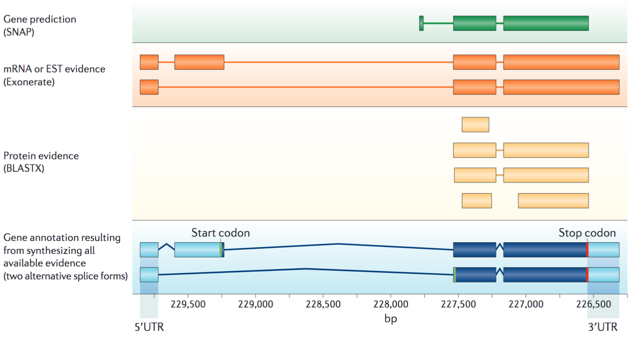
annotation: ab initio prediction + evidence
Nature Reviews Genetics 13:329–342 (2012)

Slide 17
Geib SM, Hall B, Derego T, Bremer FT, Cannoles K, Sim SB. Genome Annotation Generator: a simple tool for generating and correcting WGS annotation tables for NCBI submission. Gigascience. 2018;7(4):1-5.

