Slide 1
Phylogenetic tree Bioinformatics Applications (PLPTH813)
Sanzhen Liu
3/25/2021

Slide 2
Goal of today’s lab
Preparation of variant data
Construction of phylogenetic trees using "ape"
Other software packages
online tools: itol

Slide 3
package installation
install.packages("ape")
library("ape")
https://cran.r-project.org/web/packages/ape/ape.pdf

Slide 4
Create a working directory in Beocat
mkdir lab07_phylogeny

Slide 5
Newick tree data
### Phylogenetic Tree of 193 HIV-1 Sequences
data(hivtree.newick) ### load data
hivtree.newick ### check the Newick format
### output to a file:
cat(hivtree.newick, file = "HIV.tree.newick")
### load tree information to R
ht <- read.tree("HIV.tree.newick")

Slide 6
plot.phylo(ht)

Slide 7
Tree data examination
### tree data
summary(ht)
edges <- ht$edge
ht$Nnode
tips <- ht$tip.label
edge.lens <- ht$edge.length
# head, summary to check each data

Slide 8
edge data
> head(edges, 3)
[,1] [,2]
[1,] 194 195
[2,] 195 196
[3,] 196 197
The matrix edge contains the beginning (1st column) and ending (2nd column) node number for all the nodes and tips in the tree. By convention, the tips of the tree are numbered 1 through n for n tips; and the nodes are numbered n + 1 through n + m for m nodes. m = n - 1 for a fully bifurcating tree.

Slide 9
Plotting
### plotting
plot.phylo(ht)
plot.phylo(ht, cex=0.2, type="radial")
### try different parameters for type
?plot.phylo

Slide 10
Highlighted the specified tips
### tips
tips <- ht$tip.label
head(tips)
### two tips to be highlighted
highlight.tips <- c("A97DCKS14", "U97DCKFE267")
### defined colors
tip.cols <- rep("grey", length(tips))
tip.cols[tips %in% highlight.tips] <- "red"
### plotting
plot.phylo(ht, cex=0.2, type="radial", no.margin=T, tip.color=tip.cols)
Notes:
plot.phylo

Slide 11
From DNA sequences to tree – step1: data formatting
pd.file <- "phylo.data.txt"
cat(6, 20, "\n", file = pd.file)
cat("1", "ATCAGATCGCTTCCGGACGA\n", file=pd.file, append=T)
cat("2", "ATAAGATCGCTACCGGACGA\n", file=pd.file, append=T)
cat("3", "ATCAGATCGCTACCGGAGGA\n", file=pd.file, append=T)
cat("4", "ATAAGATCGCTACCGGAGGA\n", file=pd.file, append=T)
cat("5", "ATAAGATCCCTTGCGGACGT\n", file=pd.file, append=T)
cat("6", "ATCAGATCGCATGCGGACGT\n", file=pd.file, append=T)

Slide 12
From DNA sequences to tree – step2: Distance calculation
### read data:
dna <- read.dna(pd.file)
### determine pair-wise distance (matrix):
dist.matrix <- dist.dna(x=dna, model="RAW", pairwise.deletion=T)
dist.matrix

Slide 13
From DNA sequences to tree – step3: construct tree and plotting
### neighbor joining
njs.tree <- njs(dist.matrix)
njs.tree
### plotting
plot.phylo(njs.tree, type="phylogram", cex=1.5)

Slide 14
output a Newick file
### newick output
write.tree(njs.tree, file="example.tree.newick")

Slide 15
tree summary
### load tree information to R
td <- read.tree("example.tree.newick")
summary(td)
td$edge
td$Nnode
td$tip.label
td$edge.length
compare data to the tree (graph)

Slide 16
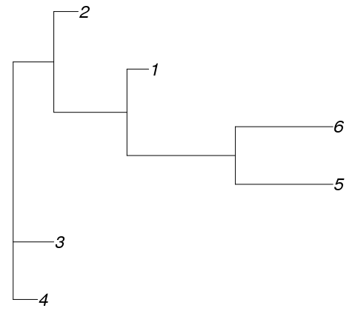
Tree
7
> td$edge
[,1] [,2]
[1,] 7 1
[2,] 7 2
[3,] 7 8
[4,] 8 9
[5,] 9 10
[6,] 10 3
[7,] 10 4
[8,] 9 5
[9,] 8 6
8
9
10

Slide 17
Problems
color-highlight the tips of "2" and "4"

Slide 18
Highlight tips
ntips <- td$tip.label
### two tips to be highlighted
highlight.tips <- c("2", "4")
### defined colors
tip.cols <- rep("grey", length(ntips))
tip.cols[ntips %in% highlight.tips] <- "red"
### plotting
plot.phylo(td, cex=2, type="radial",
no.margin=T, tip.color=tip.cols)

Slide 19
highlight edges
color-highlight the edges (clades) with the tips of "1", "5", "6"
nedges <- td$edge # edge link with leaf and node IDs
# convert leaf IDs to leaf names
leafnode.names <- td$tip.label[nedges[, 2]]
edge.cols <- rep("grey", nrow(nedges))
edge.cols[leafnode.names %in% c("1", "5", "6")] <- "red"
edge.cols
plot.phylo(td, cex=2, no.margin=T,
edge.color=edge.cols)

Slide 20
Interactive tree of life (iTOL)
https://itol.embl.de
Input data: Newick, Nexus, and phyloXML
Interactive editing
Output vector graphic images (editable)
https://itol.embl.de/help.cgi#popup
https://itol.embl.de/video_tutorial.cgi

