Slide 1
In-class project – DE Bioinformatics Applications (PLPTH813)
Sanzhen Liu
4/20/2021

Slide 2
RNA-Seq procedure
total RNA
mRNA
RNA to sequencing reads
1
DNA library
sequencing
reads
reads to read counts per gene
c
2
QC, alignment
read counts
read counts to significant genes
statistical test
3
q-values/FDR
significance

Slide 3
Directories
mkdir 0-ref 1-raw 2-trim 3-aln 4-DE
0-ref
1-raw
2-trim
3-aln
4-DE

Slide 4
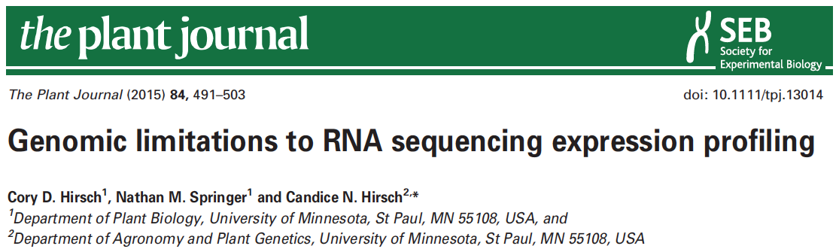

data information
SRR1238718
Makarevitch et al., 2015
Hirsch et al., 2016

Slide 5
Part I: Data downloading
Introduction of Sequence Read Archive (SRA) (2007)
Data download (SRA toolkit)
- fasterq-dump

Slide 6
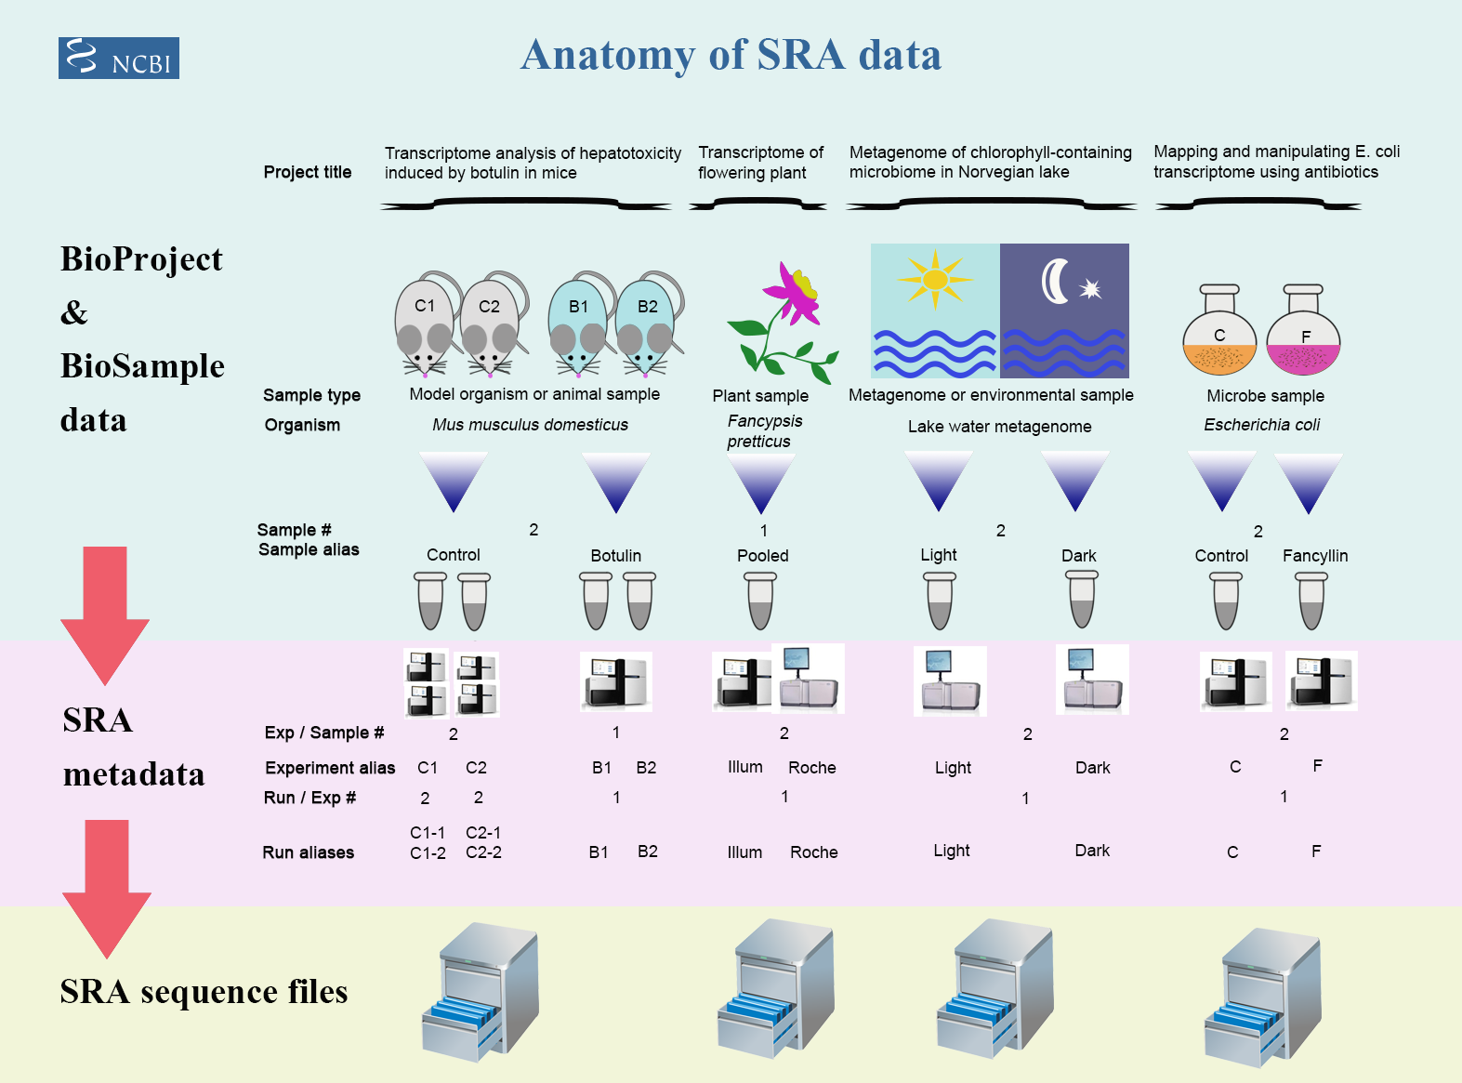
Framework of data submission

Slide 7
Metadata and sequence data
Study – a set of experiments with an overall goal
SRA Study accessions – SRP, DRP, or ERP
Experiment –laboratory operations on input material
SRA Experiment accessions – SRE, DRE, or ERE
Sample – An experiment targets one or more samples
SRA Sample accessions – SRS, DRS, or ERS
Run –the data gathered for a sample or sample bundle
SRA Run accessions – SRR, DRR, or ERR
Notes:
The SRA metadata describes the technical aspects of sequencing experiments: the sequencing libraries, preparation techniques and data files.

Slide 8
format conversion - fastq-dump in Beocat
fasterq-dump [options] <accession>
#!/bin/bash -l
#SBATCH --mem-per-cpu=16G
#SBATCH --time=12:00:00
#SBATCH --nodes=1
#SBATCH --ntasks-per-node=1
/homes/liu3zhen/software/sra_tools/current/fasterq-dump \
--split-files <accession>
/homes/liu3zhen/software/sra_tools/current/fasterq-dump \
--split-files SRR1238718
SRR1238718_1.fastq
SRR1238718_2.fastq

Slide 9
Configure sra_tools
/homes/liu3zhen/software/sra_tools/current/vdb-config \
--interactive --interactive
/homes/liu3zhen/software/sra_tools/current/fasterq-dump

Slide 10
Beocat pipeline to download SRA in batch - I
# step 1: Prepare data: dataset.txt
Order | ID | Genotype | Sample | Treatment | Citation
1 | SRR1238718 | B73 | norm1 | norm | Hirsch2015TPJ
2 | SRR1819617 | B73 | norm2 | norm | Hirsch2015TPJ
3 | SRR1819621 | B73 | norm3 | norm | Hirsch2015TPJ
4 | SRR1238717 | B73 | cold1 | cold | Hirsch2015TPJ
5 | SRR1819204 | B73 | cold2 | cold | Hirsch2015TPJ
6 | SRR1819205 | B73 | cold3 | cold | Hirsch2015TPJ
Makarevitch et al., 2015
Hirsch et al., 2016

Slide 11
Beocat pipeline to download SRA in batch - II
working directory: 1-raw
# step 2: Run and download
# must check
meta_file=/homes/liu3zhen/teaching/datasets/DE/1-raw/dataset.txt
srr_col=2
rename_col=4
# running
perl /homes/liu3zhen/local/slurm/SRA/fasterq_dump.sbatch.pl \
--in /homes/liu3zhen/teaching/datasets/DE/1-raw/dataset.txt \
--srrcol 2
# create a script to rename downloaded files
cut $meta_file -f $srr_col,$rename_col | grep "^[EDS]RR" \
| sed 's/^/rename /g' | sed 's/\t/ /g' | \
sed 's/$/ *fastq/g' > rename.sh

Slide 12
Beocat pipeline to download SRA in batch - III
# step 3: Run "rename.sh" to change names (optional)
# must check
meta_file=/homes/liu3zhen/teaching/datasets/DE/1-raw/dataset.txt
srr_col=2
rename_col=4
cut $meta_file -f $srr_col,$rename_col | grep "^[EDS]RR" \
| sed 's/^/rename /g' | sed 's/\t/ /g' | \
sed 's/$/ *fastq/g' > rename.sh
bash rename.sh
working directory: 1-raw

Slide 13
Part II. Trimming
working directory: 2-trim
perl /homes/liu3zhen/local/slurm/trimmomatic/trimmomatic.sbatch.pl \
--mem 16G \
--time 0-23:00:00 \
--trim_shell "/homes/liu3zhen/local/slurm/trimmomatic/trimmomatic.pe.sh" \
--trimmomatic "/homes/liu3zhen/software/trimmomatic/Trimmomatic-0.38/trimmomatic-0.38.jar" \
--adaptor_file "/homes/liu3zhen/software/trimmomatic/Trimmomatic-0.38/adapters/TruSeq3-PE.fa" \
--indir ”../1-raw" \
--outdir "." \
--fq1feature "_1.fastq" \
--fq2feature "_2.fastq" \
--threads 4 \
--min_len 40

Slide 14
Part II. Trimming: sbatch command
#!/bin/bash -l
#SBATCH --mem-per-cpu=16
#SBATCH --time=12:00:00
#SBATCH --cpus-per-task=4
module load Java
bash /homes/liu3zhen/local/slurm/trimmomatic/trimmomatic.pe.sh \
/homes/liu3zhen/software/trimmomatic/Trimmomatic-0.38/trimmomatic-0.38.jar \
/homes/liu3zhen/software/trimmomatic/Trimmomatic-0.38/adapters/TruSeq3-PE.fa \
../1-raw . _1.fastq _2.fastq 4 40 SRR1238717_1.fastq

Slide 15
RNA-Seq procedure
total RNA
mRNA
RNA to sequencing reads
1
DNA library
sequencing
reads
reads to read counts per gene
c
2
alignment
read counts
read counts to significant genes
statistical test
3
q-values/FDR
significance

Slide 16

STAR
as of 4/18/2021
High speed
Unbiased de novo detection of canonical junctions
discovery of non-canonical splices and chimeric transcripts
Capable of mapping full-length RNA sequences

Slide 17

STAR Reference genome indexing
Index the reference genome with the annotation file
#!/bin/bash
#SBATCH --cpus-per-task=4
#SBATCH --mem-per-cpu=8g
#SBATCH --time=0-23:00:00
/homes/liu3zhen/local/bin/STAR --runThreadN 4 \
--runMode genomeGenerate \
--genomeDir /homes/liu3zhen/teaching/datasets/DE/0-ref \
--genomeFastaFiles B73Ref4.fa \
--sjdbGTFfile Zea_mays.B73_RefGen_v4.46.gtf \
--sjdbOverhang 100
Notes:
NOTE: In case of reads of varying length, the ideal value for --sjdbOverhang is max(ReadLength)-1. In most cases, the default value of 100 will work similarly to the ideal value.

Slide 18
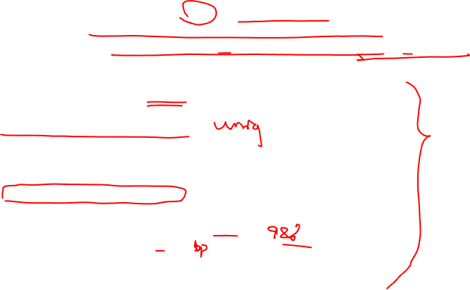
Part III. STAR: sbatch script (one sample)
working directory: 3-aln
/homes/liu3zhen/local/bin/STAR --runThreadN 1 \
--genomeDir /homes/liu3zhen/teaching/datasets/DE/0-ref \
--readFilesIn ../2-trim/cold1.R1.pair.fq ../2-trim/cold1.R2.pair.fq \
--alignIntronMax 100000 \
--alignMatesGapMax 100000 \
--outFileNamePrefix cold1 \
--outSAMattrIHstart 0 \
--outSAMmultNmax 1 \
--outSAMstrandField intronMotif \
--outFilterIntronMotifs RemoveNoncanonicalUnannotated \
--outSAMtype BAM SortedByCoordinate \
--quantMode GeneCounts \
--outFilterMismatchNmax 1 \
--outFilterMismatchNoverLmax 0.02 \
--outFilterMatchNmin 40 \
--outSJfilterReads Unique \
--outFilterMultimapNmax 1 \
--outFilterMultimapScoreRange 2

Slide 19
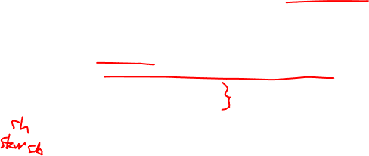
Part III. STAR: generate sbatch script and submit jobs
working directory: 3-aln
perl /homes/liu3zhen/local/slurm/STAR/STAR.sbatch.pl \
--java "Java" \
--mem 48 --threads 1 --time 12:00:00 \
--star_cmd /homes/liu3zhen/local/bin/STAR \
--indir ../2-trim \
--dbdir /homes/liu3zhen/teaching/datasets/DE/0-ref \
--fq1feature .R1.pair.fq \
--fq2feature .R2.pair.fq \
--alignIntronMax 100000 \
--alignMatesGapMax 100000 \
--outSAMattrIHstart 0 \
--outSAMmultNmax 1 \
--outSAMstrandField intronMotif \
--outFilterIntronMotifs RemoveNoncanonicalUnannotated \
--outSAMtype "BAM SortedByCoordinate" \
--quantMode GeneCounts \
--outFilterMismatchNmax 1 \
--outFilterMismatchNoverLmax 0.05 \
--outFilterMatchNmin 40 \
--outSJfilterReads Unique \
--outFilterMultimapNmax 1 \
--outFilterMultimapScoreRange 2

Slide 20

STAR output – cold1 sample
cold1Aligned.sortedByCoord.out.bam
cold1Log.final.out
cold1Log.out
cold1Log.progress.out
cold1ReadsPerGene.out.tab
cold1SJ.out.tab

Slide 21
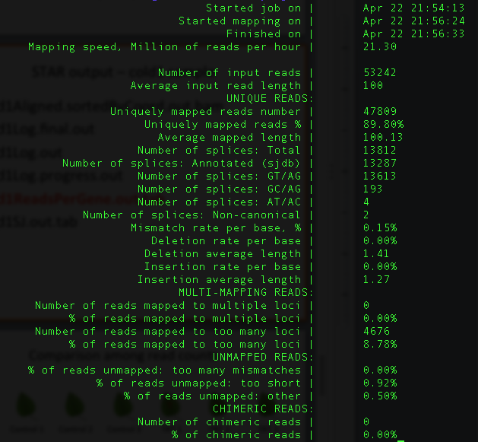
cold1Log.final.out

Slide 22
cold1ReadsPerGene.out.tab
column 1: gene ID
column 2: counts for unstranded RNA-seq
column 3: counts for the 1st read strand aligned with RNA (htseq-count option -s yes)
column 4: counts for the 2nd read strand aligned with RNA (htseq-count option -s reverse)
Notes:
https://github.com/alexdobin/STAR/issues/703
N_multimapping is the total number of multimapping reads, which are not counted at all, so the number is the same for each column. N_noFeature: if a read overlaps a gene on the opposite strand, it will be counted as noFeature for one of the stranded columns, but will be counted towards the gene (and not as noFeature) in the unstranded column. Hence N_noFeature(unstranded) can be < N_noFeature(+) + N_noFeature(-).
https://groups.google.com/g/rna-star/c/qFLxINhF7cI/m/D0v-BRtpDAAJ?pli=1
if exons of these two genes overlap completely on *opposite* strands, the unstranded counting will yield 0 - all the reads will be considered "ambiguous".
The stranded counts, however, will be done towards the correspodning gene.
The easiest way to check this is to view annotations on a genome browser.

Slide 23
RNA-Seq procedure
total RNA
mRNA
RNA to sequencing reads
1
DNA library
sequencing
reads
reads to read counts per gene
c
2
alignment
read counts
read counts to significant genes
statistical test
3
q-values/FDR
significance

Slide 24
Install DESeq2
R code
if (!requireNamespace("BiocManager",quietly=T))
install.packages("BiocManager")
BiocManager::install("DESeq2")
Notes:
install.packages(“matrixStats”)
BiocManager::install("MatrixGenerics", "DelayedArray", "SummarizedExperiment")

Slide 25
Part IV. DE: merge counting data
R code
setwd("/homes/liu3zhen/teaching/datasets/DE/4-DE")
library("DESeq2")
### Parameters - Subject to change
datapath <- "/homes/liu3zhen/teaching/datasets/DE/3-aln"
suffix <- "ReadsPerGene.out.tab"
count.files <- dir(path = datapath, pattern = suffix)
### merge all counts
allcounts <- NULL
for (cf in count.files) {
counts <- read.delim(paste0(datapath, "/", cf), header = F, stringsAsFactors = F, skip = 4)
base <- gsub(suffix, "", cf)
counts <- counts[, 1:2]
colnames(counts) <- c("Gene", base)
### merge data
if (is.null(allcounts)) {
allcounts <- counts
} else {
allcounts <- merge(allcounts, counts, by = "Gene")
}
}

Slide 26
data preparation for DESeq2
R code
# count information
geneid <- allcounts$Gene
in.data <- allcounts[, 2:7]
in.data <- as.matrix(in.data)
rownames(in.data) <- geneid
# sample names and grouping information (treatment)
sample.ids <- colnames(in.data)
treatment <- c("cold", "cold", "cold", "norm", "norm", "norm")
sample.info <- data.frame(row.names=sample.ids, trt=treatment)
dds <- DESeqDataSetFromMatrix(countData=in.data,
colData=sample.info, formula(~trt))
dds <- DESeq(dds, "Wald")

Slide 27
Wald test
Wald test is the default method in DESeq2 when comparing two groups.
DESeq2 implements the Wald test by:
Divide LFC (log2 fold change) by its standard error to obtain a z-statistic
The z-statistic is compared to a standard normal distribution, and a p-value is computed

Slide 28
DE output

Slide 29
Part VI. DE summary
R
de.summary <- DE.summary(DE.path=".",
DE.files="cold-norm.DESeq2.txt",
qval.feature=".qval",
log2FC.feature=".log2FC",
fdr=fdr.cutoff,
out.path=".",
out.file="cold-norm.DESeq2.summary.txt")

Slide 30
Part V. DE
R
### load modules
source("/homes/liu3zhen/local/share/LiuLabScripts/DESeq2.single.trt.R")
source("/homes/liu3zhen/local/share/LiuLabScripts/DE.summary.R")
### DE parameters
fdr.cutoff <- 0.05
# data reformat:
input <- allcounts[, 2:7]
rownames(input) <- allcounts[, 1]
# DE statistical analysis:
DE.out <- DESeq2.single.trt(input.matrix = input,
min.mean.reads = 5,
group1.col = 1:3,
group2.col = 4:6,
comparison = c("norm", "cold"),
geneID = rownames(input),
fdr = fdr.cutoff,
logpath = ".",
logfile = "cold-norm.log.md")
# merge DE with counts and output DE result:
DE.out <- data.frame(DE.out)
final.out <- merge(allcounts, DE.out, by.x = "Gene", by.y = "GeneID")
write.table(final.out, "cold-norm.DESeq2.txt", sep="\t", quote=F, row.names=F)

Slide 31
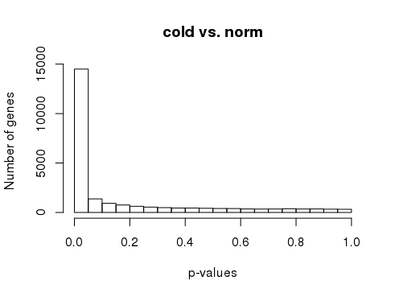
p-values
R
# p-value histogram
hist(DE.out$cold_norm.pval, xlab = "p-values",
ylab = "Number of genes", main = "cold vs. norm")

Slide 32
your turn (Three persons as a group)
Order | Runs | Samples | Tissue | Replicate
1 | SRR3466605 | RH1 | root hairs | rep1
2 | SRR3466606 | RH2 | root hairs | rep2
3 | SRR3466607 | RH3 | root hairs | rep3
4 | SRR3466608 | RH4 | root hairs | rep4
5 | SRR3466609 | root1 | root hair less roots | rep1
6 | SRR3466610 | root2 | root hair less roots | rep2
7 | SRR3466611 | root3 | root hair less roots | rep3
8 | SRR3466612 | root4 | root hair less roots | rep4
root hair (RH) vs. root without hair (root)

