Slide 1
In-class project – DE Bioinformatics Applications (PLPTH813)
Sanzhen Liu
5/2/2019

Slide 2
RNA-Seq procedure
total RNA
mRNA
RNA to sequencing reads
1
DNA library
sequencing
reads
reads to read counts per gene
c
2
QC, alignment
read counts
read counts to significant genes
statistical test
3
q-values/FDR
significance

Slide 3
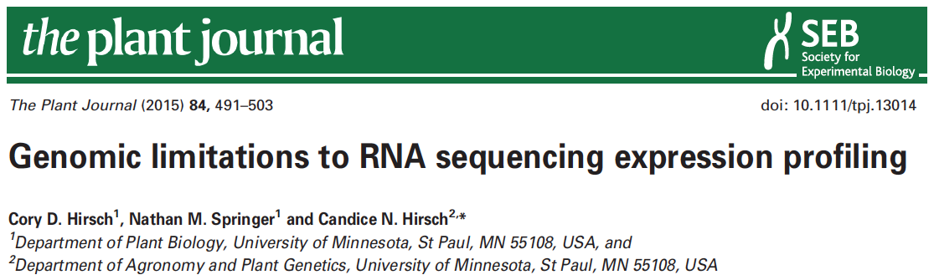

data information
SRR1238718
Makarevitch et al., 2015
Hirsch et al., 2016

Slide 4
Part I: Data downloading
Introduction of Sequence Read Archive (SRA) (2007)
Data download (SRA toolkit)
- fasterq-dump

Slide 5
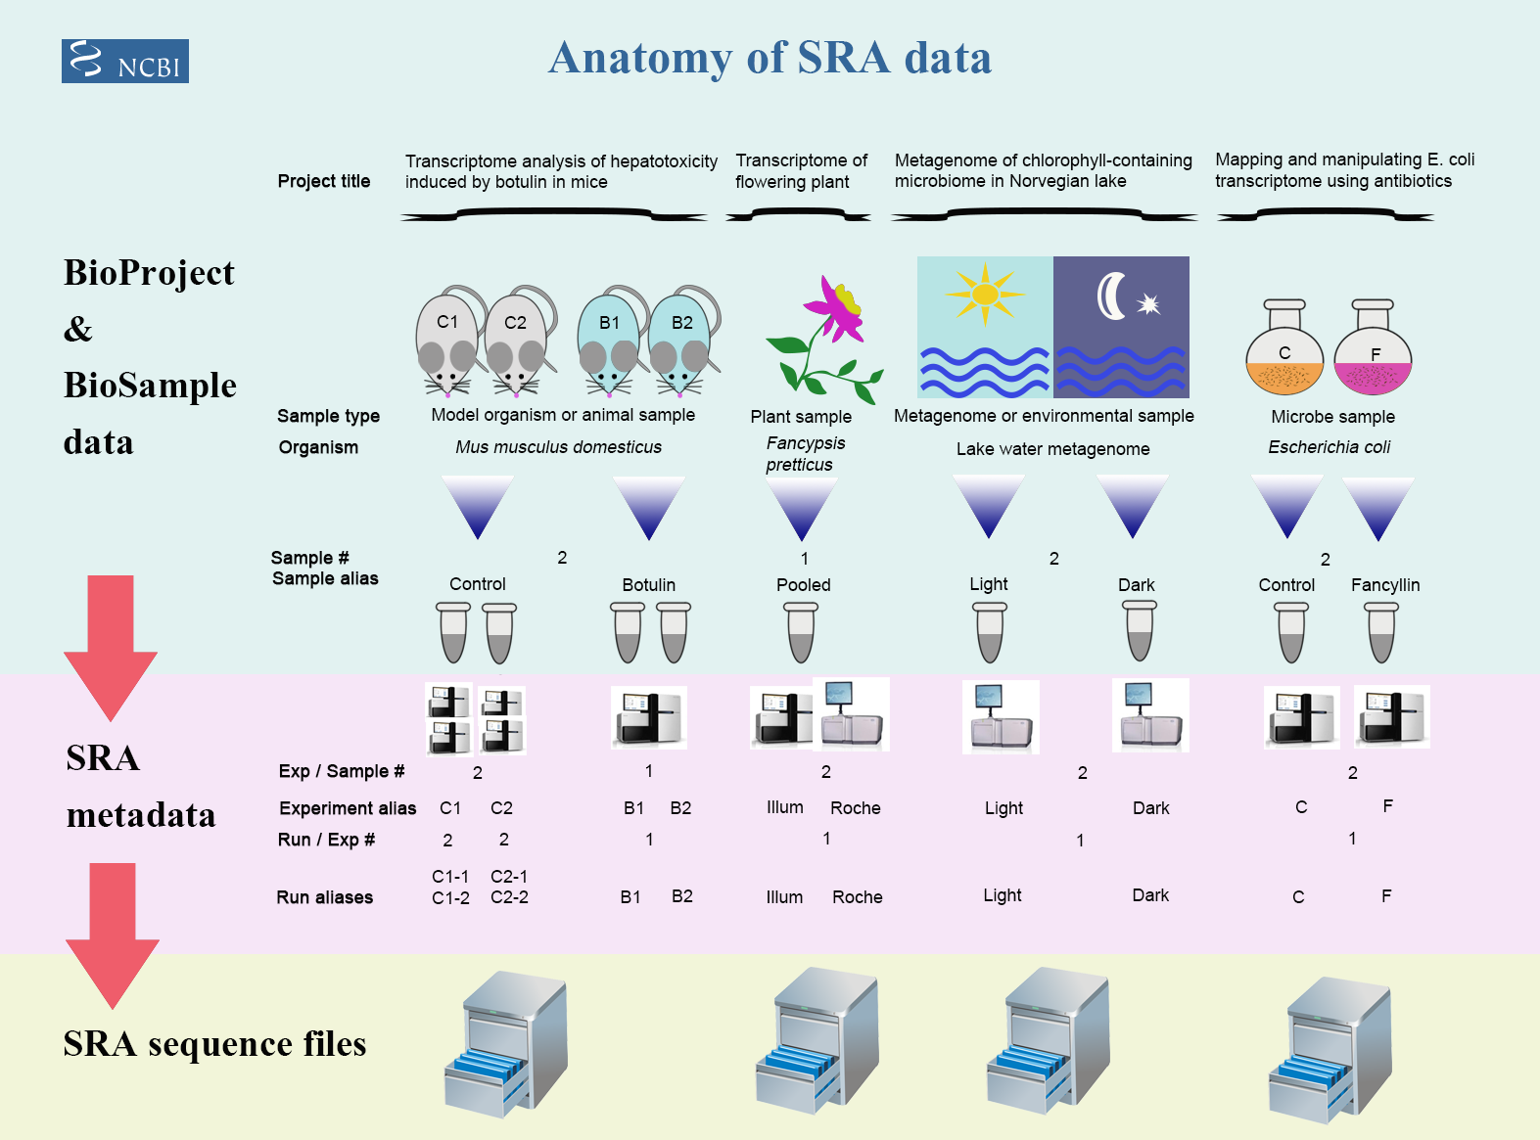
Framework of data submission

Slide 6
Metadata and sequence data
Study – a set of experiments with an overall goal
SRA Study accessions – SRP, DRP, or ERP
Experiment –laboratory operations on input material
SRA Experiment accessions – SRE, DRE, or ERE
Sample – An experiment targets one or more samples
SRA Sample accessions – SRS, DRS, or ERS
Run –the data gathered for a sample or sample bundle
SRA Run accessions – SRR, DRR, or ERR
Notes:
The SRA metadata describes the technical aspects of sequencing experiments: the sequencing libraries, preparation techniques and data files.

Slide 7
format conversion - fastq-dump in Beocat
fasterq-dump [options] <accession>
#!/bin/bash -l
#SBATCH --mem-per-cpu=16G
#SBATCH --time=12:00:00
#SBATCH --nodes=1
#SBATCH --ntasks-per-node=1
/homes/liu3zhen/software/sra_tools/current/fasterq-dump \
--split-file <accession>

Slide 8
Beocat pipeline to download SRA in batch - I
# step 1: Prepare data: dataset.txt
Order | ID | Genotype | Sample | Treatment | Citation
1 | SRR1238718 | B73 | norm1 | norm | Hirsch2015TPJ
2 | SRR1819617 | B73 | norm2 | norm | Hirsch2015TPJ
3 | SRR1819621 | B73 | norm3 | norm | Hirsch2015TPJ
4 | SRR1238717 | B73 | cold1 | cold | Hirsch2015TPJ
5 | SRR1819204 | B73 | cold2 | cold | Hirsch2015TPJ
6 | SRR1819205 | B73 | cold3 | cold | Hirsch2015TPJ
Makarevitch et al., 2015
Hirsch et al., 2016

Slide 9
Beocat pipeline to download SRA in batch - II
working directory: 1-raw
# step 2: Run and download
# must check
meta_file=/homes/liu3zhen/teaching/datasets/DE/1-raw/dataset.txt
srr_col=2
rename_col=4
# running
perl /homes/liu3zhen/local/slurm/SRA/fasterq_dump.sbatch.pl \
--in /homes/liu3zhen/teaching/datasets/DE/1-raw/dataset.txt \
--srrcol 2
# create a script to rename downloaded files
cut $meta_file -f $srr_col,$rename_col | grep "^[EDS]RR" | sed 's/^/rename /g' | sed 's/\t/ /g'| sed 's/$/ *fastq/g' > rename.sh

Slide 10
Beocat pipeline to download SRA in batch - III
# step 3: Run "rename.sh" to change names (optional)
working directory: 1-raw
bash rename.sh

Slide 11
Part II. Trimming
working directory: 2-trim
perl /homes/liu3zhen/local/slurm/trimmomatic/trimmomatic.sbatch.pl \
--mem 16G \
--time 0-23:00:00 \
--trim_shell "/homes/liu3zhen/local/slurm/trimmomatic/trimmomatic.pe.sh" \
--trimmomatic "/homes/liu3zhen/software/trimmomatic/Trimmomatic-0.38/trimmomatic-0.38.jar" \
--adaptor_file "/homes/liu3zhen/software/trimmomatic/Trimmomatic-0.38/adapters/TruSeq3-PE.fa" \
--indir "../1-raw" \
--outdir "." \
--fq1feature "_1.fastq" \
--fq2feature "_2.fastq" \
--threads 4 \
--min_len 40

Slide 12
Part II. Trimming: sbatch command
#!/bin/bash -l
#SBATCH --mem-per-cpu=16
#SBATCH --time=12:00:00
#SBATCH --cpus-per-task=4
module load Java/1.8.0_192
bash /homes/liu3zhen/local/slurm/trimmomatic/trimmomatic.pe.sh \
/homes/liu3zhen/software/trimmomatic/Trimmomatic-0.38/trimmomatic-0.38.jar \
/homes/liu3zhen/software/trimmomatic/Trimmomatic-0.38/adapters/TruSeq3-PE.fa \
../1-raw . _1.fastq _2.fastq 4 40 SRR1238717_1.fastq

Slide 13
RNA-Seq procedure
total RNA
mRNA
RNA to sequencing reads
1
DNA library
sequencing
reads
reads to read counts per gene
c
2
alignment
read counts
read counts to significant genes
statistical test
3
q-values/FDR
significance

Slide 14

STAR
algorithm: sequential maximum mappable seed search in uncompressed suffix arrays followed by seed clustering and stitching procedure
High speed
Unbiased de novo detection of canonical junctions
discovery of non-canonical splices and chimeric transcripts
Capable of mapping full-length RNA sequences

Slide 15
STAR Reference genome indexing
Index the reference genome with the annotation file
#!/bin/bash
#SBATCH --cpus-per-task=4
#SBATCH --mem-per-cpu=8g
#SBATCH --time=0-23:00:00
/homes/liu3zhen/local/bin/STAR --runThreadN 4 \
--runMode genomeGenerate \
--genomeDir /homes/liu3zhen/teaching/datasets/DE/0-ref \
--genomeFastaFiles B73Ref4.fa \
--sjdbGTFfile Zea_mays.AGPv4.32.gtf \
--sjdbOverhang 100

Slide 16
Part III. STAR: sbatch script (one sample)
working directory: 3-aln
/homes/liu3zhen/local/bin/STAR --runThreadN 1 \
--genomeDir /homes/liu3zhen/teaching/datasets/DE/0-ref \
--readFilesIn ../2-trim/cold1.R1.pair.fq ../2-trim/cold1.R2.pair.fq \
--alignIntronMax 100000 \
--alignMatesGapMax 100000 \
--outFileNamePrefix cold1 \
--outSAMattrIHstart 0 \
--outSAMmultNmax 1 \
--outSAMstrandField intronMotif \
--outFilterIntronMotifs RemoveNoncanonicalUnannotated \
--outSAMtype BAM SortedByCoordinate \
--quantMode GeneCounts \
--outFilterMismatchNmax 1 \
--outFilterMismatchNoverLmax 0.02 \
--outFilterMatchNmin 40 \
--outSJfilterReads Unique \
--outFilterMultimapNmax 1 \
--outFilterMultimapScoreRange 2

Slide 17
Part III. STAR: generate sbatch script and submit jobs
working directory: 3-aln
perl /homes/liu3zhen/local/slurm/STAR/STAR.sbatch.pl \
--java "Java/1.8.0_192" \
--mem 48 --threads 1 --time 12:00:00 \
--star_cmd /homes/liu3zhen/local/bin/STAR \
--indir ../2-trim \
--dbdir /homes/liu3zhen/teaching/datasets/DE/0-ref2 \
--fq1feature .R1.pair.fq \
--fq2feature .R2.pair.fq \
--alignIntronMax 100000 \
--alignMatesGapMax 100000 \
--outSAMattrIHstart 0 \
--outSAMmultNmax 1 \
--outSAMstrandField intronMotif \
--outFilterIntronMotifs RemoveNoncanonicalUnannotated \
--outSAMtype "BAM SortedByCoordinate" \
--quantMode GeneCounts \
--outFilterMismatchNmax 1 \
--outFilterMismatchNoverLmax 0.05 \
--outFilterMatchNmin 40 \
--outSJfilterReads Unique \
--outFilterMultimapNmax 1 \
--outFilterMultimapScoreRange 2

Slide 18
STAR output – cold1 sample
cold1Aligned.sortedByCoord.out.bam
cold1Log.final.out
cold1Log.out
cold1Log.progress.out
cold1ReadsPerGene.out.tab
cold1SJ.out.tab

Slide 19
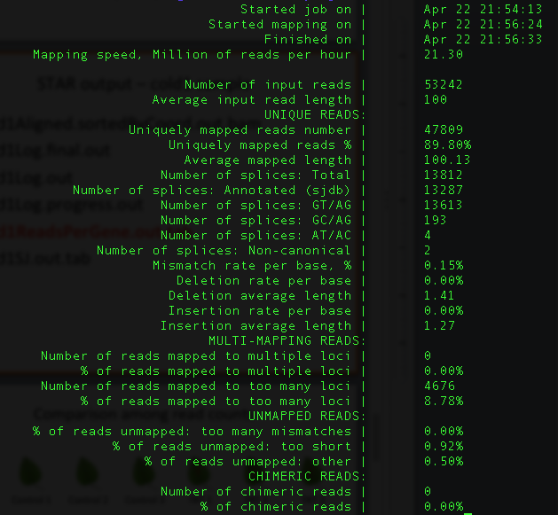
cold1Log.final.out

Slide 20
cold1ReadsPerGene.out.tab
N_unmapped | 5433 | 5433 | 5433
N_multimapping | 0 | 0 | 0
N_noFeature | 2927 | 25138 | 25275
N_ambiguous | 566 | 125 | 119
Zm00001d027230 | 3 | 1 | 2
Zm00001d027231 | 2 | 1 | 1
Zm00001d027232 | 0 | 0 | 0
Zm00001d027233 | 0 | 0 | 0
Zm00001d027234 | 0 | 0 | 0
Zm00001d027235 | 0 | 0 | 0
column 1: gene ID
column 2: counts for unstranded RNA-seq
column 3: counts for the 1st read strand aligned with RNA (htseq-count option -s yes)
column 4: counts for the 2nd read strand aligned with RNA (htseq-count option -s reverse)

Slide 21
RNA-Seq procedure
total RNA
mRNA
RNA to sequencing reads
1
DNA library
sequencing
reads
reads to read counts per gene
c
2
alignment
read counts
read counts to significant genes
statistical test
3
q-values/FDR
significance

Slide 22

Comparison among read counts
T
T
T
Control 1
Control 2
Control 3
TRT 1
TRT 2
TRT 3
Gene 1 | C1 | C2 | C3 | T1 | T2 | T3
…
Sum | N1 | N2 | N3 | N4 | N5 | N6
Sequence depth (total read number) influences read counts.
Can we generate some comparable numbers among samples?

Slide 23
Statistical test for differential expression
Statistical test to discover differential expression (DE)
Count data: Generalized Linear Model (GLM) to deal with count data
e.g., Poisson GLM could handle count data but overdispersion exits
Dispersion issue: Using negative binomial GLM to incorporate dispersion into the model
Small n problem: a few number of replication
Borrowing information across all the genes to estimate gene-specific variation
edgeR (Robinson and Smyth, 2007), DESeq (Anders and Huber, 2010), NBPSeq (Di et al., 2011), and QuasiSeq (Lund 2012)

Slide 24
data organization
### count information
geneid <- grc$GeneID
in.data <- grc[, 2:5]
in.data <- as.matrix(in.data)
### sample names and grouping information (treatment)
sample.ids <- colnames(in.data)
treatment <- c("mut", "wt", "mut", "wt")
sample.info <- data.frame(row.names=sample.ids, trt=treatment)
sample.info
dds <- DESeqDataSetFromMatrix(countData=in.data,
colData=sample.info, formula(~trt))
dds <- DESeq(dds, "Wald")

Slide 25
Part IV. DE: merge counting data
setwd("/homes/liu3zhen/teaching/datasets/DE/3-aln/4-DE")
library("DESeq2")
### Parameters - Subject to change
datapath <- "/homes/liu3zhen/teaching/datasets/DE/3-aln"
suffix <- "ReadsPerGene.out.tab"
count.files <- dir(path = datapath, pattern = suffix)
### merge all counts
allcounts <- NULL
for (cf in count.files) {
counts <- read.delim(paste0(datapath, "/", cf), header = F, stringsAsFactors = F, skip = 4)
base <- gsub(suffix, "", cf)
counts <- counts[, 1:2]
colnames(counts) <- c("Gene", base)
### merge data
if (is.null(allcounts)) {
allcounts <- counts
} else {
allcounts <- merge(allcounts, counts, by = "Gene")
}
}

Slide 26
data preparation for DESeq2
# count information
geneid <- allcounts$Gene
in.data <- allcounts[, 2:7]
in.data <- as.matrix(in.data)
rownames(in.data) <- geneid
# sample names and grouping information (treatment)
sample.ids <- colnames(in.data)
treatment <- c("cold", "cold", "cold", "norm", "norm", "norm")
sample.info <- data.frame(row.names=sample.ids, trt=treatment)
dds <- DESeqDataSetFromMatrix(countData=in.data,
colData=sample.info, formula(~trt))
dds <- DESeq(dds, "Wald")

Slide 27
Part V. DE
### load modules
source("/homes/liu3zhen/local/share/LiuLabScripts/DESeq2.single.trt.R")
source("/homes/liu3zhen/local/share/LiuLabScripts/DE.summary.R")
### DE parameters
fdr.cutoff <- 0.05
# data reformat:
input <- allcounts[, 2:7]
rownames(input) <- allcounts[, 1]
# DE statistical analysis:
DE.out <- DESeq2.single.trt(input.matrix = input,
min.mean.reads = 5,
group1.col = 1:3,
group2.col = 4:6,
comparison = c("norm", "cold"),
geneID = rownames(input),
fdr = fdr.cutoff,
logpath = ".",
logfile = "cold-norm.log.md")
# merge DE with counts and output DE result:
DE.out <- data.frame(DE.out)
final.out <- merge(allcounts, DE.out, by.x = "Gene", by.y = "GeneID")
write.table(final.out, "cold-norm.DESeq2.txt", sep="\t", quote=F, row.names=F )

Slide 28
Part VI. DE summary
de.summary <- DE.summary(DE.path=".",
DE.files="cold-norm.DESeq2.txt",
qval.feature=".qval",
log2FC.feature=".log2FC",
fdr=fdr.cutoff,
out.path=".",
out.file="cold-norm.DESeq2.summary.txt")

Slide 29
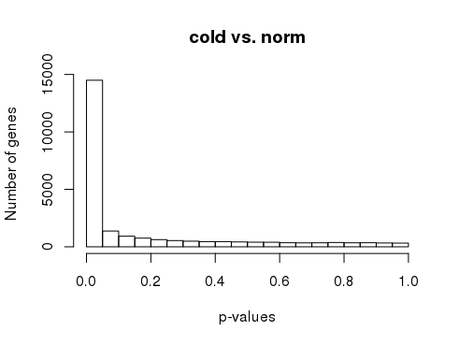
p-values
# p-value histogram
hist(DE.out$cold_norm.pval, xlab = "p-values",
ylab = "Number of genes", main = "cold vs. norm")

Slide 30
your turn (Three persons as a group)
Order | Runs | Samples | Tissue | Replicate
1 | SRR3466605 | RH1 | root hairs | rep1
2 | SRR3466606 | RH2 | root hairs | rep2
3 | SRR3466607 | RH3 | root hairs | rep3
4 | SRR3466608 | RH4 | root hairs | rep4
5 | SRR3466609 | root1 | root hair less roots | rep1
6 | SRR3466610 | root2 | root hair less roots | rep2
7 | SRR3466611 | root3 | root hair less roots | rep3
8 | SRR3466612 | root4 | root hair less roots | rep4
root hair (RH) vs. root without hair (root)

