Slide 1
In-class project – DE Bioinformatics Applications (PLPTH813)
Sanzhen Liu
4/20/2021

Slide 2
RNA-Seq procedure
total RNA
mRNA
RNA to sequencing reads
1
DNA library
sequencing
reads
reads to read counts per gene
c
2
QC, alignment
read counts
read counts to significant genes
statistical test
3
q-values/FDR
significance

Slide 3
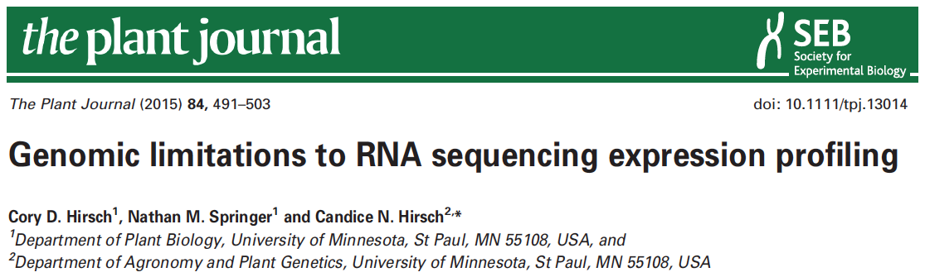

data information
SRR1238718
Makarevitch et al., 2015
Hirsch et al., 2016

Slide 4
Part I: Data downloading
Introduction of Sequence Read Archive (SRA) (2007)
Data download (SRA toolkit)
- fasterq-dump

Slide 5
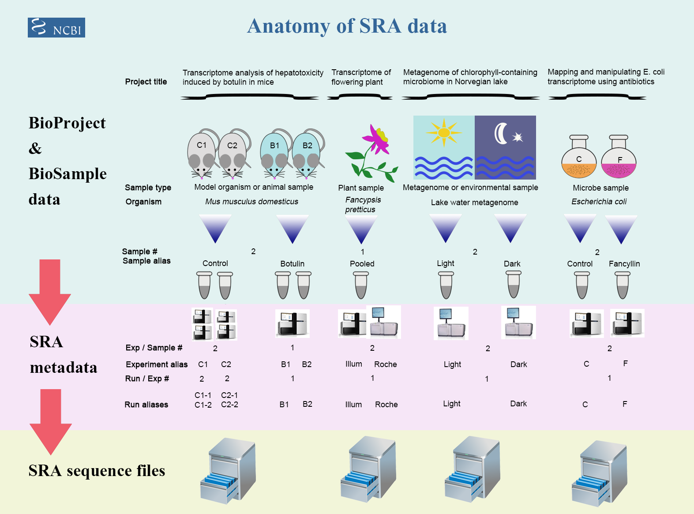
Framework of data submission

Slide 6
Metadata and sequence data
Study – a set of experiments with an overall goal
SRA Study accessions – SRP, DRP, or ERP
Experiment –laboratory operations on input material
SRA Experiment accessions – SRE, DRE, or ERE
Sample – An experiment targets one or more samples
SRA Sample accessions – SRS, DRS, or ERS
Run –the data gathered for a sample or sample bundle
SRA Run accessions – SRR, DRR, or ERR
Notes:
The SRA metadata describes the technical aspects of sequencing experiments: the sequencing libraries, preparation techniques and data files.

Slide 7
format conversion - fastq-dump in Beocat
fasterq-dump [options] <accession>
#!/bin/bash -l
#SBATCH --mem-per-cpu=16G
#SBATCH --time=12:00:00
#SBATCH --nodes=1
#SBATCH --ntasks-per-node=1
/homes/liu3zhen/software/sra_tools/current/fasterq-dump \
--split-files <accession>
/homes/liu3zhen/software/sra_tools/current/fasterq-dump \
--split-files SRR1238718
SRR1238718_1.fastq
SRR1238718_2.fastq

Slide 8
Beocat pipeline to download SRA in batch - I
# step 1: Prepare data: dataset.txt
Order | ID | Genotype | Sample | Treatment | Citation
1 | SRR1238718 | B73 | norm1 | norm | Hirsch2015TPJ
2 | SRR1819617 | B73 | norm2 | norm | Hirsch2015TPJ
3 | SRR1819621 | B73 | norm3 | norm | Hirsch2015TPJ
4 | SRR1238717 | B73 | cold1 | cold | Hirsch2015TPJ
5 | SRR1819204 | B73 | cold2 | cold | Hirsch2015TPJ
6 | SRR1819205 | B73 | cold3 | cold | Hirsch2015TPJ
Makarevitch et al., 2015
Hirsch et al., 2016

Slide 9
Beocat pipeline to download SRA in batch - II
working directory: 1-raw
# step 2: Run and download
# must check
meta_file=/homes/liu3zhen/teaching/datasets/DE/1-raw/dataset.txt
srr_col=2
rename_col=4
# running
perl /homes/liu3zhen/local/slurm/SRA/fasterq_dump.sbatch.pl \
--in /homes/liu3zhen/teaching/datasets/DE/1-raw/dataset.txt \
--srrcol 2
# create a script to rename downloaded files
cut $meta_file -f $srr_col,$rename_col | grep "^[EDS]RR" \
| sed 's/^/rename /g' | sed 's/\t/ /g' | \
sed 's/$/ *fastq/g' > rename.sh

Slide 10
Beocat pipeline to download SRA in batch - III
# step 3: Run "rename.sh" to change names (optional)
# must check
meta_file=/homes/liu3zhen/teaching/datasets/DE/1-raw/dataset.txt
srr_col=2
rename_col=4
cut $meta_file -f $srr_col,$rename_col | grep "^[EDS]RR" \
| sed 's/^/rename /g' | sed 's/\t/ /g' | \
sed 's/$/ *fastq/g' > rename.sh
bash rename.sh
working directory: 1-raw

Slide 11
Part II. Trimming
working directory: 2-trim
perl /homes/liu3zhen/local/slurm/trimmomatic/trimmomatic.sbatch.pl \
--mem 16G \
--time 0-23:00:00 \
--trim_shell "/homes/liu3zhen/local/slurm/trimmomatic/trimmomatic.pe.sh" \
--trimmomatic "/homes/liu3zhen/software/trimmomatic/Trimmomatic-0.38/trimmomatic-0.38.jar" \
--adaptor_file "/homes/liu3zhen/software/trimmomatic/Trimmomatic-0.38/adapters/TruSeq3-PE.fa" \
--indir "../1-raw" \
--outdir "." \
--fq1feature "_1.fastq" \
--fq2feature "_2.fastq" \
--threads 4 \
--min_len 40

Slide 12
Part II. Trimming: sbatch command
#!/bin/bash -l
#SBATCH --mem-per-cpu=16
#SBATCH --time=12:00:00
#SBATCH --cpus-per-task=4
module load Java
bash /homes/liu3zhen/local/slurm/trimmomatic/trimmomatic.pe.sh \
/homes/liu3zhen/software/trimmomatic/Trimmomatic-0.38/trimmomatic-0.38.jar \
/homes/liu3zhen/software/trimmomatic/Trimmomatic-0.38/adapters/TruSeq3-PE.fa \
../1-raw . _1.fastq _2.fastq 4 40 SRR1238717_1.fastq

Slide 13
RNA-Seq procedure
total RNA
mRNA
RNA to sequencing reads
1
DNA library
sequencing
reads
reads to read counts per gene
c
2
alignment
read counts
read counts to significant genes
statistical test
3
q-values/FDR
significance

Slide 14

STAR
as of 4/18/2021
High speed
Unbiased de novo detection of canonical junctions
discovery of non-canonical splices and chimeric transcripts
Capable of mapping full-length RNA sequences

Slide 15
STAR Reference genome indexing
Index the reference genome with the annotation file
#!/bin/bash
#SBATCH --cpus-per-task=4
#SBATCH --mem-per-cpu=8g
#SBATCH --time=0-23:00:00
/homes/liu3zhen/local/bin/STAR --runThreadN 4 \
--runMode genomeGenerate \
--genomeDir /homes/liu3zhen/teaching/datasets/DE/0-ref \
--genomeFastaFiles B73Ref4.fa \
--sjdbGTFfile Zea_mays.B73_RefGen_v4.46.gtf \
--sjdbOverhang 100
Notes:
NOTE: In case of reads of varying length, the ideal value for --sjdbOverhang is max(ReadLength)-1. In most cases, the default value of 100 will work similarly to the ideal value.

Slide 16
Part III. STAR: sbatch script (one sample)
working directory: 3-aln
/homes/liu3zhen/local/bin/STAR --runThreadN 1 \
--genomeDir /homes/liu3zhen/teaching/datasets/DE/0-ref \
--readFilesIn ../2-trim/cold1.R1.pair.fq ../2-trim/cold1.R2.pair.fq \
--alignIntronMax 100000 \
--alignMatesGapMax 100000 \
--outFileNamePrefix cold1 \
--outSAMattrIHstart 0 \
--outSAMmultNmax 1 \
--outSAMstrandField intronMotif \
--outFilterIntronMotifs RemoveNoncanonicalUnannotated \
--outSAMtype BAM SortedByCoordinate \
--quantMode GeneCounts \
--outFilterMismatchNmax 1 \
--outFilterMismatchNoverLmax 0.02 \
--outFilterMatchNmin 40 \
--outSJfilterReads Unique \
--outFilterMultimapNmax 1 \
--outFilterMultimapScoreRange 2

Slide 17
Part III. STAR: generate sbatch script and submit jobs
working directory: 3-aln
perl /homes/liu3zhen/local/slurm/STAR/STAR.sbatch.pl \
--java "Java" \
--mem 48 --threads 1 --time 12:00:00 \
--star_cmd /homes/liu3zhen/local/bin/STAR \
--indir ../2-trim \
--dbdir /homes/liu3zhen/teaching/datasets/DE/0-ref \
--fq1feature .R1.pair.fq \
--fq2feature .R2.pair.fq \
--alignIntronMax 100000 \
--alignMatesGapMax 100000 \
--outSAMattrIHstart 0 \
--outSAMmultNmax 1 \
--outSAMstrandField intronMotif \
--outFilterIntronMotifs RemoveNoncanonicalUnannotated \
--outSAMtype "BAM SortedByCoordinate" \
--quantMode GeneCounts \
--outFilterMismatchNmax 1 \
--outFilterMismatchNoverLmax 0.05 \
--outFilterMatchNmin 40 \
--outSJfilterReads Unique \
--outFilterMultimapNmax 1 \
--outFilterMultimapScoreRange 2

Slide 18
STAR output – cold1 sample
cold1Aligned.sortedByCoord.out.bam
cold1Log.final.out
cold1Log.out
cold1Log.progress.out
cold1ReadsPerGene.out.tab
cold1SJ.out.tab

Slide 19
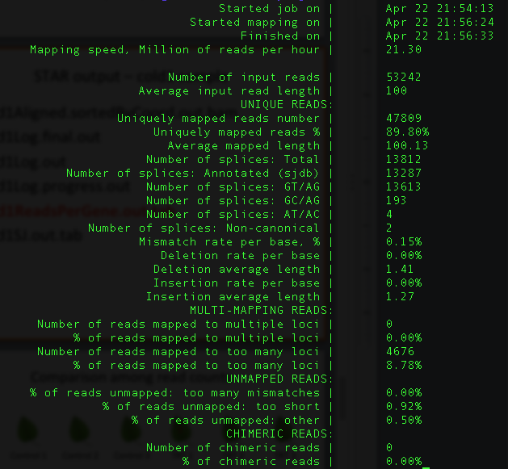
cold1Log.final.out

Slide 20
cold1ReadsPerGene.out.tab
N_unmapped | 5433 | 5433 | 5433
N_multimapping | 0 | 0 | 0
N_noFeature | 2927 | 25138 | 25275
N_ambiguous | 566 | 125 | 119
Zm00001d027230 | 3 | 1 | 2
Zm00001d027231 | 2 | 1 | 1
Zm00001d027232 | 0 | 0 | 0
Zm00001d027233 | 0 | 0 | 0
Zm00001d027234 | 0 | 0 | 0
Zm00001d027235 | 0 | 0 | 0
column 1: gene ID
column 2: counts for unstranded RNA-seq
column 3: counts for the 1st read strand aligned with RNA (htseq-count option -s yes)
column 4: counts for the 2nd read strand aligned with RNA (htseq-count option -s reverse)

Slide 21
RNA-Seq procedure
total RNA
mRNA
RNA to sequencing reads
1
DNA library
sequencing
reads
reads to read counts per gene
c
2
alignment
read counts
read counts to significant genes
statistical test
3
q-values/FDR
significance

Slide 22
Part IV. DE: merge counting data
R code
setwd("/homes/liu3zhen/teaching/datasets/DE/4-DE")
library("DESeq2")
### Parameters - Subject to change
datapath <- "/homes/liu3zhen/teaching/datasets/DE/3-aln"
suffix <- "ReadsPerGene.out.tab"
count.files <- dir(path = datapath, pattern = suffix)
### merge all counts
allcounts <- NULL
for (cf in count.files) {
counts <- read.delim(paste0(datapath, "/", cf), header = F, stringsAsFactors = F, skip = 4)
base <- gsub(suffix, "", cf)
counts <- counts[, 1:2]
colnames(counts) <- c("Gene", base)
### merge data
if (is.null(allcounts)) {
allcounts <- counts
} else {
allcounts <- merge(allcounts, counts, by = "Gene")
}
}

Slide 23
data preparation for DESeq2
R code
# count information
geneid <- allcounts$Gene
in.data <- allcounts[, 2:7]
in.data <- as.matrix(in.data)
rownames(in.data) <- geneid
# sample names and grouping information (treatment)
sample.ids <- colnames(in.data)
treatment <- c("cold", "cold", "cold", "norm", "norm", "norm")
sample.info <- data.frame(row.names=sample.ids, trt=treatment)
dds <- DESeqDataSetFromMatrix(countData=in.data,
colData=sample.info, formula(~trt))
dds <- DESeq(dds, "Wald")

Slide 24
Part V. DE
R
### load modules
source("/homes/liu3zhen/local/share/LiuLabScripts/DESeq2.single.trt.R")
source("/homes/liu3zhen/local/share/LiuLabScripts/DE.summary.R")
### DE parameters
fdr.cutoff <- 0.05
# data reformat:
input <- allcounts[, 2:7]
rownames(input) <- allcounts[, 1]
# DE statistical analysis:
DE.out <- DESeq2.single.trt(input.matrix = input,
min.mean.reads = 5,
group1.col = 1:3,
group2.col = 4:6,
comparison = c("norm", "cold"),
geneID = rownames(input),
fdr = fdr.cutoff,
logpath = ".",
logfile = "cold-norm.log.md")
# merge DE with counts and output DE result:
DE.out <- data.frame(DE.out)
final.out <- merge(allcounts, DE.out, by.x = "Gene", by.y = "GeneID")
write.table(final.out, "cold-norm.DESeq2.txt", sep="\t", quote=F, row.names=F )

Slide 25
Part VI. DE summary
R
de.summary <- DE.summary(DE.path=".",
DE.files="cold-norm.DESeq2.txt",
qval.feature=".qval",
log2FC.feature=".log2FC",
fdr=fdr.cutoff,
out.path=".",
out.file="cold-norm.DESeq2.summary.txt")

Slide 26
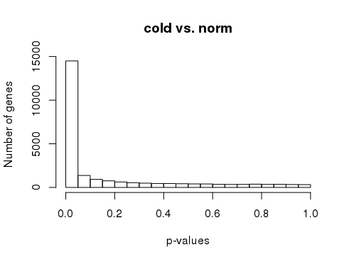
p-values
R
# p-value histogram
hist(DE.out$cold_norm.pval, xlab = "p-values",
ylab = "Number of genes", main = "cold vs. norm")

Slide 27
your turn (Three persons as a group)
Order | Runs | Samples | Tissue | Replicate
1 | SRR3466605 | RH1 | root hairs | rep1
2 | SRR3466606 | RH2 | root hairs | rep2
3 | SRR3466607 | RH3 | root hairs | rep3
4 | SRR3466608 | RH4 | root hairs | rep4
5 | SRR3466609 | root1 | root hair less roots | rep1
6 | SRR3466610 | root2 | root hair less roots | rep2
7 | SRR3466611 | root3 | root hair less roots | rep3
8 | SRR3466612 | root4 | root hair less roots | rep4
root hair (RH) vs. root without hair (root)

